Slide 1
Git : Les bases
- Git clone : récupérer le code
- git checkout -b branch_name
- git add, git commit
- création de PR (pull request, merge request)
- review et merge
- git rebase master
- git pull

Slide 2
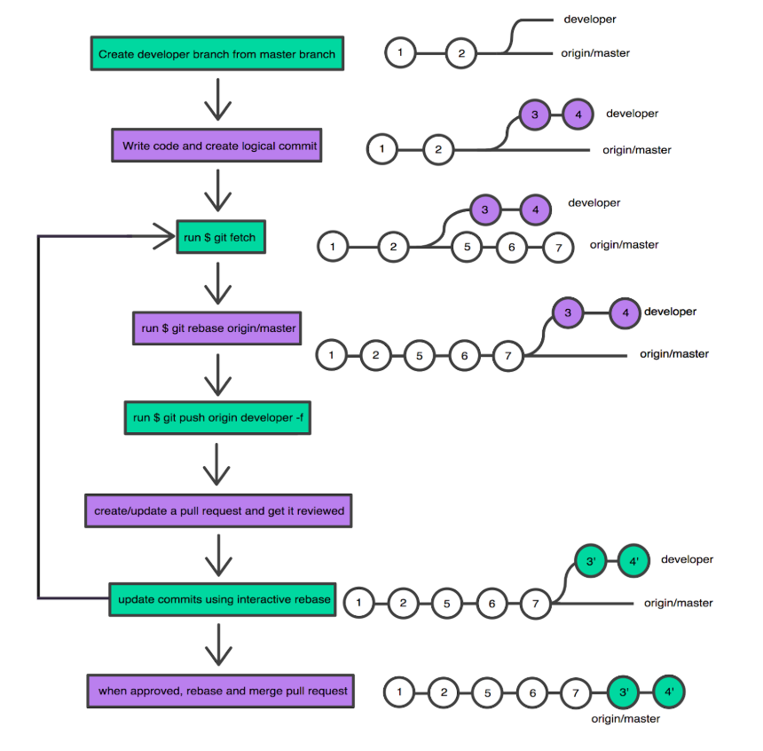

Slide 3
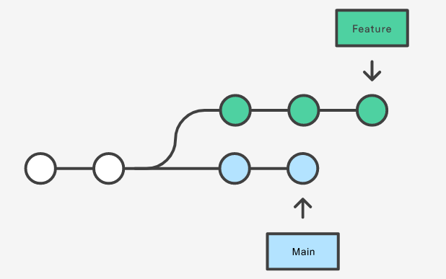
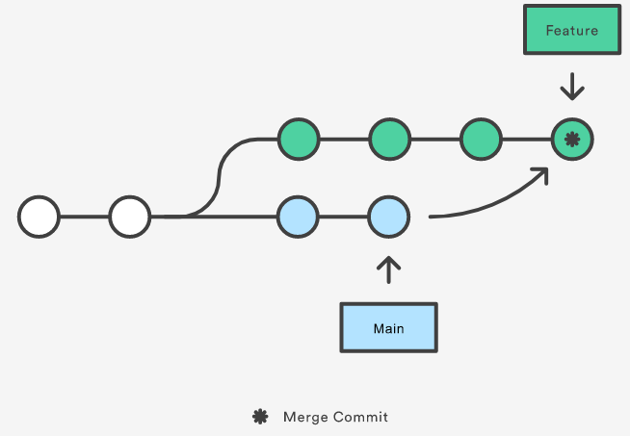
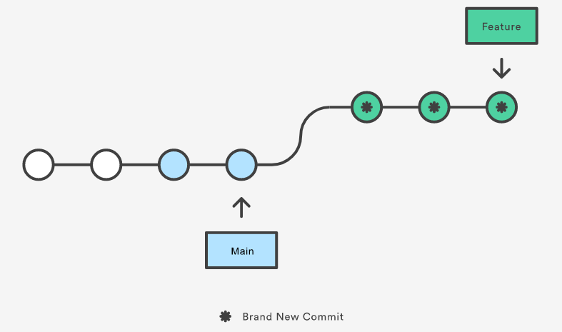
MERGE
REBASE

Slide 4
Once you understand what rebasing is, the most important thing to learn is when not to do it. The golden rule of git rebase is to never use it on public branches.

Slide 5
GIT « avancé »
- PR, conflicts
- squashing
- rebasing
- revert (reset, checkout and… revert)
- cherry picking

Slide 6
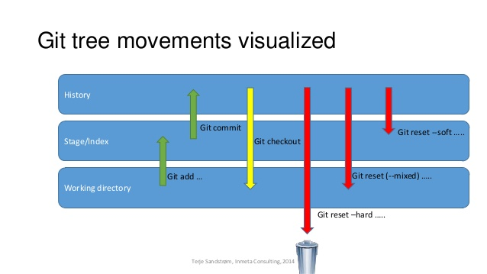
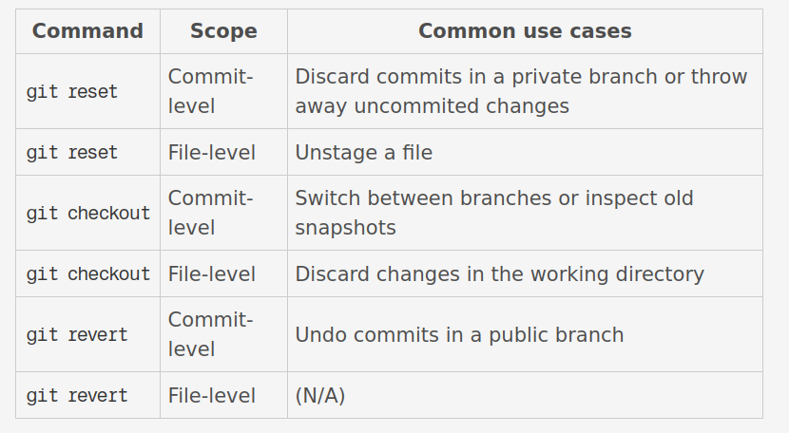
- Checkout and reset → undo local stuff
- revert → undo public stuff

Slide 7
