Slide 1
Team typology Dev typology
Centralized
Decentralized
Dev alone
Dev with devs

Slide 2
“Code is maintained more often than it is written”
“Code is read more often than it is written”
“Your code is your brand” (git blame)
The smartest code

Slide 3
Extreme programming has been described as having 12 practices, grouped into four areas:
Fine-scale feedback
Pair programming
Planning game
→ MVP (waterblocks example)
Test-driven development (+ bug fixing process):
- Write unit test: The programmers write a minimal test that should fail because the functionality hasn't been fully implemented in the production code.
- Watch the new test fail: The programmers verify the test does indeed fail. While it may seem like a waste of time, this step is critical because it verifies that your belief about the state of the production code is correct. If the test does not fail, the programmers should determine whether there is a bug in the test code, or that the production code does support the functionality described by the new test.
- Write code: The programmers write just enough production code so the new test will pass.
- Run test: The unit tests are executed to verify that the new production code passes the new test, and that no other tests are failing.
- Refactor: Remove any code smells (see also anti patterns) from both the production and test code.
Whole team (customer, product owner, PPO)
https://en.wikipedia.org/wiki/Extreme_programming_practices

Slide 4
Extreme programming
Continuous process
Continuous integration
The development team should always be working on the latest version of the software. Since different team members may have versions saved locally with various changes and improvements, they should try to upload their current version to the code repository every few hours, or when a significant break presents itself. Continuous integration will avoid delays later on in the project cycle, caused by integration problems.
Design improvement
Because XP doctrine advocates programming only what is needed today, and implementing it as simply as possible, at times this may result in a system that is stuck. One of the symptoms of this is the need for dual (or multiple) maintenance: functional changes start requiring changes to multiple copies of the same (or similar) code. Another symptom is that changes in one part of the code affect many other parts. XP doctrine says that when this occurs, the system is telling you to refactor your code by changing the architecture, making it simpler and more generic.
Small releases
The delivery of the software is done via frequent releases of live functionality creating concrete value. The small releases help the customer to gain confidence in the progress of the project. This helps maintain the concept of the whole team as the customer can now come up with his suggestions on the project based on real experience.
Programmer welfare
Sustainable pace
https://en.wikipedia.org/wiki/Extreme_programming_practices

Slide 5
Shared understanding
Coding standard
Coding standard is an agreed upon set of rules that the entire development team agree to adhere to throughout the project. https://en.wikipedia.org/wiki/Lint_(software). The standard specifies a consistent style and format for source code, within the chosen programming language, as well as various programming constructs and patterns that should be avoided in order to reduce the probability of defects.[5] The coding standard may be a standard conventions specified by the language vendor (e.g. The Code Conventions for the Java Programming Language, recommended by Sun), or custom defined by the development team.
Extreme Programming backers advocate code that is self-documenting to the furthest degree possible. This reduces the need for code comments, which can get out of sync with the code itself.
Collective code ownership
Everyone is responsible for all the code. Better backups.
Simple design
Programmers should take a "simple is best" approach to software design. Whenever a new piece of code is written, the author should ask themselves 'is there a simpler way to introduce the same functionality?'. If the answer is yes, the simpler course should be chosen. Refactoring should also be used to make complex code simpler.
System metaphor
The system metaphor is a story that everyone - customers, programmers, and managers - can tell about how the system works. It's a naming concept for classes and methods that should make it easy for a team member to guess the functionality of a particular class/method, from its name only. For example a library system may create loan_records(class) for borrowers(class), and if the item were to become overdue it may perform a make_overdue operation on a catalogue(class). For each class or operation the functionality is obvious to the entire team.
https://en.wikipedia.org/wiki/Extreme_programming_practices

Slide 6
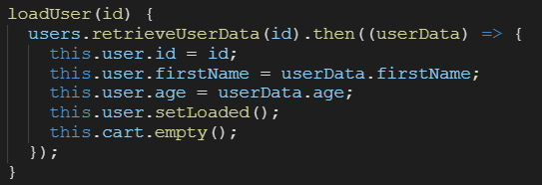
Application-level smells
Mysterious Name: functions, modules, variables or classes that are named in a way that does not communicate what they do or how to use them.
Duplicated code: identical or very similar code that exists in more than one location.
Contrived complexity: forced usage of overcomplicated design patterns where simpler design patterns would suffice.
Shotgun surgery: a single change that needs to be applied to multiple classes at the same time.
Uncontrolled side effects: side effects of coding that commonly cause runtime exceptions, with unit tests unable to capture the exact cause of the problem
Variable mutations: mutations that vary widely enough that refactoring the code becomes increasingly difficult, due to the actual value's status as unpredictable and hard to reason about.
Boolean blindness: easy to assert on the opposite value and still type checks.
function printSortedArray(array) {
array.sort();
for (const item of array) {
console.log(item);
}
}

Slide 7
Class-level smells
Large class: a class that has grown too large. See God object.
Feature envy: a class that uses methods of another class excessively.
Inappropriate intimacy: a class that has dependencies on implementation details of another class. See Object orgy.
Refused bequest: a class that overrides a method of a base class in such a way that the contract of the base class is not honored by the derived class. See Liskov substitution principle.
Lazy class/freeloader: a class that does too little.
Excessive use of literals: these should be coded as named constants, to improve readability and to avoid programming errors. Additionally, literals can and should be externalized into resource files/scripts, or other data stores such as databases where possible, to facilitate localization of software if it is intended to be deployed in different regions.
Cyclomatic complexity: too many branches or loops; this may indicate a function needs to be broken up into smaller functions, or that it has potential for simplification/refactoring.
Downcasting: a type cast which breaks the abstraction model; the abstraction may have to be refactored or eliminated.
Orphan variable or constant class: a class that typically has a collection of constants which belong elsewhere where those constants should be owned by one of the other member classes.
Data clump: Occurs when a group of variables are passed around together in various parts of the program. In general, this suggests that it would be more appropriate to formally group the different variables together into a single object, and pass around only the new object instead.

Slide 8
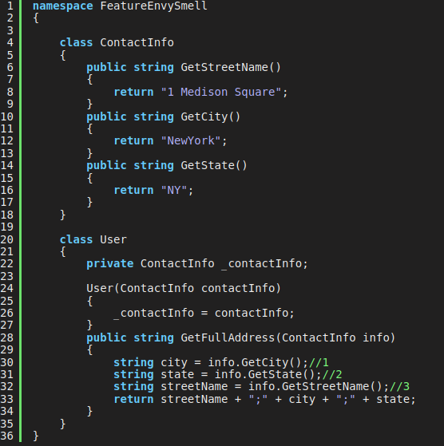

Slide 9
Method-level smells
Too many parameters: a long list of parameters is hard to read, and makes calling and testing the function complicated. It may indicate that the purpose of the function is ill-conceived and that the code should be refactored so responsibility is assigned in a more clean-cut way.
Long method: a method, function, or procedure that has grown too large.
Excessively long identifiers: in particular, the use of naming conventions to provide disambiguation that should be implicit in the software architecture.
Excessively short identifiers: the name of a variable should reflect its function unless the function is obvious.
Excessive return of data: a function or method that returns more than what each of its callers needs.
Excessive comments: a class, function or method has irrelevant or trivial comments. A comment on an attribute setter/getter is a good example.
Excessively long line of code (or God Line): A line of code which is too long, making the code difficult to read, understand, debug, refactor, or even identify possibilities of software reuse.
https://en.wikipedia.org/wiki/Code_smell

Slide 10
The SOLID concepts are
The Single-responsibility principle: "There should never be more than one reason for a class to change." In other words, every class should have only one responsibility.
The Open–closed principle: "Software entities ... should be open for extension, but closed for modification."
The Liskov substitution principle: "Functions that use pointers or references to base classes must be able to use objects of derived classes without knowing it." See also design by contract.
The Interface segregation principle: "Many client-specific interfaces are better than one general-purpose interface."
The Dependency inversion principle: "Depend upon abstractions, [not] concretions."
https://en.wikipedia.org/wiki/SOLID

Slide 11
3 rules of Optimization
- Don’t
- (for experts only) Don’t yet
- [ Profile before optimizing ]
https://wiki.c2.com/?RulesOfOptimization

Slide 12
And today:
https://williamdurand.fr/2013/06/03/object-calisthenics/

