Slide 2
Summary
- Security
- Reviews
- Dimensionality reduction + feature extraction. OHE is not your only option
- Git : don’t be afraid, don’t destroy history on a public branch (unless…)
https://herway.net/love-like-lost-fart-force-probably-shit/
- Code : Don’t optimize, don’t be smart (next slide)
- MVP
- https://williamdurand.fr/2013/06/03/object-calisthenics/

Slide 3
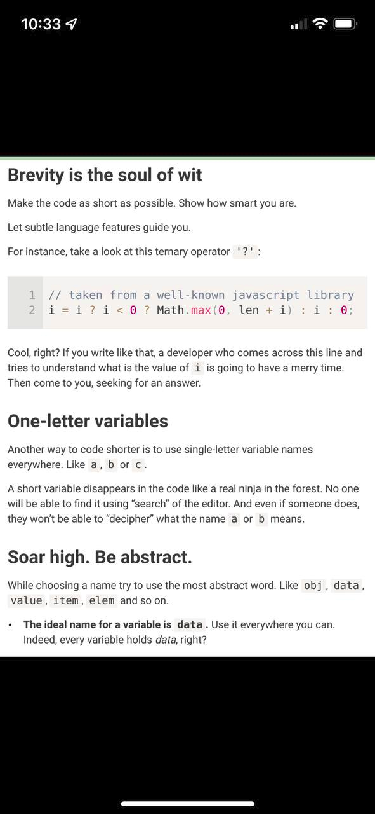

Slide 4
What’s missing to go in prod?
- Querying
- update, retrain
- optimize latency
- dependency
- doc (app usage, technical, deployment)
- logs

Slide 5
What’s missing?
- Doc (how it’s done, how to deploy)
- Retrain / update
- querying (API)
- batch querying
- monito (SLA, perfs)
- historization of data
- histo / roll back of model
- requirements.txt / dockerization
- CI/CD
- Auto ML, optim hyper parameters.
- Interpretation (overall, per prediction)

Slide 6
Requirements
- requirements.txt
- pip install pipreqs
- pip freeze
venv
- python -m venv env
- source env/bin/activate
- pip install -r requirements.txt
- deactivate

Slide 7
Input format ?

Slide 8
https://scotch.io/tutorials/build-a-restful-api-with-flask-the-tdd-way

