Slide 1
A few ML tricks

Slide 2
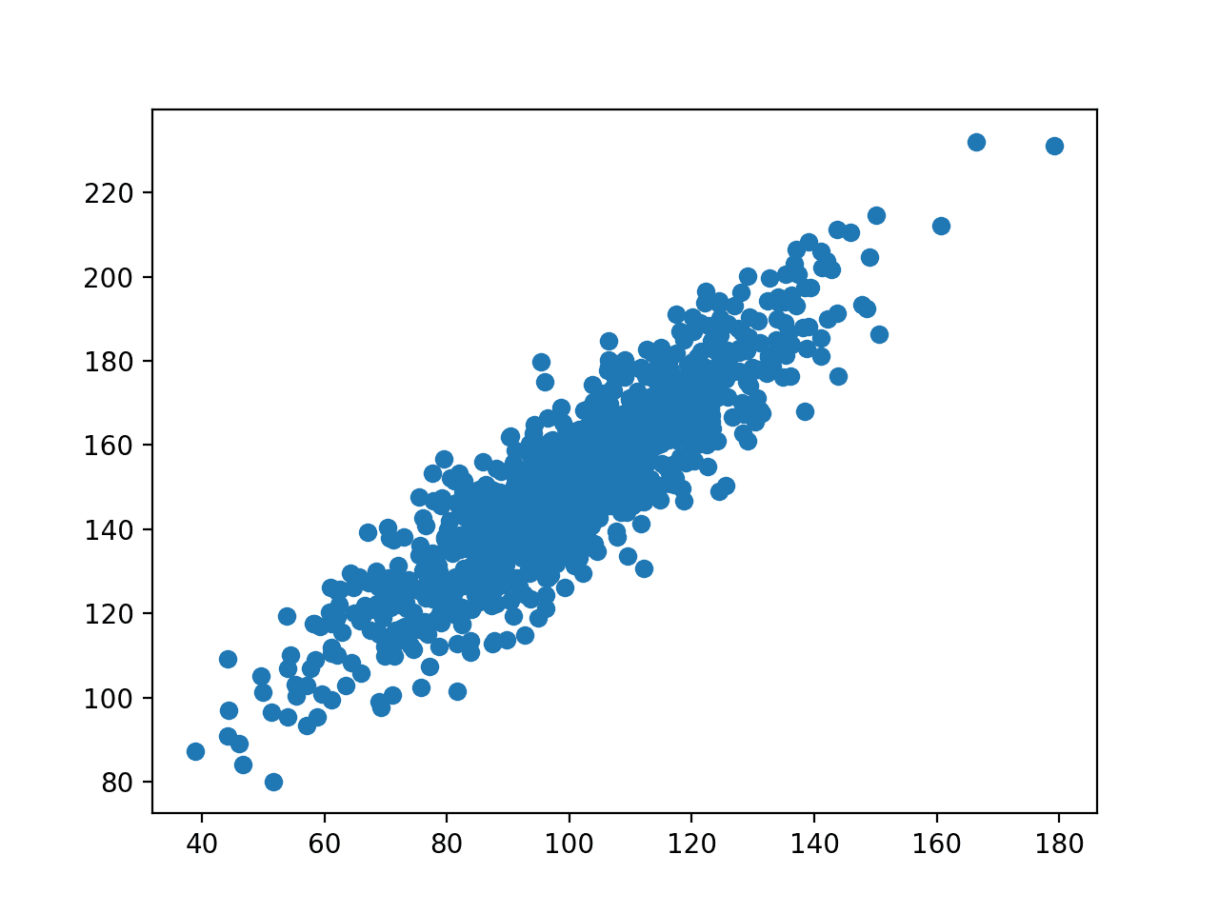

Slide 3
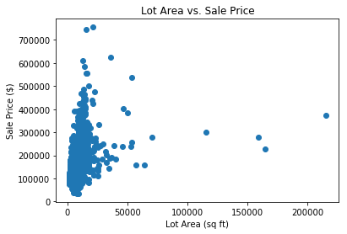

Slide 4
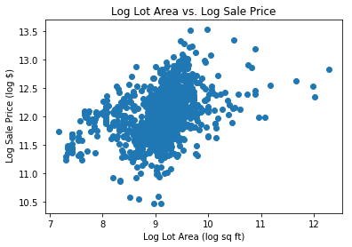

Slide 5
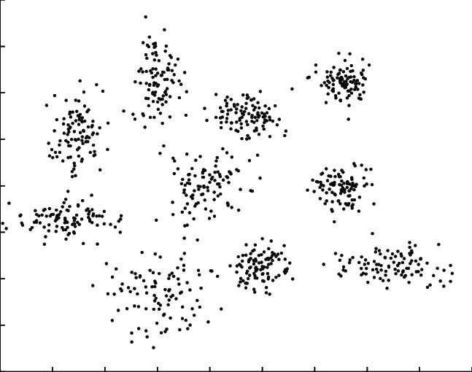

Slide 6
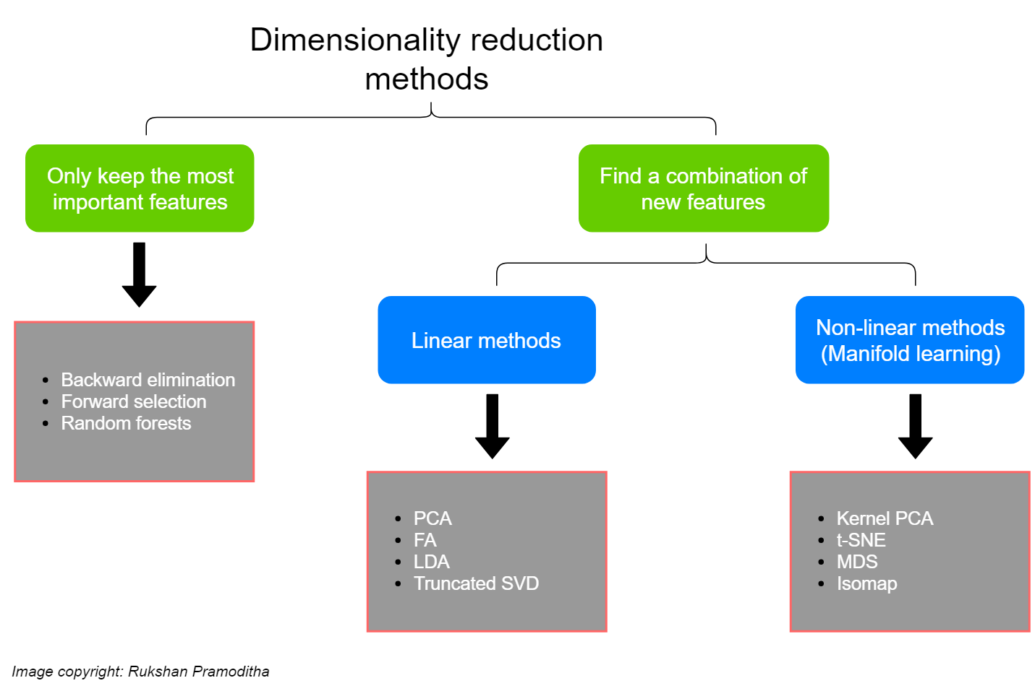

Slide 7
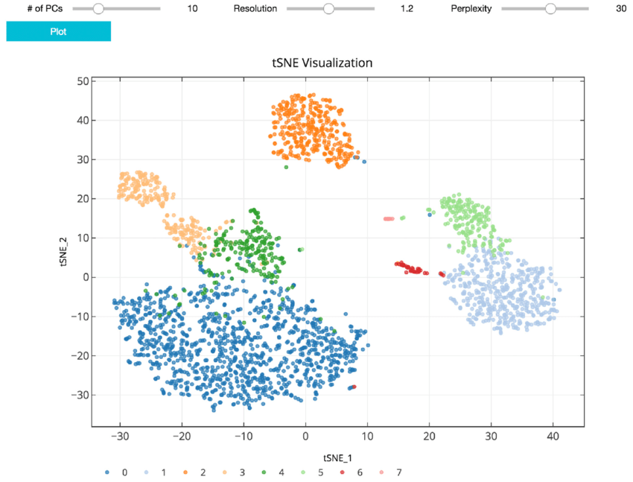

Slide 8
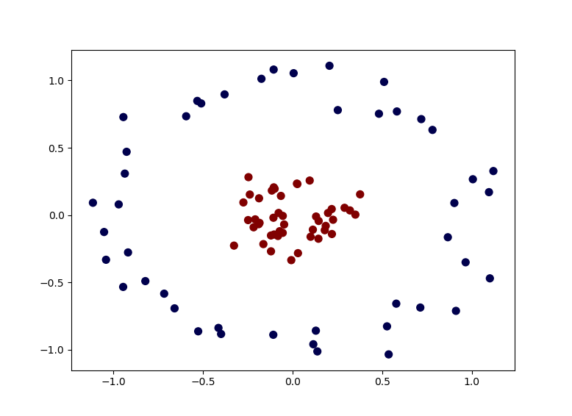

Slide 9
Feature extraction
« The aim of feature extraction is to find the most compacted and informative set of features (distinct patterns) to enhance the efficiency of the classifier. »

Slide 10
Numerical features
- scaling, normalization, standardization
- standard functions
- bucketizing
- Integers?

Slide 11
Cleaning
- Missing values
- get rid of useless columns (almost no values, low variance)
- get rid of duplicates or badly acquired records

Slide 12
Categorical features
- one hot encoding
- label coding (replace by # of occurrences)
- level coding (replace by % of target)
https://towardsdatascience.com/all-about-categorical-variable-encoding-305f3361fd02

Slide 13
Hashing
- Hashing trick
- LSH
- Embeddings

Slide 14
NLP
- Stemming, Lemming, stop words
- Bag of words
- n-grams
- tf-idf
- Embedings (word2vec, bert and the likes)

