Slide 1

Automatic Alternative Image Recognition to Voice

Slide 2
Phan Trung Thành (Leader)
Nguyễn Vũ Hoàng Sơn
Võ Hà Quân
Nguyễn Cao Duy (Dropped Out)
Supervisor
Kiều Trọng Khánh

Slide 3
Outline
01
Introduction

Slide 4
Outline
01
Introduction
02
Problem

Slide 5
Outline
01
Introduction
02
Problem
03
Our Solution

Slide 6
Outline
01
Introduction
02
Problem
03
Our Solution
04
Main features

Slide 7
Outline
01
Introduction
02
Problem
03
Our Solution
04
Main features
05
Future plan

Slide 8
Introduction
Introduction

Slide 9


Introduction
Notes:
cuộc sống hiện đại => có nhiều thiết bị hiện đại => smart phone

Slide 10
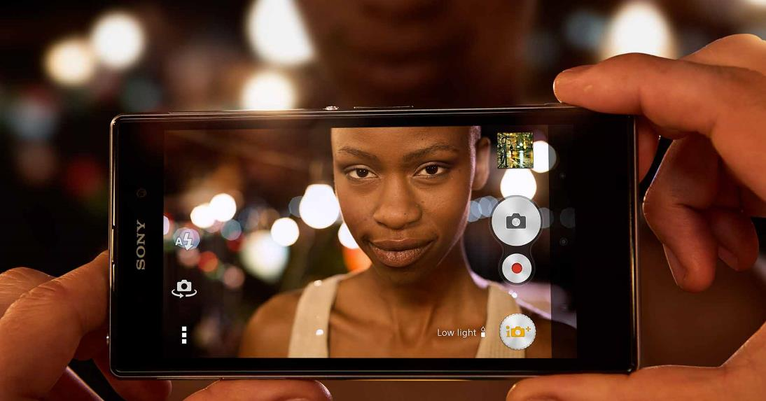

Introduction
Capture Pictures
Voice Control
Notes:
hỗ trợ nhiều tính năng....

Slide 11

Introduction
Notes:
Đối với người mù thì không đơn giản như thế

Slide 12

Introduction
Notes:
Khó tương tác vs công nghệ, vd như điện thoại smartphone

Slide 13

Introduction
Notes:
Laptop

Slide 14

Introduction
Notes:
Ngoài những cái kể trên thì còn Khó khăn trong giao tiếp hàng ngày

Slide 15
Introduction
How can we use Technologies to improve their Life ?

Slide 16

Introduction

Slide 17
Introduction
Help blind Person interact and communicate with others easily.

Slide 18
Introduction
Help blind Person interact and communicate with others easily.
Help blind Person fulfill everyday task that seems impossible.

Slide 19
Introduction
Problems

Slide 20

Problems
Notes:
Liệt kê những ứng dụng đã có

Slide 21
Problems
Pros:
Detect everyday life objects through taken pictures.
Ex: Money, colors…

Slide 22
Problems
Pros:
Detect everyday life objects through taken pictures.
Ex: Money, colors…
Cons
Poor performance
Detect object only
Cannot train to identify new object.
No Voice Control.
Only support English.

Slide 23

Problems

Slide 24
Problems
Pros:
High accuracy.
Can identify various things.
Control through interact with volunteer.

Slide 25
Problems
Pros:
High accuracy.
Can identify various things.
Control through interact with volunteer.
Cons:
Always need volunteers.
No Voice control.
Security problems.

Slide 26
Introduction
Our Solution

Slide 27

Our Solution
Identify Person

Slide 28

Our Solution
Identify Person
Identify Objects

Slide 29
Our Solution
Identify Person
Identify Objects
Training

Slide 30

Our Solution
Identify Person
Identify Objects
Training
Voice Control

Slide 31
Person
Identification
Introduction

Slide 32
Person Identification
Problem

Slide 33

Person Identification
Problem
Mr. Son

Slide 34

Person Identification
Problem
Hello !
Mr. Son
Mr. Thanh

Slide 35
Person Identification
Problem
Who is this ?
Hello !
Mr. Son
Mr. Thanh

Slide 36
Person Identification
Problem
Who is this ?
How can Mr. Son knows who is the person calling him ?
Notes:
Làm sao biết người đang gọi mình là ai
Làm sao chào hỏi người đó như thế nào

Slide 37
Person Identification
Problem
Who is this ?
How can Mr. Son knows who is the person calling him ?
How can Mr. Son greeting that person ?
Notes:
Làm sao biết người đang gọi mình là ai
Làm sao chào hỏi người đó như thế nào

Slide 38
Person Identification
Our Proposal

Slide 39

Person Identification
Our Proposal
System

Slide 40
Person Identification
Our Proposal
Detect Person
System

Slide 41
Person Identification
Our Proposal
Describe the Person back to the blind
Detect Person
System

Slide 42
Person Identification
Our Proposal
Describe the Person back to the blind
Detect Person
System
The blind know who is the Person calling them

Slide 43
Person Identification
Our Proposal
Describe the Person back to the blind
Detect Person
System
User can now greeting the person by their name
The blind know who is the Person calling them

Slide 44
Person Identification
How can we do that ?

Slide 45


Person Identification
How can we do that ?
1. Capture Picture
Camera

Slide 46

Person Identification
How can we do that ?
1. Capture Picture
Camera
System

Slide 47

Person Identification
How can we do that ?
2. Send Image
1. Capture Picture
Camera
System
Microsoft Cognitive Service

Slide 48
Person Identification
How can we do that ?
2. Send Image
1. Capture Picture
Camera
System
3. Response Result
Microsoft Cognitive Service

Slide 49

Person Identification
How can we do that ?
2. Send Image
1. Capture Picture
Camera
System
3. Response Result
Microsoft Cognitive Service
4. Process

Slide 50

Person Identification
How can we do that ?
2. Send Image
1. Capture Picture
Camera
System
3. Response Result
Microsoft Cognitive Service
4. Process
5. Describe
Blind user

Slide 51

Person Identification
How can we do that ?
2. Send Image
1. Capture Picture
Camera
System
3. Response Result
Microsoft Cognitive Service
4. Process
5. Describe
Blind user

Slide 52
Person Identification
Technology

Slide 53

Person Identification
Technology

Slide 54
Person Identification
Technology
Detect Human Faces, Gender, Age

Slide 55
Person Identification
Technology
Detect Human Faces, Gender, Age
Train system to identify a Person

Slide 56
Person Identification
Technology
Detect Human Faces, Gender, Age
Train system to identify a Person
Identify Person Face

Slide 57
Person Identification
Technology
How can a machine detect a Human Face ?

Slide 58
Person Identification
Technology
Understand Human Face

Slide 59
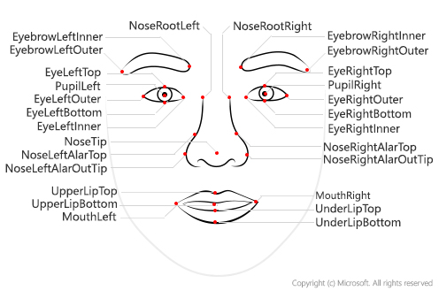
Person Identification
Technology
Understand Human Face

Slide 60

Person Identification
Technology
Understand Human Face

Slide 61
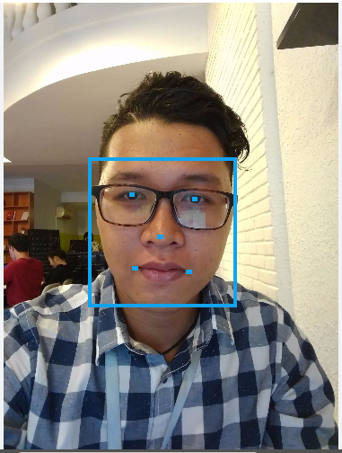
Person Identification
Technology
Understand Human Face

Slide 62
Person Identification
Technology
How it works

Slide 63

Person Identification
Technology
How it works
Input

Slide 64

Person Identification
Technology
How it works
Input
1. Convert to black and white

Slide 65

Person Identification
Technology
How it works
Input
1. Convert to black and white
2. Divide into small parts
Notes:
#nham thuat toan. can coi lai. xem them concept của google: https://developers.google.com/vision/face-detection-concepts

Slide 66
Person Identification
Technology
How it works

Slide 67

Person Identification
Technology
How it works
3. Scan each pixel

Slide 68
Person Identification
Technology
How it works

Slide 69

Person Identification
Technology
How it works
4. Neural
Networks
Matrix

Slide 70
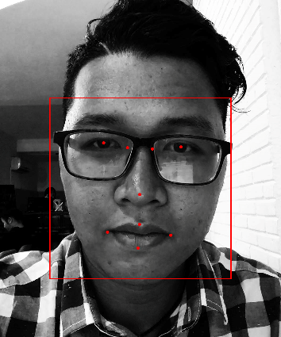
Person Identification
Technology
How it works
5. Algorithms
Matrix
Face landmarks

Slide 71
Person Identification
Demo
Detect a Person

Slide 72
Person Identification
Summary – Demo Detect Person

Slide 73
Person Identification
Summary – Demo Detect Person
User know the gender of the Person in front of them

Slide 74
Person Identification
Summary – Demo Detect Person
User know the gender of the Person in front of them
User know how to greet the Person properly

Slide 75
Person Identification
Problem
Okay cool, but what if I want to know his / her name ?
How can Mr. Son knows exactly who is calling him ?
Notes:
Làm sao biết người đang gọi mình là ai
Làm sao chào hỏi người đó như thế nào

Slide 76
Person Identification
Problem
Okay cool, but what if I want to know his / her name ?
How can Mr. Son knows exactly who is calling him ?
Identify Process
Notes:
Làm sao biết người đang gọi mình là ai
Làm sao chào hỏi người đó như thế nào

Slide 77
Person Identification
Technology
How can Microsoft Cognitive Service Identify a Person ?

Slide 78
Person Identification
Technology
Training Process

Slide 79
Person Identification
Technology
Training Process
Create New Person

Slide 80
Person Identification
Technology
Training Process
Create New Person
Add Person Face

Slide 81
Person Identification
Technology
Training Process
Create New Person
Add Person Face
Training

Slide 82
Person Identification
Technology
Understand Terms

Slide 83
Person Identification
Technology
Understand Terms
Person Group

Slide 84
Person Identification
Technology
Understand Terms
Person Group
Person

Slide 85
Person Identification
Technology
Understand Terms
Person Group
Person
Face

Slide 86
Person Identification
Understand Terms
Person Group

Slide 87
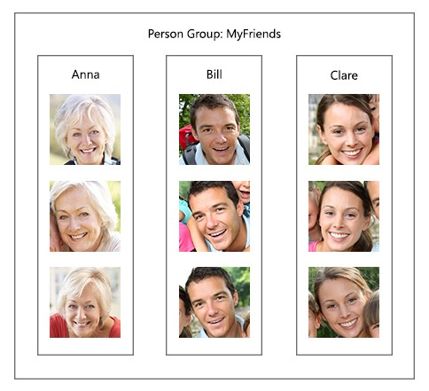
Person Identification
Understand Terms
Person Group

Slide 88
Person Identification
Understand Terms
Person Group
Most important

Slide 89
Person Identification
Understand Terms
Person Group
Most important
Unique for each user

Slide 90
Person Identification
Understand Terms
Person Group
Most important
Unique for each user
Contains up to 1000 Person

Slide 91
Person Identification
Understand Terms
Person

Slide 92
Person Identification
Understand Terms
Person
Belong to a unique Person Group

Slide 93
Person Identification
Understand Terms
Person
Belong to a unique Person Group
Have a unique Person ID

Slide 94
Person Identification
Understand Terms
Person
Belong to a unique Person Group
Have a unique Person ID
Have Name, Description

Slide 95
Person Identification
Understand Terms
Person
Belong to a unique Person Group
Have a unique Person ID
Have Name, Description
Have up to 248 faces.

Slide 96



Person Identification
Understand Terms
Face
Have a unique Persisted Face ID
Hà Quân

Slide 97
Person Identification
Understand Terms
Face
Have a unique Persisted Face ID
Belong to a certain Person
Hà Quân

Slide 98
Person Identification
Technology
Understand Terms

Slide 99
Person Identification
Technology
Understand Terms
Person Group

Slide 100
Person Identification
Technology
Understand Terms
Person Group
Person

Slide 101
Person Identification
Technology
Understand Terms
Person Group
Person
Faces

Slide 102
Person Identification
Technology
Understand Terms
Person Group
Person
Identify Faster
Faces

Slide 103
Person Identification
Technology
Training Process
Create New Person
Add Person Face
Training

Slide 104
Person Identification
Technology
Training Process
Create New Person
Add Person Face
Training

Slide 105
Person Identification
Create New Person
Microsoft Cognitive Service
System
User

Slide 106
Person Identification
Create New Person
Microsoft Cognitive Service
System
1. Input
User
Name
Description

Slide 107
Person Identification
Create New Person
Microsoft Cognitive Service
System
Person Group
Person
1. Input
Name
Description
User
Name
Description

Slide 108
Person Identification
Create New Person
Microsoft Cognitive Service
System
Person Group
Person
2. Create Person
1. Input
Name
Description
User
Name
Description

Slide 109
Person Identification
Create New Person
Microsoft Cognitive Service
System
Person Group
Person Group
Person
Person
2. Create Person
1. Input
Name
Description
Name
Description
Person ID
User
Name
Description

Slide 110
Person Identification
Create New Person
Microsoft Cognitive Service
System
Person Group
Person Group
Person
Person
2. Create Person
1. Input
Name
Description
Name
Description
Person ID
User
Name
Description
3. Person ID

Slide 111
Person Identification
Create New Person
Microsoft Cognitive Service
System
Person Group
Person Group
Person
Person
2. Create Person
1. Input
Name
Description
Person ID
Name
Description
Person ID
User
Name
Description
3. Person ID

Slide 112
Person Identification
Technology
Training Process
Create New Person
2. Add Person Face
3. Training

Slide 113
Person Identification
Technology
Training Process
Create New Person
2. Add Person Face
3. Training

Slide 114
Person Identification
Add Person Face
Microsoft Cognitive Service
System
Person Group
Person Group
Person
Person
Name
Description
Person ID
Name
Description
Person ID
User

Slide 115

Person Identification
Add Person Face
Microsoft Cognitive Service
System
Person Group
Person Group
1. Input
Person
Person
Name
Description
Person ID
Name
Description
Person ID
User

Slide 116
Person Identification
Add Person Face
Microsoft Cognitive Service
System
Person Group
Person Group
1. Input
Person
2. Send
Person
Name
Description
Person ID
Name
Description
Person ID
User
Person ID
Person Group ID

Slide 117
Person Identification
Add Person Face
Microsoft Cognitive Service
System
Person Group
Person Group
1. Input
Person
2. Send
Person
Name
Description
Person ID
Name
Description
Person ID
User
Person ID
Person Group ID
Face

Slide 118
Person Identification
Add Person Face
Microsoft Cognitive Service
System
Person Group
Person Group
1. Input
Person
2. Send
Person
Name
Description
Person ID
Name
Description
Person ID
User
Person ID
Person Group ID
Face
3. Return
Persisted Face ID

Slide 119
Person Identification
Add Person Face
Microsoft Cognitive Service
System
Person Group
Person Group
1. Input
Person
2. Send
Person
Name
Description
Person ID
Name
Description
Person ID
User
Person ID
Face
Face
Person Group ID
Persisted Face ID
3. Return
Persisted Face ID

Slide 120
Person Identification
Technology
Training Process
Create New Person
Add Person Face
3. Training

Slide 121
Person Identification
Technology
Training Process
Create New Person
Add Person Face
3. Training

Slide 122
Person Identification
Training
Microsoft Cognitive Service
System
Person Group
User

Slide 123
Person Identification
Training
Microsoft Cognitive Service
System
Person Group
1. Train
User

Slide 124
Person Identification
Training
Microsoft Cognitive Service
System
Person Group
2. Send
1. Train
Person Group ID
User

Slide 125

Person Identification
Training
Microsoft Cognitive Service
System
Person Group
Person Group
2. Send
1. Train
Person Group ID
User
Train Person Group

Slide 126
Person Identification
Training
Microsoft Cognitive Service
System
Person Group
Person Group
2. Send
1. Train
Person Group ID
User
3. Return Status
4. Notify
Train Person Group

Slide 127
Person Identification
Technology
Training Process
Create New Person
Add Person Face
Training

Slide 128
Person Identification
Demo
Training Unidentified Person

Slide 129
Person Identification
Summary – Demo Training Unidentified Person

Slide 130
Person Identification
Summary – Demo Training Unidentified Person
New Person is successfully added into system.

Slide 131
Person Identification
Summary – Demo Training Unidentified Person
New Person is successfully added into system.
System can now Identify trained Person.

Slide 132
Person Identification
Problem
Okay cool, but what if I want to know his / her name ?
How can Mr. Son knows exactly who is calling him ?
Notes:
Quay trở lại với vấn đề nêu trên => giờ đã có thể nhận diện được đó là ai

Slide 133
Person Identification
Technology
Identifying Process
Detect Human Face

Slide 134
Person Identification
Technology
Identifying Process
Detect Human Face
Identify Face and get Candidates

Slide 135
Person Identification
Technology
Identifying Process
Detect Human Face
Identify Face and get Candidates
Get Person Information

Slide 136
Person Identification
Technology
Identifying Process
Detect Human Face
Identify Face and get Candidates
Get Person Information

Slide 137
Person Identification
Detect Human Face
Microsoft Cognitive Service
System
User

Slide 138

Person Identification
Detect Human Face
Microsoft Cognitive Service
System
1. Capture
User

Slide 139

Person Identification
Detect Human Face
Microsoft Cognitive Service
System
1. Capture
2. Detect API
User

Slide 140
Person Identification
Detect Human Face
Microsoft Cognitive Service
System
1. Capture
2. Detect API
User

Slide 141
Person Identification
Detect Human Face
Microsoft Cognitive Service
System
1. Capture
2. Detect API
User

Slide 142
Person Identification
Detect Human Face
Microsoft Cognitive Service
System
1. Capture
2. Detect API
User
Face ID

Slide 143
Person Identification
Detect Human Face
Microsoft Cognitive Service
System
1. Capture
2. Detect API
User
3. Return
Face ID
Face ID

Slide 144
Person Identification
Detect Human Face
Microsoft Cognitive Service
System
Face ID
1. Capture
2. Detect API
User
3. Return
Face ID
Face ID

Slide 145
Person Identification
Technology
Identifying Process
Detect Human Face
2. Identify Face and get Candidates
3. Get Person Information

Slide 146
Person Identification
Technology
Identifying Process
Detect Human Face
2. Identify Face and get Candidates
3. Get Person Information

Slide 147
Person Identification
Identify Face and Get Candidates
Microsoft Cognitive Service
System
Face ID
Person Group
User

Slide 148
Person Identification
Identify Face and Get Candidates
Microsoft Cognitive Service
System
Face ID
Person Group
2. Detect API
Face ID
Person Group ID
User

Slide 149
Person Identification
Identify Face and Get Candidates
Microsoft Cognitive Service
System
Face ID
Person Group
2. Detect API
Person Group
Face ID
Person Group ID
User

Slide 150
Person Identification
Identify Face and Get Candidates
Microsoft Cognitive Service
System
Face ID
Person Group
2. Detect API
Person Group
Face ID
Person Group ID
User
Candidates

Slide 151
Person Identification
Identify Face and Get Candidates
Microsoft Cognitive Service
System
Face ID
Person Group
2. Detect API
Person Group
Face ID
Person Group ID
User
3. Return
Candidates
Person ID
Confidence

Slide 152
Person Identification
Identify Face and Get Candidates
Microsoft Cognitive Service
System
Face ID
Confidence Rate:
Similarity between two Faces.
Range [0, 1]
Person Group
2. Detect API
Person Group
Face ID
Person Group ID
User
3. Return
Candidates
Person ID
Confidence

Slide 153
Person Identification
Identify Face and Get Candidates
Microsoft Cognitive Service
System
Face ID
Confidence Rate >= 0.65
Person Group
2. Detect API
Person Group
Face ID
Person Group ID
User
3. Return
Candidates
Person ID
Confidence

Slide 154
Person Identification
Identify Face and Get Candidates
Microsoft Cognitive Service
System
Face ID
2. Detect API
Person Group
Person ID
Confidence >= 0.65
Face ID
Person Group ID
User
3. Return
Candidates
Person ID
Confidence

Slide 155
Person Identification
Technology
Identifying Process
Detect Human Face
Identify Face and get Candidates
3. Get Person Information

Slide 156
Person Identification
Technology
Identifying Process
Detect Human Face
Identify Face and get Candidates
3. Get Person Information

Slide 157
Person Identification
Get Person Information
System
Face ID
Person ID
Confidence >= 0.65
User

Slide 158
Person Identification
Get Person Information
System
Face ID
User
Person ID

Slide 159
Person Identification
Get Person Information
System
Face ID
Person
Person ID
User

Slide 160
Person Identification
Get Person Information
System
Face ID
Person
Person ID
User
Describe

Slide 161
Person Identification
Demo
Identify a Person

Slide 162
Person Identification
Result
Hello Thanh !
Hello !
Mr. Son
Mr. Thanh

Slide 163
Person Identification
Problem
This is great, but do I have to give the command every time ?
Notes:
Quay trở lại với vấn đề nêu trên => giờ đã có thể nhận diện được đó là ai

Slide 164
Person Identification
Problem
This is great, but do I have to give the command every time ?
Giving command every time Mr. Son meets somebody is pretty inconvenient.
Notes:
Quay trở lại với vấn đề nêu trên => giờ đã có thể nhận diện được đó là ai

Slide 165
Person Identification
Problem
This is great, but do I have to give the command every time ?
Giving command every time Mr. Son meets somebody is pretty inconvenient.
Is there a way that can help Mr. Son Identify person more comfortably ? Or “Hand-free” ?
Notes:
Quay trở lại với vấn đề nêu trên => giờ đã có thể nhận diện được đó là ai

Slide 166
Person Identification
Our Proposal
Real-time Identification Process

Slide 167
Person Identification
Our Proposal
Detect Person Face Continuously and
Automatically
System
Notes:
#need to talk about process of detect face???

Slide 168
Person Identification
Our Proposal
Detect Person Face Continuously and
Automatically
Describe the Person back to the blind
System

Slide 169
Person Identification
Our Proposal
Detect Person Face Continuously and
Automatically
Describe the Person back to the blind
System
Blind user does not have to give command every time

Slide 170
Person Identification
Our Proposal
Detect Person Face Continuously and
Automatically
Describe the Person back to the blind
System
Blind user does not have to give command every time
Hand-free, more convenient

Slide 171
Person Identification
How can we do that ?

Slide 172
Person Identification
How can we do that ?
Continuously Streaming
Camera

Slide 173
Person Identification
How can we do that ?
Continuously Streaming
Detect Human Face
Camera

Slide 174

Person Identification
How can we do that ?
Continuously Streaming
Detect Human Face
Camera
Capture Picture
Microsoft Cognitive Service

Slide 175
Person Identification
How can we do that ?
Continuously Streaming
Detect Human Face
Camera
Capture Picture
Microsoft Cognitive Service
Response Result

Slide 176
Person Identification
How can we do that ?
Continuously Streaming
Detect Human Face
Camera
Capture Picture
Microsoft Cognitive Service
Response Result
Blind user

Slide 177
Person Identification
Demo
Real-time Identifying Process

