Slide 1
CSC 490 Senior Capstone Presentation 2:
“MyAlmanack”
By: Justin Oakley, Hao Zhang, Mark Bures, Mike Resnik, and Pooya Motee
Notes:
Speaker Notes

Slide 2
Project Roles
User Interface:
Mike Resnik and Mark Bures
Database System:
Justin Oakley
Authentication (Login/Registration) & Authorization (Permission):
Hao Zhang
Calendar Data/Modifications:
Pooya Motee
Notes:
Justin

Slide 3
System - Design Perspective

Slide 4
System Design-Perspective:
Use Cases
Actors: New User, User, Admin
New User: Has can only “Register a new account”
User: Can access personal and some social calendar data using an interface.
Admin: Has read and write access to all user data in the database.
Use Case Diagram
Notes:
Mike

Slide 5
System Design-Perspective:
Entity-Relationship
ER Diagram
Notes:
Justin

Slide 6
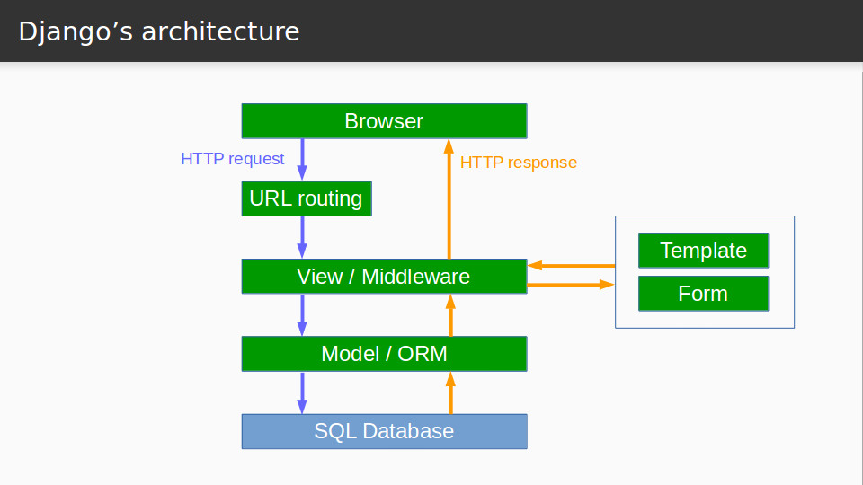
System Design-Perspective:
Django Architecture
Notes:
Mike

Slide 7
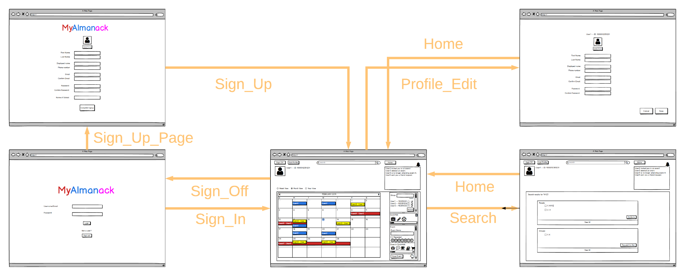
System Design-Perspective:
System Model (Users)
Notes:
Mike

Slide 8
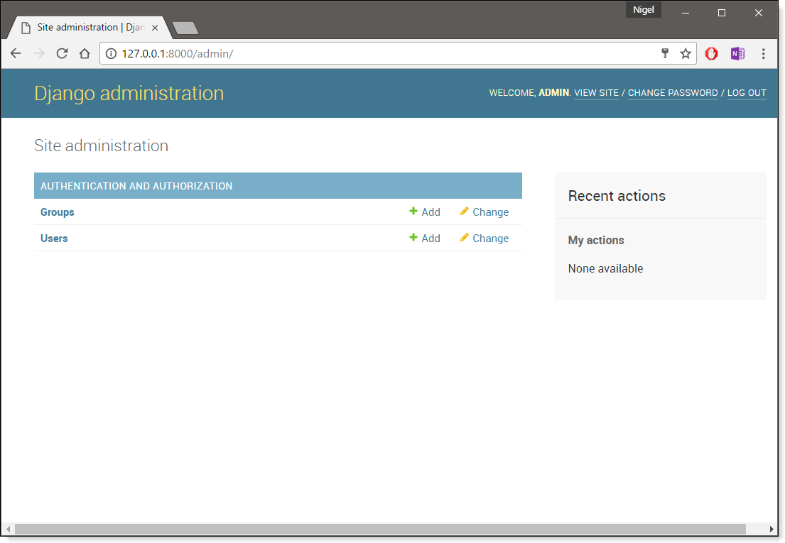
System Design-Perspective:
Admin Access
Django has a built in admin feature that we can use to visualize the user data in our database.
By default, each link corresponds to a different set of models in the database.
Notes:
Mark

Slide 9
System - Analysis Perspective

Slide 10
System Design-Analysis:
Data Dictionary
Data Dictionary
Notes:
Justin

Slide 11
System - Analysis Perspective:
Subsystem: User Interface
Purpose:
Create an intuitive environment for storing social and personal calendar information.
Protect user data by visualizing authorization restrictions.
All views that access other subsystems must have a graphical interface to accompany it.
Notes:
Mark

Slide 12
System - Analysis Perspective:
Subsystem: Database
In the database:
Each profile has:
Access to a unique contact list that connects to other users and groups.
Access to a unique calendar containing the owner’s schedule.
The ability to create, delete, or accept three different types of invites.
A system administrator to manage user data.
Each group has:
Access to a unique calendar containing group members’ schedules.
At least one group administrator to create, delete, or accept group or event invites.
A system administrator to manage group data.
Notes:
Justin

Slide 13
System - Analysis Perspective:
Subsystem: Database
Each calendar has:
Access to various events
Each invite has:
The ability to be classified as a friend request, an event invite, or a group invite and, respectively, gain each subclass attributes.
Should be directly sent to either a profile or a group.
Notes:
Justin

Slide 14
System - Analysis Perspective:
Subsystem: Authentication
Main goals
Handle user login and registration
Session management
Not the same as authorization
There is no permission handling in the authentication subsystem.
Will involve heavy integration with Google Firebase’s API
Only the authentication component
Notes:
Hao

Slide 15
System - Analysis Perspective:
Subsystem: Authentication
Why use Google Firebase?
Enables multiple authentication methods for user convenience
Email & password
Google account
GitHub account
Phone number
Offloads implementation of account security to external providers
Google’s and GitHub’s account security models have already been heavily tested; no need to implement potentially vulnerable model from ground up
Simplifies implementation and unifies authentication model
No need to store additional metadata such as Google/GitHub usernames along with passwords
Notes:
Hao

Slide 16
System - Analysis Perspective:
Subsystem: Authorization
Main goals
Provide a consistent permission management framework for other subsystems
Offload and abstract complex permission logic from other subsystems
Uses the attribute-based access control (ABAC) model
Allows for user-configurable permissions
Programmatically define policies - hidden from other subsystems
Not strictly confined to roles and groups which might have conflicts
User A and user B are in group G
… but they are not in each other’s contact list
… but user A has configured to allow other users that are in the same group(s) as them to view their profile regardless
Notes:
Hao

Slide 17
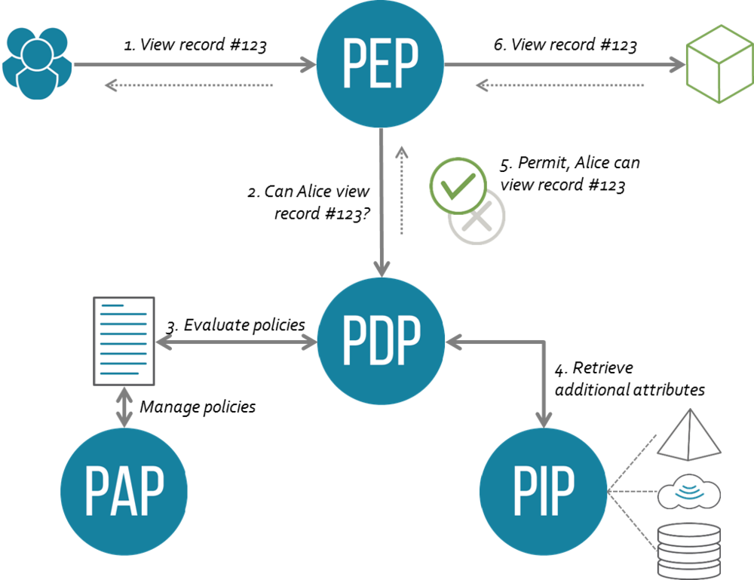
System - Analysis Perspective:
Subsystem: Authorization
Pre-construct the authorization request in plain English.
Extract the subject, action, object, and context (if applicable).
Construct the authorization request using the provided API and relevant action model.
Query the enforcement authority with the request and receive an authorization result.
Notes:
Hao

Slide 18
System - Analysis Perspective:
Subsystem: Calendar Data Manipulation
Display Format:
The Calendar subsystem uses a series of string manipulation and array algorithms to display the data requested from the database in its proper format.
Weekly View Format: Displays the set of events in the requested week. The event times displayed in HH:MM.
Month View Format: Displays the set of events in the requested month without the event times.
Yearly View Format: Displays the set of events in the requested year. Only show the number of events for each day of the year.
Notes:
Pooya

Slide 19
System - Analysis Perspective:
Subsystem: Calendar Data Manipulation
Overlapping and Color Coordination:
When the user is in a group, other group members events can be overlapped and displayed using different colors for readability purposes.
A filtering option can help the user decide which group members events should be displayed or filtered out on their calendar.
Notes:
Pooya

Slide 20
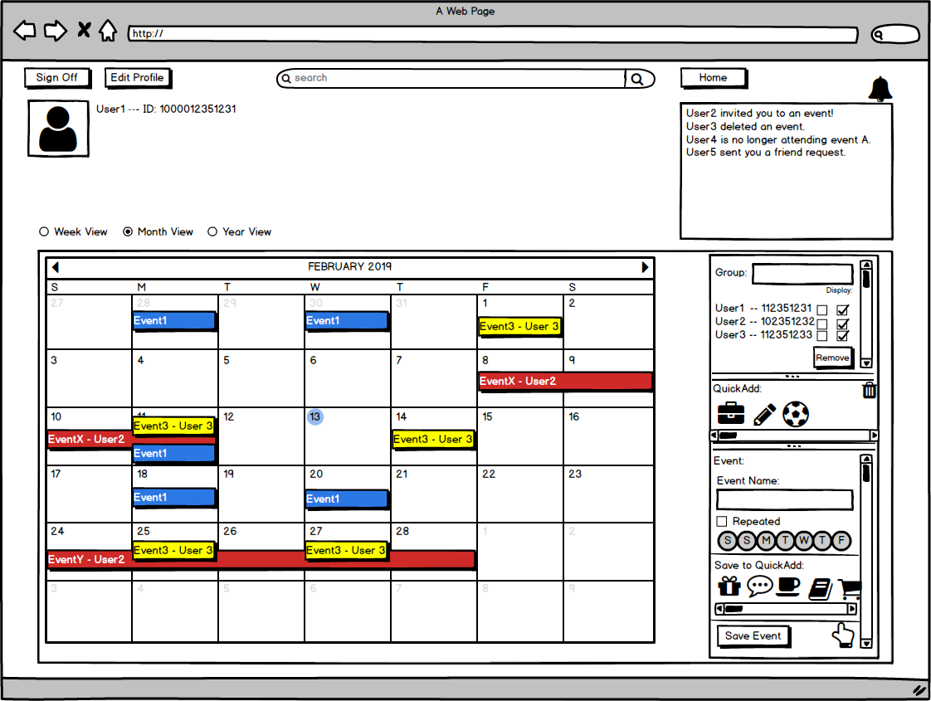
System - Analysis Perspective:
Subsystem: Calendar Data Manipulation
Examples of:
Overlapping: Events on the same day can be overlapped.
Color Coordination: Events from different users are displayed in different colors.
Filtering: Other users events can be filtered out.
Notes:
Pooya

