Slide 1
Debug_Thugs_01
Group Members :-
Meet Barasara – 202301176
Manav Kalavadiya – 202301054
Karan Makasana – 202301053
Tapas Santoki - 202301088

Slide 2
Project – 3 Entry queue manager
You need to build an entry queue manager for a stadium. There are N entry gates. As people keep coming in, they can line up in any of the queues or switch queues anytime if they think that will get them a quicker entry.
The entry queue manager helps them in making that decision by suggesting (i) the time for the last person in the queue to enter through any gate (assume that it takes p mins to enter any gate), (ii) the particular queue number(s) in the line who should be switching.
The queue manager must be designed to minimize the time for M people to enter the stadium. Each gate has an initial random assignment of M/2 people (a gate may not have anyone assigned).

Slide 3
EstimateDWaitTime(int queueLength, int p) : Constant time and space : O(1)
2. SuggestShortestQueue (const vector& queues) : Linear time : O(N) , constant space: O(1) [N= Number of queue].
3. Random_gate(int N) : constant time and space O(1).
4. Main Function Portions:
Initializing queues: O(N).
Randomly assigning attendees (M/2 times): O(M/2) = O(M) [M = Total attendees].
Updating estimated wait time after initial assignment : O(N).
Attendee arrival loop (M/2 - M iterations) : Inside this loop.
i) Suggesting shortest queue: O(N) .
ii) Update queue : insert at front of list : O(1) .

Slide 4
iii) Update wait time O(1) .
Overall O(M*N).
Display final time O(N) .
5. Entry gate structure :
Space complexity : O(M)
6. The queues vector itself has a fixed size of N (number of gates), contributing O(N) space complexity.
So, overall TC : if M is large then O(M) && if N is large then O(N).
And overall space complexity will be O(M) if M is large as compare to N.

Slide 5
Algorithm
structure
function function
Initialization
EntryGateQueue
Attendees
Stores the IDs of the attendees who are in queue
EstimatedWaitTime
Shows the estimated wait time for the last person in the queue

Slide 6
Main function
Number of entry gates(N) , total number of attendees (M) and processing time per attendee (p) are taken as input
Initialize a vector queues of size N to store information for each entry gate
Randomly distribute half of the attendees (M/2) to each queue using rand() fun. and print the initial estimated wait time for each queue

Slide 7
Attendee arrival loop
Update estimated wait time for each queue after initial assignment
Remaining m/2 attendee enter one by one
Suggest queue with lowest estimate time for last person

Slide 8
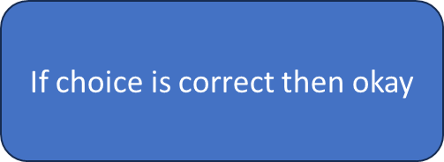
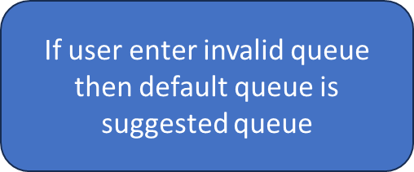
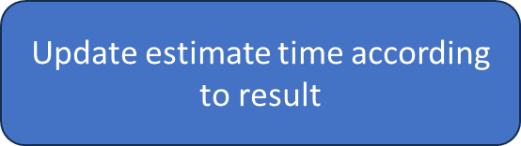
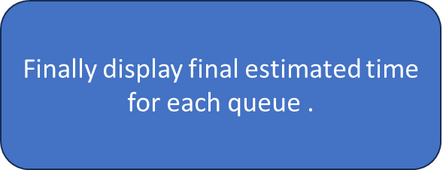
Allow attendee to choose queue

Slide 9
Data structure
Data structure used in our project are :
Link list : To store attendee , each node of the link list can represent one attendee.
Vector of list : To store attendee list for each gate .
Advantage of using link list over array to store attendee.
For a queue implementation, especially when using push_front (or similar enqueue at the front operations), a linked list offers a clear advantage due to its efficient constant time insertions at the beginning. This aligns well with the FIFO nature of queues. While vectors might be suitable for some queue scenarios, their inefficiency with push_front and if memory is not contiguous and we want to add more attendee then we need to move all element it makes them a less desirable choice in this specific case .

Slide 10
Voice recording
https://drive.google.com/file/d/1Jxem4wpHXLNtKOKdh93zgE1VCmeL4ett/view?usp=drive_link

