Slide 1
Red Epsilon

Slide 2
Concept
Cooperative multiplayer puzzle game
2-4 players over Internet
Can play with known friends or use matchmaking to play with random people
2D platformer

Slide 3
Value
Real-time multiplayer interaction
Most existing multiplayer games are turned based (Words with Friends, Draw Something)
Good for learning problem solving and collaboration
Probably family friendly so that children can hone these skills

Slide 4
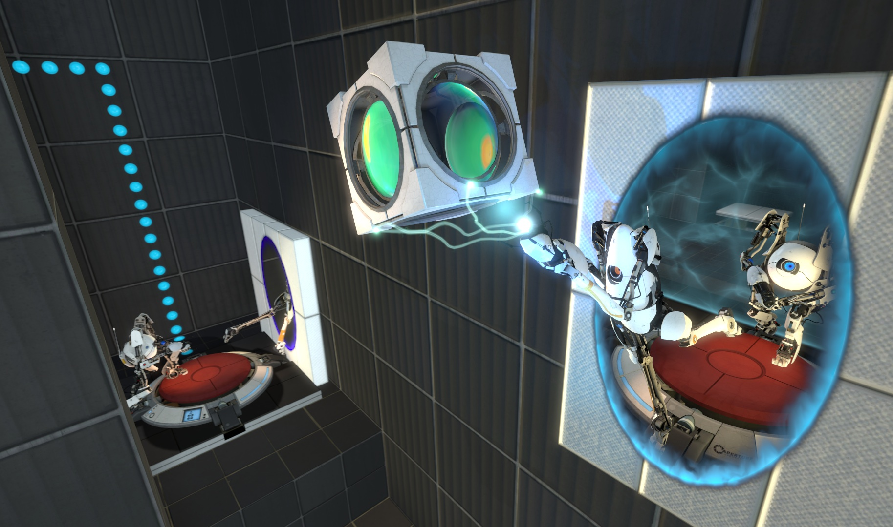
Inspiration
Portal 2
Tale of Two Brothers
Splinter Cell
That one part in Majora’s Mask

Slide 5

Technologies
Unity 2D
AndEngine
Gideros

Slide 6
Extras
Asymmetric gameplay
Story mode
Avatar customization
Level Designer

