Slide 1
Capture the Flag
Luke Colburn
Chris LaBauve
Tyler Johnson

Slide 2
Overview
Most mobile multiplayer games on the market provide a turn-based experience
Words with Friends, Draw Something
Some are real-time, but are mostly competitive in nature
Need for a real-time cooperative game
Portal 2

Slide 3
Overview
Capture the Flag is a real-time, multiplayer puzzle game
Goal is to collect all of the flags on a map
Users choose from a collection of characters with unique abilities
Players will need to work together and combine abilities to be able to collect all of the flags on a map

Slide 4
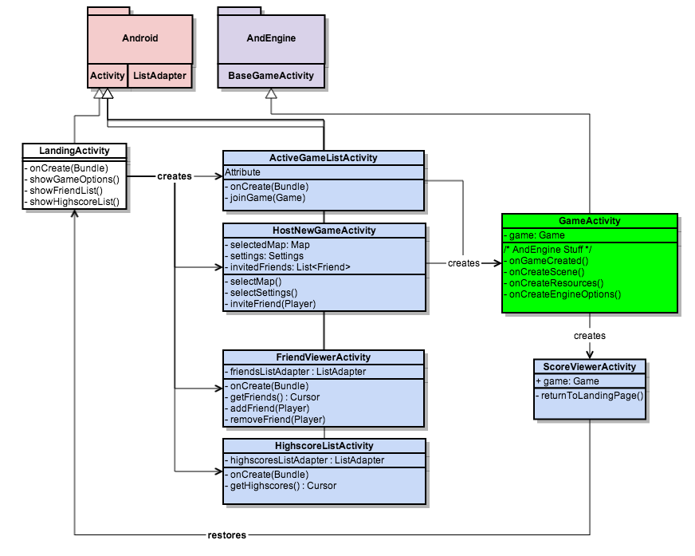
Class Diagrams

Slide 5
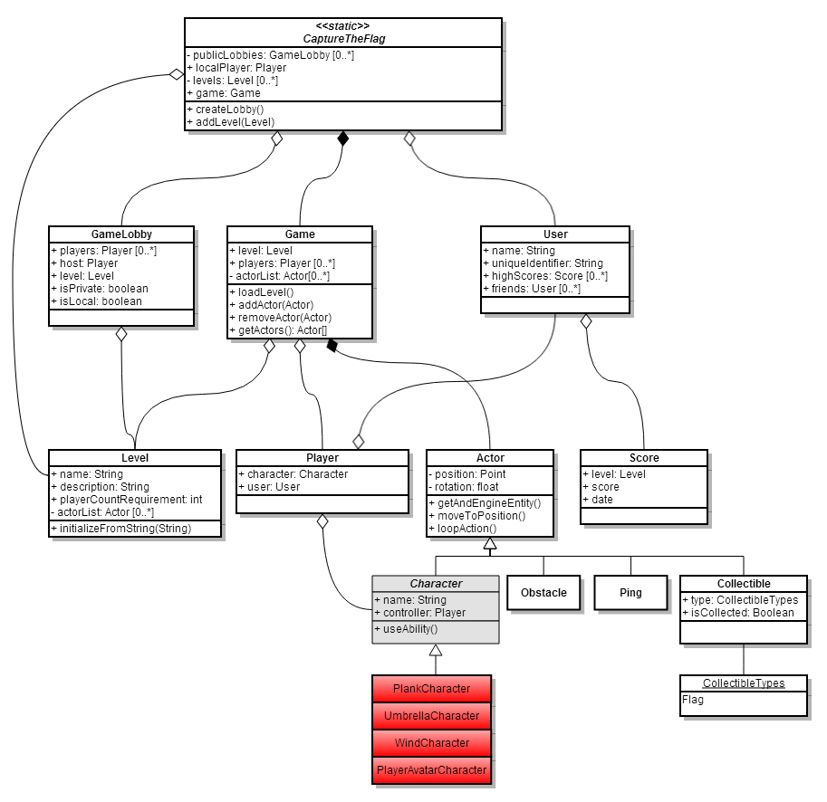
Class Diagrams

Slide 6
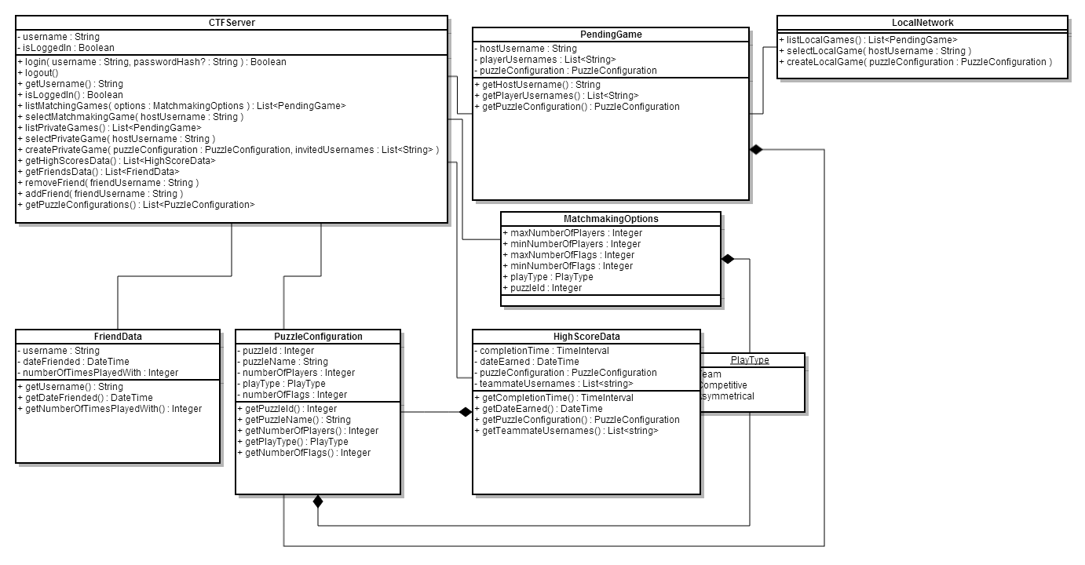
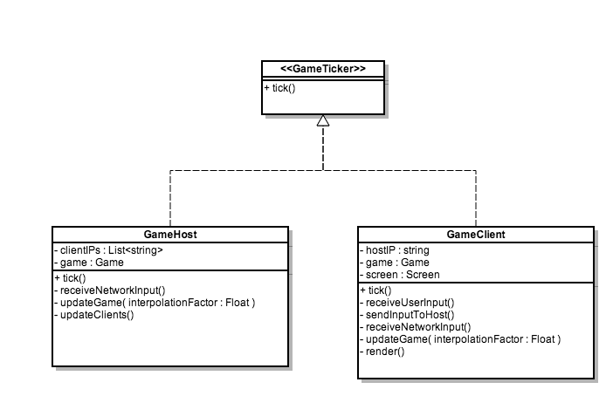
Class Diagrams

Slide 7
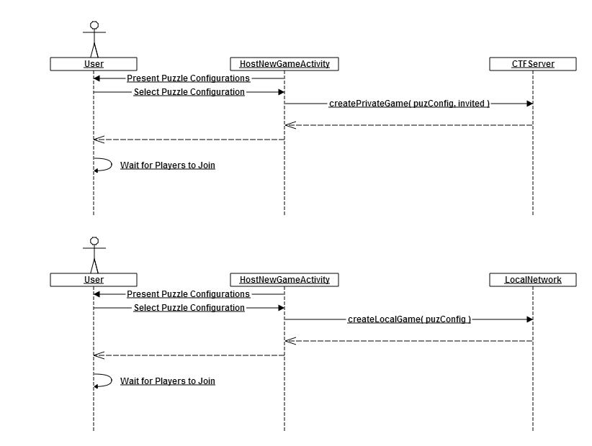
Sequence Diagrams
Host New Game

Slide 8
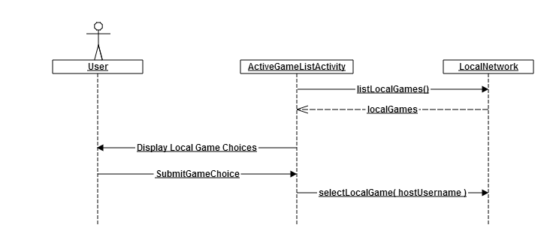
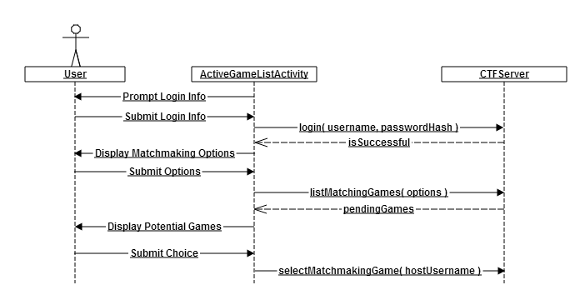
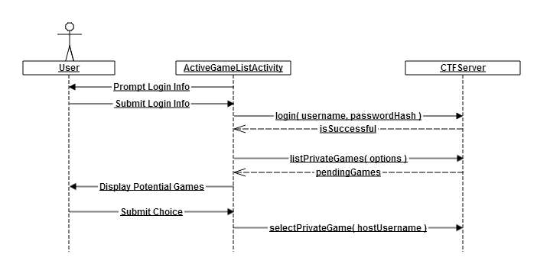
Sequence Diagrams
Join Local Game
Join Matchmaking Game
Join Private Game

Slide 9
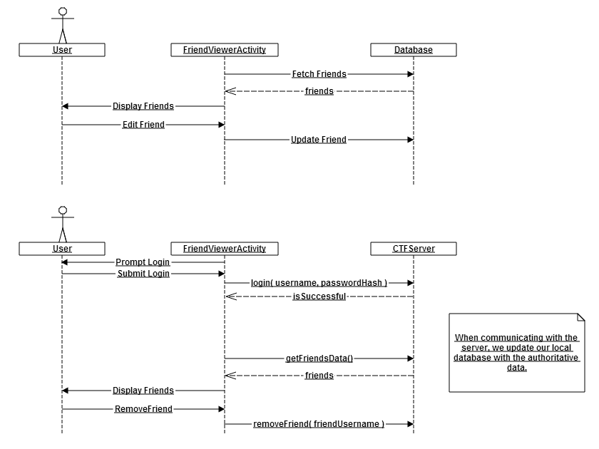
Sequence Diagrams
View/Update/Remove Friends

Slide 10
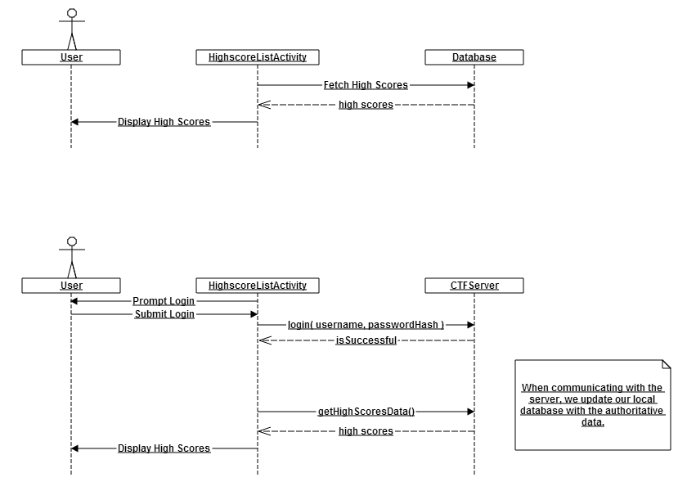
Sequence Diagrams
View High Scores

Slide 11
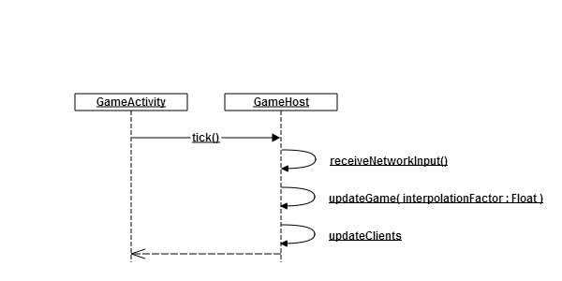
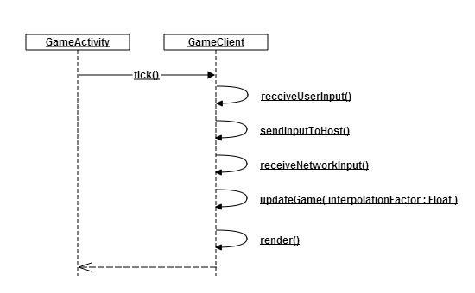
Sequence Diagrams
Game Client
Game Host

Slide 12
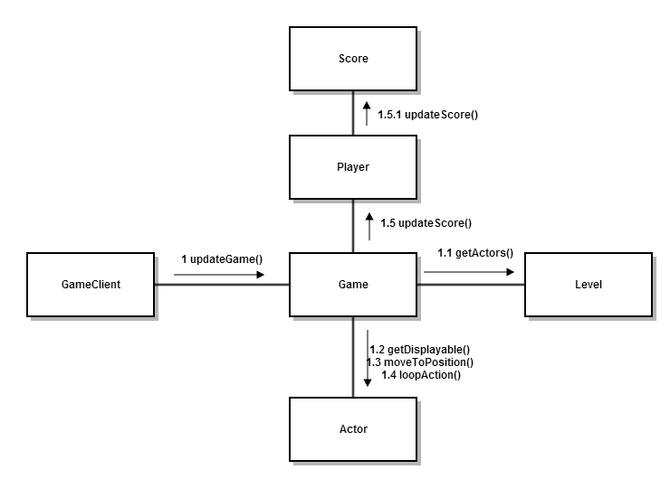
Collaboration Diagrams

Slide 13
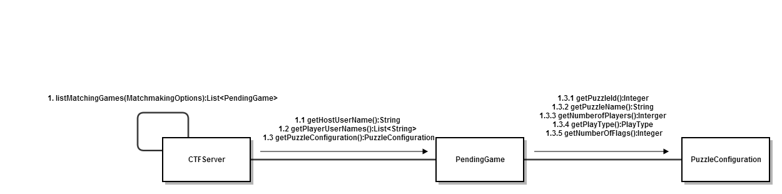
Collaboration Diagrams

