Slide 1
Capture the Flag
Luke Colburn
Chris LaBauve
Tyler Johnson

Slide 2
Overview
Most mobile multiplayer games on the market provide a turn-based experience
Words with Friends, Draw Something
Some a real-time, but are mostly competitive in nature
Need for a real-time cooperative game
Portal 2

Slide 3
Overview
Capture the Flag is a real-time, multiplayer puzzle game
Goal is to collect all of the flags on a map
Users choose from a collection of characters with unique abilities
Players will need to work together and combine abilities to be able to collect all of the flags on a map

Slide 4
Functional Requirements
Name | Description | Priority
Puzzle | Collect all of the flags on the map by solving puzzles | Required
Character Selection | Players can select different characters with different abilities | Required
Game Orientation | The game perspective will be from the side, screen orientation will be landscape | Required
High Score | Players will have high scores for each map | Possible
Local Multiplayer | Up to four players can connect over a local network | Required
Team Play | 2-4 players can work together to solve a puzzle | Required
Player Communication | Players can point to locations on the map, and alert other players of their location | Possible
Multiplayer Matchmaking | Players will be able to join random games with other players on the Internet | Future Work

Slide 5
Non-Functional
Name | Description | Priority
Graphics | Graphics will be sprit-based | Required
Game Engine | The AndEngine library will assist with game functions | Required
Physics | Physics will be handled with the Box2D extension for AndEngine | Required
Synchronous Gameplay | Will use UDP for networked gameplay | Required
User System | Will be needed to uniquely identify users for friends and matchmaking | Possible

Slide 6
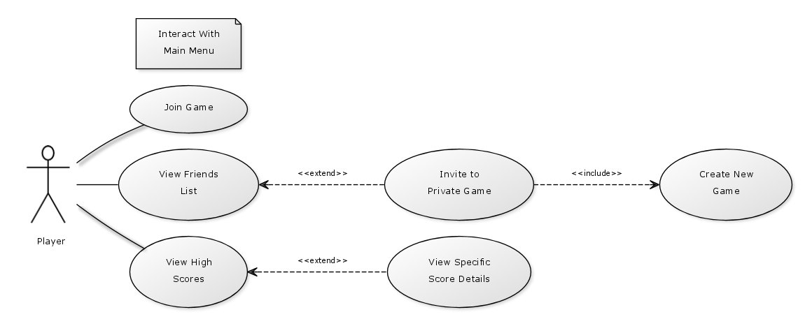
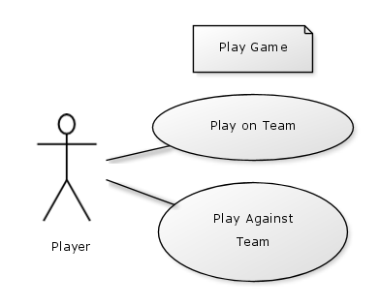
Use Cases

Slide 7
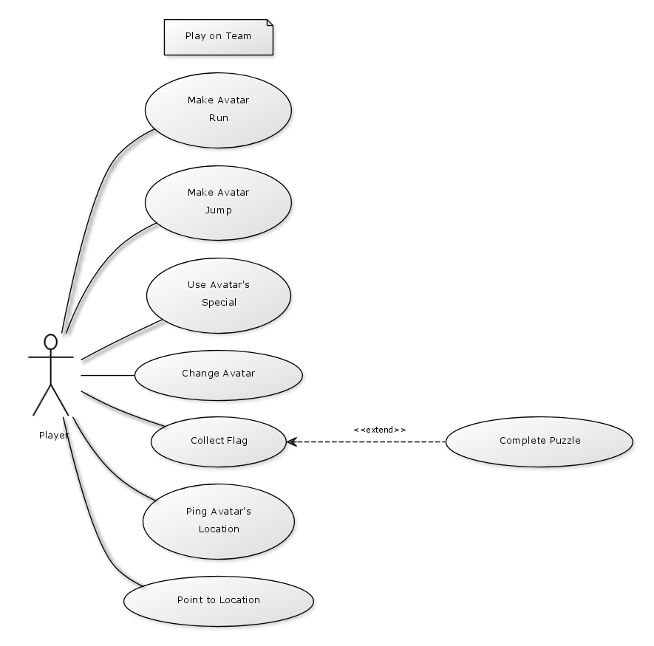
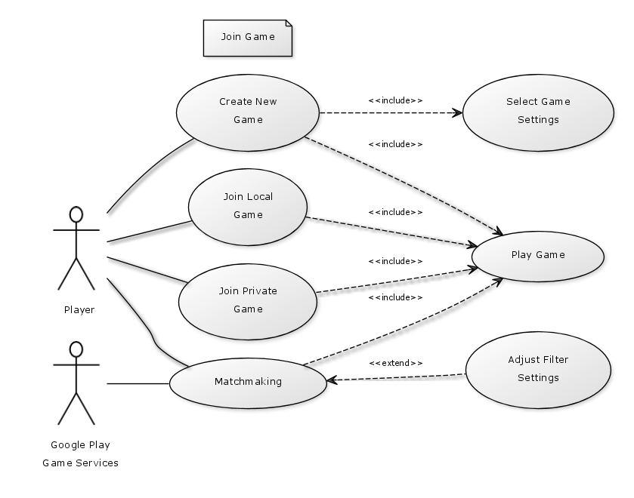
Use Cases

Slide 8
Mockups
Fluid UI

Slide 9
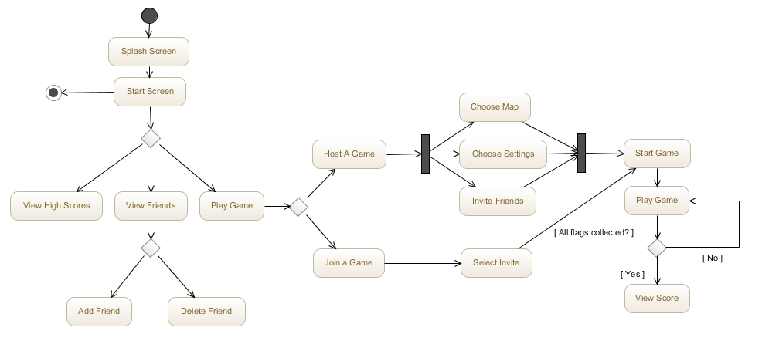
Activity Diagrams

Slide 10
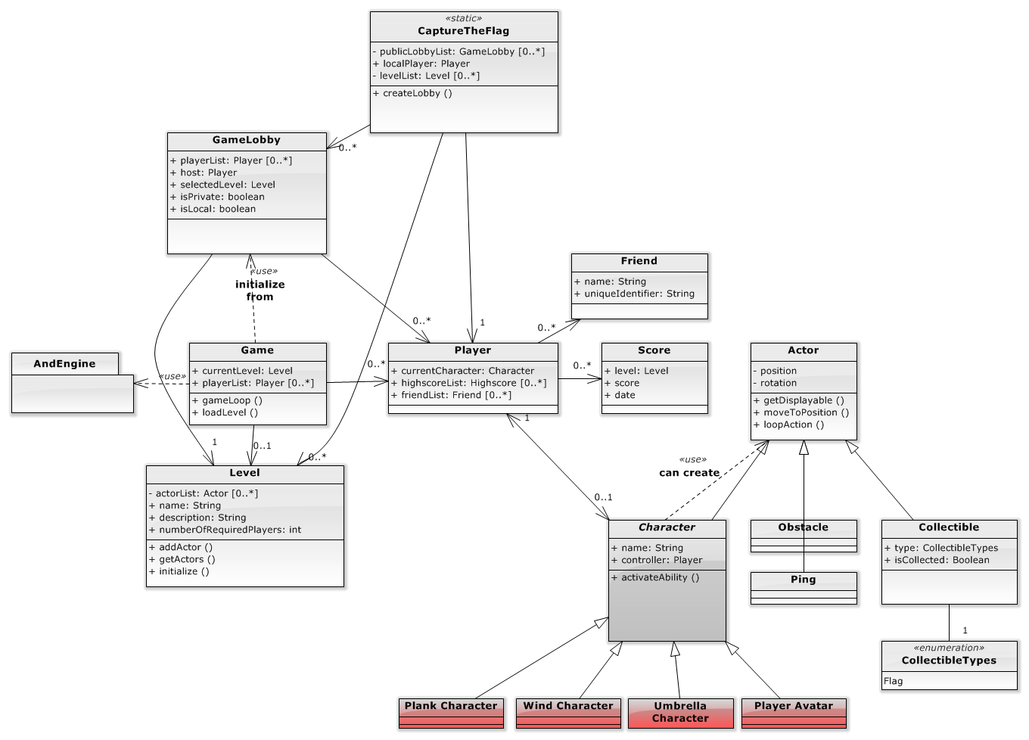
Class Diagram

Slide 11
Risks
AndEngine is poorly documented
Little team experience with networking
Obtaining artwork
Device compatibility

