Slide 1
Preventing Black Holes in MANETs
9785-23-7

Slide 2
Our Project Team
Dr Yibe Alem
Maryam Sousani
Project Sponsor
Project Mentor
Daniel Davaris
Minjeong “Ellie” Kim
Curtis Richardson
Programming & Modelling
Research & Project Direction
System Operations & Documentation

Slide 3
Introduction
Our project tackles Black Hole nodes in mobile networks, which divert and block traffic. By employing Machine Learning, we aim to create a tool that detects and addresses this issue, improving network safety and efficiency. We apply a combination of academic and industry knowledge, employing structured planning and agile methods to safeguard networks and conserve energy.

Slide 4
Agenda
Introduction
Project Parameters
What is the Benefit?
Undertaking the Project
Key Lessons and Takeaways
Summary

Slide 5
Project Parameters
Notes:
Scope / What the project is about

Slide 6
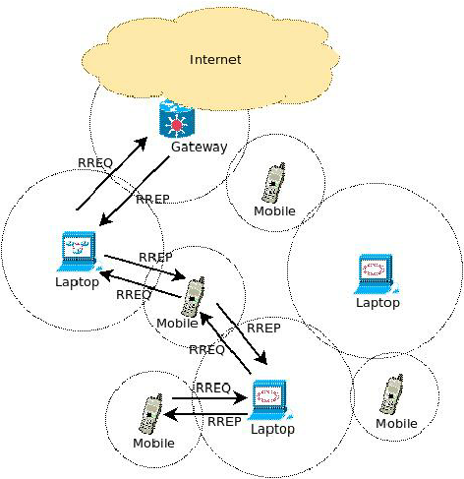
Mobile Ad-hoc Networks
Singh Sengar, Sandeep & Singh, Alok & Narayan Tripathi, Pramod. (2011). A Survey on Telecommunication Technology Standards. Viewed 7 October 2023, <https://www.researchgate.net/figure/Architecture-of-MANET_fig1_241688995>
Notes:
A MANET is a type of wireless network where mobile devices communicate with each other directly without the need for a fixed infrastructure like routers or access points. Imagine a group of smartphones forming a network on the go, without relying on any central hub.
Description of MANETs – best to use a visual stimulus
Architecture of MANETs :
Singh Sengar, Sandeep & Singh, Alok & Narayan Tripathi, Pramod. (2011). A Survey on Telecommunication Technology Standards. Viewed 7 October 2023, <https://www.researchgate.net/figure/Architecture-of-MANET_fig1_241688995>
AODV flow chart will be here

Slide 7
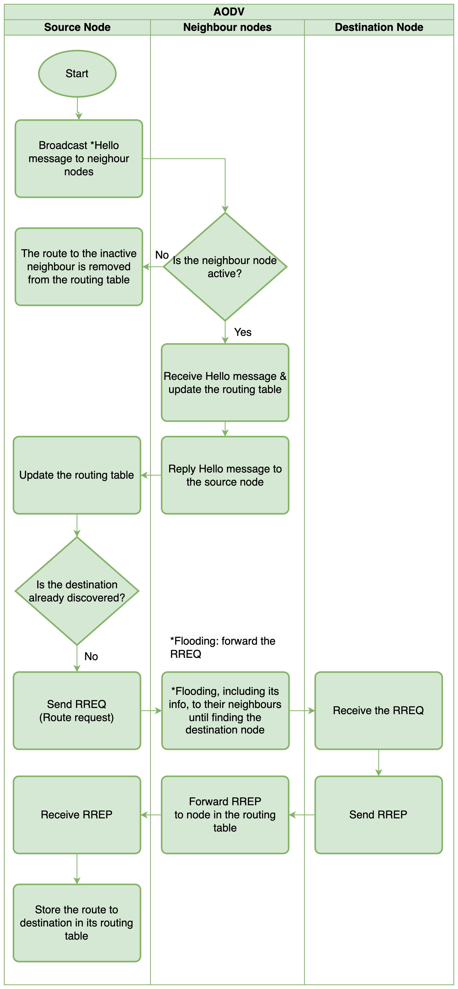
Ad-hoc On-demand Distance Vector Routing
Notes:
Description of AODV – best to use a visual stimulus
The flow chart on the screen shows the process of discovering the destination node through communication between source node and neighbour nodes.
*Hello message contains - the node's identification number - sequence number, - and list of neighbour nodes.
Routing table: hop count number

Slide 8
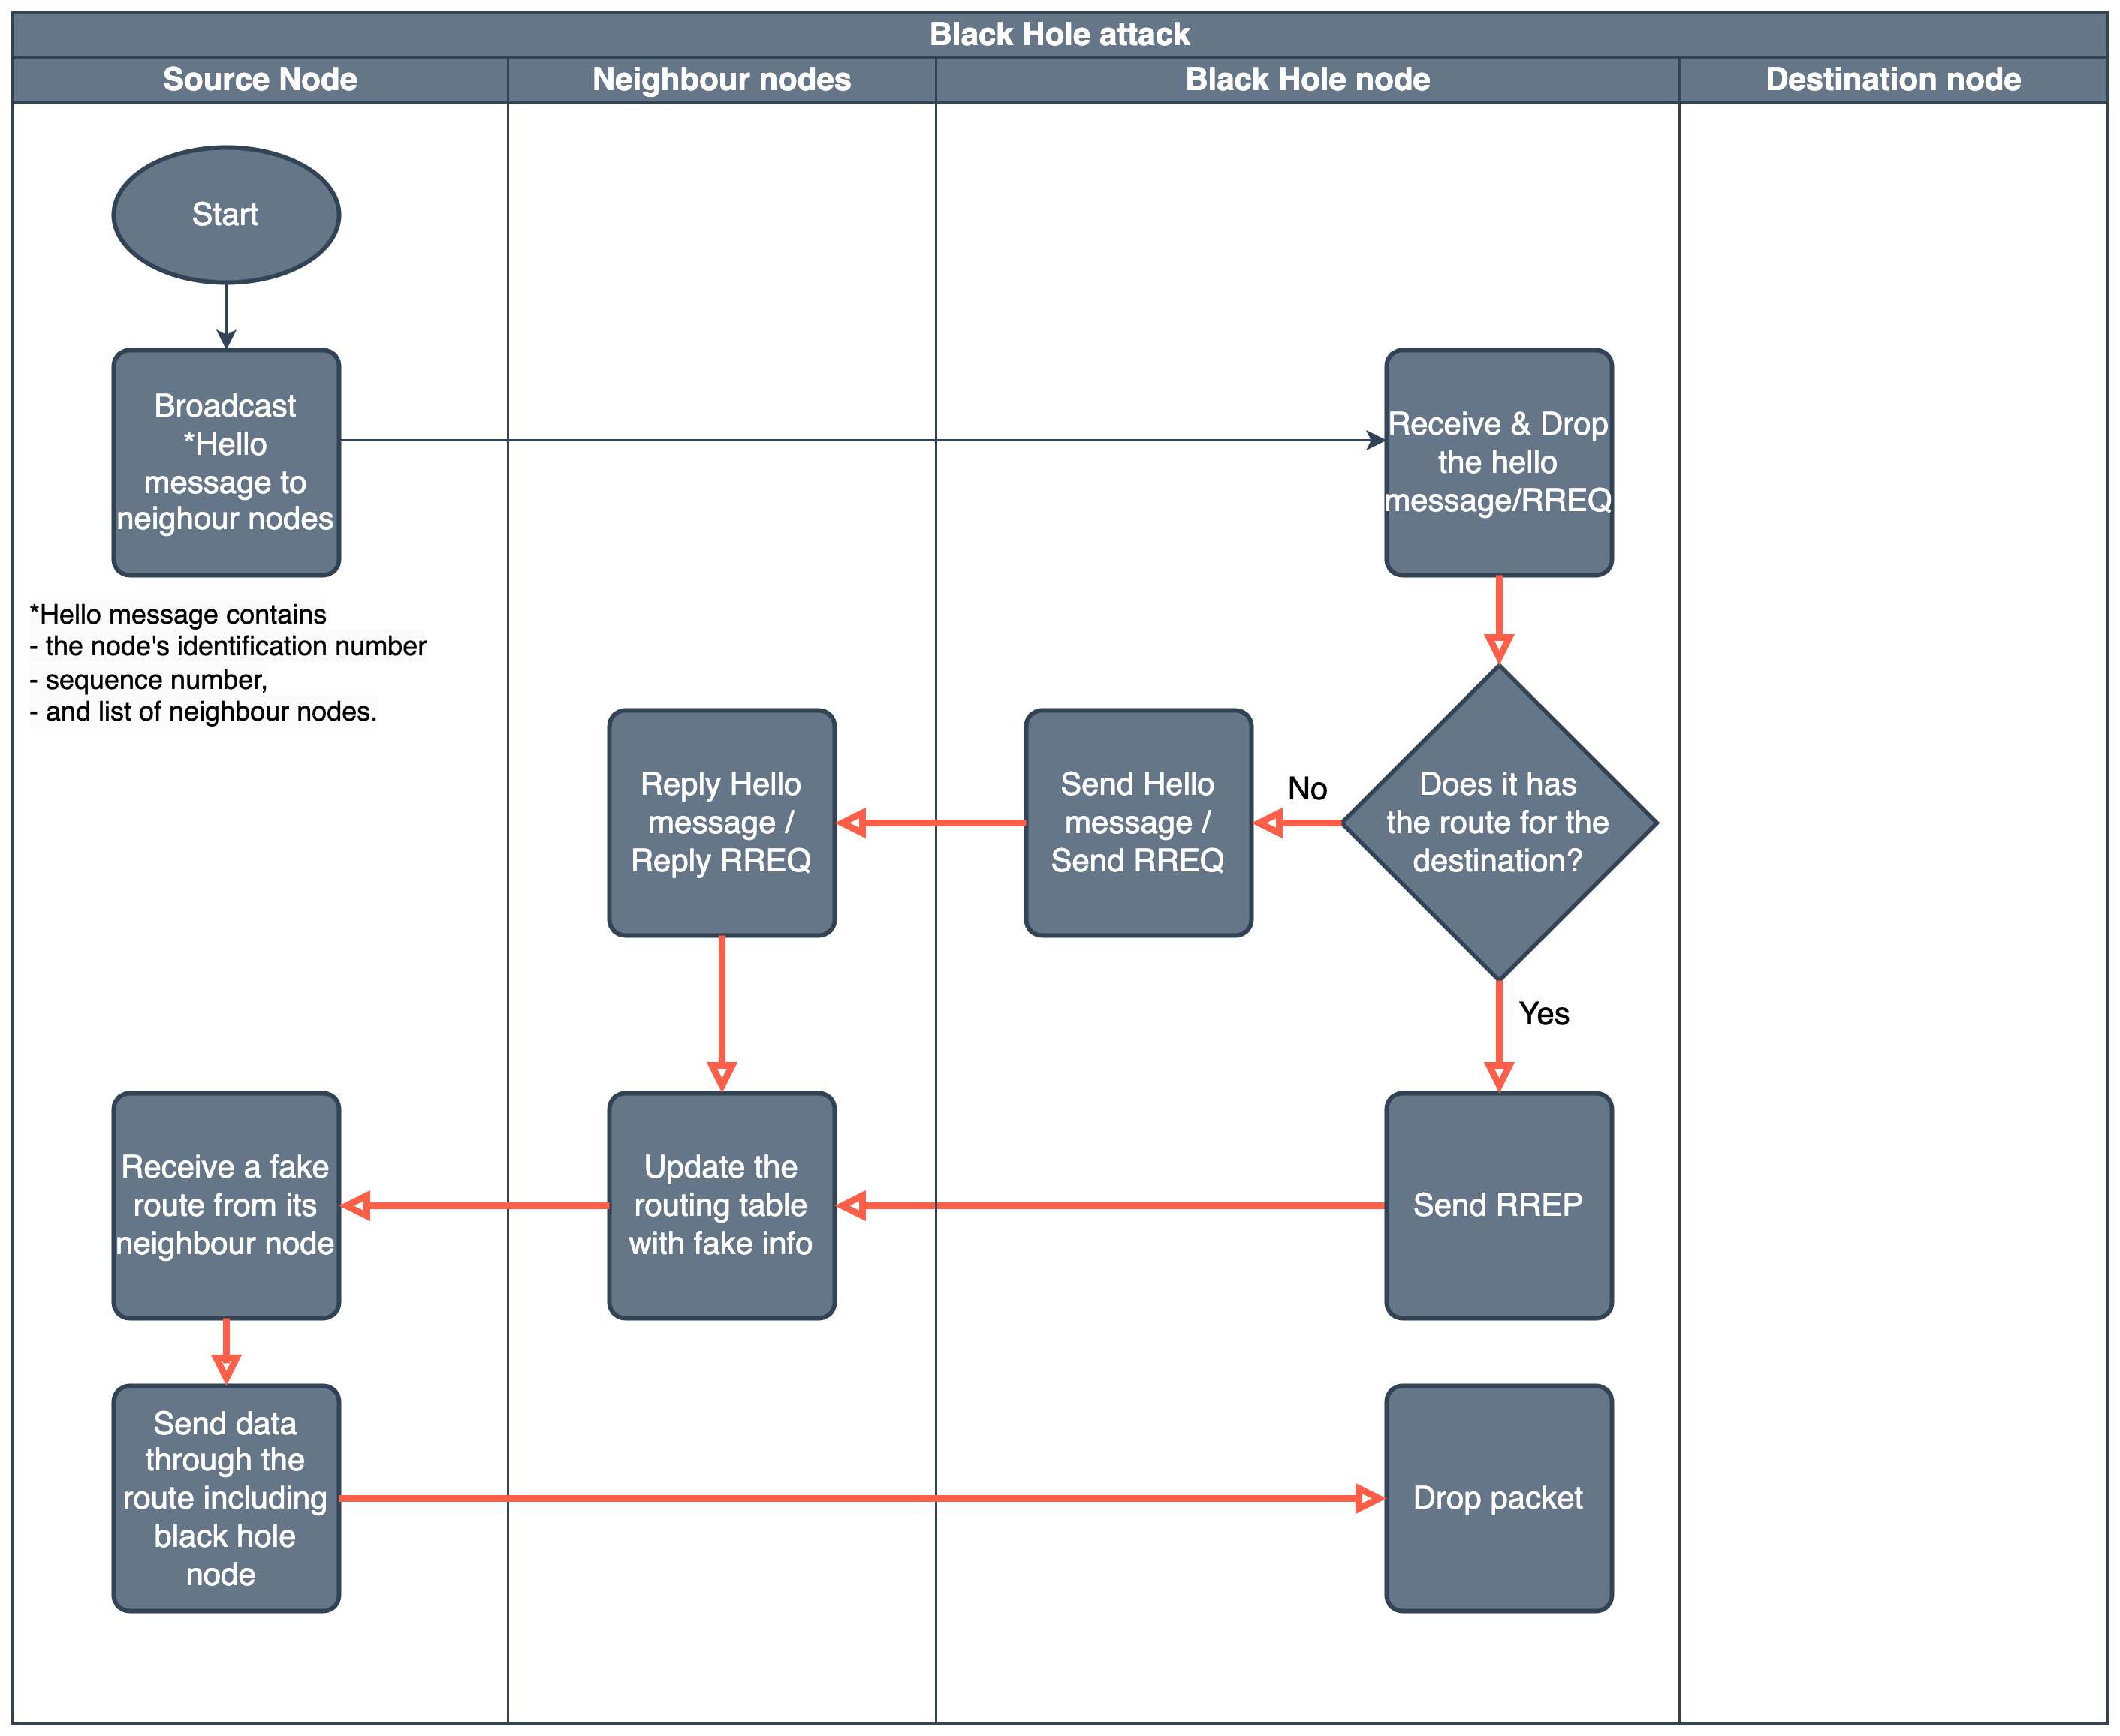
Black Hole Node
Notes:
Ellie’s Flow Chart goes here (replaces table)
Black Hole node
Black hole node
Transcription for presentation:
Black hole node attack
A black hole node attack is a type of denial-of-service attack in which a malicious node in a network pretends to be a legitimate node and then drops any packets that it receives. This can cause a disruption in service for legitimate users of the network.
This flow chart shows how a black hole node advertises itself
A black hole node advertises itself as having the shortest path to all destinations by sending fake routing information to other nodes in the network. It can do this in a few ways:
Hello messages: Hello messages are used by nodes to announce their presence to other nodes in the network. A black hole node can include false routing information in its hello messages, such as claiming to have a route to all destinations with a hop count of 1.
Route request (RREQ) messages: RREQ messages are used by nodes to discover routes to destinations. A black hole node can send RREQ messages to other nodes in the network, claiming to have a route to all destinations.
Route reply (RREP) messages: RREP messages are used by nodes to reply to RREQ messages. A black hole node can reply to RREQ messages with fake routing information, claiming to have a route to all destinations.
Once a black hole node has advertised itself as having the shortest path to all destinations, other nodes in the network will start sending traffic to it. The black hole node will then drop all of the traffic that it receives.

Slide 9
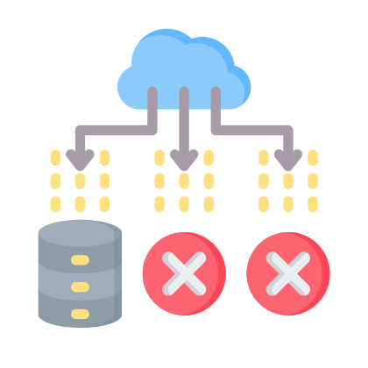

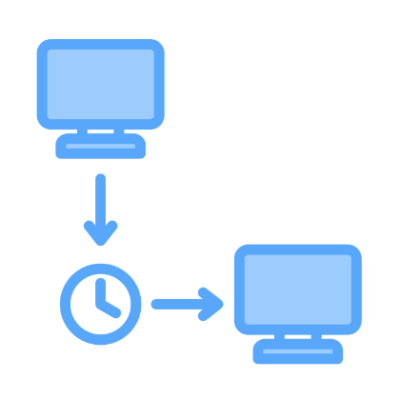

Effects of Black Hole Attack
Increase of packet loss
Reduced output of network
Increased delay
Denial of service
Notes:
Ellie’s Flow Chart goes here (replaces table)
Black Hole node
Maybe 15 secs

Slide 10
How can we capture and observe this behaviour?
?
?
Curious audience member

Slide 11
Network Simulator 3 Architecture
Application
Software / Overall
Discrete Event Simulator
Modifiable simulation scenarios
User programs written in C++ or Python
Node
Computing device that connects to a network
C++ class "Node" provides methods for management and functions of computing devices in simulation
Application
Basic abstraction for program that generates some simulated activity
C++ class "Application" provides methods for simulation of activities
Channel
Simulated media via which data flows between nodes
C++ class "Channel" provides methods for simulating media types and behaviours
Net Device
Abstraction for simulated software drivers and hardware
C++ class "NetDevice" provides methods for simulated driver behaviours
Application
Node
Node
Application
Net Device
Net Device
Node
Channel
Channel
Net Device
Channel
Net Device
Net Device
Node
Net Device
Application
Notes:
Screenshot of NetAnim with diagram

Slide 12
Network Simulator Data Vis.
Notes:
Graphs (for presentation) of data output, go here (Data visualisation)

Slide 13






Stakeholders
Smart Cars
Connected Farms
Smart Cities
Connected Infrastructure
Inter-space / inter-satellite comms
IoT Appliances and Applications
Notes:
All stakeholders utilise AODV networks (generally, AODV is one of the implementable protocols available to each stakeholder)

Slide 14
What is the Benefit?
Notes:
What are the goals and value derived from project implementation
What is the benefit it is delivering?
Less wasted communications with malicious neighbours
Less consumed energy via unnecessary communication with malicious neighbours

Slide 15
Areas of focus
Computationally Inexpensive
Excellent Usability
Low-powered devices
Often utilise own separate power supply (e.g. from battery)
Execution must be quick
Reasonable real detection and mitigation rates
___
Applicable to production networks
Notes:
Computationally Inexpensive:
AODV-configured nodes generally low powered devices – CPU needs to be able to handle computational load
AODV-configures nodes often implemented as independent sensors, with its own separate power supply (from battery)
In cases where dangerous circumstances could arise (e.g. smart car collisions), the execution time of communication is extremely important
Excellent Usability:
Get real detection of malicious/Black Hole nodes to greater than 90%
Mitigation procedure
Develop drop-in model, able to be applied to current production networks

Slide 16
Timeline
Follow-up review with Project Sponsor on Project Delivery
Jul 2023
Apply EOI for Project
Aug 2023
Create Project Plan
Sep 2023
Familiarisation with NS3
Oct 2023
Execute Machine Learning
Nov 2023
Create GitHub Project
Research AODV protocol and Black Hole Nodes
Customisation of NS3 files
Develop and Implement new Model
Deliver Project Presentation, Poster, and Report
Review previous group's Project documentation
Research Project implementation strategy similarity
___

Slide 17
Undertaking the Project
Notes:
What did we do
Challenges we had
What we have delivered
Changes we had along the way
Remember to say: We went to sponsor to discuss change and get it approved, when we noticed it wouldn’t be feasible
Use language of process “got it approved by sponsor”, etc.

Slide 18
Challenges
Simulation Environment Setup
Project Goal Similarity
Program Customisation
Trial and Error
Different base OSes and modules; git recursion
Patch availability
AODV/Black Hole mitigation originality
Focus on value desired goal can provide
Understand NS3 architecture
Artefact handling and overall management
Notes:
Additional to challenge of undertaking technical research project, and also continue working on Project Management unit assessments
Simulation Environment Setup – getting the software to run/build, in the first place
Project Goal Similarity – ensuring our project provides value to wider academic and industry community; so much time spent getting other two aspects working, difficulties in staying focused on being able to discern the value we are aiming for
Program Customisation – NS3 is a very modular, and complex system: not only does the filesystem structure of the program need to be understood, but so too does the manner in which it outputs results (and how that can be customised through the different available modules – or even building your own modules)

Slide 19
Deliverables
Black Hole resistant model
Professional documentation
Specifically, for AODV protocol based networks
___
___
Target audience may desire sensor-based networks, but not understand the technical requirements
___
___

Slide 20
Changes
Aug 2023
Sep 2023
Oct 2023
<Use mock dataset, instead of real generated>
Use GitHub Project as source of truth for documentation (previously MS Teams)
Organise independent Azure instance during UC outage
Notes:
Remember to say: We went to sponsor to discuss change and get it approved, when we noticed it wouldn’t be feasible
Use language of process “got it approved by sponsor”, etc.

Slide 21
So, it was a complete success?
?
?
Concerned audience member
Notes:
This is where we can pivot (with detail – obviously mention earlier in presentation if outcome was successful, or not)

Slide 22
Key Lessons and Takeaways
Notes:
Outcomes and recommendations; what did we learn
Outcomes:
___
Learned:
1. Managing the process and flow of a highly academic research project
2. AODV protocol
3. Black Hole nodes and related malicious MITM attacks
4. NS3 software architecture and execution
5.
Recommendations:
___

Slide 23
Project Achievements
<Black Hole Node resistant modelling for AODV networks>
Reproducable Environment Build Instructions
Concise descriptions and documentation on AODV and Black Hole Nodes
Evidentiary documentation of conducting Project in professional manner <minutes, git merge process, gantt chart, etc.>

Slide 24
How we get there
ROI
Niche Markets
Supply chains
Envision multimedia-based expertise and cross-media growth strategies
Visualize quality intellectual capital
Engage worldwide methodologies with web-enabled technologies
Pursue scalable customer service through sustainable strategies
Engage top-line web services with cutting-edge deliverables
Cultivate one-to-one customer service with robust ideas
Maximize timely deliverables for real-time schemas

Slide 25
Education from Capstone
Project Management
Managing the process and flow of a highly academic research project
Networking
The AODV protocol
Vulnerabilities
Black Hole nodes and other related malicious MITM attacks for AODV
NS3 (tooling)
Building NS3, customising it to suit a particular use case, and getting useful output from simulations
Software architecture and execution
Notes:
Learned:
1. Managing the process and flow of a highly academic research project
2. AODV protocol
3. Black Hole nodes and related malicious MITM attacks
4. NS3 software architecture and execution
5.

Slide 26
Recommendations
___
___
___
___
___
___
___
Notes:
Changes, depending on if we're recommending future groups' development, or our methods have succeeded

Slide 27
Summary
___

Slide 28
Thank you
9785-23-7
Curtis (u3201908) Daniel (u3215948) Ellie (u3225675)
Notes:
“We’ll take questions, now.” (If no one wants to ask a question, pull some from our “back pocket”).
e.g.:
Q: "If this was the 2nd time this project was run, but it still wasn't successful, how would you assist the university to have the confidence to attempt a 3rd time?
A: The major developments of the first attempt brought about significant feature engineering for the project; ours developed a robust direction for the project, as well as took the vast majority of the mystery out of dealing with the simulation environment (descriptions and documentation have been tightened up significantly, and requirements in order to utilise or customise the simulation environment have been clarified). While a future group will have some familiarisation with NS3 to contend with (and currency of research will always be a present issue), the project state is in a better place to allow more time to be spent on simulation and modelling experimentation.
“That brings us to the end of our presentation, thank you for your time.” – last line to be used.

Slide 29
Bibliography
Singh Sengar, Sandeep & Singh, Alok & Narayan Tripathi, Pramod. (2011). A Survey on Telecommunication Technology Standards. Viewed 7 October 2023, <https://www.researchgate.net/figure/Architecture-of-MANET_fig1_241688995>
___
Notes:
Bibliography slides

