Slide 1

Investigating Differentiable Neural Architecture Search
Harvard Data Science Capstone (Fall 2019)
Final Presentation
Team
Michael S. Emanuel
Julien Laasri
Dylan Randle
Jiawei Zhuang

Slide 2
Outline
Problem & Motivation
Neural Architecture Search
Datasets
Introduction to DARTS (Differentiable Neural Architecture Search)
Results
MNIST
Graphene
Galaxy Zoo
Chest X-Ray
Conclusions & Future Work

Slide 3
Problem & Motivation

Slide 4
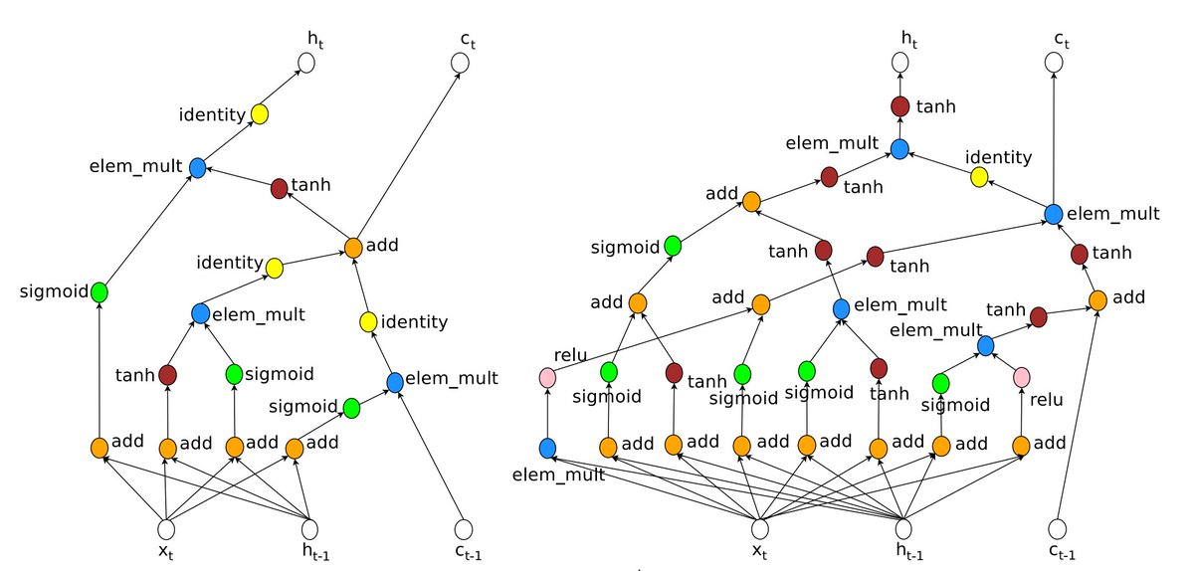
What is Neural Architecture Search?
Deep learning frees us from feature engineering, but has led us to spend valuable time on architecture engineering
Today: designed by experts
Labor-intensive
Tomorrow: Neural Architecture Search (NAS)
Automatically find best architecture
Interest in NAS is increasing rapidly: there is now far more demand for neural network models than available experts who can design model architectures
LSTM vs learned recurrent cell using reinforcement learning approach
Notes:
Dylan

Slide 5
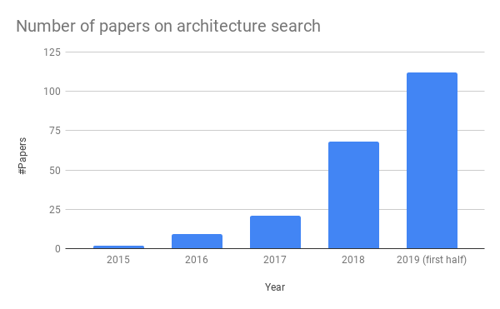
NAS papers per year based on the literature list on automl.org. The number for 2019 only considers the first half of 2019.
(Lindauer and Hutter, 2019)

Slide 6
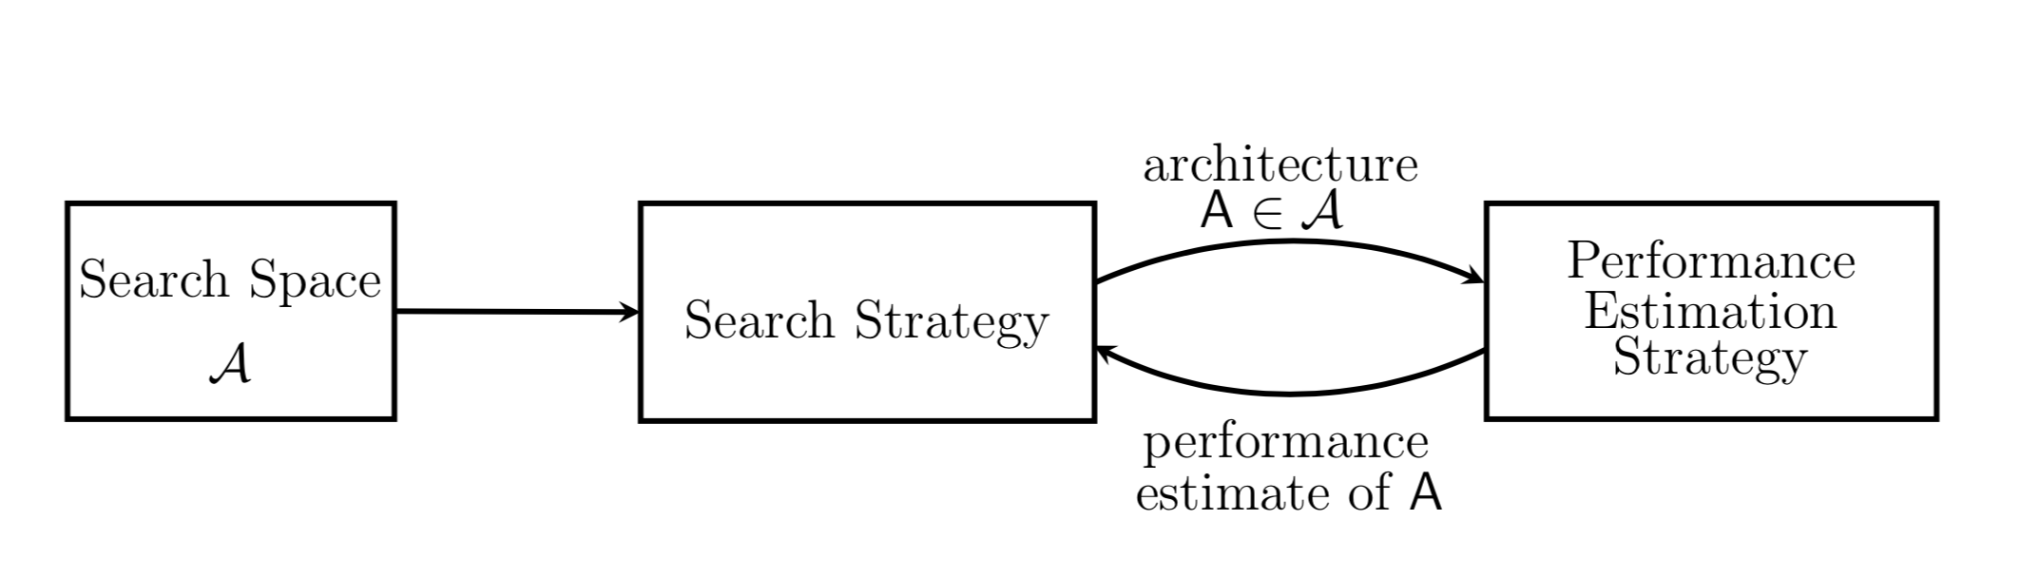
Neural Architecture Search Workflow
Credit: Elskin et. al, 2019

Slide 7
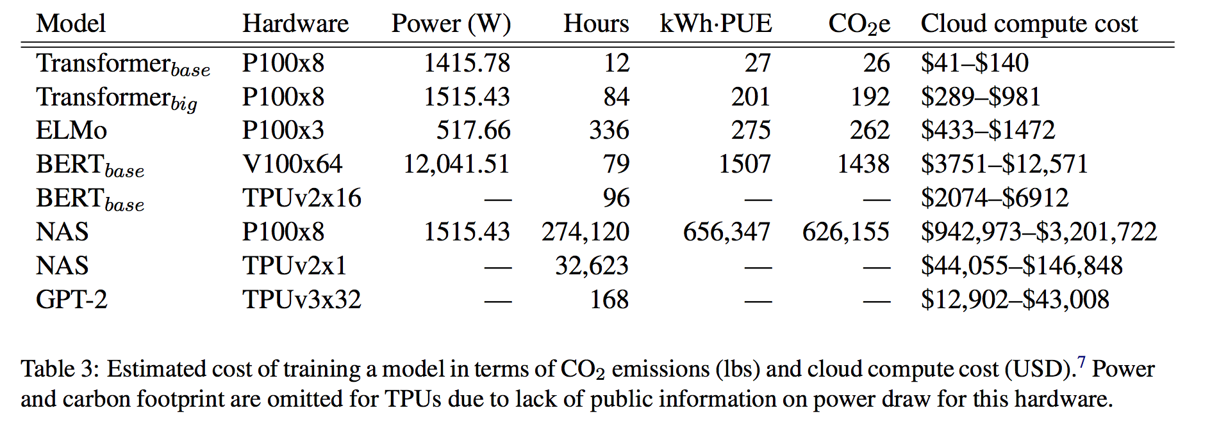
NAS can be very expensive
NAS cost is from evolutionary architecture search on Transformer (Strubell et al. 2019)

Slide 8
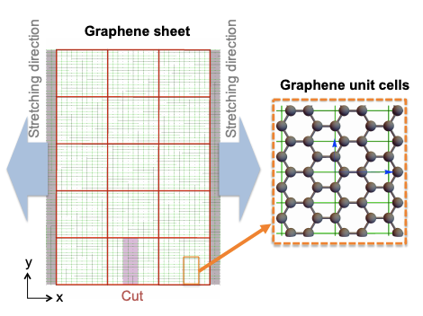
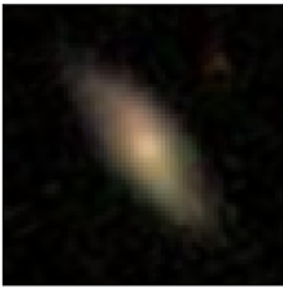
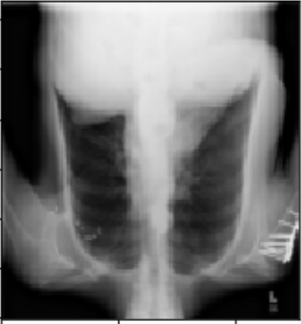
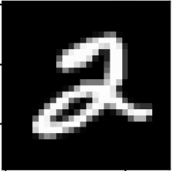
Scientific Datasets
Most NAS studies only use standard image datasets like CIFAR and ImageNet. However, deep learning also shows large potential for various physical sciences. Thus we want to see whether DARTS is useful for scientific datasets.
MNIST: classifying images of handwritten digits (non-scientific baseline)
Graphene Kirigami: cutting graphene to optimize stress/strain
Galaxy Zoo: classifying galaxy morphology from telescope images
Chest X-Ray: predicting diseases from chest x-rays
Not “scientific” but good “hello world”

Slide 9
Introduction to DARTS
(Differentiable Neural ARchiTecture Search)

Slide 10
Issues with brute-force or traditional Neural Architecture Search (NAS) approaches
Proposed solutions in DARTS (Differentiable ARchiTecture Search, Liu 2019, ICLR)
Only search for the optimal "cell", i.e. a small unit of convolutional layers. Construct the complete model by stacking identical cells.
(following NASNet, Zoph 2018, Google Brain)
Extremely large search space: arbitrary connections and operations between neural network nodes
Every "trial architecture" is re-trained from scratch, taking many GPU hours
Share weights/parameters between child models, which can be "trained together"
(similar to ENAS, Pham 2018, Google Brain)
Continuous relaxation: parameterize the choice of operation by "architecture parameter" α, which can be optimized by gradient descent
The choice of operations (e.g. Conv, Pooling) is discrete, requiring expensive optimization

Slide 11
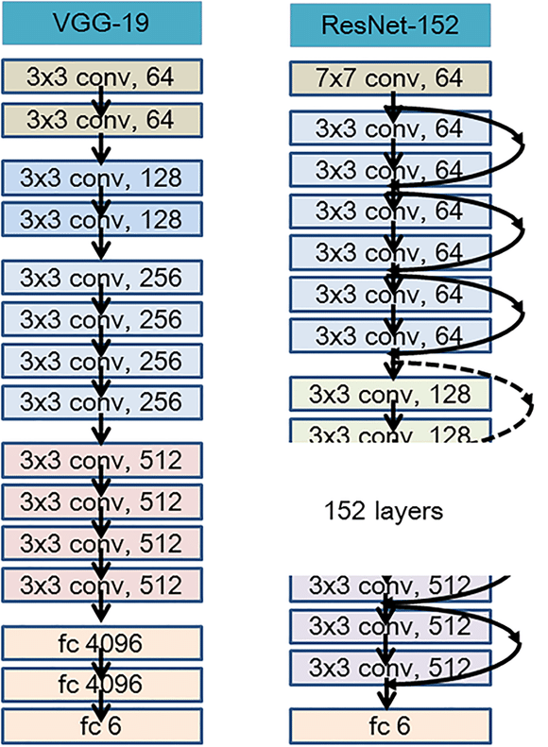
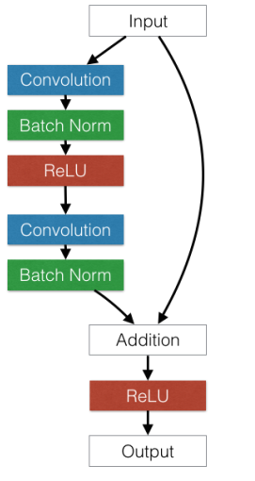
One residual block
Key observation:
popular CNN architectures often contain repeating blocks, stacked sequentially
Notes:
Figure from https://www.researchgate.net/figure/The-representation-of-model-architecture-image-for-ResNet-152-VGG-19-and-two-layered_fig2_322621180

Slide 12
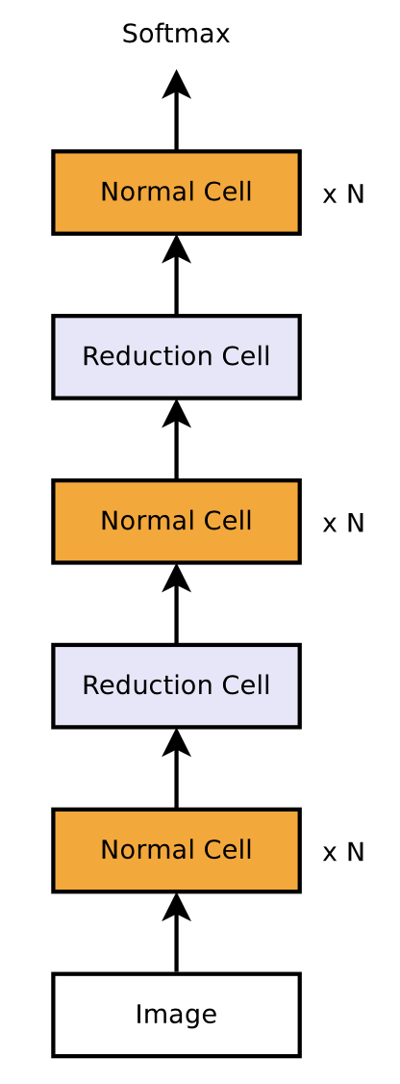
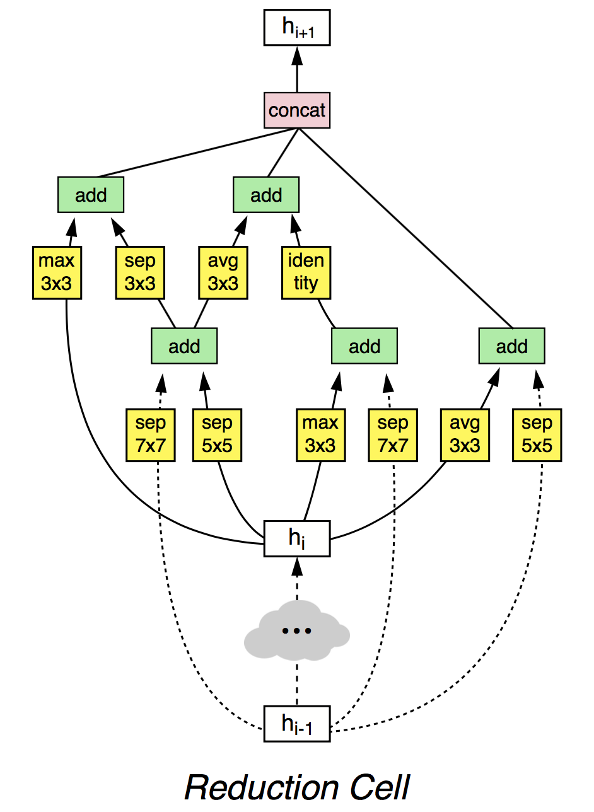
DARTS searches for the optimal "cell", not whole model
Two types of cells:
Normal Cell: output same dimension
Reduction Cell: output half dimension
Stack cells sequentially to form model
Each cell type share the same architecture but have independent weights
(following NASNet, Zoph 2018, Google Brain)
Notes:
Figure from Zoph 2018

Slide 13
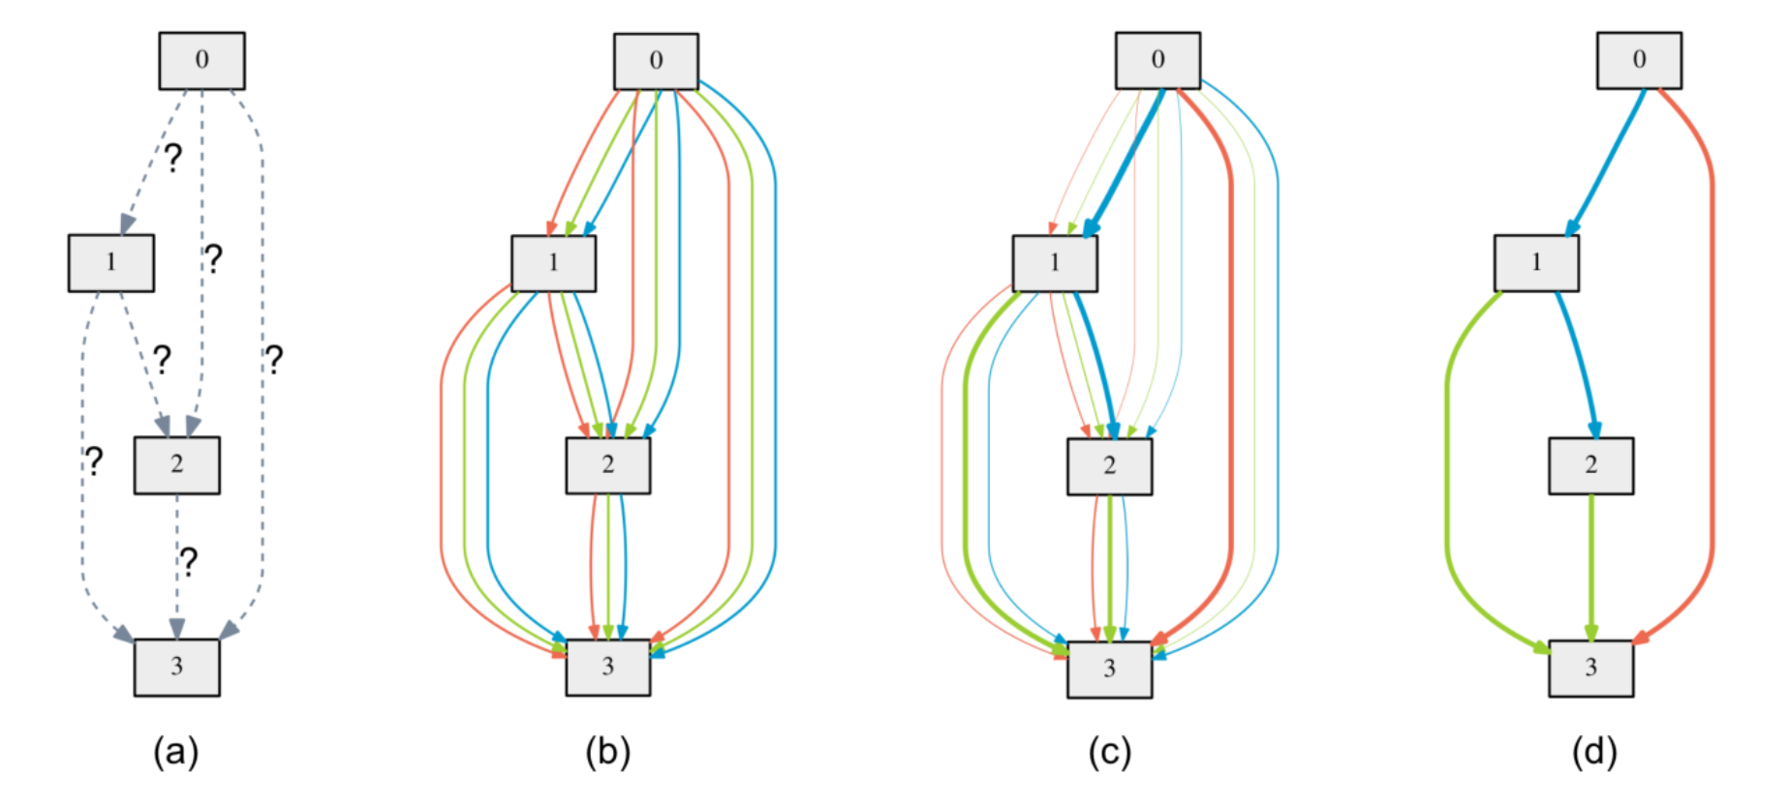
Continuous relaxation of discrete operations enables gradient descent
Example operations:
Conv 3x3
MaxPooling
Identity
Goal: Find the optimal cell, by placing proper operations (e.g. conv, pooling) at edges
Superpose: each edge is the sum over the outputs of multiple operations, weighted by continuous "architecture parameters" α
Discretize: select the operation with the highest architecture weight, to be the final architecture
Search: Optimize the architecture weights α, using gradient descent on validation loss

Slide 14
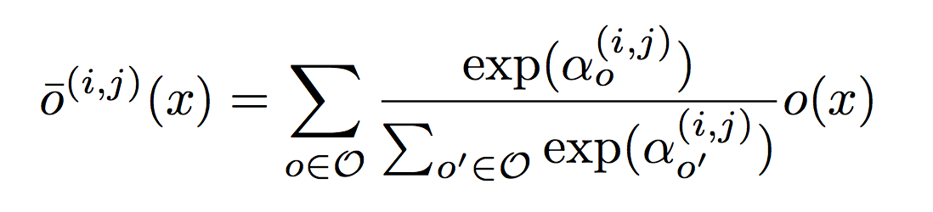
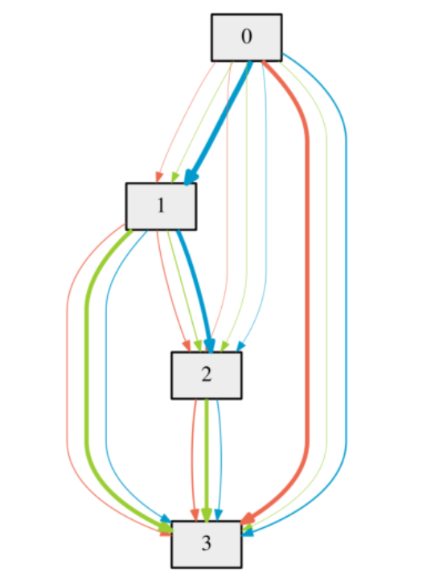
Gradient-based optimization for architecture parameter α
Example operations:
Conv 3x3
MaxPooling
Identity
The actual operation at edge (i, j) is the average of all candidate operations o(x), weighted by α:
With a certain choice of architecture weight α, the corresponding architecture can be in principle trained to convergence, leading to the optimal model weights w*(α) and the final validation loss L_{val}(w*(α), α).
The gradient of L_{val} w.r.t to α gives the direction for gradient descent!

Slide 15
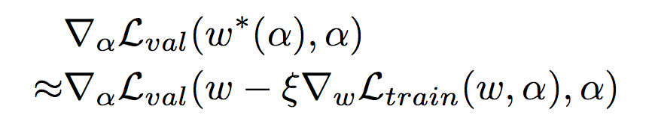
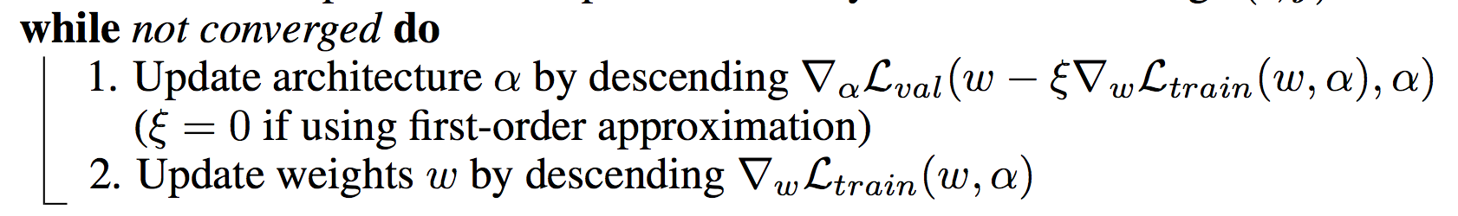
One-shot evaluation to avoid re-training
Computing the true loss L_{val} by training w to the end is too expensive; thus DARTS just trains w for one step to get a proxy loss:
where the optimal model weights w*(α) is approximated by the one-step training
The training of α and w is performed in an alternate way:

Slide 16
Results

Slide 17
Overview
Model | MNIST | Graphene | Galaxy Zoo | Chest X-Ray
DARTS (Continuous) | 99.07 | 0.89 | 0.094 | 0.157
DARTS (Discrete) | 99.27 | 0.92 | 0.114 | 0.163
Random Search | 99.31 | 0.90 | 0.098 | 0.169
ResNet | 99.40 | 0.92 | 0.095 | 0.163
Metric | Accuracy | R² | RMSE | BCE

Slide 18
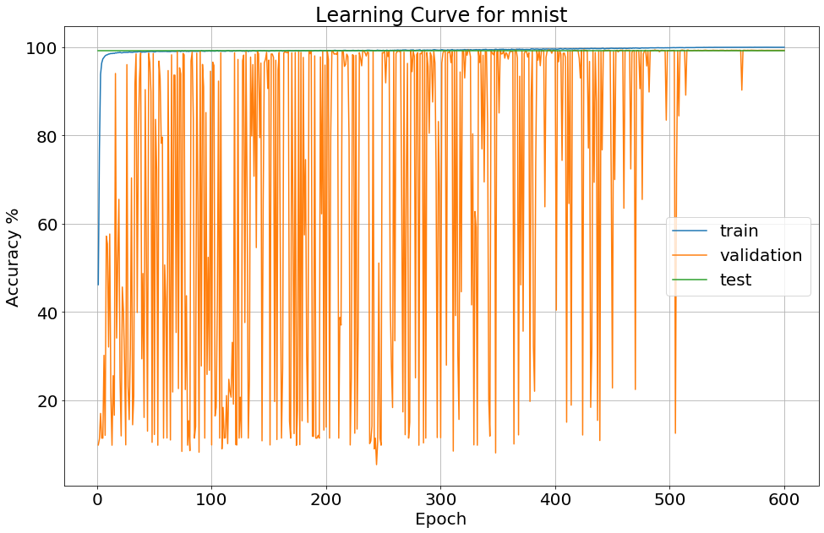
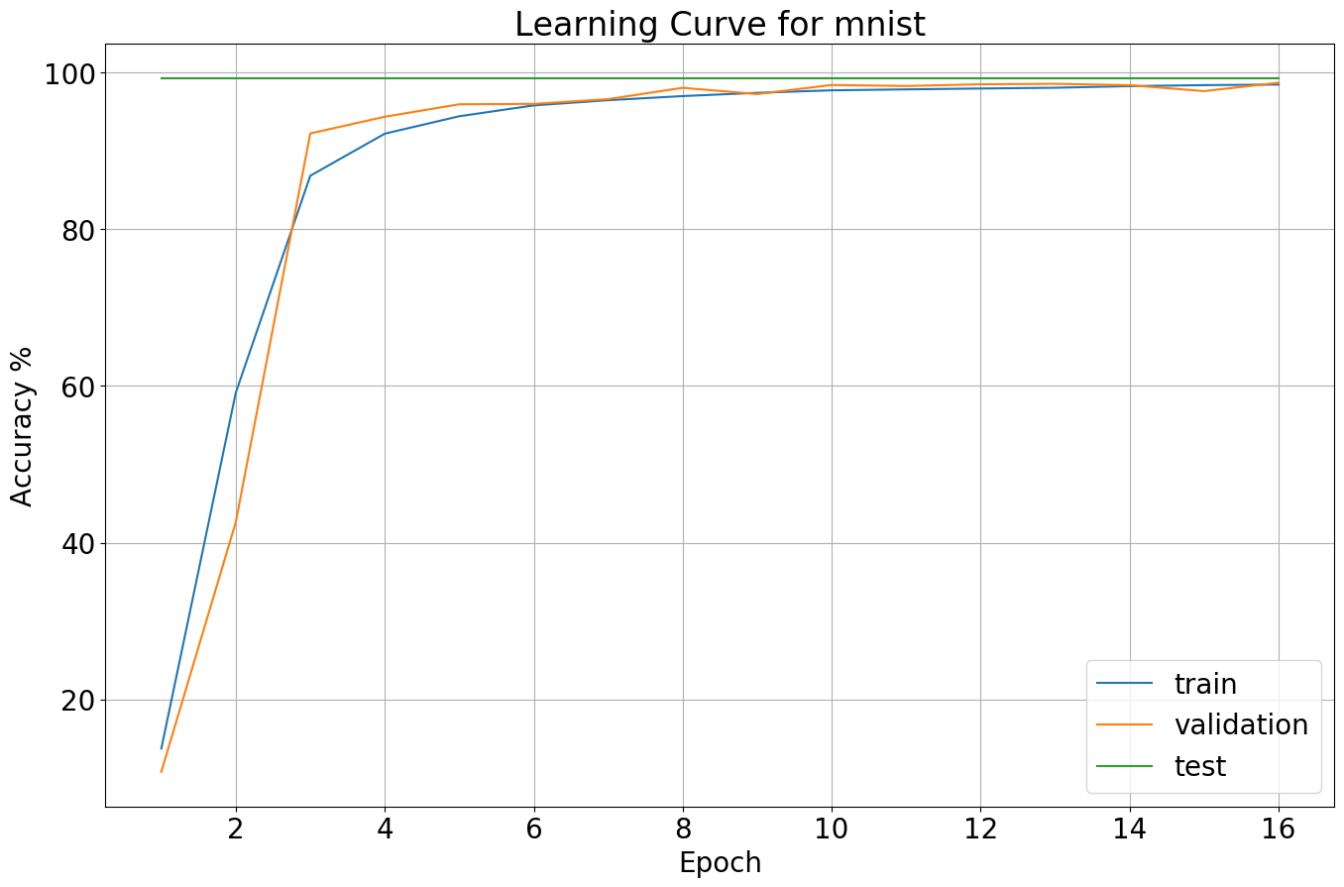
Results: MNIST
Training MNIST with default learning rate fails
Had to tune learning rate
Key point: even on easy problem, DARTS is sensitive to hyperparameters
Model | MNIST
DARTS (Continuous) | 99.07
DARTS (Discrete) | 99.27
Random Search | 99.31
ResNet | 99.40
Metric | Accuracy
Default Hyper-parameters
Tuned Hyper-parameters

Slide 19
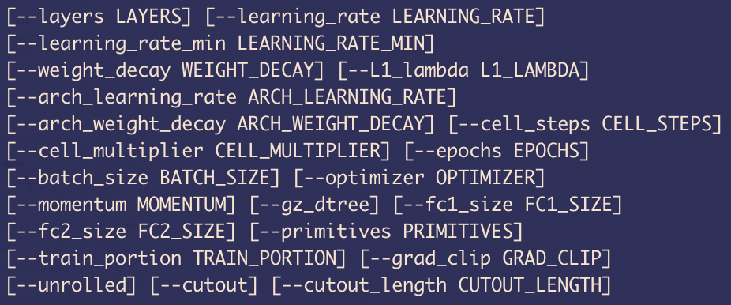
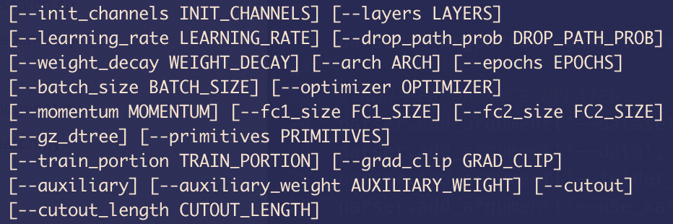
Large number of hyperparameters (~2x standard)
Train DARTS search
Train discretized

Slide 20
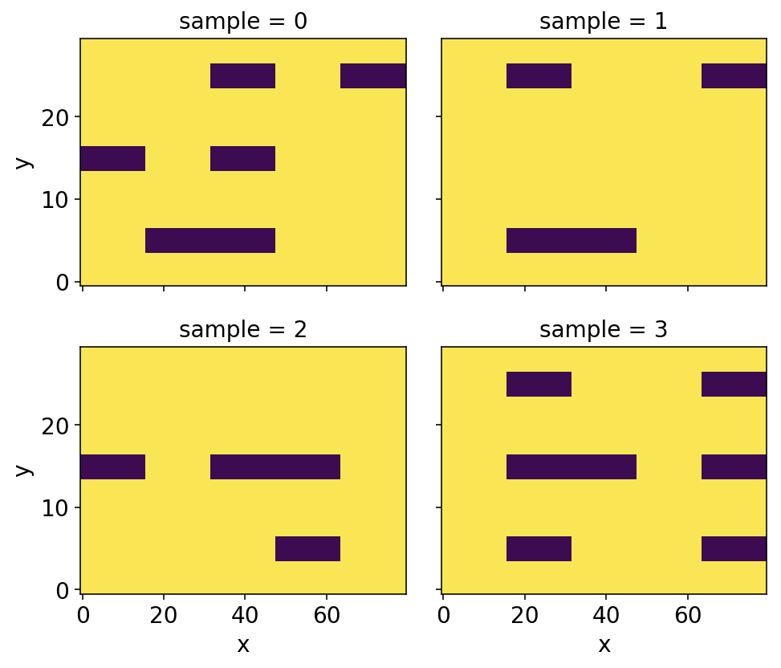
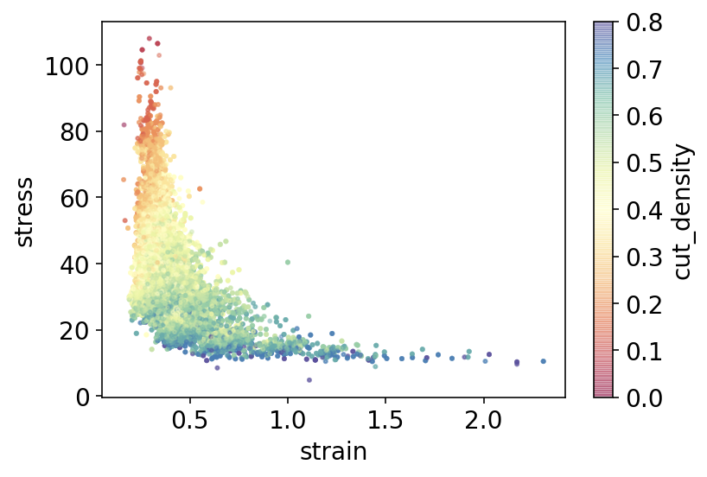
Problem: Graphene Kirigami
predict
cut configuration
stretch property
~30,000 samples
Hanakata et al. 2018, PRL
Notes:
Jiawei

Slide 21
Results: Graphene Kirigami
Method / model | No. Parameters | Training time* (minutes) | Test R²
DARTS | 195,236 | 1042 | 0.92
ResNet-18 | 11,168,193 | 11 | 0.92
"Tiny ResNet" (10 layers, 8x less filters) | 77,273 | 4 | 0.92
1. Time reported to train for 30 epochs on a single GPU.
Conclusion: Graphene Kirigami dataset is too simple for DARTS to be useful.
Notes:
Jiawei

Slide 22
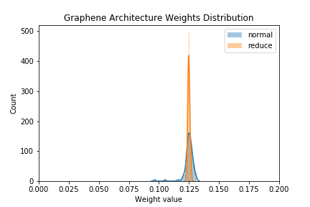
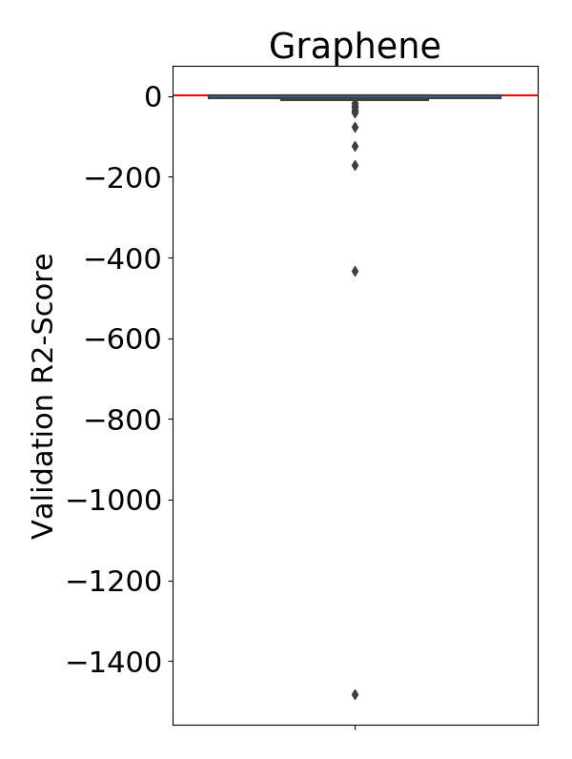
Graphene Architecture & Random Search
Simple problem → many good architectures → low sparsity in architecture weights

Slide 23
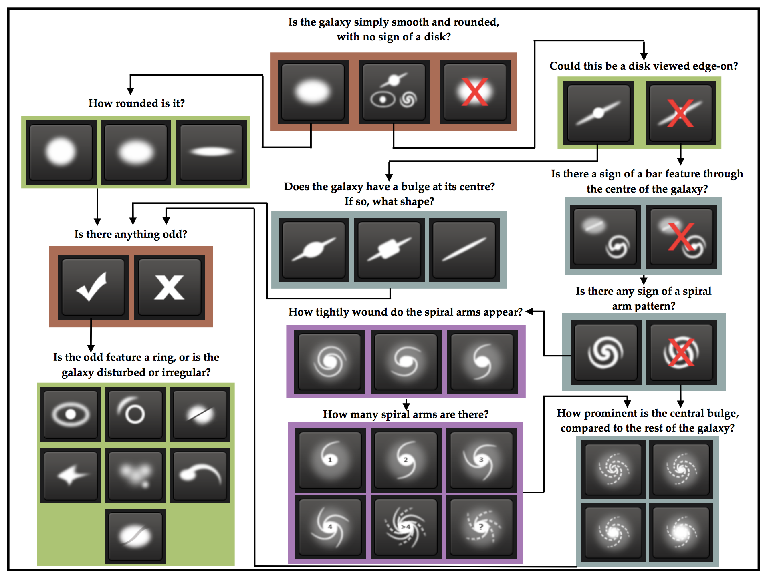
Problem: Galaxy Zoo
Predict galaxy morphology from images
37 distinct binary attributes
Scored on root mean squared error (RMSE)

Slide 24
Results: Galaxy Zoo
Continuous DARTS better than ResNet
“Discretized” architecture is worse
Shows heuristic discretization step can fail
Kaggle winner score is ~0.075 (with extensive data augmentation and model ensembling)
Model
DARTS (Continuous)
DARTS (Discrete)
Random Search
ResNet
Metric
Galaxy Zoo
0.094
0.114
0.098
0.095
RMSE

Slide 25
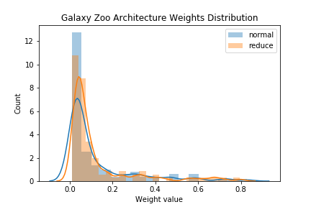
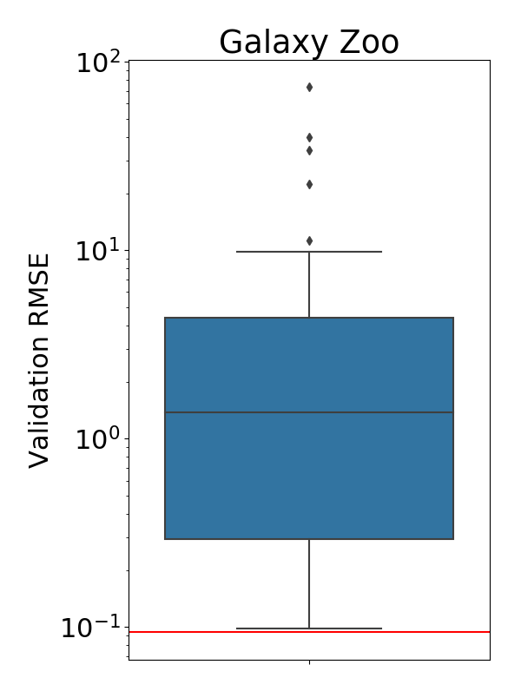
Galaxy Architecture & Random Search
Large variance in architectures → sparse cell learned by DARTS

Slide 26
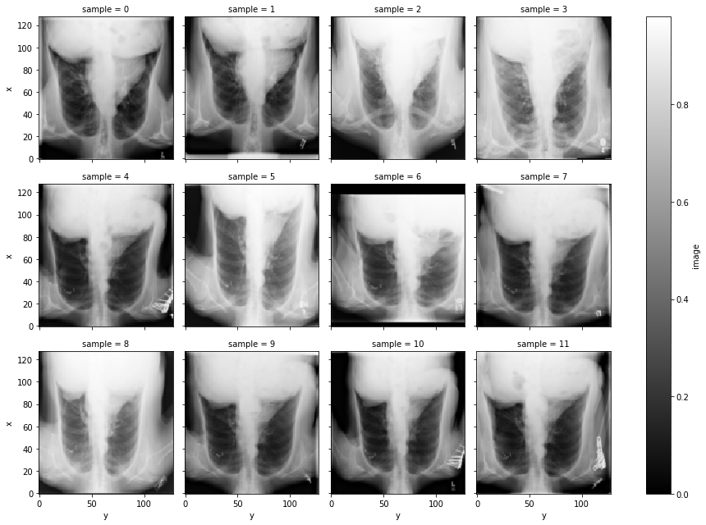
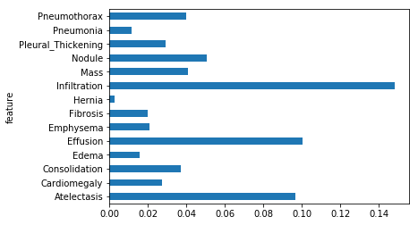
Problem: Chest X-Ray
39,589 chest X-rays
14 independent disease labels (confirmed diagnoses)
Models assessed with mean binary cross entropy (BCE)
Proportion of each disease

Slide 27
Results: Chest X-Ray
Model
DARTS (Continuous)
DARTS (Discrete)
Random Search
ResNet
Metric
Chest X-Ray
0.157
0.163
0.169
0.163
BCE
DARTS performs well after some hyperparameter tuning
The discretized network was worse (same as ResNet)
Discretization step failed again

Slide 28
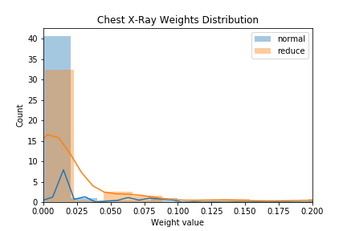
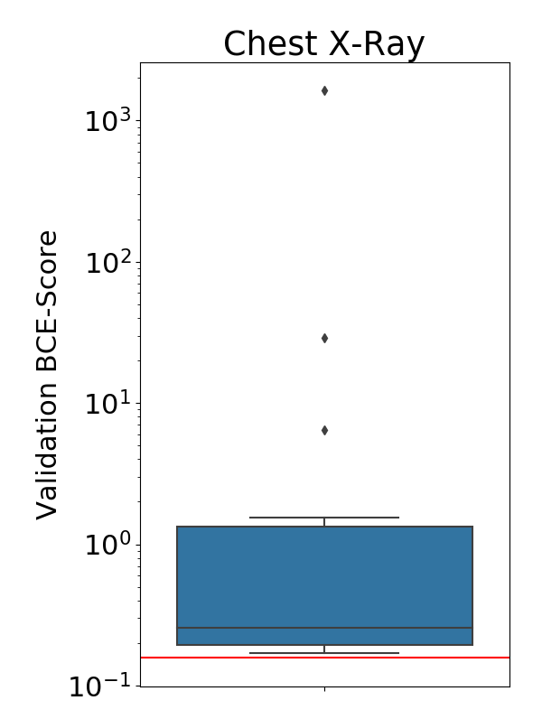
Chest X-Ray Architecture & Random Search
Again: large variance in architectures → sparse cell learned by DARTS

Slide 29
Conclusions & Future Work

Slide 30
Conclusions
DARTS a useful tool, but overkill on simple tasks
ResNet and random search could be good enough
DARTS introduces additional hyperparameters (~2x regular)
DARTS "discretization step" is heuristic and can fail
Computational cost: ~10x more expensive than single (discrete) model, due to overlapping 10 ops. Batch size reduced by ~10x due to memory footprint
Recommendation
If small increase in performance important, DARTS worthwhile

Slide 31
Future Work
Automatic tuning and/or better defaults for hyperparameters
Fix discretization heuristic, a crucially overlooked step (or eliminate it)
Encourage sparsity with sparsemax in place of softmax, or L_{p} regularization on the architecture weights
Dynamically prune architecture to remove components during training, eliminate need to re-train

Slide 32
Thank you for a great semester!

