Slide 1
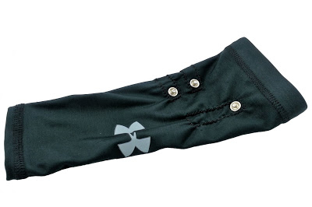
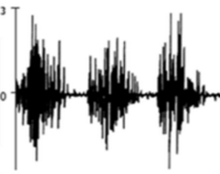
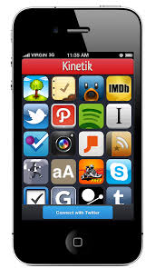
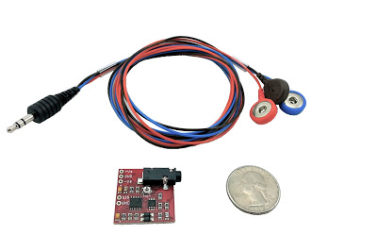
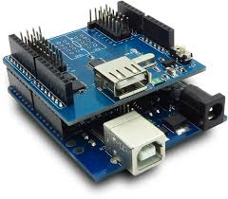
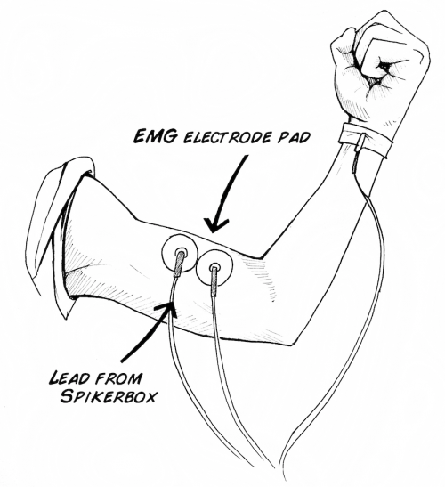
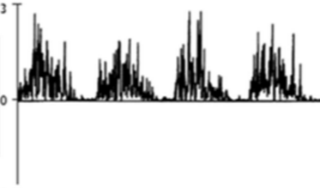
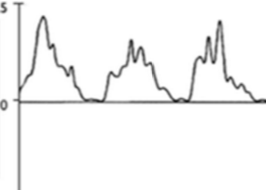


Wearable Muscle Sensing Exercise System
Team Members:
Ahmed Abdulkareem
Todd Harlow
Hai Dang Hoang
Than Tien Troung
Faculty Advisor:
Mark Faust
BACKGROUND
OVERVIEW
MARKET OPPORTUNITY
Problem
Overtraining and incorrect form are two major sources of personal injury
A need exists for a system that prevents injury and maximizes results for any person performing exercises for general fitness or for rehabilitation
Measurement
Processing and Analysis
GUI
Consumer
Transparency Market Research predicts that the wearable fitness device market will double in value in the next two years
No device currently available that measures muscle activity
Objective
To design and prototype a wearable device that can effectively support a user’s workout by allowing them to select their targeted muscle group and a corresponding exercise
Medical
Physical therapists need a way to effectively monitor rehabilitation exercises
Patients need a cheap and convenient method for critiquing their exercises
Requirements
The device must correctly detect reps and muscle fatigue
The device should have low cost and be easy to use
The sleeve should be wearable, washable and comfortable
We have created an wearable sleeve that measures an electrical signal from the user’s bicep. The signal is processed and analyzed with analog circuitry and an embedded digital system. Muscle contractions and muscle fatigue can be measured. Data is transmitted wirelessly to a smart phone.
PROJECT IMPACT
SURFACE ELECTROMYOGRAPHY
(sEMG)
SIGNAL PROCESSING
Improved Performance
Muscle specific feedback enables users to perform their exercise correctly on every rep, making workouts more efficient
Science
Contracting motor units in muscles produce voltage differentials
Amplitude: < 10mV
Frequency range: 20 – 500Hz
Cost Savings
A cheaper alternative to a personal trainer
Fewer injuries from incorrect exercise
Surface Electrodes
Sensors placed onto the skin to measure the voltage differential
Less invasive and easier to use than needle-style electrodes
Raw Signal
Rectified Signal
Smoothed Signal
Faster Recovery
People can recover faster if they are performing their prescribed exercises correctly and re-building their muscles symmetrically
Current Metric
Correct Rep
Fatigue Detection
In Development
1-Max Calculator
Audible muscle contractions
Isometric exercise support
Technique
Continuously keep track of the peak of the signal
Continuously keep track of the different between two consecutive peaks of two correct reps
Result
Count number of correct reps with high accuracy
Alert user’s muscle fatigue correctly
New Training Methods
Exercises can be developed that use the voltage signal from our system as the metric of performance
“Big Data” is a major trend in technology — our system can help provide a more complete view of a user’s exercise regime
SYSTEM
Electrodes
Custom-made sEMG sleeve
“Dry” electrodes don’t use sticky gel
Flexible material keeps electrodes in place
Analyzed Signal
SUMMARY
Analog
Muscle Sensor v3 used for prototype
Amplifier, Rectifier, Integrator
IPHONE APPLICATION
What we accomplished
Created an electrode sleeve which is lightweight and easy to use
Developed a small and effective detection algorithm to process sEMG signals which can easily run on a low-power embedded system
Developed an iPhone app which communicates with the wearable and provides control and information
Digital
Arduino used for prototype
ADC, 1 kHz sample rate
Signal Analysis
Bluetooth communication with smartphone
Verify
Signal
Enter
Goal
Choose
Exercise
Calibrate
Count Reps
Detect
Fatigue
Present
Results
Smart Device
iPhone used for prototype
Communicates with wearable via Bluetooth
Proves GUI and additional data analysis
What’s next
Develop custom PCB to integrate circuitry onto the actual sleeve
Make algorithm “smarter” to better handle varying and unexpected signals
Port iPhone application to Android for greater product support
Department of Electrical and Computer Engineering

