Slide 1
Filtering & Sample Rate
Typical sEMG signal: < 10 mV
Typical gain needed: 100 to 5000
Signal amp as close as possible to electrode(s)
Typical high-pass filter: 5 to 60 Hz
Typical low-pass filter: 500 Hz
1000 Hz sample rate (Nyquist rule)

Slide 2
Preprocessing for Classification
Classwise Principal Component Analysis(cPCA)
Data rotated by class-specific rotation matrices to specially de-correlate before feature extraction
“Tunes” the data for better classification
Independent Component Analysis (ICA)
Estimates set of independent signals from a mixture of signals using an un-mixing matrix
Reduces crosstalk

Slide 3
Decoding Myoelectric Information
Pattern based
Calculates feature vectors from signal segments
Inputs vectors into a classifier for prediction
Non-pattern based
Proportional, onset analysis, finite state machines
No 1-to-1 mapping, simple, no “training”

Slide 4
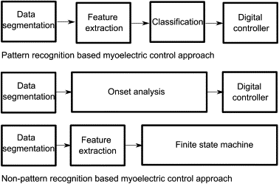
Fig. 2. Schematic diagrams of pattern and non-pattern recognition-based sEMG control methods.
Maria Hakonen, Harri Piitulainen, Arto Visala
Current state of digital signal processing in myoelectric interfaces and related applications
Biomedical Signal Processing and Control, Volume 18, 2015, 334–359
http://dx.doi.org/10.1016/j.bspc.2015.02.009

Slide 5
Windowing
sEMG needs to be analyzed in real-time
Analysis is performed on windows of time
Two important system parameters:
Classification accuracy
System response time
Controlling parameters:
Windowing technique
Window length
EMG signal state

Slide 6
Windowing Technique
Overlapped windowing is better than adjacent
Better classification accuracy
Steadier controller delay
Reduced maximum delay

Slide 7
Window Length
Longer windows improve classification accuracy but decrease response time
Shorter windows increase errors
Not “controllable” at error percentages >35%
Ideal window length: 50 to 400 ms
50 to 400 samples @ 1000 Hz
25 to 200 samples @ 500 Hz

Slide 8
EMG Signal State
Transient state
An abrupt change in contraction level or position
Steady state
Muscle is under constant contraction
More accurate signal classification
Accuracy decreases less relative to window length

