Slide 1

SHAF (Safe, Healthy, Active and Flexible)

Slide 2
Team Information
Students:
Ahmed Abdulkareem - Undergraduate Computer Engineer
Hai Dang Hoang - Undergraduate Computer Engineer
Todd Harlow - Undergraduate Computer Engineer
Thanh Tien Truong - Undergraduate Computer Engineer
Supervisor:
Mark Faust - Assistant Professor

Slide 3
Topics
What is the challenge we want to focus on?
What is our solution to that challenge ?
How can we implement our solution ?
What work have we done so far ?
What are our next steps ?

Slide 4
Challenge and Solution
45 million American adults have gym memberships in recent year
The ideal solution:
Inexpensive and easy-to-use device
Effective at providing correct methods for many exercises
Accurate at alerting users to when they should stop
35 percent increase in workout-related injuries in recent years due to improper technique or inappropriate exercises
Many people don’t maximize the benefits of the exercises they perform because they don’t train the muscle intensely enough.

Slide 5
Objective
To design and prototype a wearable device that can effectively support a user’s workout by allowing them to select their targeted muscle group and a corresponding exercise. Our device will provide users examples of the chosen exercise, count correct repetitions, and accurately alert them when they should stop the exercise. The device should be safe, easy to use, and portable.

Slide 6
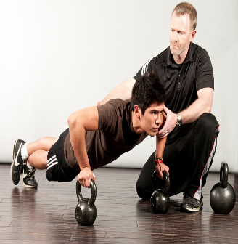
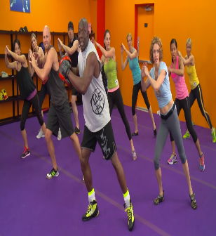
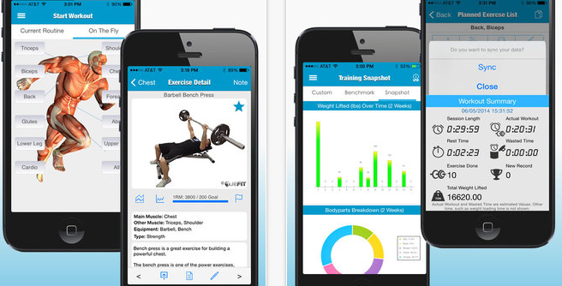
Current Existing Solutions and Our Solution
 | Personal Trainers
Cost | 1
Effectiveness | 5
Flexibility | 4
Ease of use | 5
Support all types of exercise | 5
Total | 20
Workout Videos
3
3
2
5
5
18
Videos Recording
5
3
2
4
3
17
Our Solution
4
4
5
5
3
21
A device that can:
Measure the intensity of muscle activity
Record the results
Correct your form
Detect muscle fatigue
Be used by anyone who wishes to improve their workouts and avoid injury

Slide 7
Main Use Cases
Measure the intensity of a given muscle’s activity
Are my biceps “pumped”?
Count the number of reps
How many correct reps have I done so far?
Detect the muscle fatigue index
When should I stop?
How can I perform an exercise correctly?
Provide video examples

Slide 8
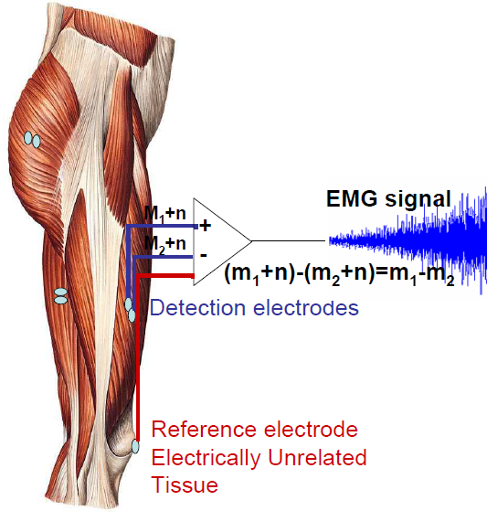
Our Technical Solution
We use surface electromyography (sEMG) sensors to capture the voltage difference created by a contracting muscle
sEMG signals
We employ both simple and complex digital signal processing to extract key features
Time-domain processing
Frequency-domain processing
Is the muscle active ?
When is the muscle contracted / relaxed ?
How intense is the muscle activity?
Is the muscle fatigued?

Slide 9
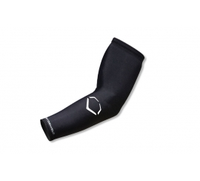

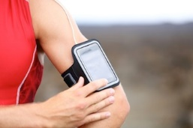
Our Physical Solution
A wearable sleeve working in conjunction with an Intel powered smart device
A wearable sleeve will measure sEMG signals and transmit data to a smart device
The smart device will let users choose the target muscle, the specific exercise for that muscle, and provide feedback

Slide 10
Our Solution Summary
sEMG sensors to record muscle data
Wearable garment containing custom-made sEMG electrodes and supporting circuitry.
Communicates via Bluetooth to smart device
Intel Atom powered smart device to process data
Time-domain processing for muscle activation
Frequency-domain processing for muscle fatigue
Device will also provide user interface
Audio and visual cues to keep user informed

Slide 11

Flowchart for Our Solution
Time-domain analysis
Frequency-domain analysis
Intel Atom
Wearable sleeve with sEMG sensors
Is the muscle active?
When is the muscle contracted/relaxed?
How intense is the muscle activity?
Is the muscle fatigued?
User Interface

Slide 12
Risks
What if the Intel Atom cannot handle all the signal and user interface processing?
Shift some or all signal processing
to an FPGA
What if our custom-made electrodes fail to provide an adequate signal?
We will use the off the shelf electrodes

Slide 13
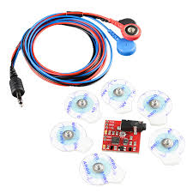
Our Current Achievements
Successfully detected when muscle is contracted or relaxed and can count repetitions
Making progress on detecting muscle fatigue
Completed a concept for user interface
Muscle Sensor V3 (sEMG sensor)

Slide 14
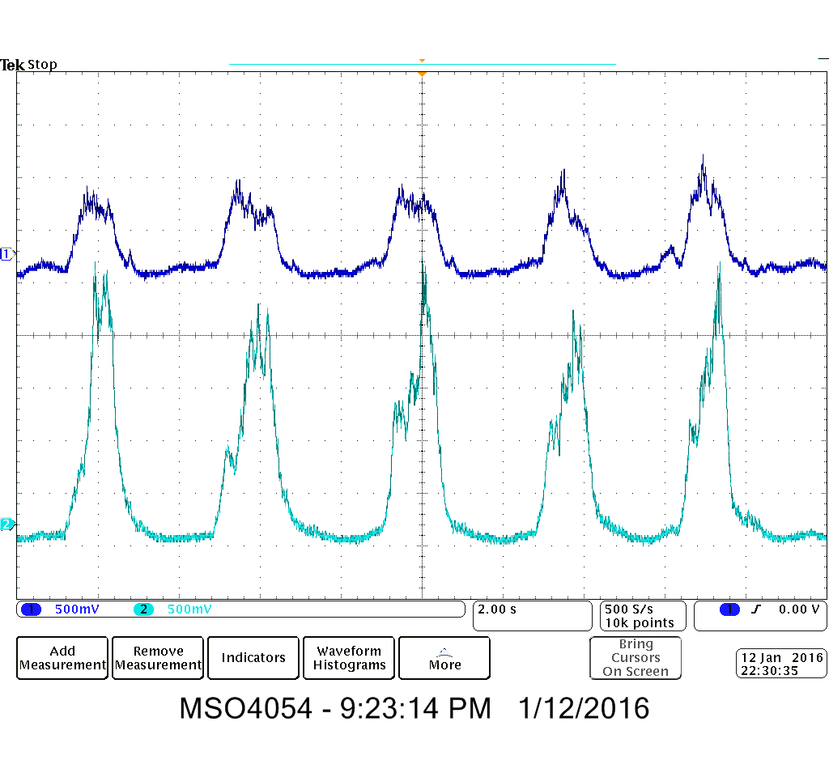
Muscle is contracted/relaxed
tricep
bicep
Doing multiple curls (sEMG signal for bicep and tricep)

Slide 15
Muscle is contracted/relaxed
sEMG signal from the sensor
ADC
Not in range
in range (contracted)
in range (relaxed)
Within acceptable range of upper bound threshold?
Within acceptable range of lower bound threshold?
Increment rep
ADC
Not in range

Slide 16
Demo Video
https://www.youtube.com/watch?v=X1IopbZivjs&fea

Slide 17
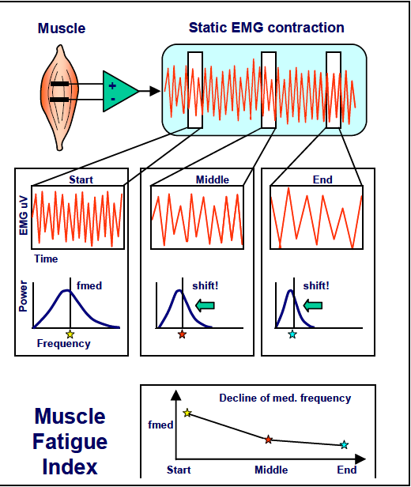
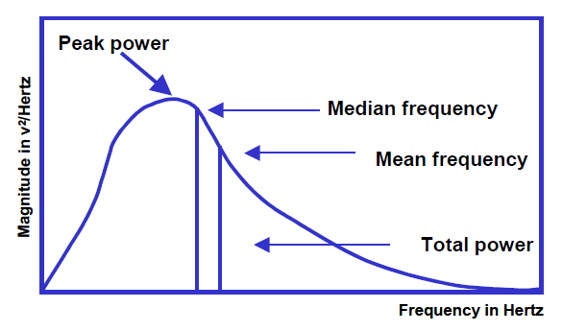
Detecting Muscle Fatigue
Key idea:
Mean or median frequency will decrease when muscle is fatigued
Konrad, P. (2006). The ABC of EMG – A Practical Introduction to Kinesiological Electromyography. Noraxon U.S.A. Inc

Slide 18
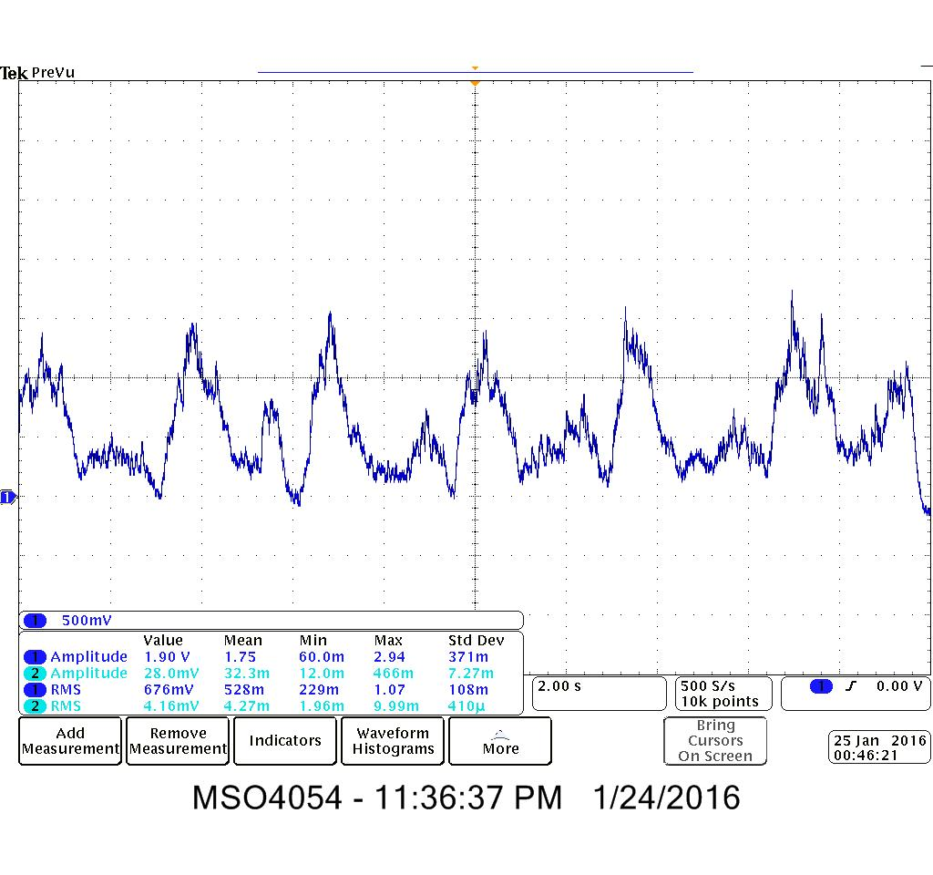
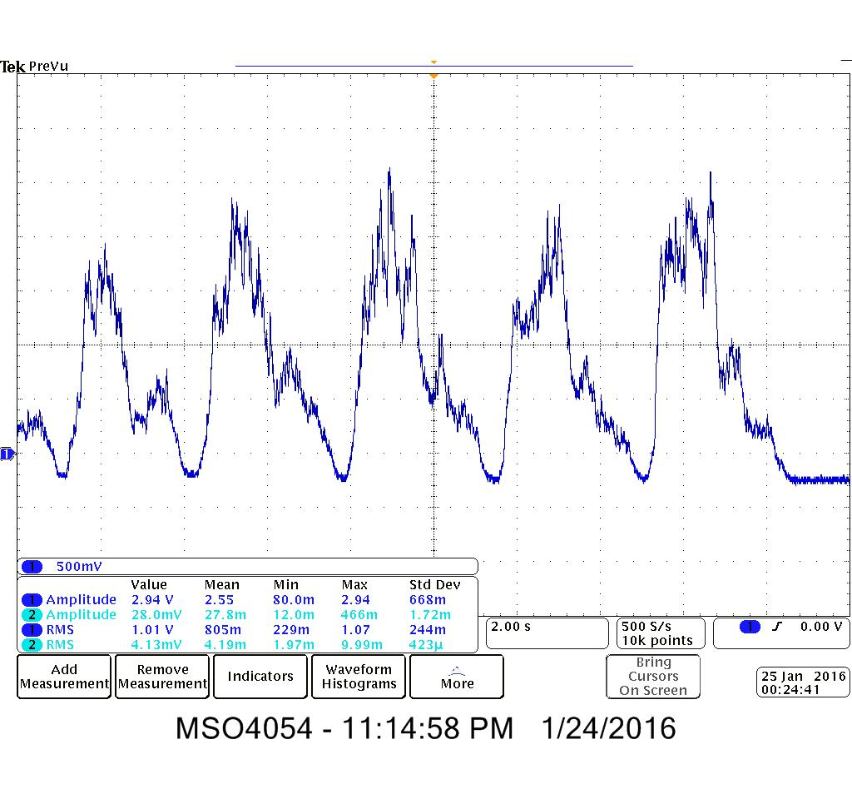
Detecting Muscle Fatigue
Bicep signal, normal curls
Bicep signal, fatigued curls

Slide 19
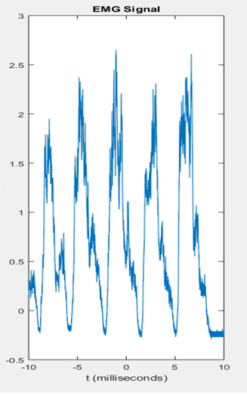
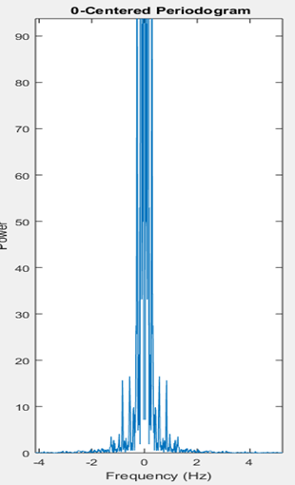
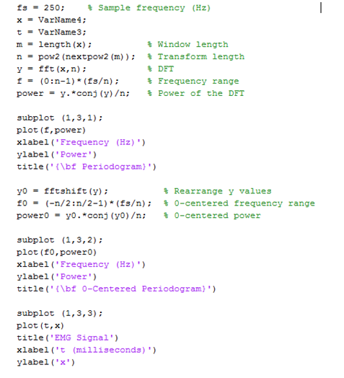
Detecting Muscle Fatigue
sEMG signal from the sensor
Apply FFT
Compute mean or median power frequency
Do the comparison
Our mean and median power frequency increases
Different from our expectation

Slide 20
User Interface
Select target muscle
Watch the example video
Perform the exercise and observe the results
Select exercise
Dumbbell Bicep Curl
Human body graphic shows which muscle is active
Bicep
Barbell Curl
Each exercise will have it own video
Drag Curl
Alert user when the target muscle is fatigued
Body-Up
Tricep
Cobra Triceps Extension

Slide 21
Where are we currently at ?
Obtain information and ideas
Define requirements and create specifications
Get samples and do signal analysis
Test the device
Deliver
Get needed equipment
Create GUI and work on Bluetooth communication
Create a wearable garment

Slide 22
How much we have spent so far ?
Equipment | Cost per unit | Quantity | Total
Muscle Sensor V3 | $50 | 3 | $150
Arduino Uno Board | $20 | 2 | $40
Electrical Components kit | $40 | 1 | $40
Wearable Garment | $82 | 1 | $82
Total | $312

Slide 23
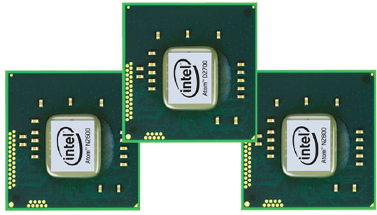
Next Steps
Create a GUI for the device
New resource required:
Learn Bluetooth communication using the Intel Atom
Develop an effective method to detect muscle fatigue index accurately
Create a wearable garment
Combine all the parts to create the prototype
Intel Atom
Test the prototype

Slide 24
Schedule and Additional Cost
Task | Time
Create GUI | Mid February - April
Learn Bluetooth communication | 1 month after we receive the Atom board
Develop method to detect muscle fatigue | Mid February - March
Create wearable garment | Mid February - March
Create working prototype | March – Mid April
Testing | Mid April - May
Additional Equipment | Cost per Unit | Quantity | Total
Electrodes | $6 | 10 | $60
Total | $60

Slide 25
Summary
Device Information
Time expectation
Budget
Purpose:
Improve individual workout quality
Device is ready for testing:
Mid April
Have been used:
$312
Functionality:
Use sEMG signal
to measure muscle activity
to detect muscle fatigue
Provide user interface
to provide workout videos
to record workout results
Device is ready for delivery:
Early May
Additional Cost:
$60

Slide 26
Thank you for listening

