Slide 1
Tuning of Rep Detection
Batch processed data sets to find ideal BASELINE and THRESHOLD values for the rep detection algorithm
Each data set processed 100 times (10 BASELINE x 10 THRESHOLD)
BASELINE and THRESHOLD calculated as fractions of first rep peak voltage
An output matrix of rep counts produced with BASELINE and THRESHOLD for indices
The absolute difference between output matrix rep counts and observed rep count was summed for all data sets
Result matrix reveals which BASELINE and THRESHOLD are best for accurately detecting reps

Slide 2
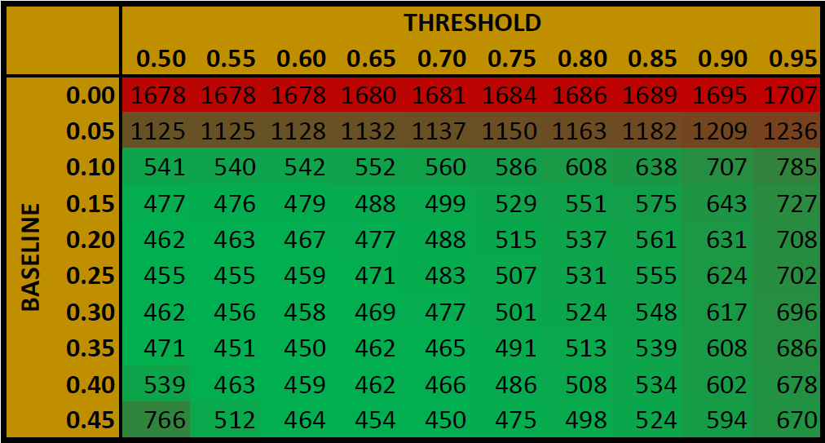
Best values for detecting reps :
BASELINE = 0.40 -> 0.35
THRESHOLD = 0.50 -> 0.60

Slide 3
Tuning Fatigue Detection
The fatigue threshold is a fraction
Fatigue is detected when the relative percent difference between the peak voltages of the two most recent reps exceeds the fatigue threshold
Each data set processed with an array of threshold values
“Fatigue Rep” is the rep in which fatigue was detected
The fatigue rep should be near the rep count for each set
Results from each set were summed into a single array

Slide 4
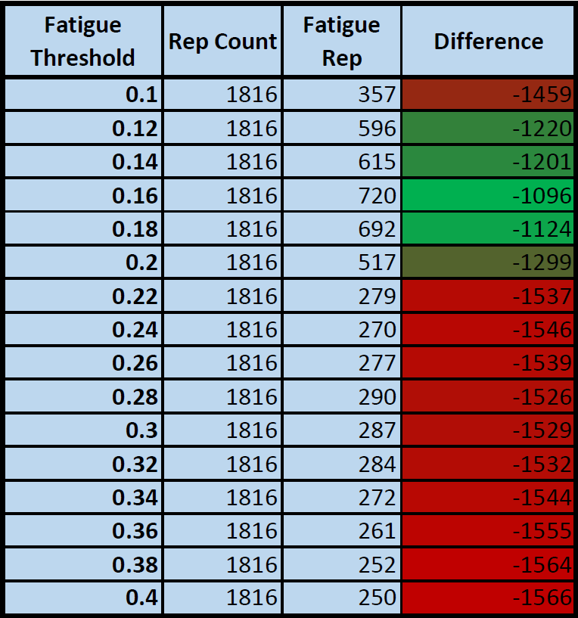
Best value for detecting fatigue: 0.16

