Slide 1
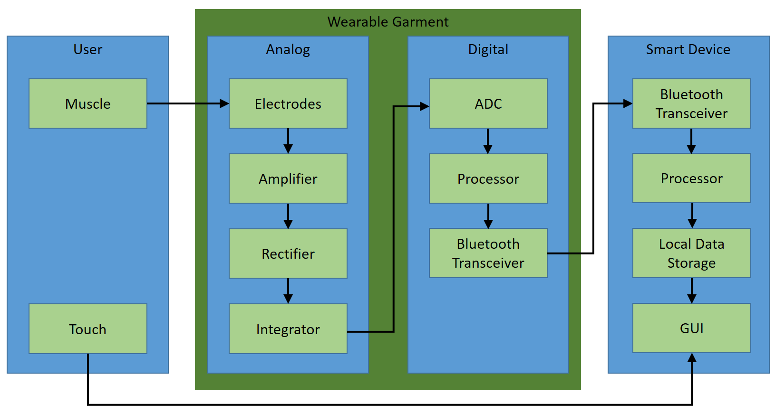
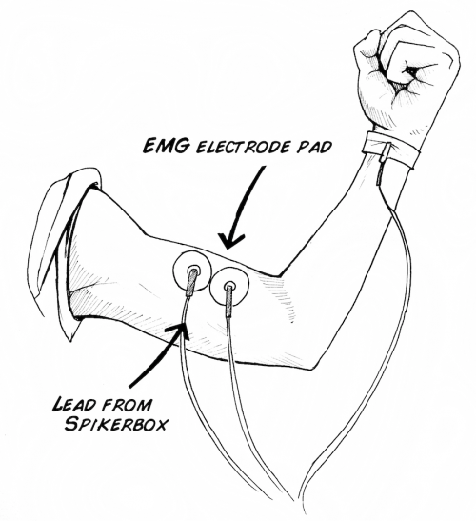
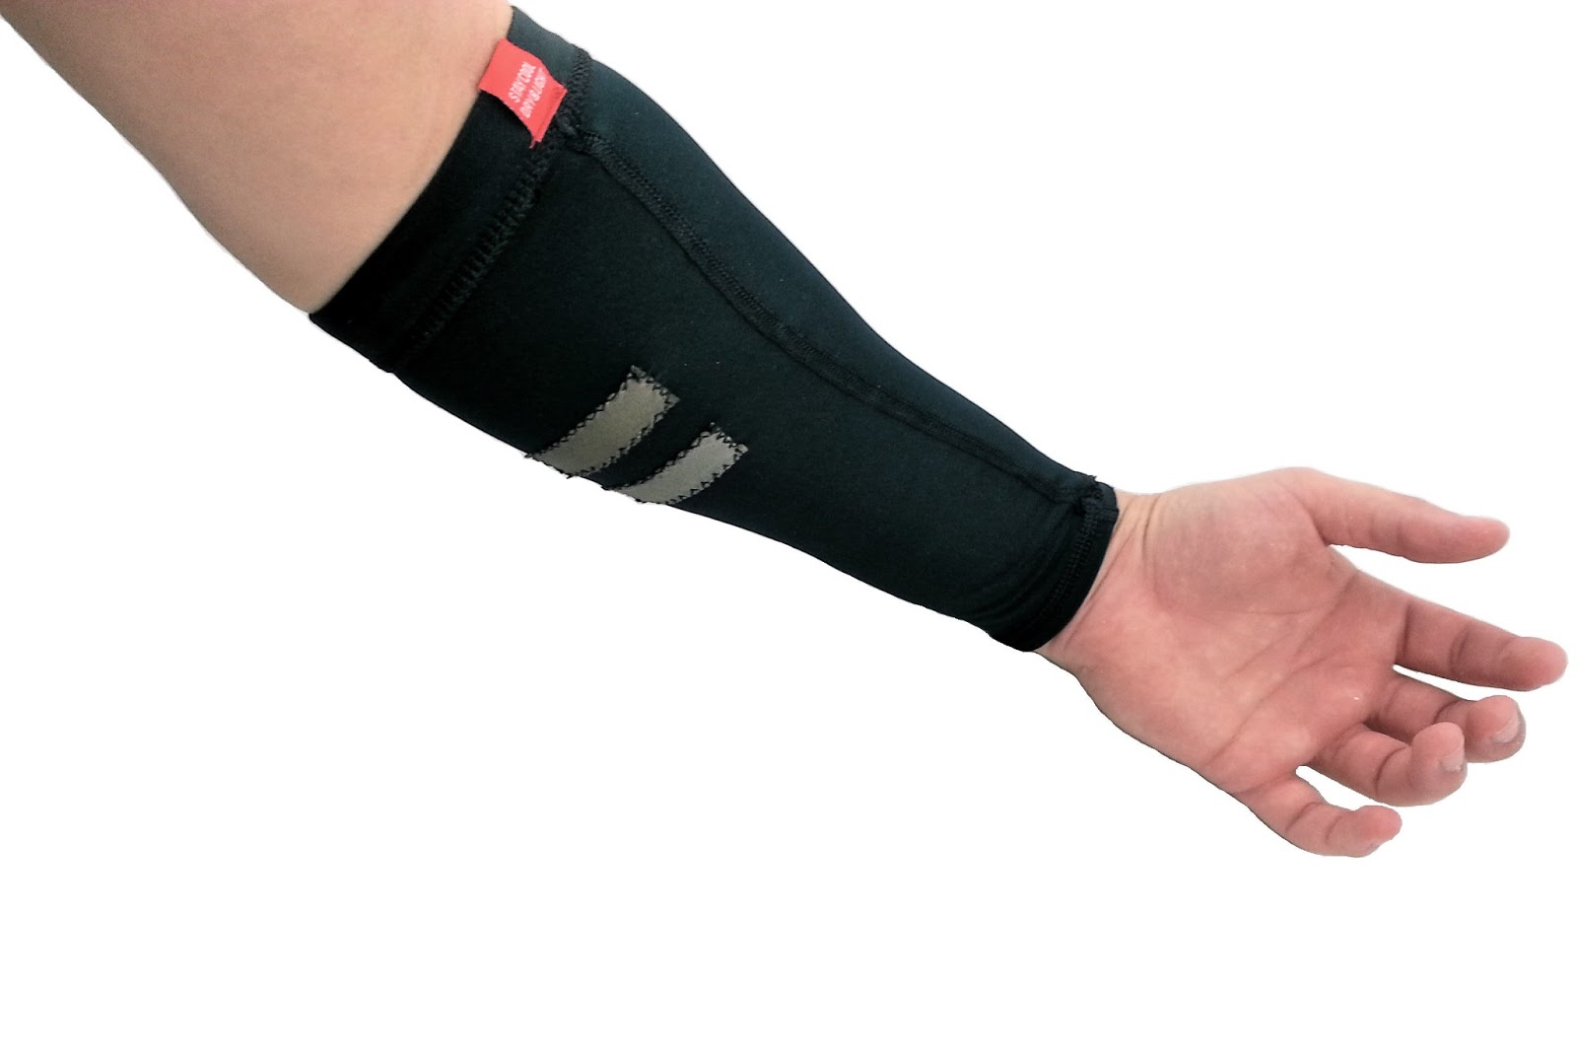
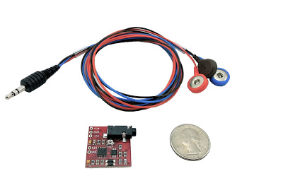
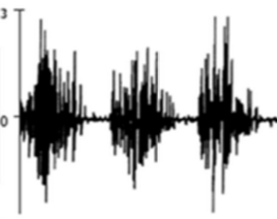
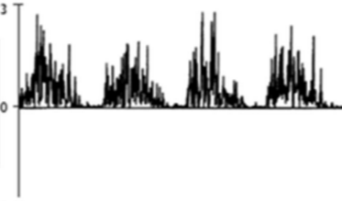
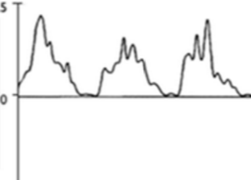
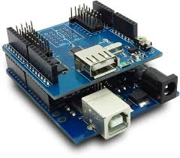

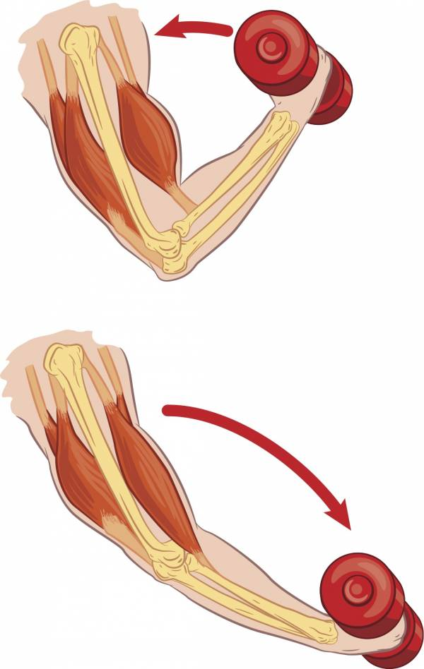

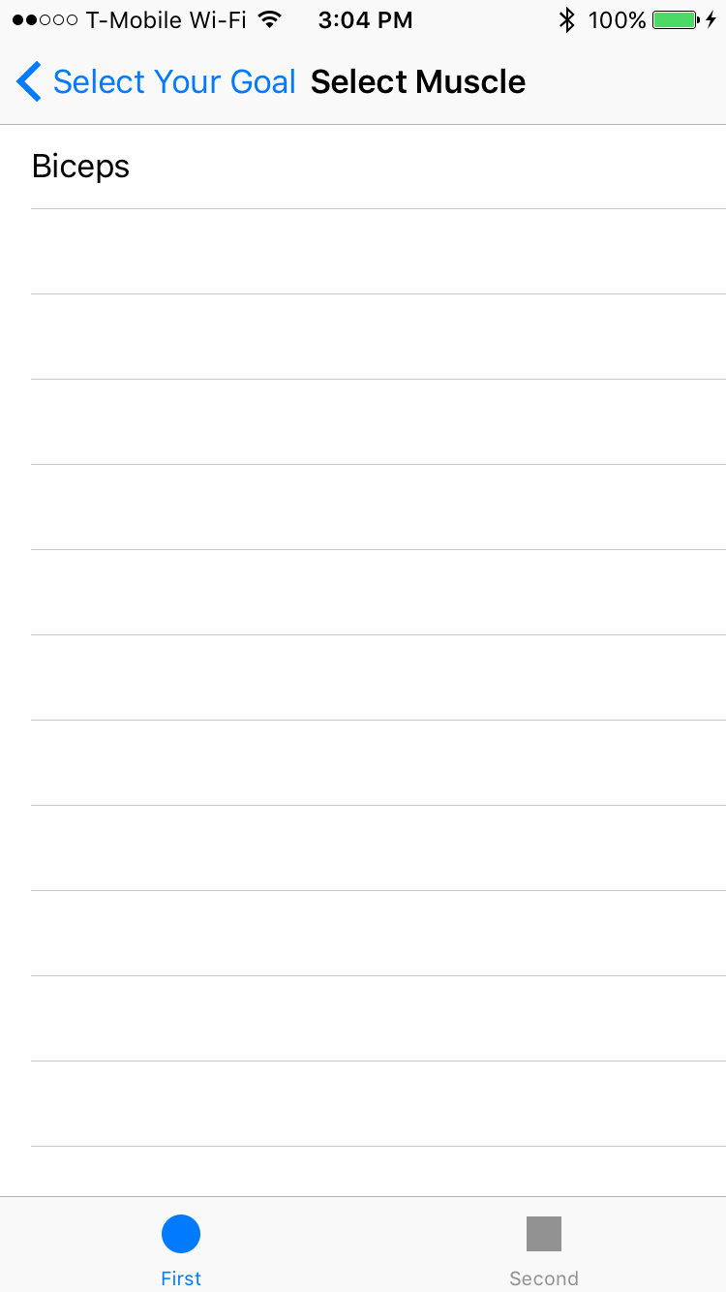
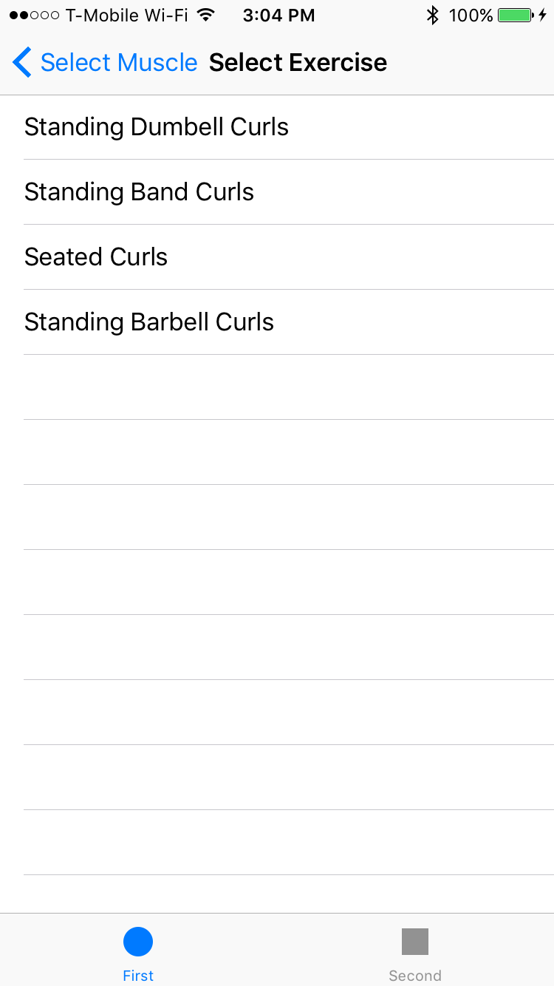
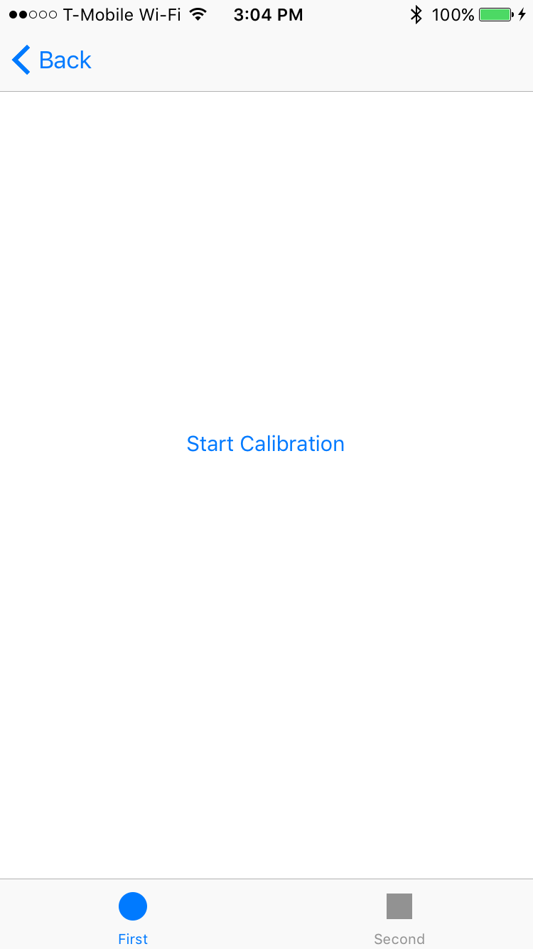
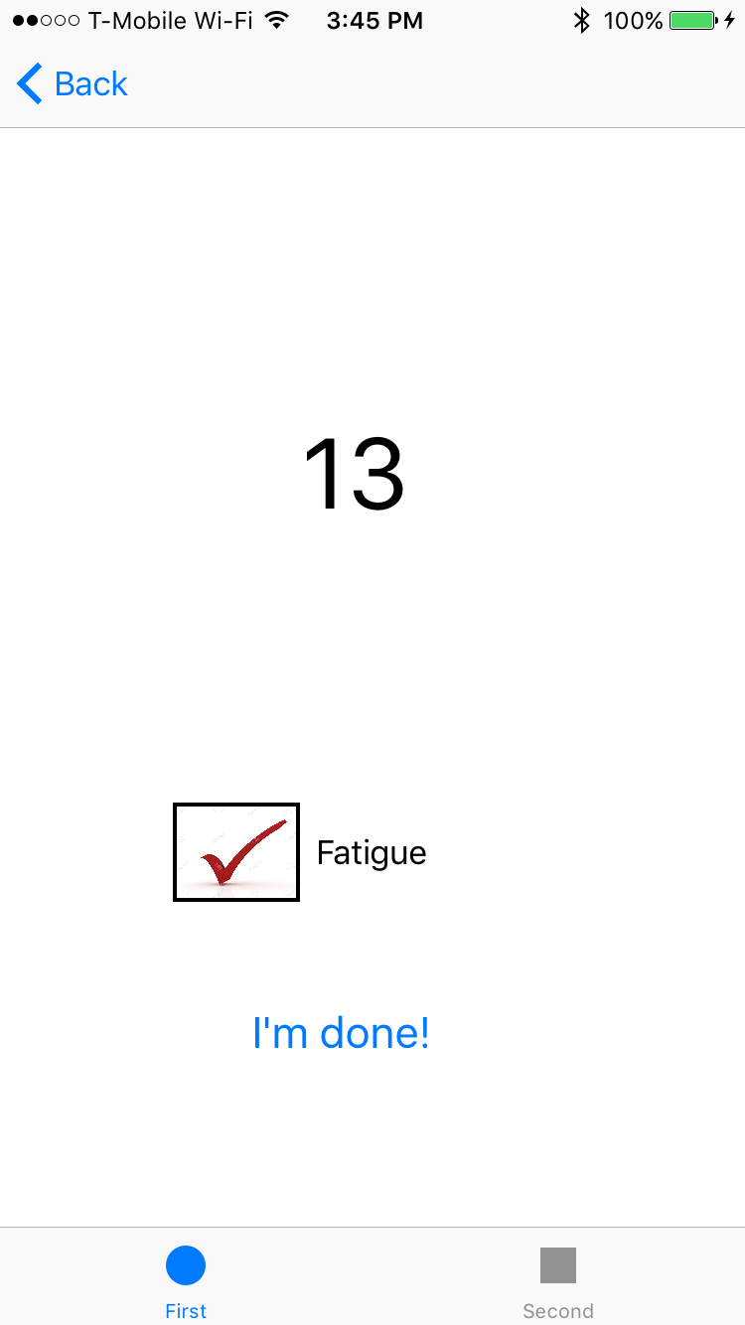

Wearable Muscle Sensing Exercise System
Team Members:
Ahmed Abdulkareem
Hai Dang Hoang
Todd Harlow
Than Tien Truong
Faculty Advisor:
Mark Faust
Background
Overview
Market Opportunity
Problem
Overtraining and incorrect form are two major sources of personal injury
A need exists for a system that prevents injury and maximizes results for any person performing exercises for general fitness or rehabilitation
We created a muscle sensing feedback system to help make exercises safer and more effective.
Our system measures the electrical signal generated by muscle activity and processes that signal to detect correct exercise repetitions and muscle fatigue. Our prototype was developed targeting the bicep muscle and using the bicep curl exercise.
Consumer
Transparency Market Research predicts that the wearable fitness device market will double in the next two years
No device currently available on the market measures muscle activity
Objective
To design and prototype a wearable device that can effectively support a user’s workout by allowing them to select their targeted muscle group and a corresponding exercise. Our device will provide users examples of the chosen exercise, count correct repetitions, and accurately alert them when they should stop the exercise.
Medical
Physical therapists need a way to effectively monitor rehabilitation exercises
Patients need a cheap and convenient method for critiquing their exercises
Requirements
The device must correctly detect reps and muscle fatigue
The device should have low cost and be easy to use
All parts in contact with user should be comfortable and washable
Benefit
Improved Performance
Muscle specific feedback enables users to perform their exercise correctly on every rep, making workouts more efficient
Surface Electromyography
(sEMG)
Cost Savings
A less expensive alternative to a personal trainer
Fewer injuries from incorrect exercise
Science
Activated motor units in muscles produce voltage differentials
Amplitude: < 10mV
Frequency range: 20 – 500Hz
Faster Recovery
People can recover faster if they are performing their prescribed exercises correctly and re-building their muscles symmetrically
Surface Electrodes
Sensors placed onto the skin measuring the voltage differential
Less invasive and easier to use than needle-style electrodes
New Training Methods
Exercises can be developed that use the voltage signal from our system as the metric of performance
“Big Data” is a major trend in technology — our system can help provide a more complete view of a user’s exercise regime
Muscle Measurement
Signal must be conditioned before the digital processing stage
3 Steps: Amplify, Rectify, Integrate (Smooth)
Summary
User
Muscle provides voltage differential signal
Touch controls system via GUI on smart device
Analog
Custom electrodes on sleeve measure signal
MuscleSensor v3 combines amplifier, rectifier, and integrator for signal conditioning
What worked
Our custom electrode sleeve is lightweight, easy to use, and effectively measures muscle activity
Our MuscleSensor/Arduino stack is able to process the sEMG signal from the sleeve and run our rep detection and fatigue detection algorithms
Our iPhone app communicates with the Arduino via Bluetooth and provides the user with system control and feedback
Digital
Arduino used for prototype
Rep & Fatigue detection algorithm
Bluetooth communication with smartphone
Smart Device
iPhone used for prototype
Bluetooth communication with wearable
Provides GUI and additional data analysis
Amplified
Rectified
Integrated
What didn’t work
Our rep detection algorithm currently fails to meet our goal of at least 98% correctness
Our fatigue detection algorithm detects fatigue earlier than anticipated and is currently not a reliable indicator of muscle fatigue by itself
Testing
iPhone Application
Data Collection
Subjects performed sets of bicep curls while wearing the electrode sleeve and connected to prototype system
Arduino analog-to-digital output stored to log file
What we learned
Research – Thorough research on the project problem and existing solutions can prevent lost time working on untenable solutions.
Documentation – Project documentation is critical to a successful capstone project and can help prevent miscommunication when dividing the work.
Specs – When ordering parts, double-checking all relevant specs is time well spent. Wrong parts waste time and money.
MATLAB Analysis
24 subjects w/ 4 sets each = 96 sets of reps to be analyzed
Developed batch processing system to run algorithm on entire dataset while using a range of tuning parameters
Analyzed batch results to choose final values used in the rep and fatigue detection algorithms
What’s next
Further tune rep detection algorithm for greater accuracy
Further develop fatigue detection algorithm for greater reliability
Develop custom PCB to integrate circuitry onto the actual sleeve
Port iPhone application to Android for greater market coverage
Select Muscle
Select Exercise
Calibrate
Feedback
Department of Electrical and Computer Engineering

