Slide 1


Predicting Energy Prices and Load Demand
TEAM G:
Pavan Kumar Boddu
Mohammed Abdul Rasheed Khan
Sneha Reddy Madhireddy
Anil Kumar Malyala

Slide 2
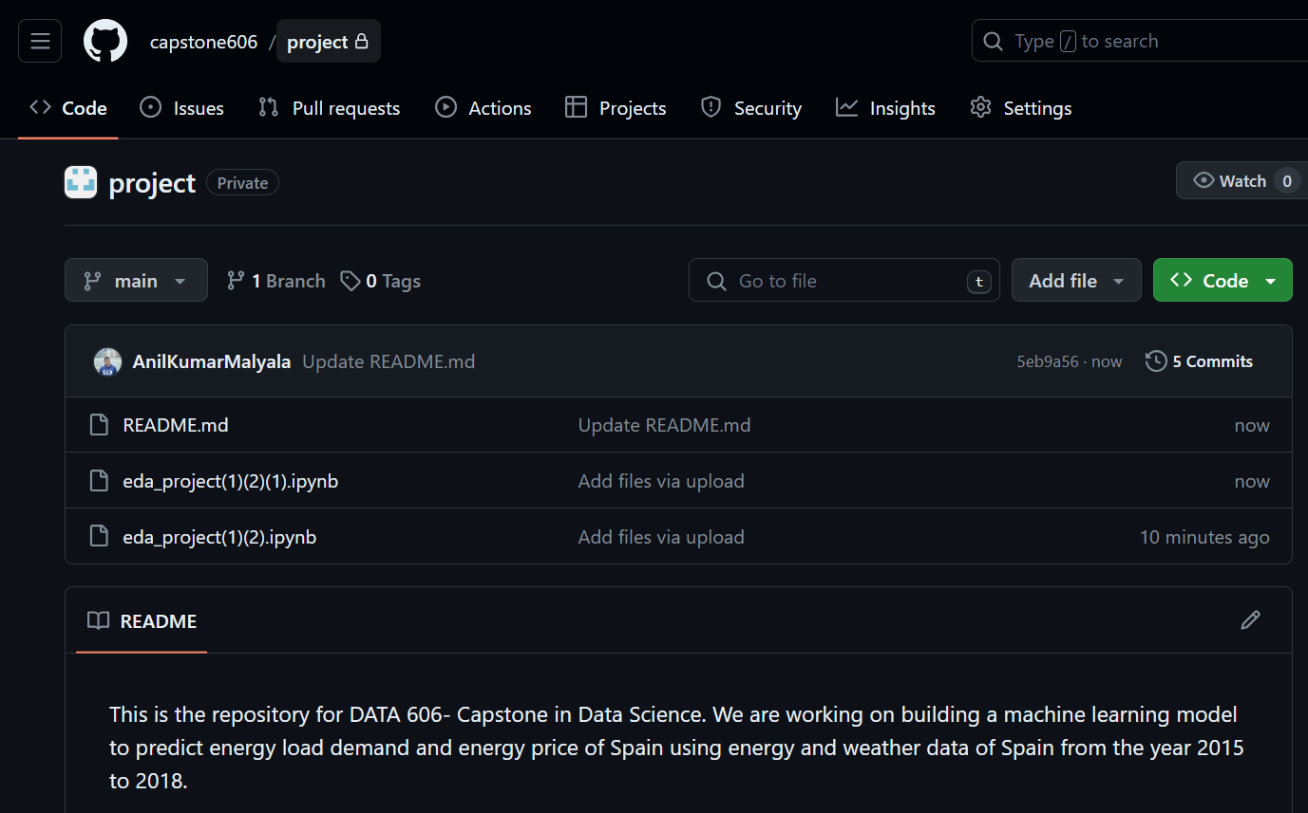
Kaggle ID: https://www.kaggle.com/snehareddy123455
GitHub Link: https://github.com/capstone606/project

Slide 3
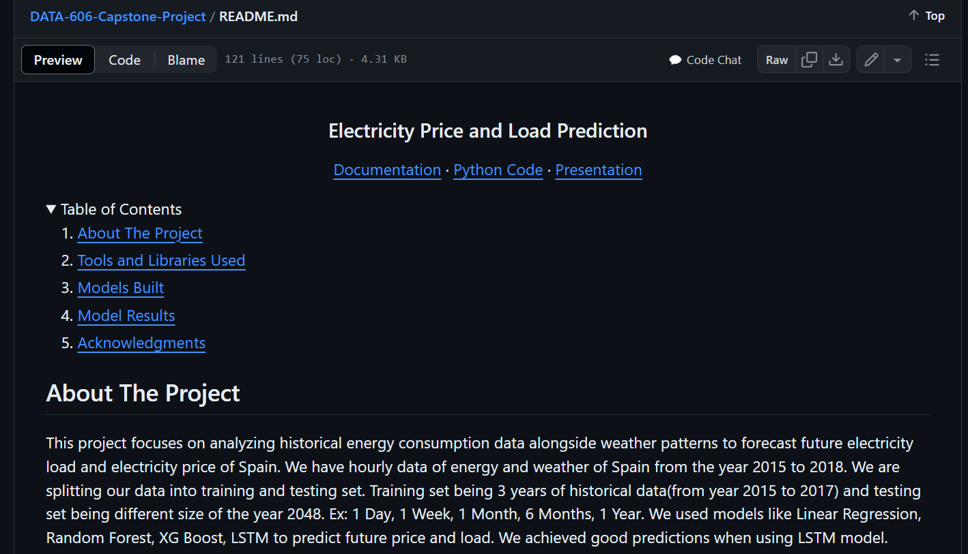
Read Me File

Slide 4
Objective of Project:
Develop predictive models to forecast energy prices and load demands of Spain by integrating energy and weather datasets, enhancing decision-making for energy market participants.
Research questions:
Can the integration of weather data with energy generation and consumption metrics significantly enhance the accuracy of energy prices and load demand forecasts?
Can we predict electrical price by time of day better than TSO(Transmission Service Operator)?

Slide 5
Dataset
Dataset Info: Combined energy and weather features data. This dataset contains hourly energy generation and weather data of Spain from the year 2015 to 2018.
Dataset Size: a) Energy Dataset: 6.27MB, 35046 records and 29 columns Weather Dataset: 19.92 MB, 178396 records and 17 columns
b) After Preprocessing and Feature Engineering: 35046 records and 74 columns
Link to the Dataset : https://www.kaggle.com/datasets/nicholasjhana/energy-consumption-generation-prices-and-weather/data

Slide 6
Analysis Approach
Type of Analysis: Prediction and forecasting of continuous variables (energy prices and load demands).
Data Preparation: Cleaning, normalization, and feature engineering to integrate weather and energy data for analysis.
Machine Learning Techniques: Liner Regression, Random Forest, XG Boost, LSTM(Long Short-Term Memory).
What are we predicting?
We are predicting Energy Demand and Energy Price in the country of Spain.

Slide 7
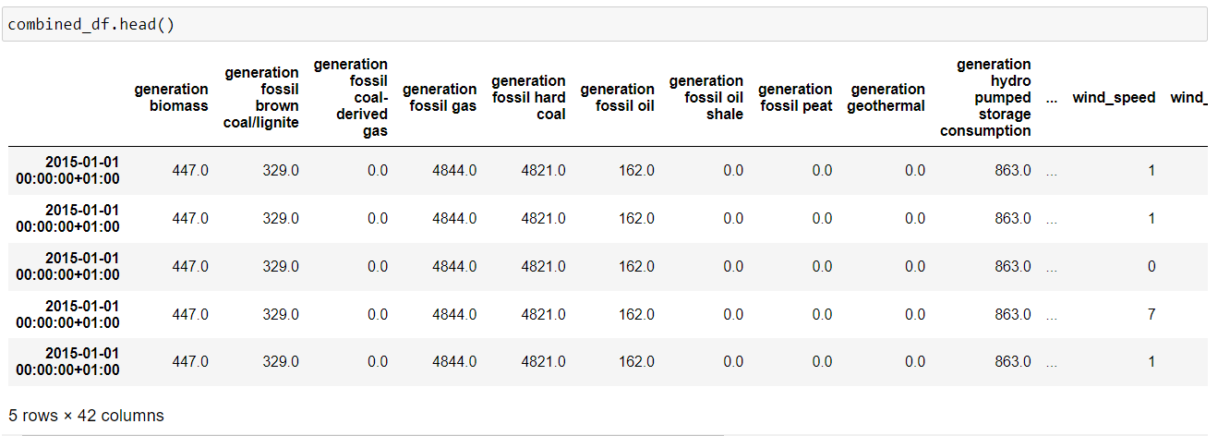
Combined Energy and Weather Dataset

Slide 8
Methodology Differentiation and Innovation
Introduction to Our Approach:
While existing studies have laid a strong foundation in predicting energy prices and load demands, our project aims to bridge the gap between conventional modeling techniques and the nuanced complexities of the energy market influenced by weather conditions.
Incorporation of Weather Data:
Data Integration: A key differentiator in our methodology is the extensive incorporation of weather variables, acknowledging their significant impact on energy generation and consumption patterns.
Predictive Power: This integration is expected to enhance the predictive power of our models, particularly for renewable energy sources like wind and solar, which are directly affected by weather conditions

Slide 9
Literature review
Study 1: A XGBoost Model with Weather Similarity Analysis and Feature Engineering for Short- Term Wind Power Forecasting -Huan Zheng and Yanghui Wu
This study introduces a new method for short-term wind power forecasting using an XGBoost model with weather similarity analysis and feature engineering. By categorizing historical weather patterns and optimizing feature selection, this approach achieves superior accuracy compared to other forecasting methods like BPNN, CART, RF, and SVR. This XGBoost-based model enhances short-term wind power predictions efficiently and effectively.
Zheng and Wu (2019)

Slide 10
Literature review
Study 2: Power Load Forecasting Based on the Combined Model of LSTM and XGBoost Chen Li1,2, Zhenyu Chen2,3, Jinbo Liu4 , Dapeng Li2 , Xingyu Gao5 , Fangchun Di2 , Lixin Li2 , Xiaohui Ji1
This paper proposes a combined LSTM-XGBoost model for accurate power load forecasting. It establishes individual LSTM and XGBoost forecast models to predict load separately and then integrates their predictions using an error reciprocal method. Experimental results show that the combined model reduces forecast error to 0.57%, surpassing individual model performance.
Li et al. (2019)

Slide 11
Literature review
Study 3: Electrical Load Forecasting Model Using Hybrid LSTM Neural Networks with Online Correction
Nan Lu, Quan Ouyang, Yang Li, Changfu Zou
This work introduces a hybrid LSTM-based model for day-ahead electrical load forecasting, integrating various feature types from the dataset. The model includes a gradient regularization-based offline training method and an online correction mechanism to enhance accuracy by adapting to data distribution changes. Experimental results demonstrate superior forecasting accuracy compared to conventional models, emphasizing the importance of accurate load forecasting for efficient power system operations.
Lu et al. (2024)

Slide 12
Literature review
Study 4: A hybrid model for integrated day-ahead electricity price and load forecasting in smart grid
Lei Wu, Mohammad Shahidehpour
This study introduces a two-stage framework for integrated load and price forecasting. Initial forecasts are generated separately for load and price using hybrid time-series models. The second stage incorporates load-price interaction using multivariate autoregressive integrated moving average models and adaptive wavelet neural networks. The approach is evaluated with metrics like average mean absolute percentage error and error variance.
Wu and Shahidehpour (2014)

Slide 13
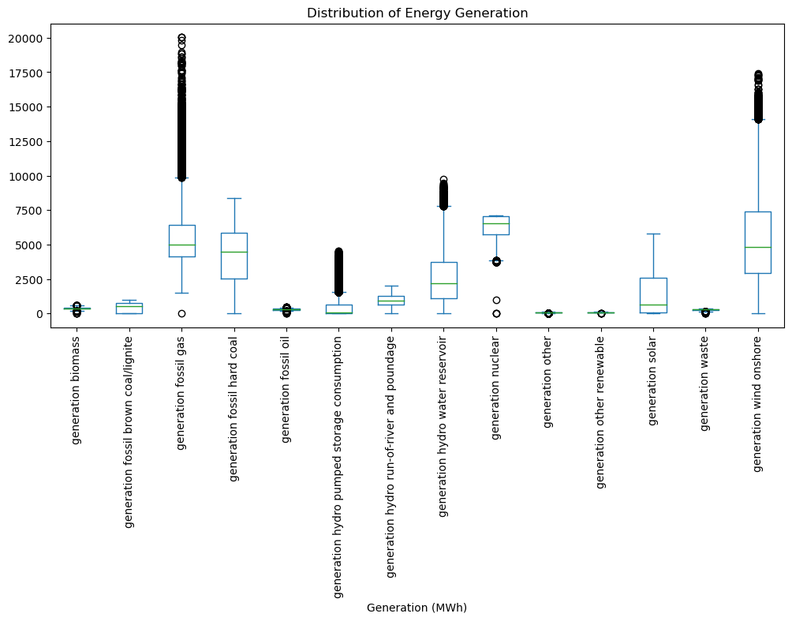
Preprocessing
Data Cleaning
Missing Values: filled missing values with Interpolation method
Outliers: used box plots to detect and mitigate outliers
Empty Columns: Removed columns with too many NANs and zeros
Removed columns that has zero correlation with “price actual” and “total load actual”

Slide 14
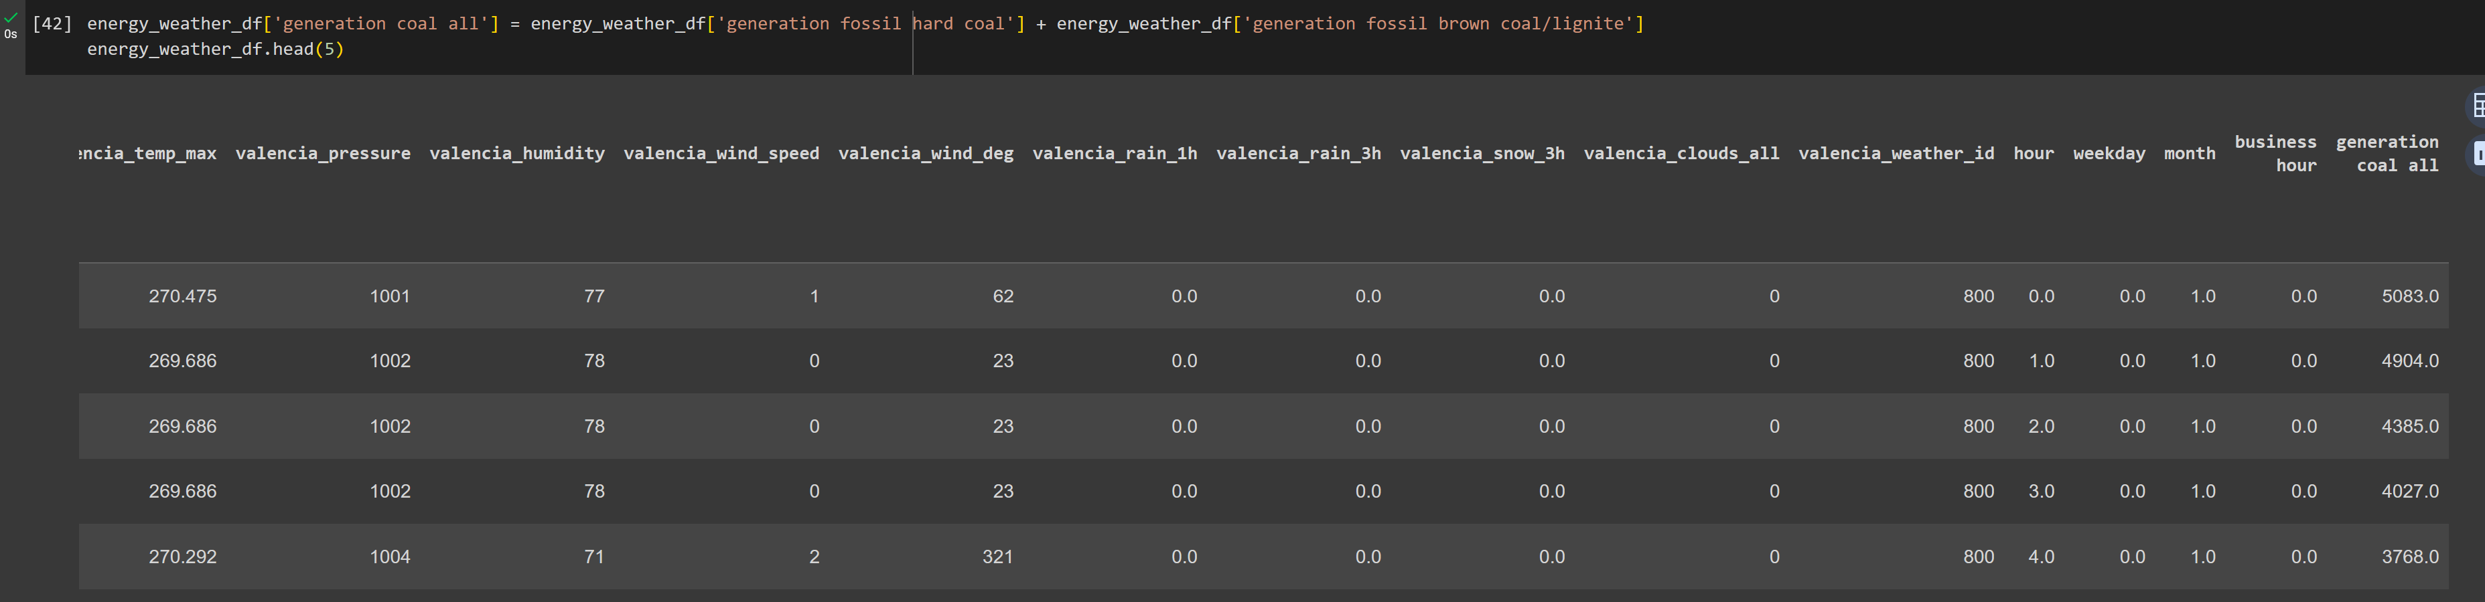
Feature Engineering
Extracted features from dataset like Hour, Month, Weekday, Business Hours.
Feature Selection: Removed low important columns and selected which has correlation with the target variables.
Total columns in merged dataset after feature engineering is 74 columns.

Slide 15
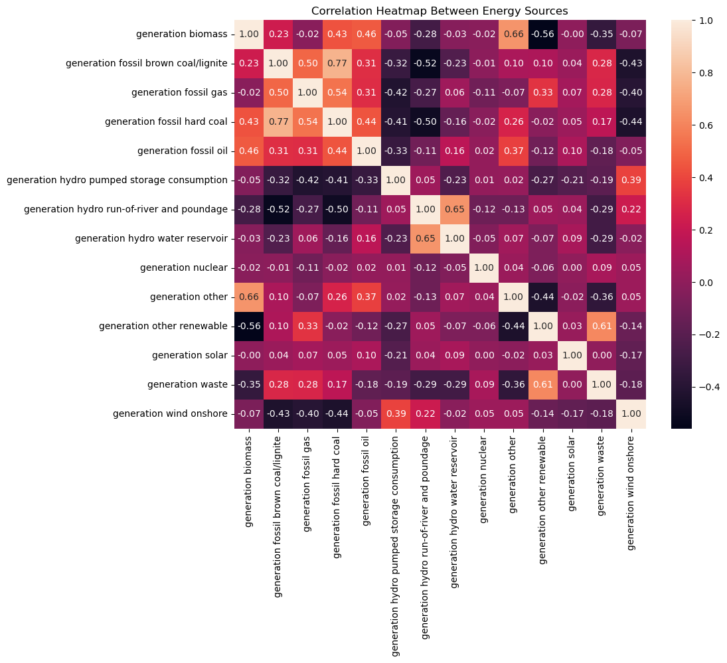

EDA
Correlation Analysis

Slide 16
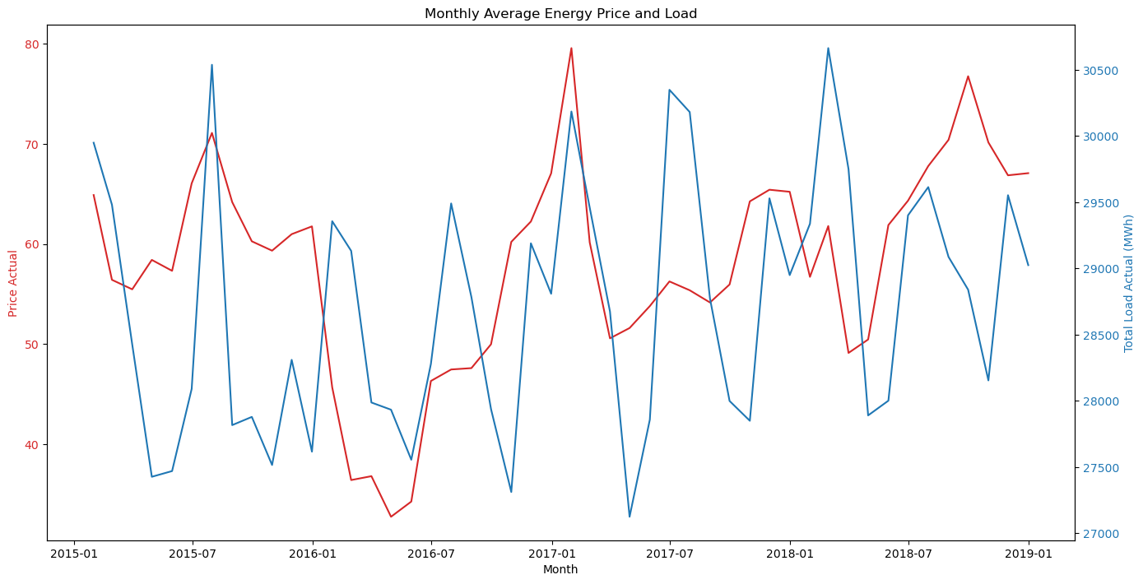
EDA
Target variables:
Price actual
Total load actual

Slide 17
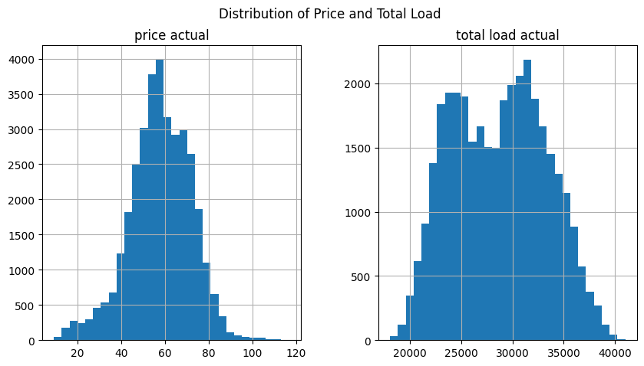
EDA

Slide 18
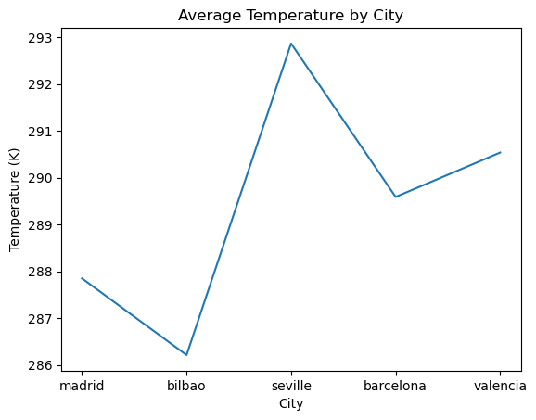
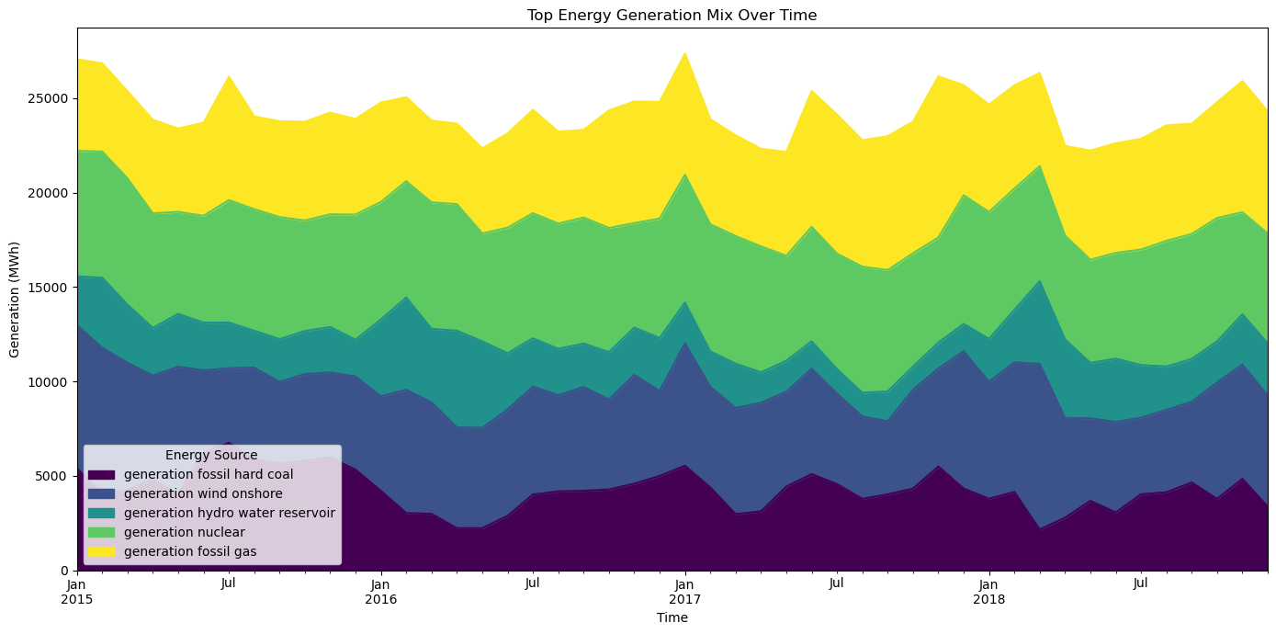
EDA

Slide 19
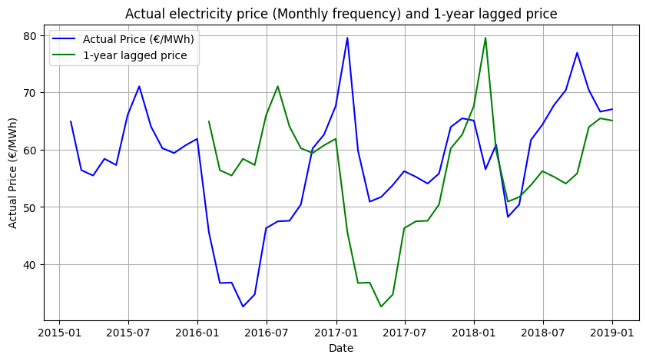
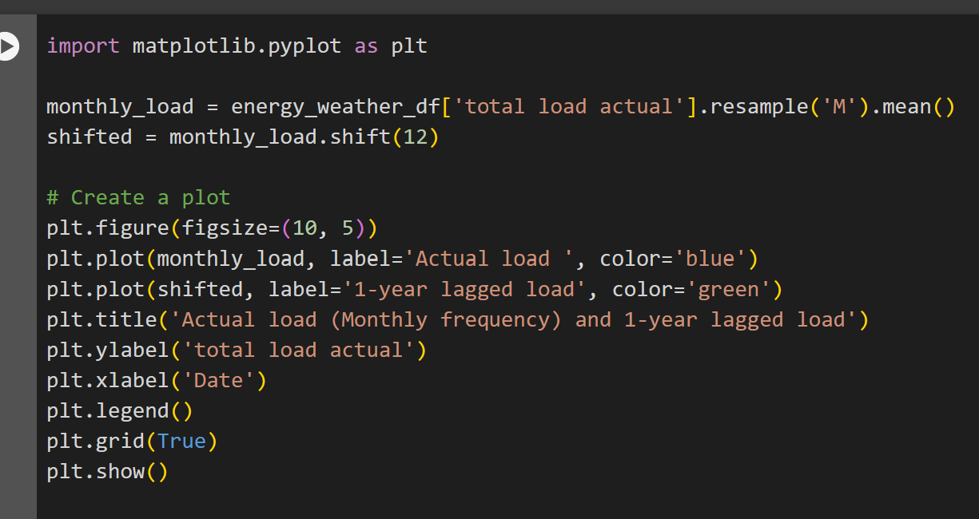
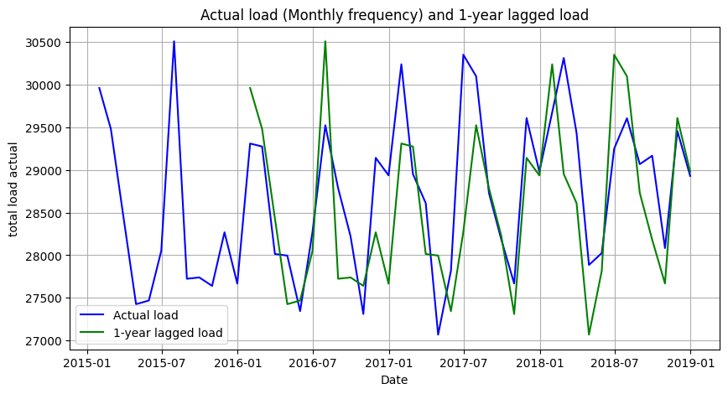
EDA

Slide 20

Model Building
Linear regression
Random forest regression
XG Boost ( Extreme Gradient Boosting)
LSTM (Long Short-Term Memory.).
Train-Test Split Size
Training Set Size: 3 Years of Hourly data (From year 2015 to 2017)
Test Set Size: a) 1st -Day (01-01-2018) to 6th Day (01-06-2018) Individually
b) 1-Week (01-01-2018 to 01-07-2018)
c) 1-Month (01-01-2018 to 01-31-2018)
d) 6-Months (01-01-2018 to 06-30-2018)
e) 1-Year (01-01-2018 to 12-31-2018)

Slide 21
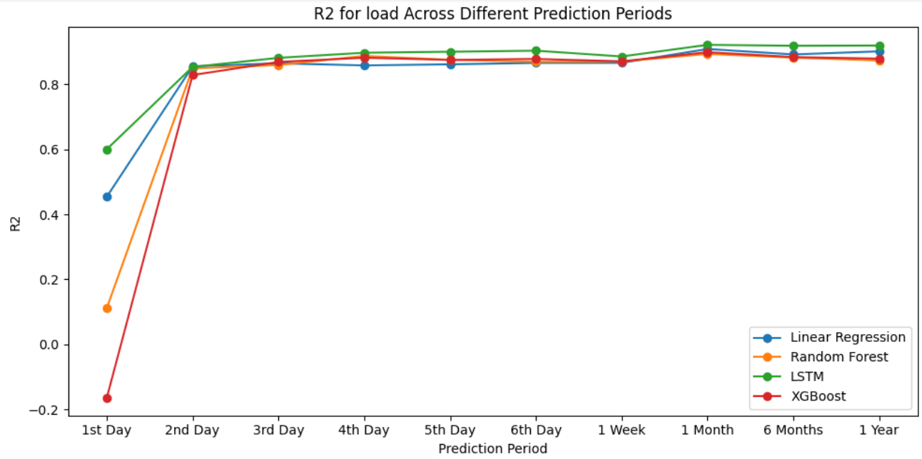
Electricity Load Prediction Results

Slide 22
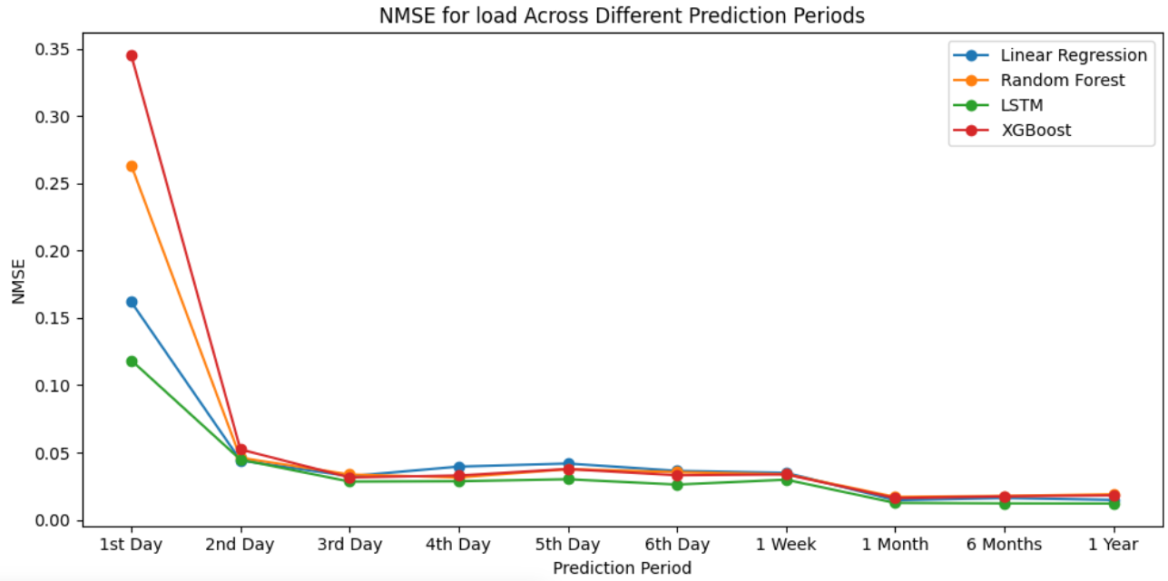
Electricity Load Prediction Results

Slide 23
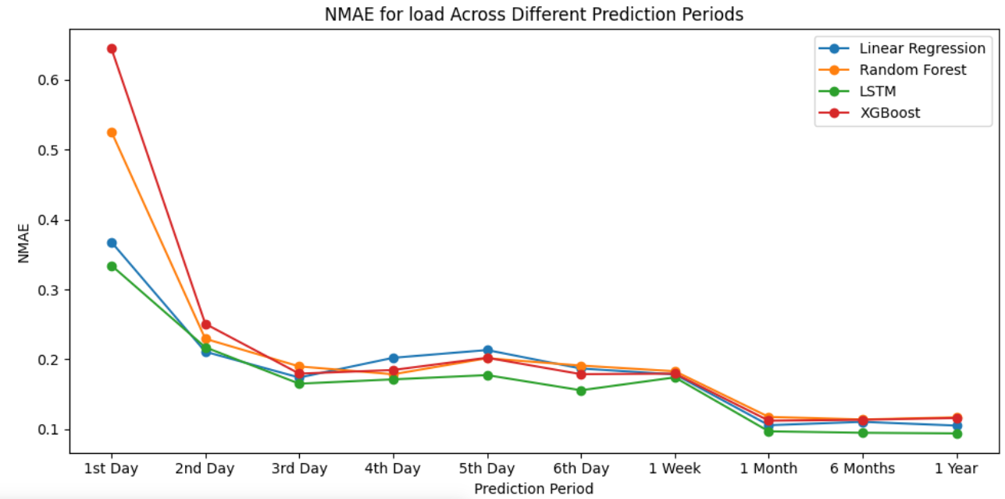
Electricity Load Prediction Results

Slide 24
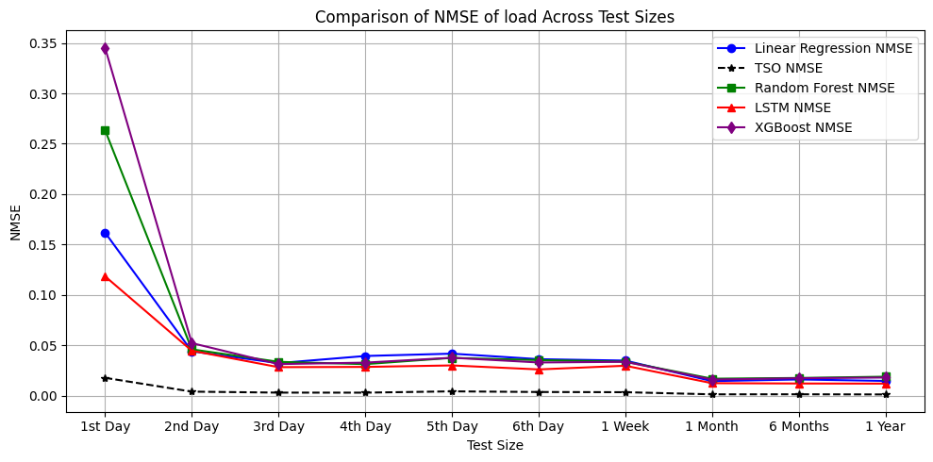
Load Prediction Comparison with TSO

Slide 25
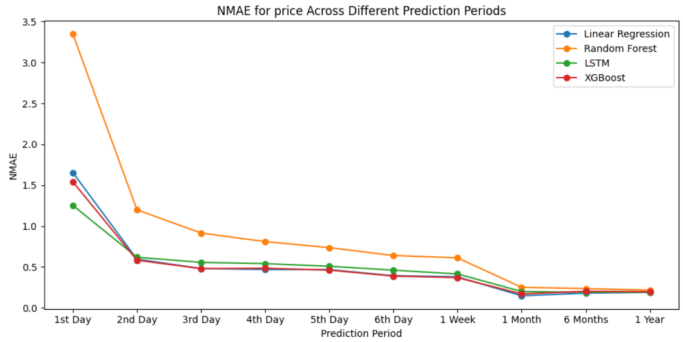
Electricity Price Prediction Results

Slide 26
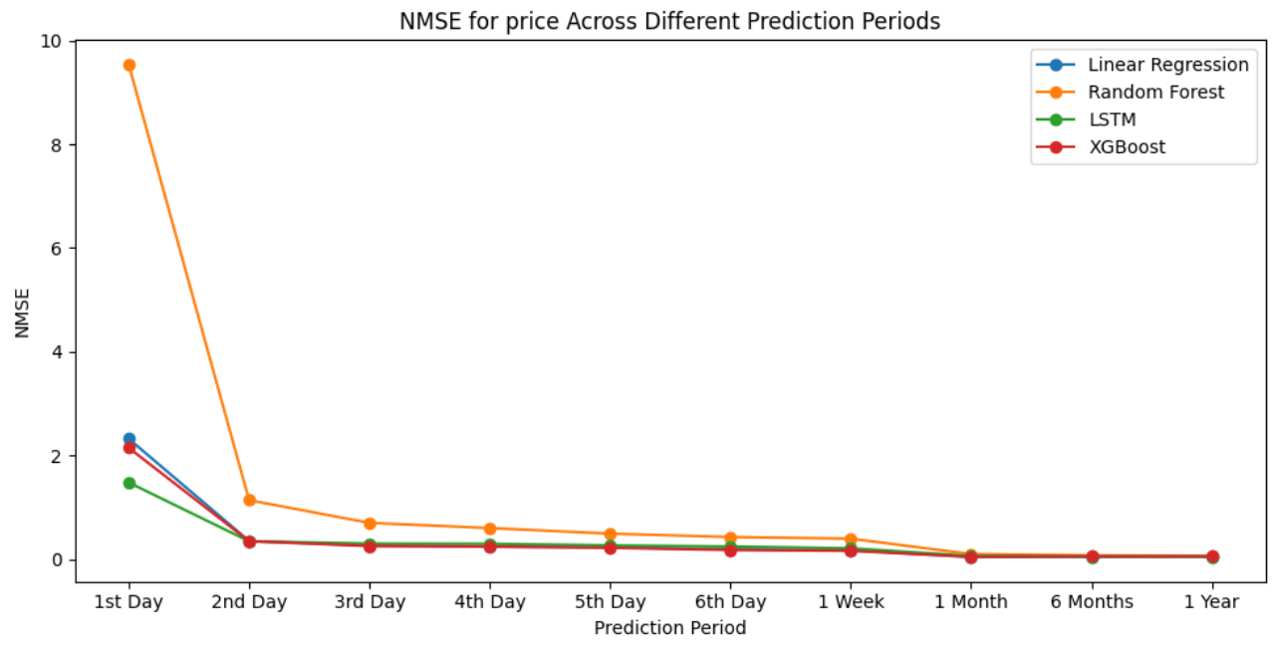
Electricity Price Prediction Results

Slide 27
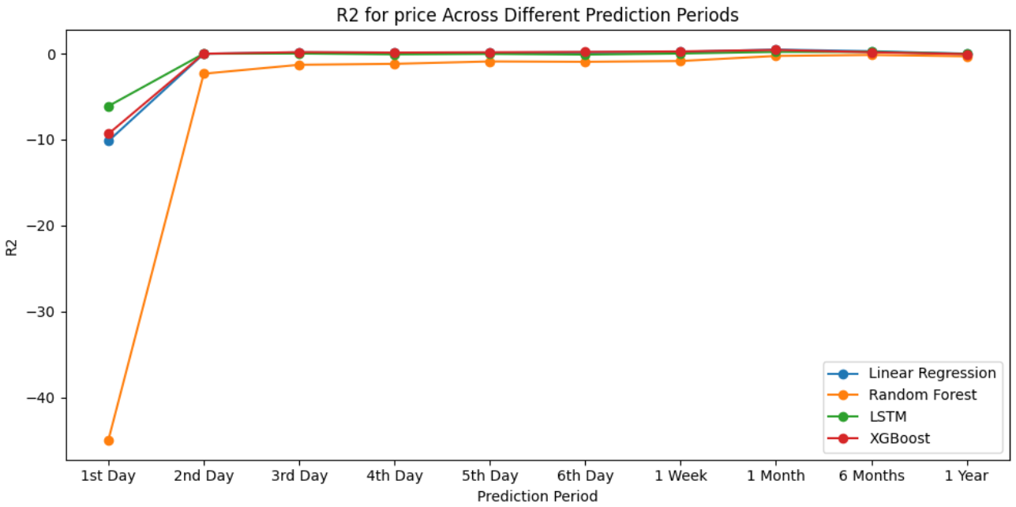
Electricity Price Prediction Results

Slide 28
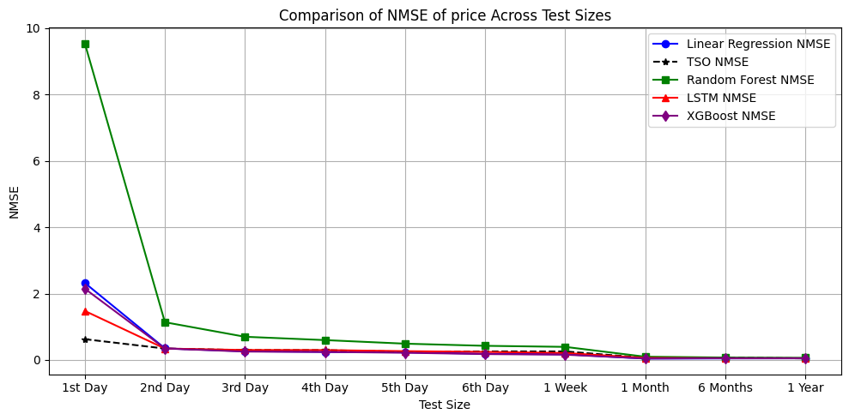
Electricity Price Prediction Comparison with TSO

Slide 29
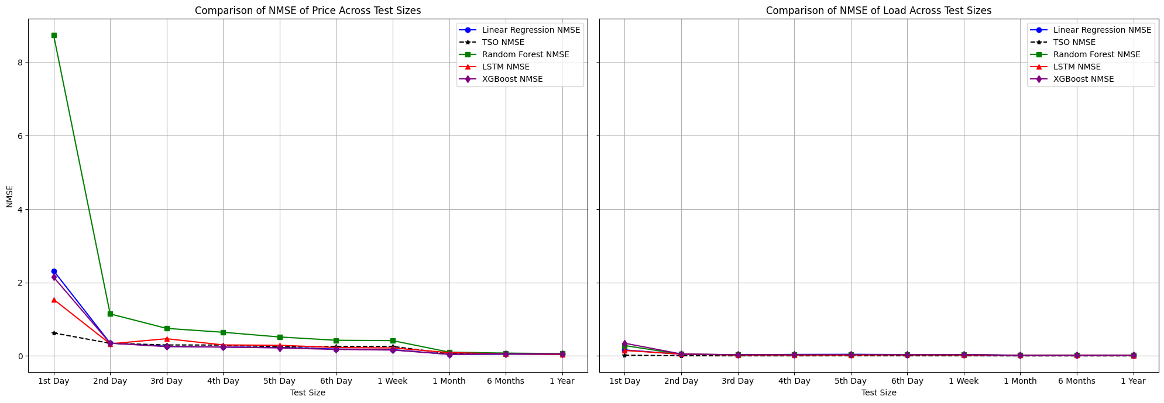
Price and Load Prediction compared to TSO

Slide 30
Model Prediction Results
Electricity Load Prediction:
LSTM: R2 Score=0.92
XG Boost: R2 Score=0.89
Electricity Price Prediction:
XG Boost: R2 Score=0.42
Linear Regression: R2 Score: 0.40

Slide 31
TSO Prediction Method vs Our Method
TSO (Transmission Service Operator) uses the data till last available day to train the model and predict the load and price for next 24 hours.
We used 3 years of data(from the year 2015 to 2017) to train our models and predict the next 24 hours, 1-week, 1-month, 6-months and 1-year data. This might be one of the reasons why our models are under performing compared to TSO.

Slide 32
References
Sagi, O., & Rokach, L. (2018). Ensemble learning: A survey. WIREs Data Mining and Knowledge Discovery, 8(4). https://doi.org/10.1002/widm.1249
Mahajan, P., Uddin, S., Hajati, F., & Moni, M. A. (2023). Ensemble Learning for Disease Prediction: A review. Healthcare, 11(12), 1808. https://doi.org/10.3390/healthcare11121808
Kerenhalevy. (n.d.). GitHub - kerenhalevy/EDA_Energy_Demand_Generation_and_Weather: The dataset contains hourly intervals of electrical consumption, generation, pricing and weather data in Spain. The project focused on Exploratory Data Analysis (EDA): data cleaning and updating, trends and relationship between variables. GitHub. https://github.com/kerenhalevy/EDA_Energy_Demand_Generation_and_Weather
Electricity Consumption Prediction using Energy Data, Socio-economic and Weather Indicators. A Case Study of Spain. (2021, November 11). IEEE Conference Publication | IEEE Xplore. https://ieeexplore.ieee.org/document/9646220

Slide 33
References
Zheng, H., & Wu, Y. (2019). A XGBoost Model with Weather Similarity Analysis and Feature Engineering for Short-Term Wind Power Forecasting. Applied Sciences, 9(15), 3019. https://doi.org/10.3390/app9153019
Li, C., Chen, Z., Liu, J., Li, D., Gao, X., Di, F., Li, L., & Ji, X. (2019). Power Load Forecasting Based on the Combined Model of LSTM and XGBoost. Doi. https://doi.org/10.1145/3357777.3357792
Lu, N., Ouyang, Q., Li, Y., & Zou, C. (2024, March 6). Electrical Load Forecasting Model Using Hybrid LSTM Neural Networks with Online Correction. arXiv.org. https://arxiv.org/abs/2403.03898
Wu, L., & Shahidehpour, M. (2014). A hybrid model for integrated day‐ahead electricity price and load forecasting in smart grid. IET Generation, Transmission & Distribution, 8(12), 1937–1950. https://doi.org/10.1049/iet-gtd.2013.0927

