Slide 1
Health Buddy
PIP2001 Capstone Project
Review-0
Batch Number: CIT – G38
Roll Number | Student Name
20211CIT0068 | Manasa J
20211CIT0135 | Ananya K
20211CIT0145 | S Sourabha
20211CIT0151 | Madatala Teja Shree
20221LIN0001 | Vaishini Sheryil V
Under the Supervision of,
Dr. Sharmasth Vali Y
Associate Professor
School of Computer Science and Engineering
Presidency University
Name of the Program: Capstone Project
Name of the HoD: Dr. Anandaraj S P
Name of the Program Project Coordinator: Dr. Sharmasth Vali Y
Name of the School Project Coordinators: Dr. Sampath A K / Dr. Abdul Khadar A / Mr. Md Ziaur Rahman

Slide 2
Content
Problem Statement
Analysis of Problem Statement
Timeline of the Project
References

Slide 3
Problem Statement Number:
Organization: Cognizant
Category (Hardware / Software / Both) : Software
Problem Description: Basically, our app allows you to enter the food you ate and with the help of a trained model it'll be able to predict the different types of vitamins and proteins and also calculate the calories consumed. After analyzing the data entered by the user for a couple of days, the app will tell you what vitamin you might be deficient of and the possible diseases you might get if you don't include that in your diet. It also keeps a track of the number of glasses of water you've had while also reminding you to hydrate yourself regularly. It also keeps a track of your physical activities and calories burned.
Difficulty Level: Medium

Slide 4
Analysis of Problem Statement
Technology Stack Components:
Frontend (User Interface)
- Frameworks:
- React Native (for cross-platform mobile app development)
- Flutter(another cross-platform option with a rich UI experience)
- Languages:
- JavaScript (React Native)
- Dart (Flutter)
- UI Libraries:
- Material UI (React Native)
- Ant Design (React Native)
- Custom Widgets (Flutter)

Slide 5
Analysis of Problem Statement (contd...)
Technology Stack Components:
2. Backend (Server Logic and API)
Frameworks:
- Django (Python framework that supports rapid development, includes REST APIs)
Flask (lightweight Python web framework, good for APIs)
Node.js (for real-time notifications and handling multiple concurrent requests)
Languages:
Python (for data analysis, machine learning models, and business logic)
JavaScript/TypeScript (Node.js for backend API)
APIs:
RESTful API (Django/Flask/Node.js for client-server communication)
- GraphQL (if you need more flexibility in querying data)

Slide 6
Analysis of Problem Statement (contd...)
Technology Stack Components:
3. Database (Data Storage)
- SQL Databases:
- PostgreSQL (structured, relational data storage, supports complex queries for user data and food records)
- MySQL (another robust relational database)
- NoSQL Databases (for storing flexible data like logs and user activities):
MongoDB
Cloud Database Options:
Firebase Firestore (real-time database for mobile apps)
- AWS DynamoDB (scalable NoSQL database)

Slide 7
Analysis of Problem Statement (contd...)
Technology Stack Components:
4. Machine Learning (Prediction Model)
ML Libraries:
TensorFlow/Keras (for training the model that predicts vitamin deficiencies and calorie estimations)
PyTorch (alternative deep learning library, flexible for research and prototyping)
Pretrained Models (for food classification, nutrition estimation, etc.):
Nutritional Labeling APIs (like Spoonacular API or FoodData Central)
Custom-trained model (train using datasets from nutrition databases or personal data collection)
Deployment:
TensorFlow Serving (to serve the trained model for real-time predictions)
- AWS SageMaker (for cloud-based ML model deployment)

Slide 8
Analysis of Problem Statement (contd...)
Technology Stack Components:
5. Water and Physical Activity Tracking
Sensors:
- HealthKit (for iOS integration to track hydration and activity)
Google Fit (for Android integration)
Custom API:
Create APIs to track user-reported water intake and link it with reminder systems.
6. Push Notifications
Firebase Cloud Messaging (FCM): For sending hydration reminders, activity updates, etc.
OneSignal: A popular service for push notifications.
- Expo Notifications: If using React Native and need simple notification handling.

Slide 9
Analysis of Problem Statement (contd...)
Technology Stack Components:
7. Data Analytics and Insights
- Pandas/Numpy (for analyzing user data to identify deficiencies and trends)
- Matplotlib/Plotly (for visualizing data trends in the app)
Elasticsearch (for full-text search and analysis of food logs, useful for predictive suggestions)
8. Cloud Hosting and Infrastructure
AWS:
EC2 (for hosting backend)
S3 (for storing large data such as images or logs)
Lambda (for serverless computing, to run specific tasks like activity tracking)
Google Cloud:
Google App Engine (auto-scaling for web and mobile app backends)
Google Cloud Storage (for storing images, data logs)
- Heroku (easy-to-use cloud platform for quick deployment)

Slide 10
Analysis of Problem Statement (contd...)
Technology Stack Components:
9. Authentication & User Management
Firebase Authentication (for easy email, social media login integration)
Auth0 (another solution for user authentication)
JWT (JSON Web Tokens) (for securing API requests)
10. Testing and CI/CD
Jest (for JavaScript/React Native unit testing)
PyTest (for Python unit testing)
CI/CD:
GitHub Actions (automate testing, deployment pipelines)
CircleCI or Travis CI (for continuous integration and delivery)
11. Security and Data Privacy
SSL (secure data transfer)
OAuth2 (for secure user authentication)
- GDPR Compliance (for handling user data in the app)

Slide 11
Analysis of Problem Statement (contd...)
Technology Stack Components:
Overall Architecture:-
Client-Server Architecture: Frontend mobile apps communicate with backend servers via RESTful or GraphQL APIs. Backend handles all the data processing, model predictions, and user insights.
Microservices (Optional): If the app scales, consider breaking the backend into smaller, independent services (e.g., separate services for nutrition analysis, activity tracking, etc.).

Slide 12
Analysis of Problem Statement (contd...)
Software and Hardware Requirements:
Frontend Requirements (Mobile App Development)
• Platform: Android (Kotlin or Java)
• The app will be built for Android, supporting versions from API level 21 (Lollipop) onwards for wider compatibility.
• UI/UX Design:
• Intuitive, user-friendly interface to allow easy input of meals, physical activities, and water consumption.
• Dashboards to display daily, weekly, and monthly statistics on calorie intake, vitamin/protein consumption, hydration, and activity levels.
• Notifications/reminders to hydrate, log food intake, or enter physical activities.
• Input Forms:
• Meal logging interface to enter food items consumed with options for portion size, food type, and meal time.
• Water intake tracking with a simple tap-to-add feature.
• Physical activity logging through manual input or integration with Google Fit API for automated data collection.
• Visualization:
• Charts and graphs to show trends in calories, vitamin/protein intake, and activity levels.
• Deficiency warnings for specific nutrients based on analysis over time.

Slide 13
Analysis of Problem Statement (contd...)
Software and Hardware Requirements:
2. Backend Requirements
• Machine Learning (ML) Model:
• Framework: Python (TensorFlow, PyTorch, or scikit-learn).
• ML model for predicting vitamin and protein content based on the food entered.
• The model should be pre-trained with nutritional datasets (e.g., USDA, FoodData Central) and should be fine-tuned for accuracy.
• Prediction:
• Calories and nutrient predictions based on the type of food and portion size entered by the user.
• Deficiency tracking, highlighting potential nutrient deficiencies based on user data over time.
• Integration with Google Fit API:
• Retrieve physical activity data (steps, exercises, calories burned, etc.) using the Google Fit SDK.
• Sync the app with Google Fit for automatic logging of physical activity.
• Firebase (Backend as a Service):
• Firebase Authentication: To manage user authentication (sign up, login).
• Firebase Firestore: To store user data such as food intake, water intake, activity history, and app preferences.
• Firebase Cloud Messaging: For sending reminders/notifications to users (e.g., drink water, log meals, etc.).
• Firebase Storage: For storing any media (e.g., images of food, if necessary).
• Real-Time Database/Firestore: To maintain real-time updates for user statistics and reports.

Slide 14
Analysis of Problem Statement (contd...)
Software and Hardware Requirements:
3. Data Sources & API Integration
• Food Database Integration:
• Pre-built API such as Nutritionix API or Edamam Food Database API to fetch detailed nutritional information for food items.
• Data points like calories, proteins, vitamins, and minerals to be pulled from the A
• Google Fit API:
• Access Google Fit’s activity, step count, and health data (e.g., calories burned, distance covered) for physical activity tracking.
4. Notification and Reminder System
• Hydration Reminders:
• Set recurring notifications to remind users to drink water throughout the day based on user input.
• Meal and Activity Logging Reminders:
• Notify users if they haven’t logged meals or physical activities for the day.

Slide 15
Analysis of Problem Statement (contd...)
Software and Hardware Requirements:
5. Core Functionalities
• Food Logging:
• Allow users to manually enter or search for food items and portion sizes.
• Provide breakdowns of calories, macronutrients (proteins, fats, carbs), and micronutrients (vitamins, minerals).
• Activity Tracking:
• Automatically fetch activity data via Google Fit or allow manual logging of physical activities like walking, running, or exercises.
• Display calories burned based on activity.
• Hydration Tracking:
• Track the number of glasses of water consumed daily with simple input mechanisms.
• Provide hydration goals based on weight, activity levels, and environment (customizable).
• Nutrient Deficiency Analysis:
• After consistent logging for a certain period (e.g., one week), the app will analyze the user’s diet and detect potential deficiencies in vitamins or minerals.
• Suggest foods to include in their diet to address these deficiencies.
• Warn users of possible diseases that could occur from long-term nutrient deficiencies.
• Progress Reports:
• Generate daily, weekly, and monthly reports on calories consumed/burned, hydration, and nutrient intake.
• Show long-term trends for users to see their improvement or areas where they need to focus.

Slide 16
Analysis of Problem Statement (contd...)
Software and Hardware Requirements:
6. Database and Cloud Requirements
• Firebase Firestore or Realtime Database:
• Store all user data securely, including meals, physical activities, and hydration logs.
• Ensure synchronization across devices for users with multiple Android devices.
• Cloud Functions:
• Execute server-side tasks, such as analyzing nutrient deficiencies or sending reminders based on the user’s activity log.
7. Security Requirements:
• User Authentication:
• Secure sign-in using Firebase Authentication (support for Google, email/password, and other OAuth providers).
• Data Privacy:
• Ensure all user data is stored securely in compliance with GDPR and HIPAA standards (if applicable).
• Provide users with the option to delete their data at any time.
• Encryption:
• Ensure all user data is encrypted both in transit (SSL/TLS) and at rest in Firebase Firestore.

Slide 17
Analysis of Problem Statement (contd...)
Software and Hardware Requirements:
8. Performance Requirements
• Speed:
• Fast response times for food data queries and nutrient calculations.
• Efficient use of device resources to prevent slowdowns.
• Offline Mode:
• Allow users to log meals, water intake, and activities while offline, syncing the data when back online.
9. Testing and Quality Assurance
• Unit Testing:
• Write unit tests for the ML model, especially for nutrient and calorie prediction accuracy.
• Integration Testing:
• Test integration with Google Fit API to ensure activity tracking works seamlessly.
• Usability Testing:
• Ensure the app provides a smooth experience, with easy navigation and minimal effort required for daily logging.
• Performance Testing:
• Load testing on Firebase backend to ensure scalability.

Slide 18
Analysis of Problem Statement (contd...)
Software and Hardware Requirements:
10. Deployment
• Play Store Deployment:
• Prepare the app for release on Google Play, following best practices for security, data handling, and user privacy.
• Version Control:
• Use Git for version control and collaborative development.

Slide 19
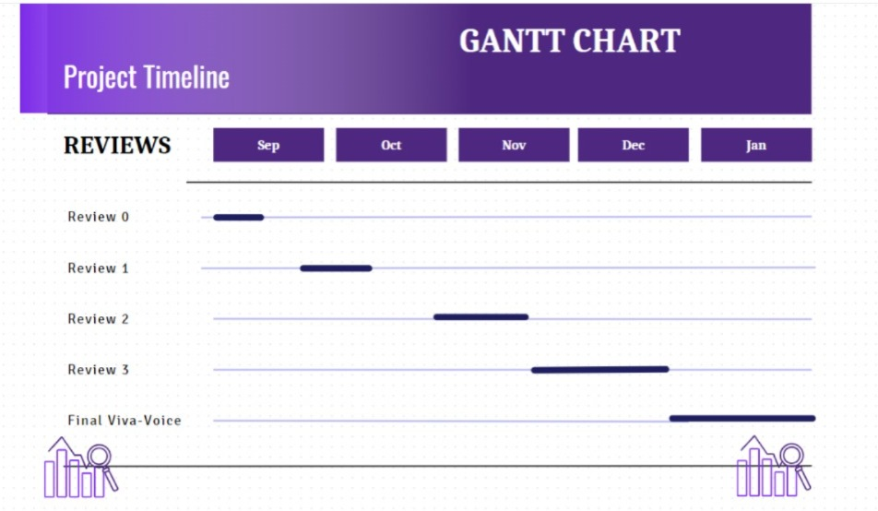
Timeline of the Project (Gantt Chart)

Slide 20
References (IEEE Paper format)
Add APA Citation for all references.
Use the below link for various APA styles :
cronometer.com
absopure.com
wellnessverge.com
bing.com
https://www.indeed.com/career-advice/career-development/how-to-cite-a-research-paper

Slide 21


