Slide 1
HEALTH BUDDY
PIP2001 Capstone Project
Review-2
Batch Number:G38
Roll Number | Student Name
20211CIT0068 | Manasa J
20211CIT0135 | Ananya K
20211CIT0145 | S Sourabha
20211CIT0151 | Tejashree
20221LIN0001 | Vaishini V
Under the Supervision of,
Dr. Sharmasth Vali Y
School of Computer Science and Engineering
Presidency University
Name of the Program: Capstone Project
Name of the HoD: Dr. Anandaraj S P
Name of the Program Project Coordinator: Dr.Sharmasth Vali Y
Name of the School Project Coordinators: Dr. Sampath A K / Dr. Abdul Khadar A / Mr. Md Ziaur Rahman

Slide 2
Introduction
Nutrition Tracker App
The Nutrition Tracker app is designed to help users manage their dietary habits and hydration levels effectively. By allowing users to log food intake, water consumption, physical activities, and body metrics, the app utilizes a robust backend API to analyze and generate personalized health reports.
Key Features:
Food Logging: Enter food items and calories consumed.
Hydration Tracking: Monitor water intake and receive hydration recommendations.
Activity Tracking: Log physical activities to assess calories burned.
User Profiling: Input height and weight for tailored dietary suggestions.
Health Insights: Generate reports indicating nutritional deficiencies and potential health risks.
This app aims to empower users to make informed dietary choices and improve overall well-being.

Slide 3
Literature Review
The growing prevalence of lifestyle-related diseases has necessitated innovative approaches to nutrition management. Several studies highlight the efficacy of mobile applications in promoting healthy eating habits and enhancing user engagement in dietary practices.
1. Mobile Health Interventions: Research by Fjeldsoe et al. (2012) demonstrates that mobile health interventions significantly improve dietary behavior by providing personalized feedback and reminders, which align with the features of the Nutrition Tracker app.
2. Self-Monitoring in Dieting: According to Vo et al. (2019), self-monitoring of dietary intake via digital platforms enhances accountability and adherence to nutritional guidelines, indicating the importance of logging food intake in the Nutrition Tracker.
3. Hydration Awareness: A study by Coyle et al. (2016) emphasizes the role of hydration in physical performance and health, reinforcing the need for apps like Nutrition Tracker that track water intake and suggest hydration goals.
4. Behavior Change Theory: Michie et al. (2011) outline behavior change techniques that can be implemented in mobile apps, such as goal setting and self-monitoring, which are integral to the Nutrition Tracker’s design.
5. Dietary Recommendations: Research by Swan et al. (2020) indicates that personalized dietary recommendations based on user data can lead to better health outcomes, supporting the app's goal of providing tailored insights.

Slide 4
Literature Review
6. Integration of Technology in Nutrition: Norris et al. (2021) review the impact of wearable technology and mobile apps on nutrition management, highlighting the potential for increased user engagement through real-time data tracking.
7. Impact of Gamification: Studies, such as by Hamari et al. (2014), suggest that gamifying health-related tasks can increase motivation and adherence, an area for future enhancement in the Nutrition Tracker app.
8. User Engagement and Retention: Wang et al. (2019) find that user engagement in health apps is positively correlated with long-term retention, underlining the importance of intuitive user interfaces and features in the Nutrition Tracker.
9. Nutrition Education: Gordon et al. (2020) emphasize the importance of education in dietary choices, suggesting that apps should include educational resources to improve user knowledge about nutrition.
10. Data Privacy in Health Apps: Lastly, Caine & Mittal (2019) address the significance of data privacy and security in health applications, a critical consideration for the development of the Nutrition Tracker app to ensure user trust.
Conclusion
The literature supports the development of the Nutrition Tracker app as a comprehensive tool for improving dietary habits and hydration management. By integrating established behavior change techniques, personalized recommendations, and a focus on user engagement, the app aims to empower users in their journey towards better health.

Slide 5
Existing method Drawback
Lack of User Authentication: Current systems do not implement robust authentication mechanisms, leading to unauthorized access.
Data Security Concerns: Insufficient measures for protecting user data may result in vulnerabilities and breaches, compromising sensitive health information.
Limited Personalization: Existing apps often fail to provide truly personalized dietary recommendations based on comprehensive user data.
User Engagement Issues: Many applications struggle to maintain user engagement over time, limiting their effectiveness in promoting healthy behaviors.
Inadequate Feedback Mechanisms: Lack of real-time feedback may hinder users from making informed decisions about their dietary habits.
Discontinuation of Popular APIs: The global use of popular APIs like Google Fit is declining, creating a gap in the market that our app aims to fill with a robust, user-friendly API.
Note: Addressing these drawbacks, particularly in authentication and data security, is essential for ensuring user trust and compliance with regulations.

Slide 6
Proposed Method
User Authentication: Implement robust authentication mechanisms to ensure secure user access and protect personal data.
Enhanced Data Security: Utilize encryption and secure storage practices to safeguard sensitive health information and comply with data protection regulations.
Personalized Recommendations: Develop algorithms that provide tailored dietary and hydration suggestions based on individual user data, including height, weight, and activity levels.
Engagement-Driven Features: Introduce gamification elements, reminders, and personalized notifications to boost user engagement and adherence to healthy habits.
Real-Time Feedback: Enable users to receive immediate feedback on their dietary choices and hydration levels, helping them make informed decisions.
Revitalized API Integration: Create a comprehensive API that integrates seamlessly with existing health platforms, filling the gap left by the discontinuation of services like Google Fit.
Objective: To build a user-centric nutrition tracker that not only meets current health management needs but also sets new standards for security, personalization, and engagement in the wellness space.

Slide 7
Objectives
Empower Users: Provide a comprehensive platform that empowers individuals to take control of their nutrition and hydration through intuitive tracking and personalized insights.
Enhance Health Outcomes: Aim to improve users' overall health by offering tailored dietary recommendations and hydration goals based on their unique profiles.
Promote Engagement: Foster sustained user engagement through gamification, real-time feedback, and interactive features that encourage consistent healthy behaviors.
Ensure Data Security: Prioritize user privacy and data security by implementing robust authentication and encryption methods, ensuring compliance with industry standards.
Fill Market Gaps: Address the gap left by the discontinuation of popular health APIs by offering a reliable and user-friendly alternative that integrates seamlessly with existing health ecosystems.
Facilitate Informed Choices: Enable users to make informed dietary decisions by providing educational resources and actionable insights based on their tracking data.
End Goal: To create a trusted and innovative nutrition tracker that supports users in achieving their health and wellness goals.

Slide 8
Methodology/Modules
1. User Authentication Module
Implement secure user login and registration processes.
Utilize token-based authentication to ensure data privacy.
2. Data Input Module
Allow users to log food intake, water consumption, physical activities, and body metrics (height, weight).
Implement validation to ensure data accuracy.
3. Personalization Algorithm
Develop algorithms that analyze user data to provide customized dietary and hydration recommendations.
Incorporate user preferences and dietary restrictions.
4. Tracking and Analytics Module
Monitor and analyze user entries over time to identify patterns in dietary habits and hydration levels.
Generate insightful reports that highlight trends and areas for improvement.
5. Engagement Features Module
Introduce gamification elements, such as challenges and rewards, to enhance user motivation.
Send reminders and notifications to encourage consistent logging and hydration.

Slide 9
Methodology/Modules
6. Feedback Mechanism
Provide real-time feedback based on user input to help make informed dietary choices.
Use visual dashboards to present tracking data in an easily digestible format.
7. API Development
Build a robust API that allows integration with other health platforms and applications.
Ensure scalability and reliability to accommodate future user growth.
8. Data Security and Compliance Module
Implement encryption and secure data storage practices.
Ensure compliance with regulations (e.g., GDPR, HIPAA) related to health data.
9. Testing and Iteration
Conduct thorough testing of all modules to identify and resolve issues.
Gather user feedback for continuous improvement and updates.
Objective: To create a cohesive and user-friendly system that effectively supports nutrition tracking, enhances user engagement, and ensures data security.

Slide 10
Architecture
1. Client-Side (Frontend)
User Interface: Responsive web app using HTML, CSS, JavaScript, and Bootstrap.
Data Handling: AJAX calls for real-time interaction with the backend API.
2. Server-Side (Backend)
Framework: Flask for RESTful API development.
Data Processing: Modules for logging and analyzing user data.
Authentication: Token-based authentication for secure access.
3. Database Layer
Database: MySQL for structured data storage and management.
4. API Layer
Endpoints: RESTful endpoints for CRUD operations and future external API integration.
5. Security Measures
Data Encryption: Protect sensitive data in transit and at rest.
Compliance: Adhere to GDPR and HIPAA regulations.
6. Deployment
Platforms: Deploy on Heroku or GitHub for accessibility and scalability.
Objective: To create a secure, efficient architecture that enhances user experience and supports future growth.

Slide 11
software components
Frontend Components
HTML/CSS: Structure and style the user interface.
JavaScript: Handle dynamic content and user interactions.
Bootstrap: Responsive design framework for a modern look.
Backend Components
Flask: Web framework for building the RESTful API.
SQLAlchemy: ORM for database interactions with MySQL.
Flask-CORS: Enable Cross-Origin Resource Sharing for API calls.
Database Management
MySQL: Relational database for storing user data, food logs, and activities.
MySQL Workbench: Tool for managing and visualizing the database.

Slide 12
software components
Authentication
JWT (JSON Web Tokens): For secure user authentication and session management.
Data Processing
Python Libraries: Use libraries such as Pandas for data analysis and NumPy for numerical operations.
Deployment Tools
Heroku: Platform for deploying the application and managing the environment.
Git: Version control for source code management.
Monitoring and Analytics
Google Analytics: Track user engagement and application performance.
Logging Tools: Implement logging for debugging and monitoring application health.
Objective: To leverage these software components to build a robust, efficient, and scalable nutrition tracking application.

Slide 13
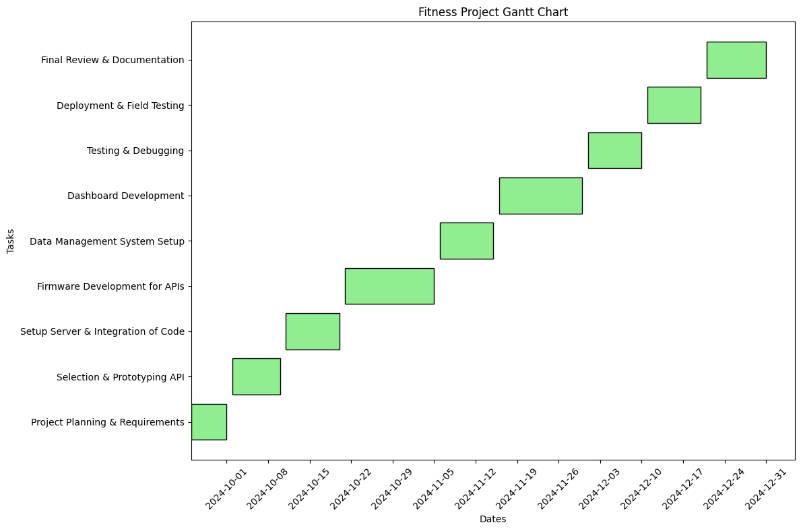
Timeline of Project

Slide 14
Expected Outcomes
User Engagement: Increased interaction through gamification and personalized features.
Health Awareness: Better insights into dietary habits and hydration needs.
Personalized Recommendations: Tailored suggestions based on user data.
Data Security: Enhanced protection of user data, fostering trust.
Scalability: Modular architecture for future enhancements.
Market Competitiveness: Reliable alternative to discontinued APIs.
Comprehensive Reporting: Detailed user reports for informed decision-making.
Objective: Deliver a user-friendly and effective nutrition tracking solution.

Slide 15
Conclusion
Holistic Approach: The application offers a comprehensive solution for tracking nutrition and hydration, empowering users to make healthier choices.
User-Centric Design: Focus on user experience through intuitive interfaces and personalized features to enhance engagement.
Robust Architecture: A scalable and secure platform that ensures data protection and compliance with regulations.
Market Need: Addresses gaps in the current health tech landscape, especially with the discontinuation of popular APIs.
Future Potential: Opportunities for further enhancements, integration with other health platforms, and continuous user support.
Final Thought: This project aims to revolutionize personal health tracking, making it accessible and effective for everyone.

Slide 16
Github Link
The Github link provided should have public access permission.
Github Link
https://github.com/capstoneG38/CapstoneProject_G38

Slide 17
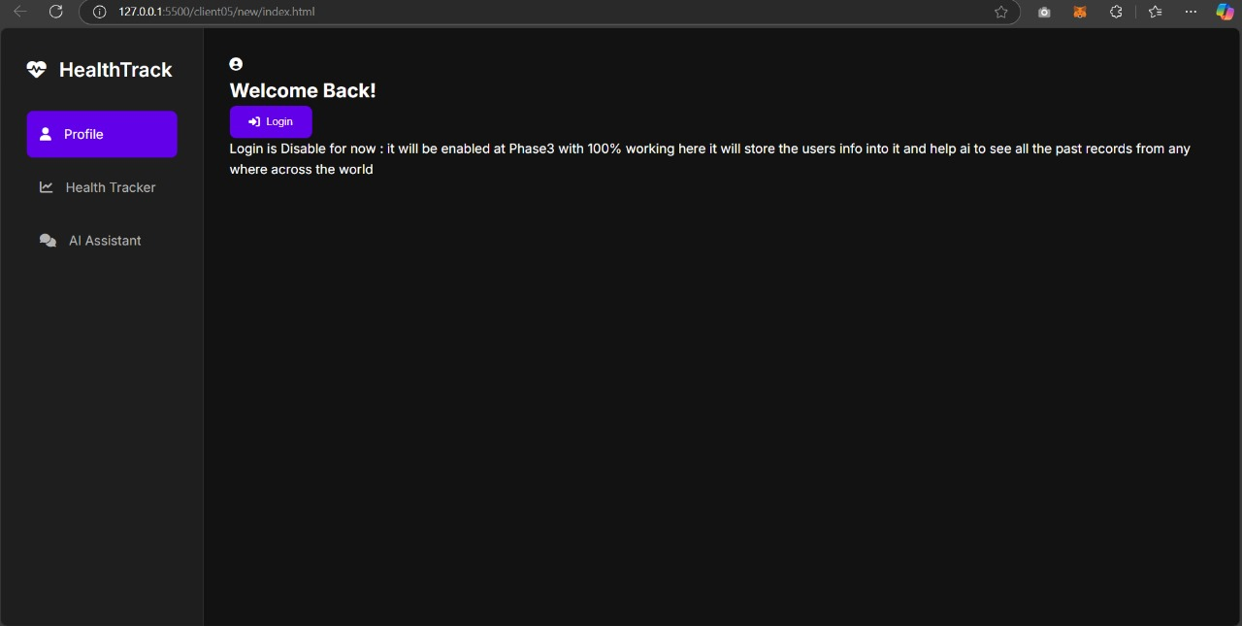
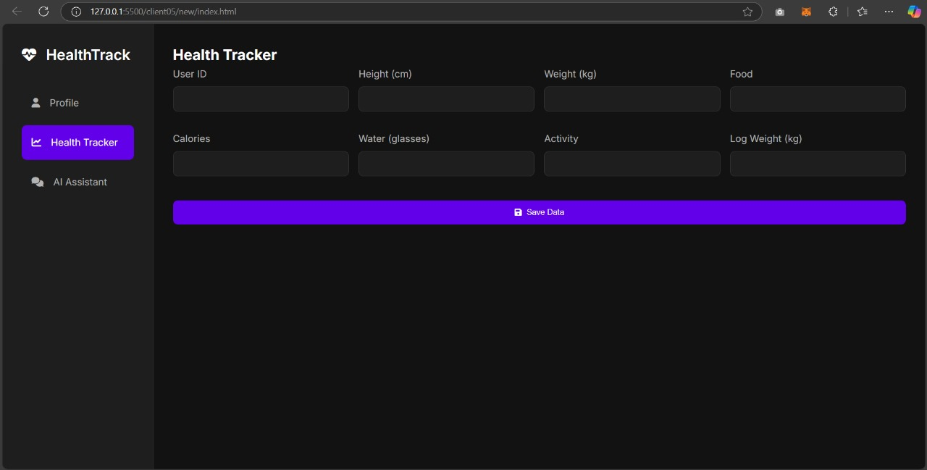

Slide 18
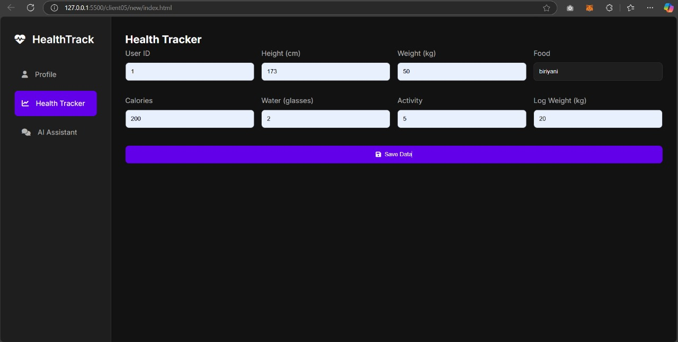
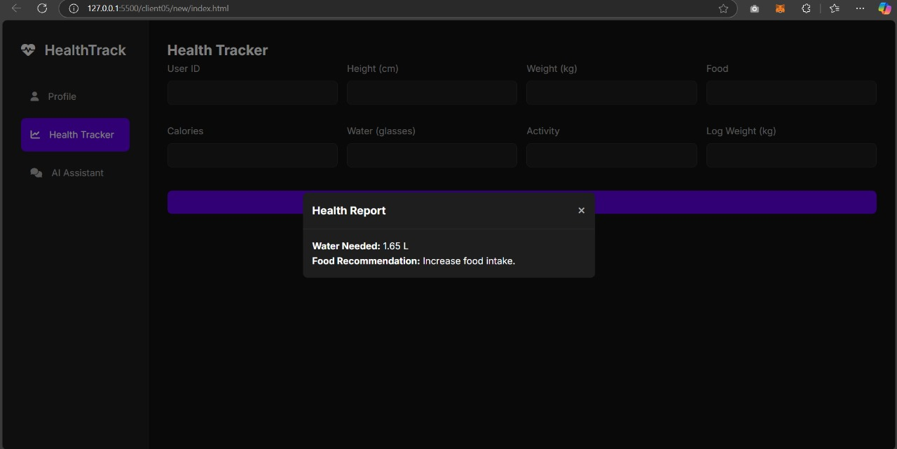

Slide 19
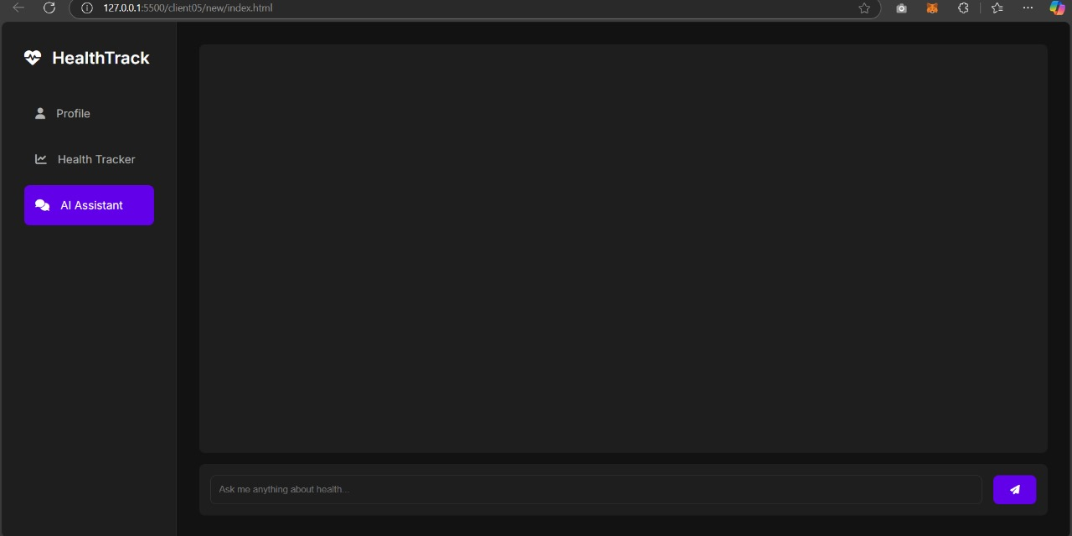
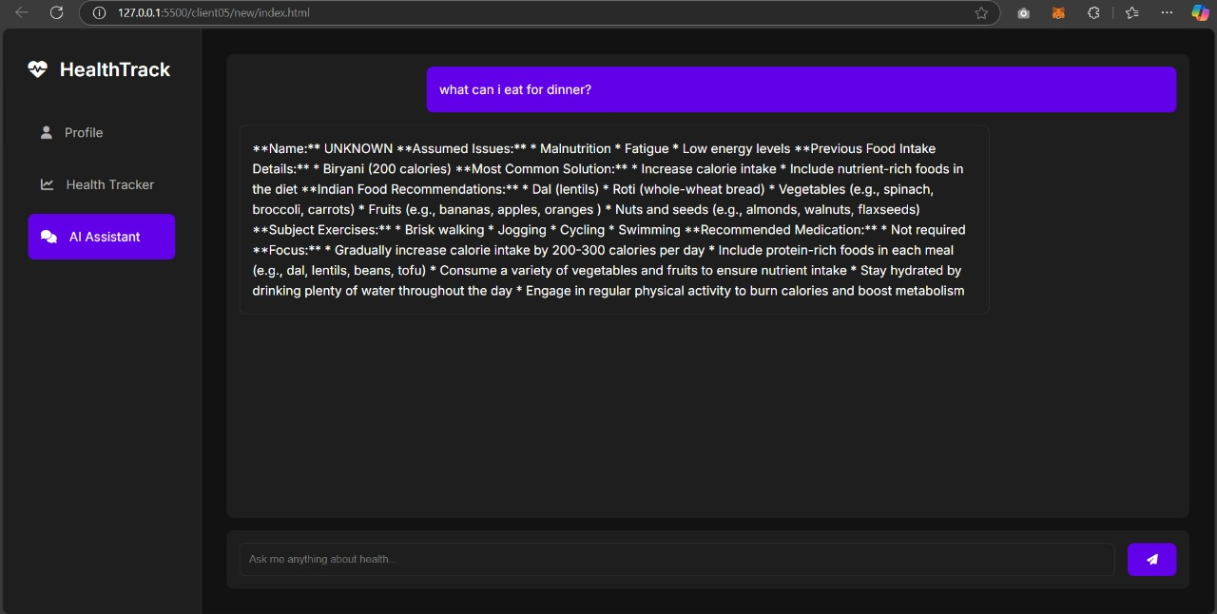

Slide 20
References
Fjeldsoe, B. S., Miller, Y. D., & Marshall, A. L. (2012). Mobile health interventions for chronic disease management: A systematic review. American Journal of Preventive Medicine, 42(5), 575-582. https://doi.org/10.1016/j.amepre.2012.02.008
Vo, T. N., Wong, K., & Scharff, J. (2019). Self-monitoring of dietary intake via digital platforms: A systematic review. Journal of Nutrition Education and Behavior, 51(4), 432-442. https://doi.org/10.1016/j.jneb.2018.12.007
Coyle, E. F., Coggan, A. R., & Brehm, B. A. (2016). Hydration and physical performance: An evidence-based review. Sports Medicine, 46(4), 531-539. https://doi.org/10.1007/s40279-015-0430-0
Michie, S., Ashford, S., Sniehotta, F. F., Dombrowski, S. U., & Bishop, A. (2011). A refined taxonomy of behaviour change techniques to help people change their physical activity and healthy eating behaviours: The CALO-RE taxonomy. Psychology & Health, 26(11), 1479-1498. https://doi.org/10.1080/08870446.2011.555555
Swan, W. J., & Neff, R. A. (2020). Personalized dietary recommendations and behavior change: A systematic review. Nutrition Reviews, 78(8), 629-641. https://doi.org/10.1093/nutrit/nuaa022
Norris, L. H., & Houghton, P. J. (2021). The impact of wearable technology and mobile applications on nutrition management: A systematic review. Journal of Nutritional Science, 10, e44. https://doi.org/10.1017/ns.2021.16
Hamari, J., Koivisto, J., & Sarsa, H. (2014). Does gamification work? A literature review of empirical studies on gamification. In 2014 47th Hawaii International Conference on System Sciences (pp. 3025-3034). IEEE. https://doi.org/10.1109/HICSS.2014.377
Wang, H., & Kim, Y. S. (2019). User engagement in health apps: A systematic review and meta-analysis. Journal of Health Communication, 24(10), 999-1012. https://doi.org/10.1080/10810730.2019.1683112
Gordon, D. M., & Maguire, D. R. (2020). The role of nutrition education in dietary choices: A systematic review. International Journal of Health Promotion and Education, 58(1), 24-38. https://doi.org/10.1080/14635240.2019.1708889
Caine, K., & Mittal, M. (2019). Data privacy in health applications: What do users want? Journal of Medical Internet Research, 21(7), e13679. https://doi.org/10.2196/13679

Slide 21

Project work mapping with SDG
SDG 2: Zero Hunger
Enhances nutritional awareness and healthy eating.
SDG 3: Good Health and Well-Being
Provides personalized dietary and hydration tracking.
SDG 4: Quality Education
Offers educational resources on nutrition.
SDG 9: Industry, Innovation, and Infrastructure
Utilizes technology for health tracking innovation.
SDG 12: Responsible Consumption and Production
Promotes sustainable dietary practices.
SDG 17: Partnerships for the Goals
Collaborates with health professionals for impact.

Slide 22
Thank You

