Slide 1
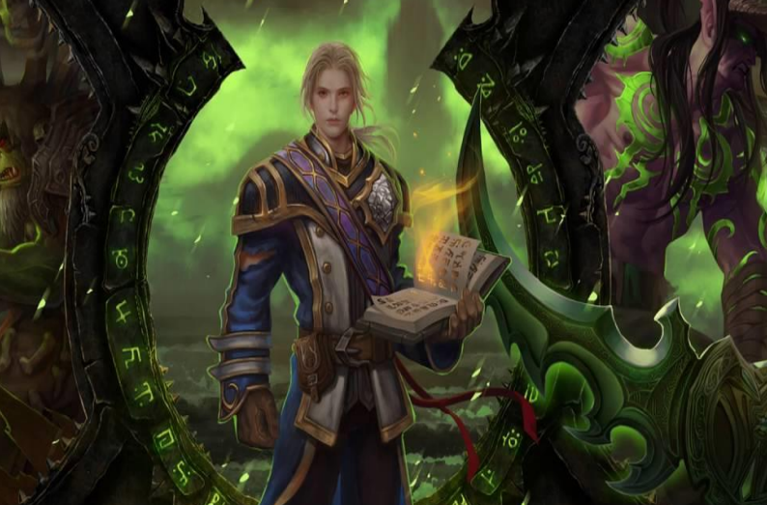
BEHAVIORAL PATTERN RECOGNITION OF MULTIPLAYER ONLINE ROLEPLAYING GAME PLAYERS USING BIG DATA ANALYTICS AND MACHINE LEARNING
Team members:
Sulekha AloorRavi
Deepa Venugopal
Niharika Thanavarapu
Lakshmipriya M
Mentor:
Dr. Narayana D

Slide 2
Context of this Project
It is challenging to develop the database engines that are needed to run a successful MMOG with millions of players. Understanding the behavior of players using their activity data is more important for these game developers to come up with better strategies in game development.
Great volumes of data are generated all the time in gaming environments. Each interaction made by a player creates data that are transferred and stored, and if properly analyzed, can contain valuable information.
This information can be vital for the continuity and improvement of a game. Patterns can be detected from these data and even predictive analysis can be made to foresee the actions and intentions of the players inside the game.

Slide 3
Objective
Objective of this Project is to perform analytics on one such Big Data Gaming Environment and the results would help game developers in
Optimizing user experience
Improving revenue
Raise the level of control over the environment

Slide 4
Problem Statement
PERFORM EXPLORATORY ANALYSIS
To cluster players into different groups based on features in dataset
To analyze and visualize timeline patterns of players by different groups and parameters
To create heat map based on the gaming zones
To visualize patterns based on player Guilds
PERFORM PREDICTIVE ANALYTICS BY APPLYING MACHINE LEARNING MODELS
Forecast the number of players expected in future time point to plan resource capacity
Predict player churning to come up with steps to avoid future churn
Recommend guilds [groups to join] to players for effective gaming and to minimize churn

Slide 5
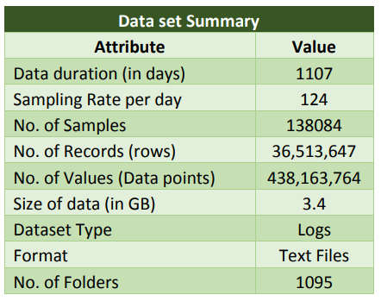
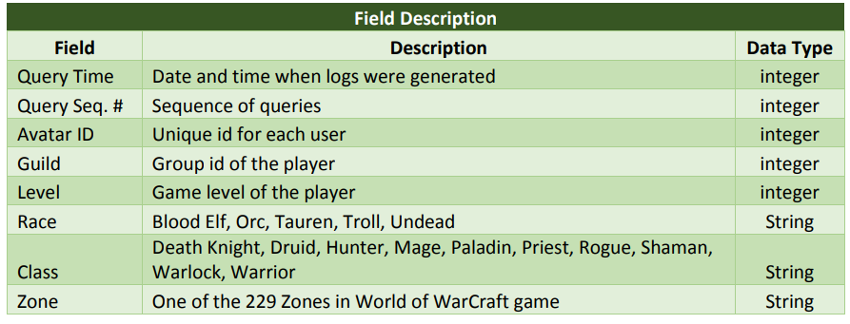
Data
We have chosen an online game named “World of Warcraft” which we found to be most suitable for this Project. A large and scalable dataset with 3 years of player logs are released by Blizzard Entertainment for research purposes. We are using this dataset of our Project.

Slide 6
Input Dataset

Slide 7
Overview of the Final Process

Slide 8
Overview of the Final Process…

Slide 9
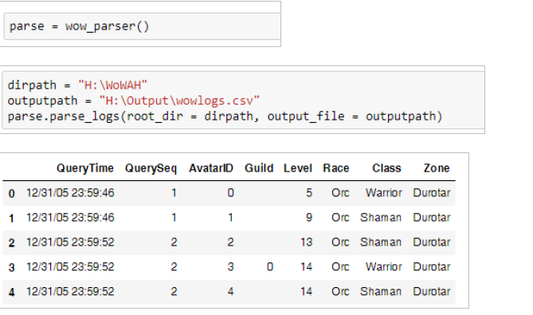
Log Parsing

Slide 10
Data Cleanup

Slide 11
Exploratory Analysis

Slide 12
Exploratory Analysis…

Slide 13
Feature Engineering
New Features are created from existing features to make the data suitable for:
Time series Forecasting
Player Churn prediction
Recommendation Engine

Slide 14
Model building and Evaluation
Time series Forecasting

Slide 15
Model building and Evaluation…
Churn prediction

Slide 16
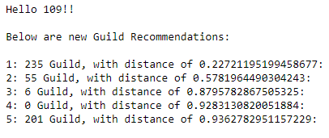
Model building and
Model building and Evaluation…
Recommendation Engine

Slide 17
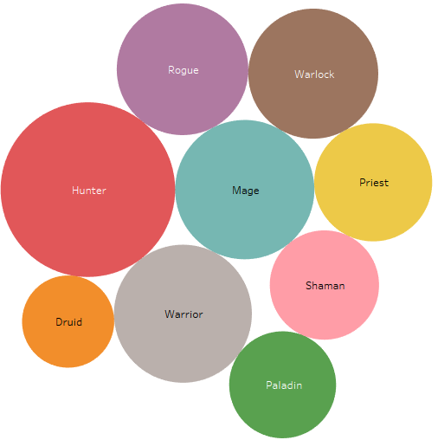
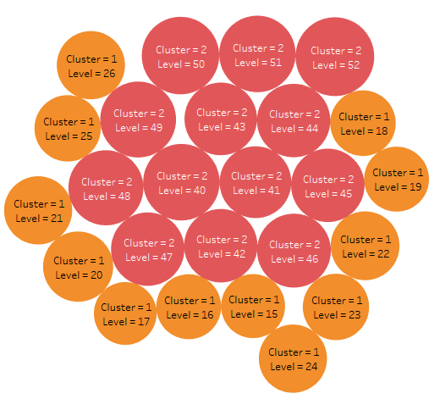
Clustering of data for visualization
Class distribution in Cluster 3
Level distribution across Clusters 2 & 3

Slide 18
Recommendations to Business

Slide 19
Limitations
These models are derived based on the data available between the three year periods of 2006 to 2009.
In real world scenario: more recent data would be required to redesign this model and to maintain continuously.
Also, the features available in the dataset is very less (7 Features) which makes it challenging to provide more in depth insights and to identify more business problems and solutions.
To enhance the solutions provided by us, it would be very essential to capture logs with more information in future.

Slide 20
Closing Reflections
Learnings:
Extensive usage of Tableau to bring more meaningful insights from World of Warcraft Logs
Multiple Time series Forecasting models and their application on WoW logs
Methods of application of Feature Engineering on WOW dataset since the available features were not enough of successful model building
Usage of Spark ML for Model building
Things to do differently next time:
Collect data that has captured more features in future logs to bring more insights
Explore the usage of Spark R for model building and Hive database for Feature Engineering

Slide 21
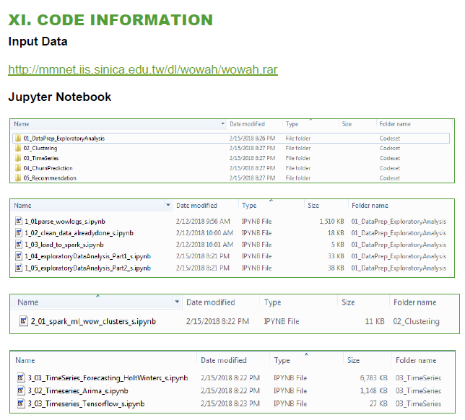
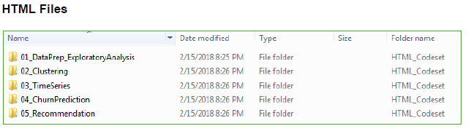
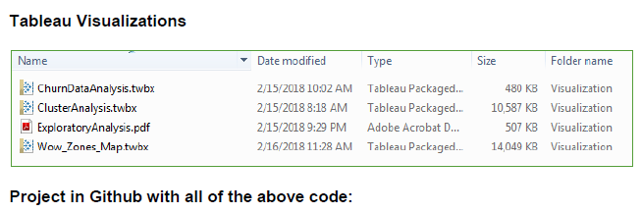
Code Repository
GitHub Repository

Slide 22
Thank you ☺

