Slide 1
INTELLIGENT VIRTUAL ASSISTANT TECHNOLOGY
Done by:
Amrisha Das 2020UCO1687

Slide 2
INTRODUCTION
What is an Intelligent Virtual personal assistant?
They are intelligent software programs that can perform a wide range of tasks and functions, from the tiniest of calculations to finding solutions of complex problems, with minimal human involvement.
Problem Statement:
Emergencies can happen at any time and in any place, leaving individuals vulnerable and in need of immediate help. Many people rely on smartphones but it has obvious disadvantages.
So, there is a need for a VPA with an emergency contact feature that can be activated through voice commands to easily notify designated contacts in case of an emergency, even when they are unable to physically access their mobile phones.

Slide 3
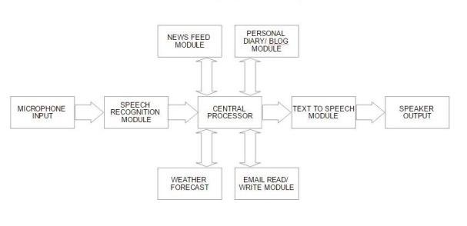
GENERAL VPA

Slide 4
OUR MOTIVATION
There has been an increased focus in the healthcare department after the covid pandemic. Taking this into account, it was brought to our knowledge that virtual personal assistants such as Alexa do not have an emergency contact feature.
If someone has fits, or screams and collapses, they do not have the time or capacity to hold the power button of their phone for a long time nor give commands to the VPA. And so, the VPA could be programmed to automatically notify emergency services or designated contacts in case of a medical emergency, reducing the risk of complications and potentially saving lives.
EMERGENCY
CONTACT

Slide 5
OUR NOVELTY
Despite IVPA’s like Alexa listening to all the conversations that go about whenever connected to a power supply, there is no emergency contact system.
To tackle this grave issue, our bot detects the frequency range of the voice, if it is found to be above a certain threshold for some amount of time, and is followed by a very low frequency sound (or disturbance noise which may or may not be present) the bot will send a WhatsApp and a telegram message to the emergency contact listed.
Moreover, it will also be able to contact the emergency helpline number 911.

Slide 6
TECHNOLOGIES USED
NLP
ASR
TTS
NLU
to convert spoken words into text. ASR enables the VAT’s to understand what users are saying and transcribe it into a format that the system can understand.
to convert text into spoken words. TTS enables it to respond to user requests with natural-sounding voice responses.
to analyze and interpret the meaning of user requests
to understand and interpret user requests. NLP enables VAT’s like Alexa to understand the context, intent, and meaning behind user request

Slide 7
WORKING
Speech
Recognition
(STT)
Speech Electrical Energy Digital Data Text
Text to speech synthesizer
Text to Speech
Speech Microphone Detection Conversion of signal Frequency analysis
Audio
Analysis
Notes:
working

Slide 8
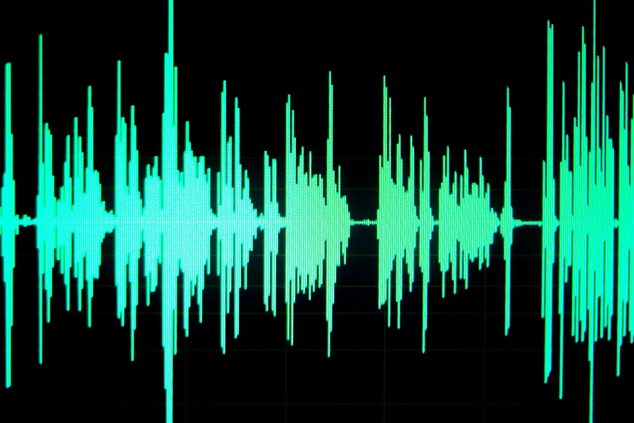
AMPLITUDE
AUDIO
DATA
FREQUENCY
TIME PERIOD

Slide 9
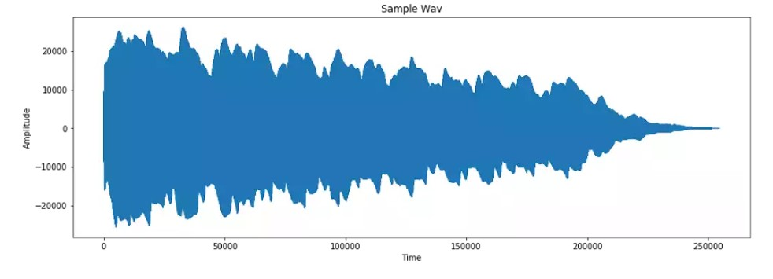
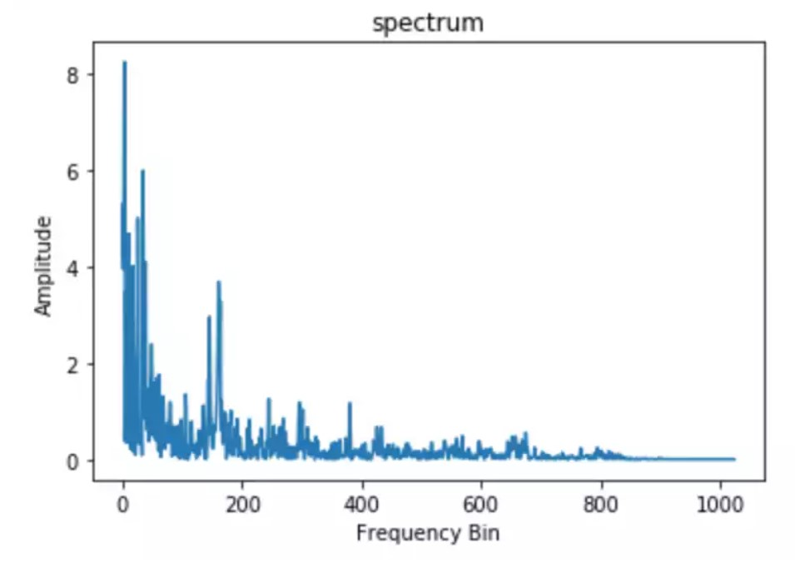
Comparing the Amplitude
with respect to Time
Comparing the Amplitude
with respect to Frequency Bin

Slide 10
Extracting the data
(RSE)
03
Obtaining the Data
(through the microphone).
Audio
Data
Analysis
01
02
Preparing the data
(Fourier Transform)

Slide 11
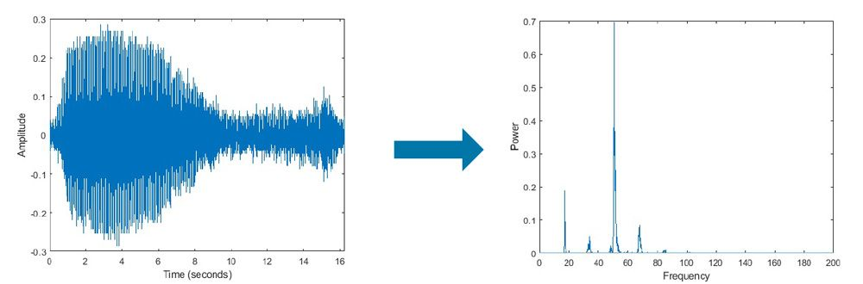
FAST FOURIER TRANSFORM
It is a mathematical algorithm which performs Fourier Transform by breaking the sound waves or signals into spikes of different amplitude and frequency .
Also used for better understanding of the signal from different viewpoints and angles

Slide 12

FLOWCHART

Slide 13
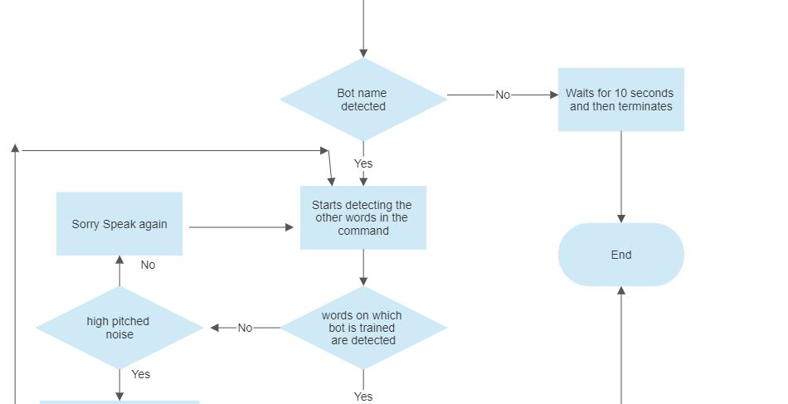
FLOWCHART

Slide 14
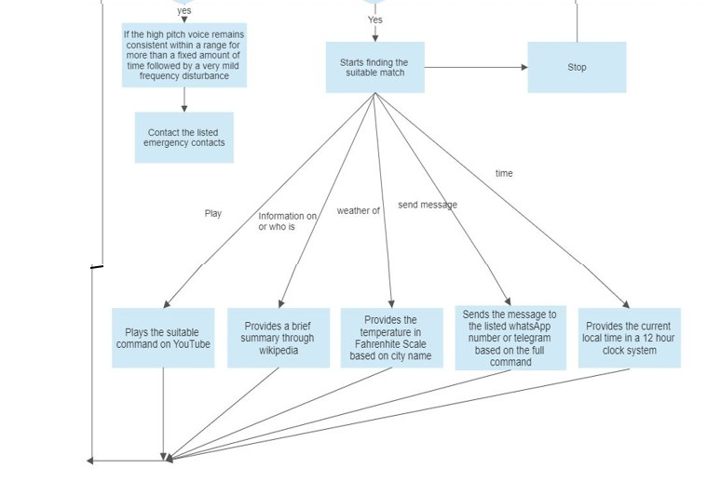
FLOWCHART
Notes:
Speak about NER - Named Entity Recognition
such as rule-based systems, statistical models, or deep learning models

Slide 15
FURTHER IMPLEMENTATION
Brain
In order to perform the task of classification, we need to make the brain of the program which can be done using CNN
BoW
The sentences that are passed through the microphone will first be arranged and the weights will be assigned but there remains a drawback as equal weights are given to each word
TF-IDF
The drawback can be overcome using this algo to a large extent as it provides different words with different weights, thus giving a priority like arrangement

Slide 16
ASSUMPTIONS
There is a risk of false alarms triggering emergency response. For example in case of loud music it might repeatedly send emergency notifications. A solution to this is to provide this service as an optional toggle product, i.e the user can switch this feature on and off as per his need.
RESULTS
The accuracy that we have been able to achieve with the current model is 76%. Since our model has been developed at a low level and we have used the most basic microphone, in order to get precise results, it is best to be present in a silent environment.
Notes:
working

Slide 17
More areas of Novelty that can be considered
Wake Word Detection - giving the user a customized way of doing so initially
Connecting it with ChatGPT’s API
Dependency on cloud and limited memory on the device, it doesn’t become like a conversational bot

Slide 18
THANK YOU !

