Slide 1
Book1
File created on: 6/14/2021 9:58:59 PM

Slide 2
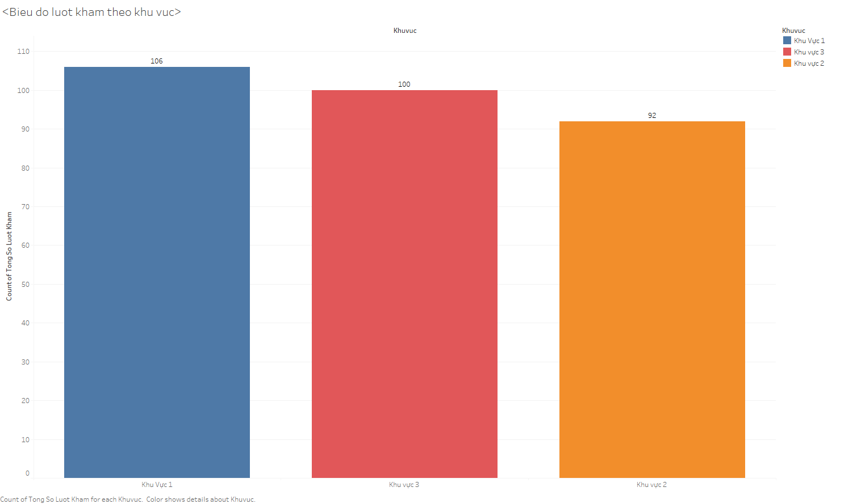

Slide 3
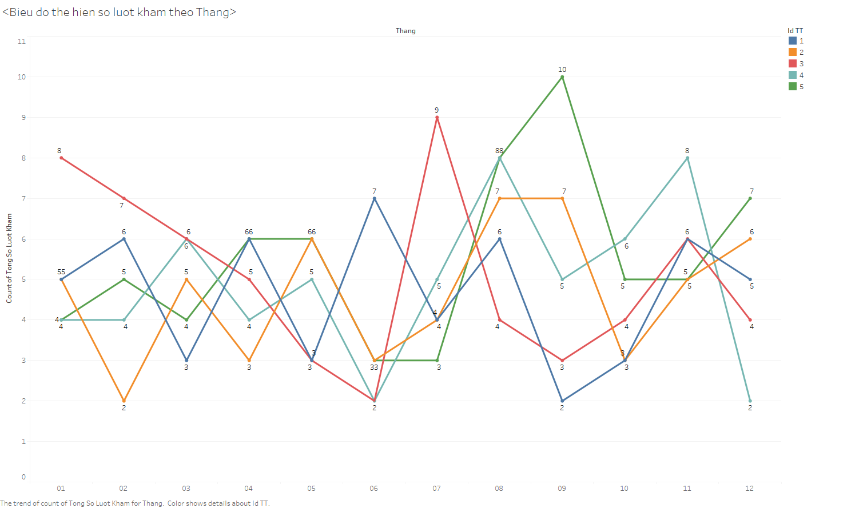

Slide 4
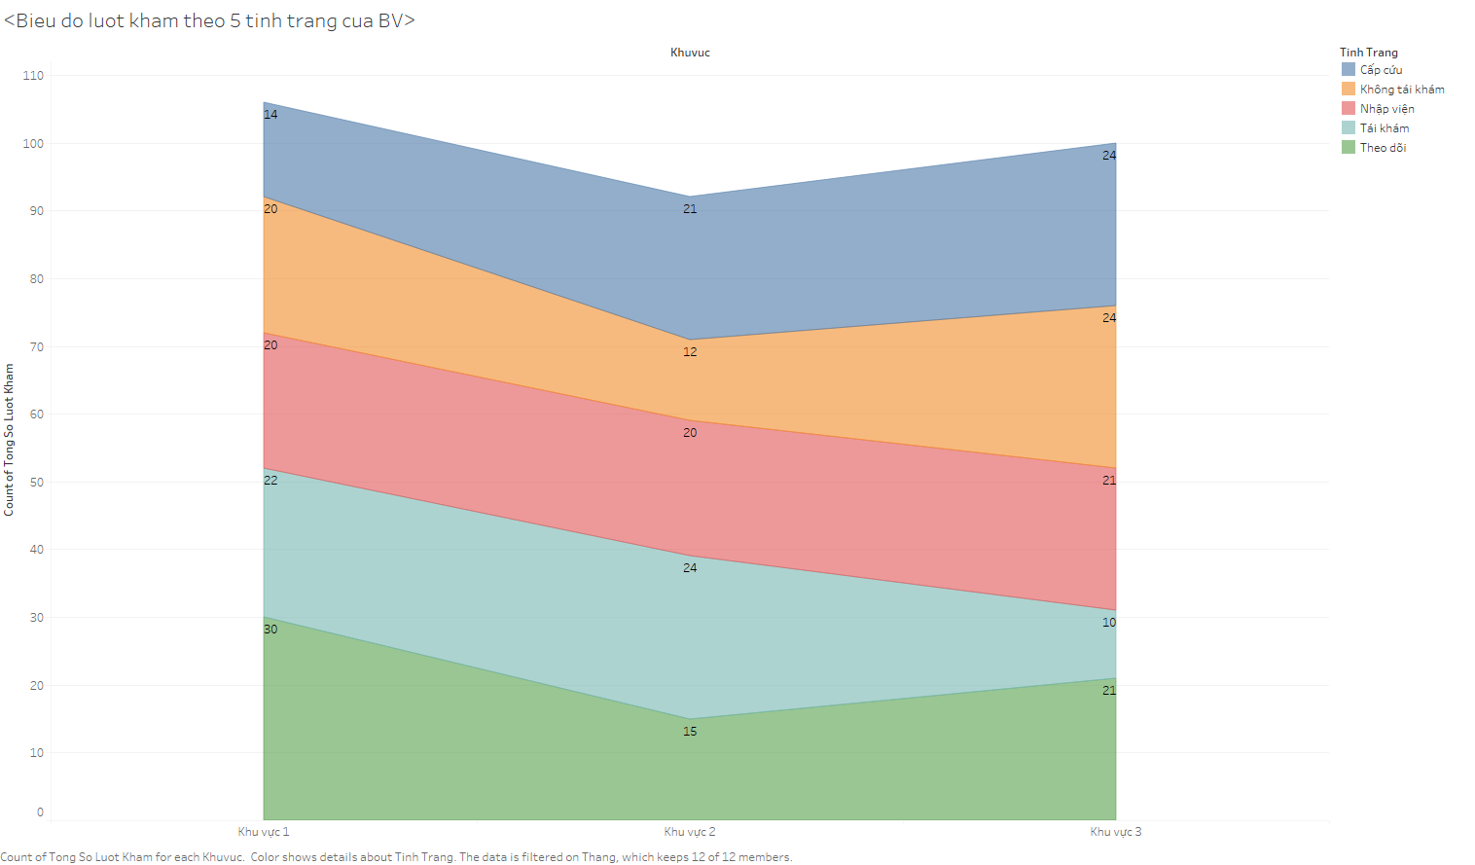

Slide 5
