Slide 1

Product Recommendation system
For :
Flipkart GriD 5.0

Slide 2
Presented by :
Prayas Mazumder
Soutrik Roy
Bipradeep Bera
IIEST Shibpur , West Bengal
Team Name : 686157-U59KA17B

Slide 3
What are Recommendation Systems?
Every day we view and purchase products on Flipkart, browse Netflix, stream music on Spotify. Have we ever wondered how accurately they know our tastes and preferences and make Recommendations based on our interests ?
The answer is they have personalized Recommendation Engines which uses advanced algorithms to recommend products to us... When we want to watch a new movie, we usually ask our friends for suggesting movies, they know our interests and accordingly they suggest us a good movie.
So, Recommendation Systems work the same way, they are nothing but data filtering tools that uses algorithms to recommend most relevant items to a particular user.

Slide 4

Internet is a vast ocean of Information, it consists of millions of items, a large catalogue of products. There are some Users that know what they are looking for whereas others have no idea what to look for in such a large library of resources, and thus, Recommendation Systems play a vital role.
There are some products which may be good but have not gained Popularity since they have not been advertised, so recommendation systems help such items gain popularity by bringing such items to one's notice.

Slide 5
Problem Statement :
Building recommendation system for products electronics and clothing
Description :
Online E-commerce websites like Amazon, Flipkart uses different recommendation models
to provide different suggestions to different users. ecommerce sites currently uses
item-to-item collaborative filtering, which scales to massive data sets and produces
high-quality recommendations in real time. This type of filtering matches each of the
user's purchased and rated items to similar items, then combines those similar items
into a recommendation list for the user. In this project we are going to build
recommendation model with the similar kind of approach.

Slide 6
Dataset :
(Building recommendation system for products electronics and clothing)
Description :
Online E-commerce websites like Flipkart uses different recommendation models
to provide different suggestions to different users. ecommerce sites currently uses
item-to-item collaborative filtering, which scales to massive data sets and produces
high-quality recommendations in real time. This type of filtering matches each of the
user's purchased and rated items to similar items, then combines those similar items
into a recommendation list for the user. In this project we are going to build
recommendation model with the similar kind of approach. Though there isn’t any specific dataset given , we have taken a dataset from kaggle for our model training

Slide 7
1. Predict the products that a user would be recommended that he/she has not yet rated.
2. Minimize the difference between predicted and actual rating and product (RMSE)
Objectives :

Slide 8
ipython-notebook - Python Text Editor
sklearn - Machine learning library
numpy, scipy- number python library
pandas - data handling library
seaborn, matplotlib.pyplot, - Visualization libraries
Prerequisites:
1. Python 3
2. Anaconda
3. Basic ML Algorithms

Slide 9
Steps Followed :
Read and explore
Read and explore the given dataset.
Take
Take a subset of the dataset to make it less sparse/ denser.
Split
Split the data randomly into train and test dataset.
Build
Build Popularity Recommender model.
Build
Build Collaborative Filtering model.
Evaluate
Evaluate both the models.
Get
Get top - N ( N = 5) recommendations.
Summarise
Summarise your insights.

Slide 10
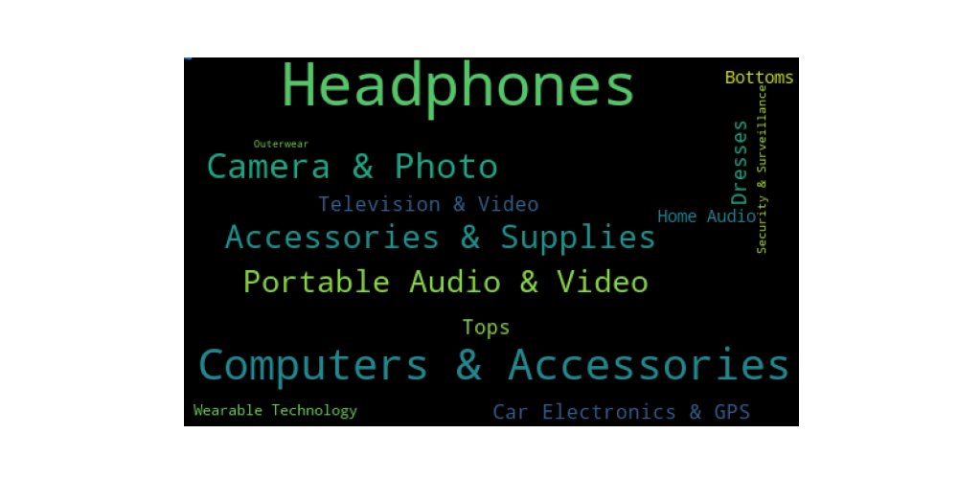
WORDCLOUD OF THE DATASET
Here we have taken the wordcloud plot of the csv dataset of clothes and electronics combined. The wordcloud shows us some important keywords regarding the dataset .

Slide 11
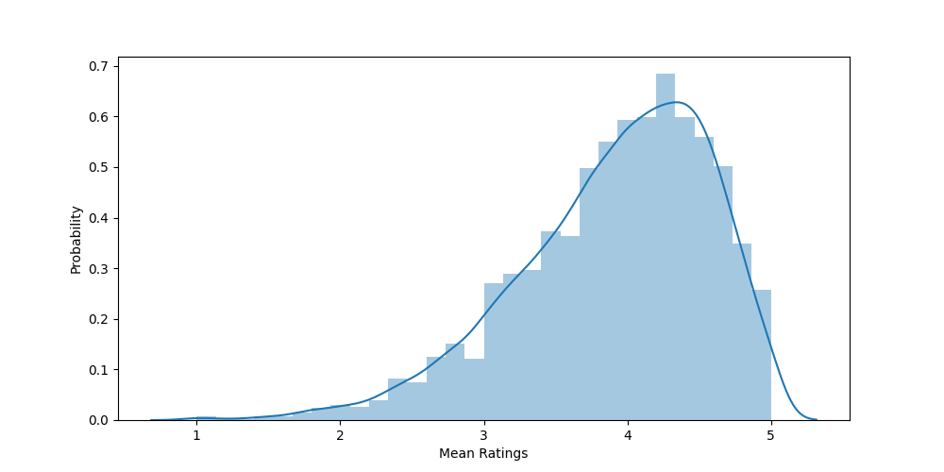
Mean - rating plot of the concatenated Dataset
Here we have taken the plot of mean ratings of the csv dataset of clothes and electronics combined. The matplotlib plot shows us the distribution of ratings users has given .

Slide 12
MODEL TRAINING
FOR MODEL TRAINING WE HAVE USED BOTH POPULARITY AND COLLABORATIVE FILTERING MODELS AND OBSERVED IT’S DIFFERENCE .
The Popularity-based recommender system is a non-personalised recommender system and these are based on frequecy counts, which may be not suitable to the user.We can see the differance above for the users, The Popularity based model has recommended the same set of 5 products to both but Collaborative Filtering based model has recommended entire different list based on the user past purchase history.
Model-based Collaborative Filtering is a personalised recommender system, the recommendations are based on the past behavior of the user and it is not dependent on any additional information.

Slide 13
COLLABORATIVE FILTERING :
Collaborative filtering is a popular technique used in recommendation systems to make automatic predictions (filtering)
about the interests of a user by collecting preferences from many users (collaborating). It's based on the idea that users who
agreed in the past will agree again in the future.
Collaborative filtering approaches can be broadly categorized into two types:
1. User-Based Collaborative Filtering:
User-based collaborative filtering recommends items to a user based on the preferences and behaviors of similar users. The idea is to find users who are similar to the target user and then recommend items that those similar users have liked or interacted with.
2. Item-Based Collaborative Filtering:
Item-based collaborative filtering recommends items to a user based on the similarity between items. It looks at which items a user has interacted with and recommends similar items based on historical interactions.

Slide 14
LIMITATIONS OF OUR MODEL (COLLABORATIVE FILTERING APPROACH ):
Collaborative filtering is a powerful recommendation technique, but it also comes with certain limitations and challenges that need to be addressed for its effective implementation. Here are some of the main limitations of collaborative filtering:
Cold Start Problem:
Collaborative filtering struggles with new users or items that lack sufficient historical interaction data. Since recommendations are based on existing user-item interactions, it's challenging to make accurate predictions for users who have just joined the platform or for items that are newly introduced.
Sparsity:
User-item interaction matrices are often sparse, meaning that most users have only interacted with a small fraction of available items. This sparsity can make it difficult to find similar users or items, leading to less accurate recommendations.
Scalability:
As the number of users and items grows, calculating similarity between all pairs of users or items can become computationally expensive and time-consuming. This can limit the real-time performance of collaborative filtering algorithms.

Slide 15
Things to Improve In The Model
Improving a collaborative filtering model involves addressing its limitations and enhancing its performance. Even after using SVD technique and a hybrid approach (with popularity based filtering) there are still many eooms to fill in this method . Here are several strategies we can consider to enhance your collaborative filtering recommendation system
Implicit Feedback Handling:
Collaborative filtering can benefit from handling implicit feedback (e.g., views, clicks) in addition to explicit feedback (e.g., ratings). Techniques like implicit matrix factorization and weighted factorization can be effective.
Embedding Techniques:
Utilize deep learning techniques like embedding layers to learn dense representations of users and items. Neural network-based models can capture intricate relationships and perform well in complex scenarios.
Contextual Information:
Incorporate contextual information such as time, location, and device into our model. Contextual data can enhance the relevance of recommendations.
and some more .....

Slide 16

Thank You

