Slide 1
VANI
Voice Analysis & Neural Intelligence System
Whisper ASR Fine-Tuning Report
LoRA Domain Adaptation for 7 Border-Region Languages
M.Tech Research Project · IIT Indore · 2026
Hardware: NVIDIA RTX 5060 8 GB · Windows 11 · CUDA · faster-whisper CT2 int8
7 Languages · LoRA r=8/16 · CTranslate2 int8 · Fully Offline
1

Slide 2
01
Introduction & Problem Statement
What VANI is, and the operational problem it solves
2

Slide 3
INTRODUCTION
Introduction & Problem Statement
VANI — an offline AI system that turns foreign-language radio intercepts into English intelligence summaries, on a single air-gapped workstation.
The Operational Problem
The Objective
✗ High-volume radio traffic in eight low-resource border languages (Punjabi, Pashto, Urdu, Nepali, Mandarin, Hindi, Kashmiri, Dogri)
▸ One end-to-end offline pipeline: speech → language ID → transcription → English translation → threat detection → structured intelligence summary
✗ Must run FULLY OFFLINE / air-gapped — no cloud, no internet at runtime
▸ Best-in-class ASR per language, auto-selected by audio language identification
✗ Generic ASR fails on these languages AND on the noisy, band-limited radio channel
▸ Rigorous, reproducible evaluation to choose the right ASR backend — under realistic radio noise
✗ Manual transcription + translation does not scale to an operational intercept volume
▸ A usable analyst GUI: map, dashboard, search, live-mic capture, coded-terminology alerts
✗ Analysts need actionable output (who / what / where / threat), not just a raw transcript
3

Slide 4
02
Deliverables
What was built and shipped
4

Slide 5
DELIVERABLES
Deliverables
Working VANI system
Streamlit GUI processing radio intercepts end-to-end, fully offline on one RTX 5060 workstation
7-language ASR backend
SeamlessM4T v2, auto-selected by MMS-LID; 4 languages on LoRA adapters, 3 zero-shot
Full intelligence pipeline
VAD → LID → ASR → NLLB translation → keyword/threat detection → ISUM (Gemma 3) → SQLite + reports
Backend-selection research
Head-to-head WER + 5-condition robustness study; 5 scoring-methodology defects found and corrected
Analyst features
Map + dashboard, transcript search, live-mic capture, coded-terminology alerts, speaker diarization
3-node LAN integration
Optional distributed mode: denoise+diarize (A) + LID/dialect (B) + VANI orchestrator (C)
Documentation
This fine-tuning report (PDF), presentation deck, correction memo, reproducible eval scripts
5

Slide 6
03
Architecture
The offline model stack, end to end
6

Slide 7
ARCHITECTURE
System Architecture
Single offline workstation · all models local (HF_HUB_OFFLINE) · GPU-resident with CPU parking on an 8 GB card
INPUT
PERCEPTION
UNDERSTANDING
OUTPUT
Radio intercept WAV
Silero VAD
NLLB-200 translation
Intelligence summary (5W)
→
→
→
Live microphone
MMS-LID-256 (language ID)
Keyword / threat detection
Map · dashboard · search
16 kHz mono
SeamlessM4T v2 ASR
(4 LoRA + 3 zero-shot)
Gemma 3 ISUM (Ollama)
SQLite transcript store
Backend selection (Stage 3.5): MMS-LID routes each language to its best ASR backend. All 7 languages now run on SeamlessM4T v2 — Hindi/Nepali/Pashto/Kashmiri with per-language LoRA adapters, Punjabi/Urdu/Mandarin zero-shot. Fine-tuned Whisper models are retained on disk for rollback only.
7

Slide 8
04
Pipeline
How one intercept flows through ten stages
8

Slide 9
PIPELINE
VANI 10-Stage Intelligence Pipeline
1
VAD
Silero — detect speech, discard silence
2
Preprocessing
Bandpass 300–3400 Hz + noise reduction + normalise
3
MMS-LID
Facebook MMS 256-language ID — route to correct model
4
ASR
SeamlessM4T v2, per-language backend (LoRA / zero-shot)
5
Script Cascade
Arabic-script override: >20% Nastaliq → Urdu routing
6
Translation
NLLB-200 distilled 600M → English transcription
7
Diarization
Speaker separation — up to 4 speakers identified
8
Keywords
Multilingual keyword + threat-entity detection
9
ISUM
Gemma 3:12B (Ollama) → 4-sentence Intel Summary
10
Export
SQLite + JSON output + Streamlit web UI (offline)
9

Slide 10
05
Features
Analyst-facing capabilities
10

Slide 11
FEATURES
Features
Multilingual ASR
Audio Language ID
7 border languages auto-routed by LID; turbo fallback for others
MMS-LID 256-language model + Arabic-script cascade
English Translation
Threat Detection
NLLB-200-distilled; IndicTrans2 for Dogri
Keyword + entity spotting with a coded-terminology lexicon
Intelligence Summary
Speaker Diarization
5W structured ISUM via Gemma 3 (Ollama), offline
Who-spoke-when; per-speaker tracks in 3-node mode
Fully Offline
GPU-Accelerated
Air-gapped runtime; no internet after model download
int8 CT2 + CPU parking to fit an 8 GB card
Searchable Database
Analyst GUI
SQLite transcript + summary store with full-text search
Map, dashboard, live-mic capture, network view
11

Slide 12
06
Results
Backend selection, robustness, and the headline WER win
12

Slide 13
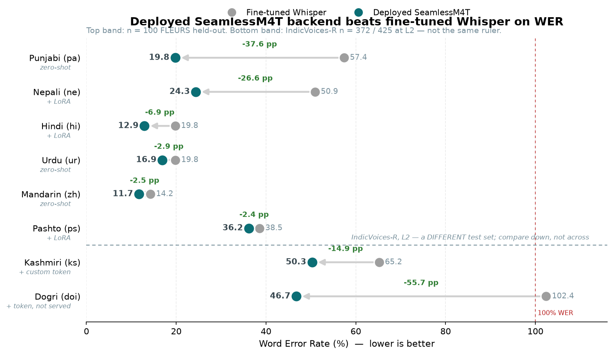
RESULTS
Result: SeamlessM4T surpasses fine-tuned Whisper on WER
All eight languages. Every one improves; the arrow points to the deployed backend. The two bands are DIFFERENT TEST SETS — top six are FLEURS n=100; Kashmiri and Dogri are absent from FLEURS, so they are IndicVoices-R (n=372 / 425) at L2. Read the lower band down its own column, not across. Dogri's 102.4% is what the system actually did before it had a Dogri model — misrouted audio, more errors than reference words.
13

Slide 14
COMPARISON
Cross-Model Benchmark — FT Whisper · NLLB · SeamlessM4T
n=100 FLEURS test / IndicVoices-R · re-run 11 Jul 2026, corrected scoring · ASR: WER ↓ better · Translation: chrF ↑ better · Baseline = true large-v3 (not turbo) · SM4T = SeamlessM4T-large-v2
Language
Script
Baseline
WER (%)
FT Whisper
WER (%)
SeamlessM4T
WER (%)
Deployed
Backend
NLLB-200
chrF ↑
SeamlessM4T
chrF ↑
Best Transl.
Model
Punjabi (pa)
Gurmukhi
77.60
57.39
19.77
SM4T
40.15
54.53
SM4T
Pashto (ps)
Nastaliq
89.76
38.55
44.40
SM4T+LoRA
44.48
40.15
NLLB
Urdu (ur)
Nastaliq
21.23
19.82
16.90
SM4T
51.34
50.73
NLLB
Nepali (ne)
Devanagari
88.85
50.92
28.46
SM4T
45.55
51.67
SM4T
Mandarin (zh)
Han Simpl.
10.99
14.22
11.69
SM4T
42.00
49.15
SM4T
Hindi (hi)
Devanagari
26.34
19.78
15.44
SM4T
53.71
51.54
NLLB
Kashmiri (ks)‡
Nastaliq
—
65.19
50.26
SM4T+tok
—
—
N/A
Zero-shot SeamlessM4T wins ASR for pa / ne / hi / ur / zh. Pashto and Kashmiri were fine-tuned Whisper's last strongholds; both fell in 2026-07 to SeamlessM4T LoRA adapters (ps: noise-augmented training; ks: a trainable __kas__ embedding row, rank 128 and a 20-character vocabulary repair, plus a scoring-ruler correction — see notes). VANI now routes all 7 languages to SeamlessM4T; FT Whisper models are retained on disk for rollback only. ‡ Kashmiri is absent from FLEURS: its two figures are the 372-clip IndicVoices-R test split at L2, not this table's FLEURS n=100 ruler, and are held-out rather than training-split. The two rulers are not comparable across a row.
14

Slide 15
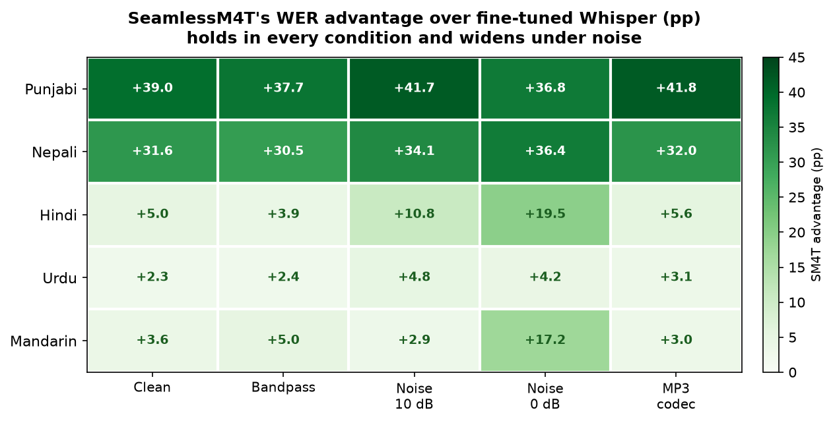
RESULTS
Result: the advantage holds — and widens — under radio degradation
SeamlessM4T's WER advantage over fine-tuned Whisper (percentage points), across five channel conditions on 30 clips/language. Positive everywhere; Hindi (+5→+19.5) and Mandarin (+3.6→+17.2) widen most at 0 dB SNR. Conservative zero-shot comparison — the deployed hi/ne LoRA adapters improve on this further.
15

Slide 16
ROBUSTNESS EVAL
Radio-Channel Robustness — LangID Accuracy (%)
5 degradation conditions × 7 languages × 4 pipeline configs | 30 samples/lang | 1-Jul-2026 | cells = MMS language-ID accuracy (%), higher is better
Channel
Condition
Pipeline
Config
PA
HI
UR
NE
ZH
PS
KS
Overall
Avg
Clean
Whisper
90%
87%
73%
27%
100%
0%
0%
54%
Full VANI
90%
83%
70%
33%
100%
80%
17%
68%
Bandpass
Whisper
70%
83%
33%
27%
100%
0%
0%
45%
Full VANI
73%
83%
33%
27%
100%
83%
23%
61%
AWGN 10dB
Whisper
97%
63%
80%
43%
100%
0%
0%
55%
Full VANI
97%
63%
80%
43%
100%
83%
3%
67%
AWGN 0dB
Whisper
57%
63%
27%
13%
100%
0%
0%
37%
Full VANI
60%
67%
27%
17%
97%
53%
0%
46%
MP3 16kbps
Whisper
77%
47%
63%
23%
100%
0%
0%
44%
Full VANI
77%
47%
63%
23%
97%
87%
20%
59%
ZH: most robust (97–100% all conditions) · PS: MMS-LID essential, Whisper-only = 0% · Full VANI avg +14 pp over Whisper-only
16

Slide 17
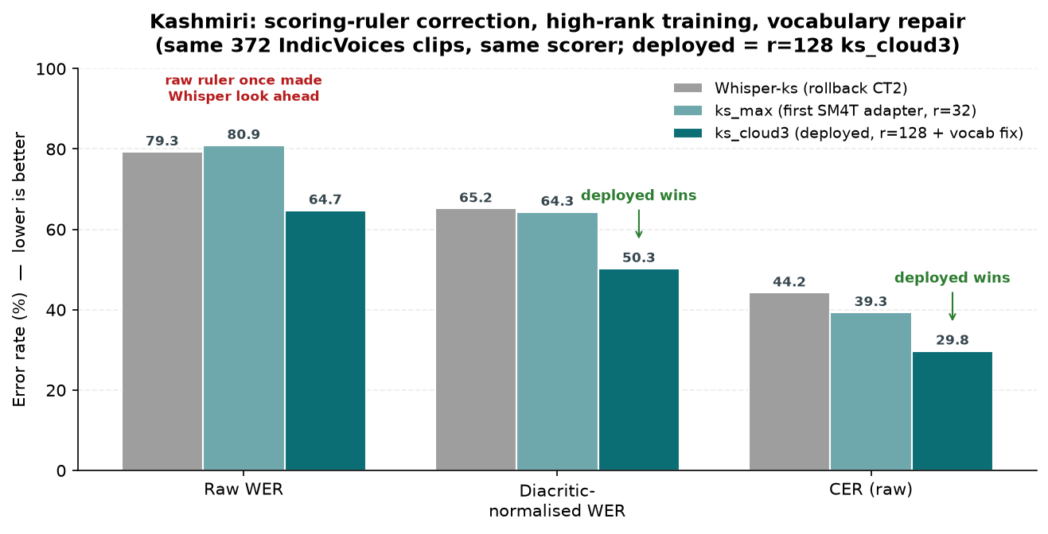
RESULTS
Result: Kashmiri — the WER gap was the scoring ruler, not the model
Raw word-error rate once made Whisper look ahead of the first adapter, but Perso-Arabic references are densely diacritised and BOTH systems drop the marks — the gap was the ruler. Corrected, every successive adapter widens the win: the deployed r=128 ks_cloud3 (rented cloud GPU, plus a repaired vocabulary) leads on all three measures and won the 5-condition degradation sweep 5/5.
17

Slide 18
RESULTS
From Whisper fine-tuning to SeamlessM4T — how the backend was chosen
Seven Whisper LoRA models were fine-tuned first; a corrected evaluation then showed SeamlessM4T wins, and a targeted adapter campaign brought all seven languages onto it.
1 · Fine-tune Whisper
7 languages, LoRA r=8/16 on FLEURS + IndicVoices-R. Kashmiri needed a custom <|ks|> vocab token.
2 · Correct the scoring
Found the baseline was mislabelled turbo, and Mandarin WER was a whitespace artefact. Re-scored with one CJK-aware normaliser.
3 · Head-to-head + robustness
Zero-shot SeamlessM4T beat fine-tuned Whisper on 5/6 languages and held under bandpass/noise/codec.
4 · Adapter campaign
hi/ne gained from IndicVoices data; Pashto fell to noise-augmented training; Kashmiri to a trainable __kas__ token + a ruler correction.
5 · Cloud capacity push
Rented A6000s (~$11) retrained ps+ks at r=128 — beyond the 8 GB laptop: Pashto 36.91→36.16, Kashmiri 61.88→50.26 (3.84 pp from simply letting the run converge, then 2.34 pp from repairing the vocabulary). Both passed their gates and deployed.
6 · Exhausting the levers
Two honest negatives closed the campaign: a warm start improved validation loss but LOST 0.43 pp WER (5th loss/WER divergence), and beam search gains ~3 pp on clean speech while losing ~3 pp at 0 dB SNR. Production decoding unchanged.
7 · Outcome
All 7 languages route to SeamlessM4T. Kashmiri 65.19 → 50.26 on one held-out L2 ruler. What remains is a data/acoustic limit, not an optimisation one. Five scoring defects caught in total.
18

Slide 19
RESULTS
Training hours & dataset sizes — the closing adapter campaign
Measured, not estimated: THREE surviving Whisper runs alone came to 103 laptop GPU-hours, and 62% of that was periodic evaluation, not training. The 19 local adapter runs spent 4.7 h evaluating between them. The two production adapters that closed the campaign cost ~$6 of rented cloud compute, total.
Run
Language
Training data (clips / hours)
LoRA r
Hardware
Wall time
Result
Status
ks_max2
Kashmiri
97,456 / 240 h — humair025 + IV-R + OpenSLR-122
32
RTX 5060 8 GB
~19 h
61.88%
Rollback
ps_aug2
Pashto
32,656 / ~55 h — CV 30k + FLEURS ps_af x8
32
RTX 5060 8 GB
~5 h
37.46%
Negative
ks_cloud
Kashmiri
144,749 / 335 h — same 3 sources, rebuilt (grown)
128
A6000 48 GB ☁
6 h 35 m
56.44%
Rollback
ks_cloud2
Kashmiri
144,749 / 335 h — as ks_cloud, 2 epochs (patience 5)
128
A6000 48 GB ☁
~9 h
52.60%
Rollback
ks_cloud3
Kashmiri
144,942 / 336 h — as ks_cloud2 + 20 vocab chars repaired
128
A6000 48 GB ☁
~8 h
50.26%
DEPLOYED
ks_cloud4
Kashmiri
as ks_cloud3, warm start, token rows at 5x LR
128
A6000 48 GB ☁
~1 h
50.69%
Rejected
ps_cloud
Pashto
18,656 / ~30 h — CV 10k + FLEURS ps_af x8
128
A6000 48 GB ☁
1 h 32 m
36.16%
DEPLOYED
doi_iv
Dogri
IndicVoices-R Dogri — 97 shards, 43.8 GB
128
A6000 48 GB ☁
~6 h
50.07%
cut short
doi_iv2
Dogri
as doi_iv, fresh LR schedule, 9,000 steps
128
A6000 48 GB ☁
~9 h
46.73%
BEST
Kashmiri result = diacritic-normalised WER, 372-clip IndicVoices-R test · Pashto result = clean FLEURS ps_af, n=100.
19
Cloud runs: rented RTX A6000s at $0.53/hr — ks_cloud ≈ $4, ks_cloud2 ≈ $5, ks_cloud3 ≈ $4, ps_cloud ≈ $2. Corpus rebuilt from source on the box;
humair025 had grown upstream → 144,749 clips / 335.4 h (131,868 unique sentences), 2–20 s filter, eval-leak blocklist applied.
The decisive lever was CAPACITY (r=128 = 6.6% trainable vs r=32 = 1.75%) — more data at unchanged capacity regressed (ps_aug2).

Slide 20
RESULTS
Renting capacity: the RunPod cloud runs — Kashmiri & Pashto
The 8 GB laptop caps LoRA at rank 32. Rank 128 trains 6.6% of the model (~107 M parameters) against rank 32's 1.75% — it simply does not fit. Five runs on a rented RTX A6000 48 GB settled both open languages.
Kashmiri
Pashto
Total spend
-11.63 pp
-0.75 pp
~$15
61.88% -> 50.26% · p < 0.001
36.91% -> 36.16% · p = 0.32, n.s.
RTX A6000 48 GB @ $0.53/hr
KASHMIRI — three levers, three separate wins
PASHTO — capacity did not help
Run
What changed
WER
Δ
Verdict
ps_cloud · rank 128, 18,656 clips / ~30 h
1 h 32 m on the A6000 · ~$2
36.91% -> 36.16%
-0.75 pp, 95% CI [-2.23, +0.70]
p = 0.32 — NOT significant
Deployed anyway, on the reasoning that
the newer of two indistinguishable
adapters is a defensible choice under
uncertainty — but the margin is a tie,
not a win, and is reported as one.
ks_max2
laptop baseline, rank 32
61.88%
—
ks_cloud
rank 32 -> 128, corpus rebuilt 145k / 335 h
56.44%
-5.44
capacity
ks_cloud2
same recipe, allowed to converge
52.60%
-3.84
p < 0.001
ks_cloud3
+ 20 unrepresentable characters repaired
50.26%
-2.35
p < 0.001
ks_cloud4
warm start, token rows at 5x LR
50.69%
+0.43
p = 0.24 ✗
DEPLOYED: ks_cloud3. Each lever was tested alone — capacity, then training length, then vocabulary.
What the money actually bought: capacity moved Kashmiri and did nothing measurable for Pashto. The two cheapest wins were not capacity at all — letting a run converge (~$5) and repairing 20 vocabulary characters (~$4) together beat the rank increase.
20

Slide 21
KEY FINDINGS
Key Findings & Technical Insights
01
LoRA Effective — but Rank Mattered More Than Expected
Full fine-tune (40+ GB VRAM) never needed. r=8/16 sufficed for Whisper; the SeamlessM4T campaign needed r=128 (6.6% of params) for Kashmiri — beyond the 8 GB laptop, hence the rented A6000.
02
20 Kashmiri Characters Were Missing from the Vocabulary
They encode to <unk> — 854,234 occurrences across 96.9% of training sentences. Of 747 test words containing the 4 affected letters, the model got 747 wrong. Repairing them: −2.35 pp (p < 0.001).
03
MMS-LID Critical for Pashto & Robustness
Whisper-only scores 0% on Pashto LangID. MMS-LID lifts it to 53–87% across 5 degradation conditions.
04
fp16 Gradient Explosion Risk at Low LR
Mandarin diverged at step ~820 (grad_norm=12.9, loss 0.15→0.77). Fix: max_grad_norm=0.5 for all subsequent.
05
CT2 Tokenizer Bug — All large-v3 Models Translated Not Transcribed
ct2-transformers-converter omits tokenizer.json. large-v3: translate=50359; tiny: transcribe=50359. One-token shift. Now automated.
06
Script Cascade Prevents Nastaliq Misidentification
>20% Nastaliq chars in transcript → Urdu override. Critical for noisy radio audio.
07
Full VANI +14 pp over Whisper-Only (Robustness Eval)
5 conditions × 7 langs × 4 configs. ZH: 97–100%. PS: MMS-LID essential. Mandarin most robust.
21

Slide 22
07
Future Work
Where VANI goes next
22

Slide 23
ROADMAP
Next Steps to Improve Accuracy
Written during the Whisper phase and since OVERTAKEN by results — four of these six were tried and are now settled, two of them negatively. Kept as a record of what was predicted against what happened.
1 · Scale Training Data — MIXED
2 · Increase Model Capacity — DONE
3 · Longer / Smarter Training — BIGGEST WIN
▸ DONE: ks 20k → 145k clips / 335 h
▸ r=32 → r=128 on a rented A6000 48 GB
▸ Two runs had stopped while still improving
▸ But data alone was NOT the lever: ps_aug2
▸ MLP adapters added, as proposed here
▸ Letting them converge: ks −3.84, doi −3.34 pp
▸ tripled Common Voice for no change (p=0.48)
▸ Kashmiri 61.88 → 56.44 (capacity alone)
▸ Both p < 0.001, ~$5 of GPU time each
▸ Harmful when it UNBALANCED the mixture
▸ Pashto: no significant gain (p = 0.32)
▸ Cheapest result of the entire campaign
4 · Radio-Domain Augmentation — DONE
5 · Decoding-Time Gains — REJECTED
6 · Recover Mandarin Headroom — DROPPED
▸ Bandpass + AWGN + MP3 applied to ps training
▸ Beam 8: clean 50.26 → 47.37; KenLM → 46.90
▸ Fine-tuning REGRESSED zh (10.99 → 14.22)
▸ ps_aug fixed the 0 dB collapse: 87% → 56%
▸ But ALL 7 configs regressed 0 dB by 2–3 pp
▸ Not worth resuming: zero-shot SeamlessM4T
▸ The decisive Pashto lever, not capacity
▸ Wrong direction for degraded radio
▸ already serves Mandarin at 11.69%
▸ Still open: SpecAugment, RIR, pseudo-labels
▸ Production stays greedy. Negative result.
▸ Whisper-zh retained for rollback only
23
Still genuinely open: the deployed decode path scores 2.07 pp worse than the evaluation path (ks 52.33 vs 50.26, p < 0.001) — unresolved. And Dogri is trained (46.73%) but NOT yet deployed.

Slide 24
Deployment & Conclusions
7 Models Fine-Tuned pa · ps · ur · ne · zh · hi · ks
Backend Selected per Language
All 7 Languages Now Run on SeamlessM4T
Dogri — 8th language TRAINED, not yet served
All CT2 int8, fully offline
SeamlessM4T ×7 · FT Whisper ×0
Whisper models kept only for rollback
46.73% (from 102.39%); deployment blocked
Production ASR Backend per Language
Next Steps
SeamlessM4T (zero-shot)
Punjabi
19.77%
Backend routing
DEPLOYED — SeamlessM4T for all 7 languages (hi/ne/ps/ks w/ LoRA)
SeamlessM4T + ps LoRA
Pashto
36.16%
Robustness
COMPLETE — 5 cond × 7 langs; SM4T lead holds under noise
SeamlessM4T (zero-shot)
Urdu
16.90%
SeamlessM4T + ne LoRA
Nepali
24.34%
Seamless timing
Per-utterance segments added; per-VAD-segment ASR live
SeamlessM4T (zero-shot)
Mandarin
11.69%
SeamlessM4T + hi LoRA
Hindi
12.91%
Reports
Regenerated from corrected n=100 scoring (this deck)
SeamlessM4T + ks LoRA
Kashmiri
50.26%*
Paper
ACM IKDD CODS 2026, Gandhinagar — deadline 13 Aug 2026; draft written
* ks: diacritic-normalised WER (raw is inflated by dense Perso-Arabic marks for BOTH systems). Deployed ks_cloud3 (r=128 + 20 repaired vocab chars) vs Whisper-ks 65.19 — see notes.
VANI · M.Tech Research · IIT Indore · 2026
24

