Slide 1
Introduction to Tidy Data & Data Manipulation with the tidyverse
OCRUG Hackathon – April 10, 2021

Slide 2
Goals for this module
Understand what tidy data is and why it's important for data analysis
Learn about the tidyverse and why it’s a great ecosystem for working with data in R
Learn about data manipulation operations using dplyr

Slide 3
Tidy Data

Slide 4
Quick note about the terms “messy” & “tidy”
Messy
Has negative connotations but that’s not the intent here
Messy data is simply data that’s not yet in a form suitable for analysis
Messy data doesn’t mean bad data
Tidy
Has positive connotations but that’s not the intent here either
Tidy data is data in a consistent format that supports the analysis process
Tidy data doesn’t mean good data
In the R ecosystem, the term “tidy data” has a very specific meaning
(that we’ll get to soon)

Slide 5
The Anna Karenina principle...
Happy families are all alike; every unhappy family is unhappy in its own way.
– Leo Tolstoy
Notes:
https://en.wikipedia.org/wiki/Anna_Karenina_principle

Slide 6
... applies to data too
Tidy datasets
Happy families are all alike; every unhappy family is unhappy in its own way.
messy dataset
messy
– Hadley Wickham
Notes:
https://r4ds.had.co.nz/tidy-data.html

Slide 7


Messy data
Most “real world” data starts out messy...
All tidy data has similar structure...
...which makes it hard to work with.
...making it easier to work with since you know what to expect

Slide 8
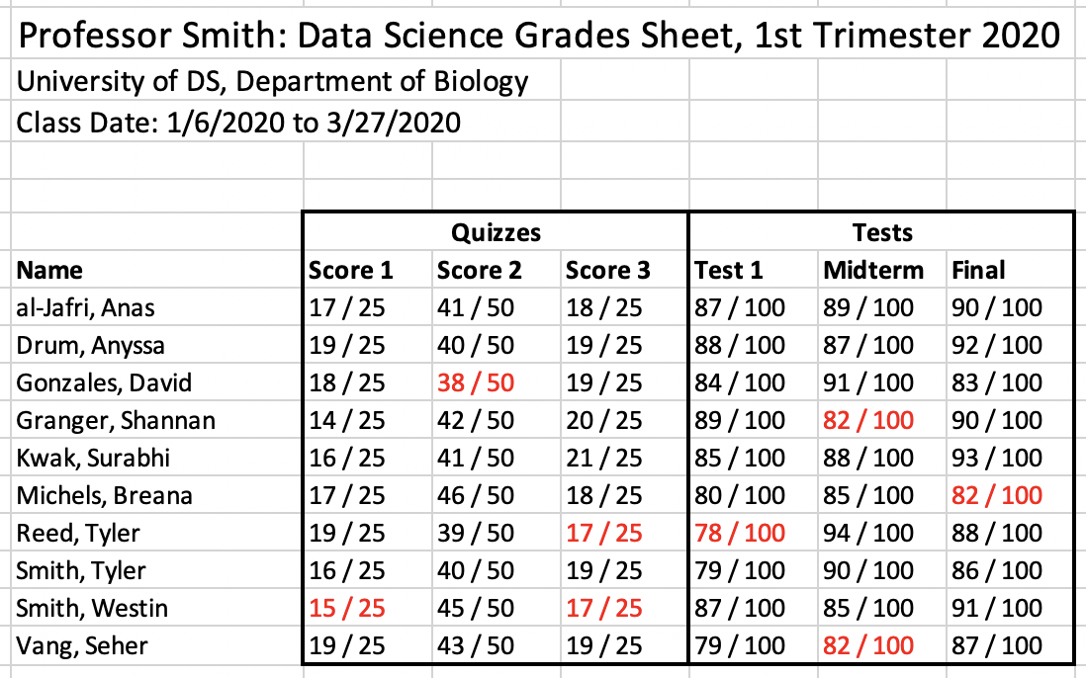
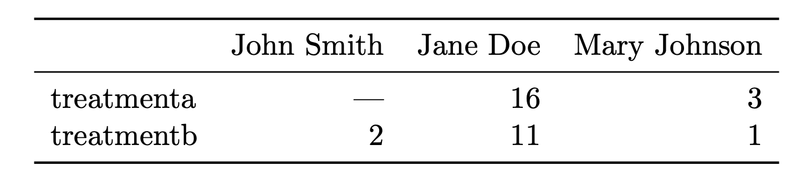
Data can be messy in all kinds of ways
Excel spreadsheet with complex formatting
Data tables in PDF (or even images!)
Tidy Data, H. Wickham, J. Stat. Software
Badly formatted text files
1, 4, 5, 6, 10
10,000, 900, 874
5,6,8
7473,134187,1398,17
Proprietary data formats 💾
Data in web pages, plots & figures, ...

Slide 9
Messy data can be hard to work with
Unclear structure & organization can make it hard to understand what’s there
Data might be optimized for data entry or visual consumption, not computer consumption
Might be represented in a strange ways (e.g. numbers combined with words, unclear coding variables)
Might be in multiple places (e.g. in different files)
Might be in strange formats (html, pdf, png 🙀)

Slide 10
Messy data isn’t necessarily bad data
Not all data is created or presented with data analysis in mind
The people who curate the data might not understand the needs of someone who needs to work with it
The goals for the data might not align directly with data analysis needs (presenting data on a slide, performance or storage requirements)
... but messy data might be a sign of lurking data problems too 🕵️‍♂️

Slide 11
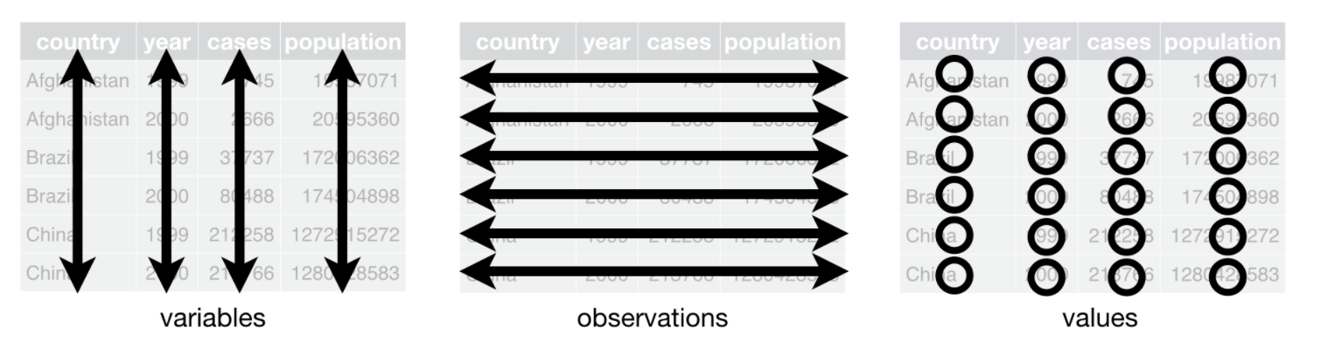
Tidy data in the R ecosystem
Tidy data has consistent structure, arranged in a rectangular table
Variables (columns) the “things” you are measuring
Observations (rows) the “things” you are making measurements on
Values
(cells) the values of the measurements
figure: https://r4ds.had.co.nz/tidy-data.html

Slide 12
Example Tidy Data Table
make_model | mpg | cyl | disp | hp | drat | wt | qsec | vs | am | gear | carb
Mazda RX4 | 21 | 6 | 160 | 110 | 3.9 | 2.62 | 16.46 | 0 | 1 | 4 | 4
Mazda RX4 Wag | 21 | 6 | 160 | 110 | 3.9 | 2.875 | 17.02 | 0 | 1 | 4 | 4
Datsun 710 | 22.8 | 4 | 108 | 93 | 3.85 | 2.32 | 18.61 | 1 | 1 | 4 | 1
Hornet 4 Drive | 21.4 | 6 | 258 | 110 | 3.08 | 3.215 | 19.44 | 1 | 0 | 3 | 1
Hornet Sportabout | 18.7 | 8 | 360 | 175 | 3.15 | 3.44 | 17.02 | 0 | 0 | 3 | 2
Valiant | 18.1 | 6 | 225 | 105 | 2.76 | 3.46 | 20.22 | 1 | 0 | 3 | 1
Duster 360 | 14.3 | 8 | 360 | 245 | 3.21 | 3.57 | 15.84 | 0 | 0 | 3 | 4
Merc 240D | 24.4 | 4 | 146.7 | 62 | 3.69 | 3.19 | 20 | 1 | 0 | 4 | 2
Merc 230 | 22.8 | 4 | 140.8 | 95 | 3.92 | 3.15 | 22.9 | 1 | 0 | 4 | 2
Merc 280 | 19.2 | 6 | 167.6 | 123 | 3.92 | 3.44 | 18.3 | 1 | 0 | 4 | 4
What is this table about?
What does each row represent?
What is being measured (what are the columns)?

Slide 13
A few notes about tidy data
Tidy data is not the only way
Other structures might be needed to optimize for performance or storage
Certain fields might follow other data conventions
Some types of data might not naturally fit into a rectangular table
BUT, if your data can fit into rectangular structure, tidy data is usually the way to go
Sometimes the differences between observations and variables is not always clear, and you might swap them depending on the context
Data tidiness isn’t necessarily black & white, different circumstances might require different levels of tidiness

Slide 14
Be on the lookout for signs of messy data!
Overall structure of the data is unclear or inconsistent
Multiple pieces of information are stored in a single cell, e.g. Male_age16, Female_age42
A variable is spread across multiple columns
An observation is spread across multiple rows
As you get more experience recognizing messy data, you can better communicate to others (i.e. collaborators) how to produce well structured data in order to make your job easier as a data analyst!

Slide 15
Going from messy to tidy data takes work!
The "dirty" secret of being a data scientist: a non-trivial amount of time is spent cleaning up data
Sometimes messy data can be cleaned-up by hand, but this is not optimal: time consuming, error-prone, tedious
Successful data scientists assemble a "toolkit" of methods/techniques for manipulating data using code
In R, the tidyr package provides useful functions for to help make messy data tidy

Slide 16
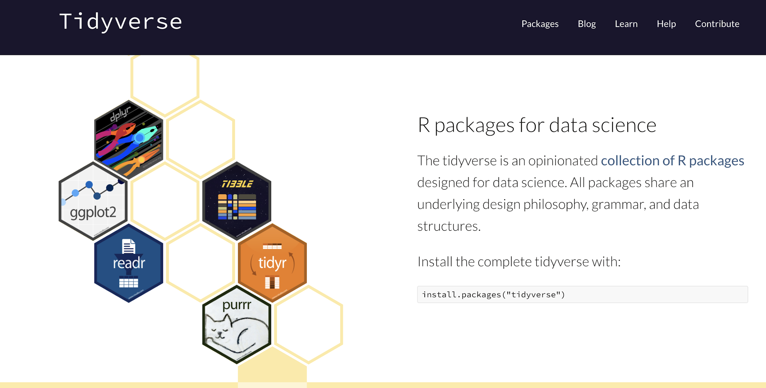
The Tidyverse An opinionated collection of R packages for data science
Once you know the general structure of the input data (i.e. tidy data), you can build all kinds of tools to work with it
That’s the tidyverse!
https://www.tidyverse.org

Slide 17








The tidyverse covers the fundamental components of the data analysis workflow
Core tidyverse Packages
Data Visualization
Read Data
Tidy Data
Fundamental Data Manipulation & Pipelines
Manipulate Specific Types of Data
https://www.tidyverse.org
And LOTS of other packages developed by others...

Slide 18
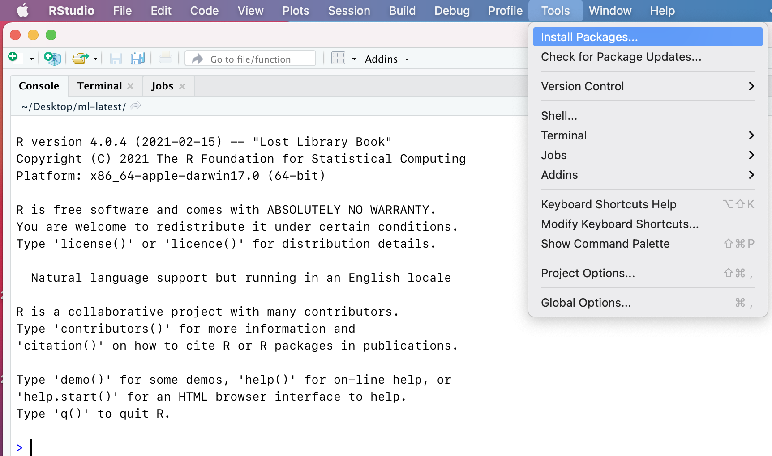
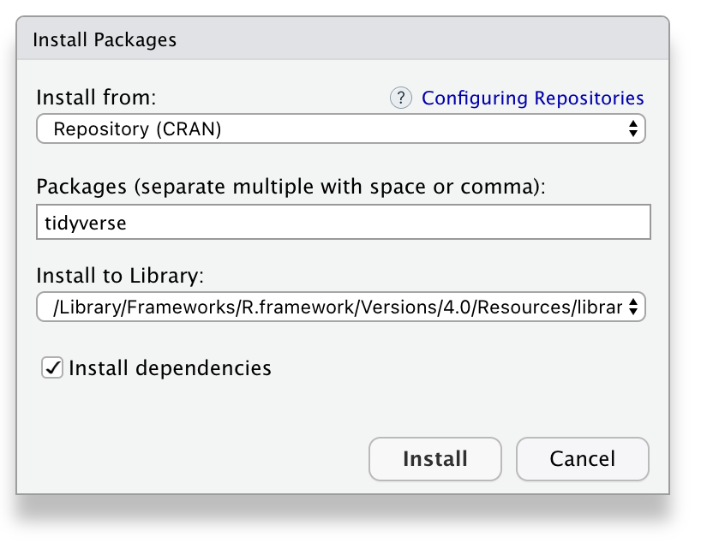
Installing the core tidyverse packages is easy
From RStudio
From the R Console
install.packages("tidyverse")
The tidyverse package is just a wrapper
It will install the core tidyverse packages for you

Slide 19
Recap
Tidy data is well structured data that's ready for analysis
In a tidy data table
each row is an observation
each column is a variable
each (individual) piece of data goes in its own cell
Messy data is everywhere – as you get more proficient with R, you'll learn how to better deal with messy data
The tidyverse leverages the well-structured nature of tidy data to provide awesome tools for working with data

Slide 20
Basic Data Manipulation with dplyr

Slide 21
dplyr is a tidyverse R package for data manipulation
Defines the fundamental operations that encompass most data analysis tasks
Assumes you already have tidy data
Uses a pipeline coding structure to perform complex operations a straight-forward, natural way

Slide 22
dplyr defines data manipulation verbs
dplyr formalizes the fundamental operations that occur when working with data into a set of “verbs”
These verbs are represented as functions that you can use to manipulate data in R
There are a small number of these verbs, which makes them easy(er) to remember and work with
Helps you to focus on the question you want to answer rather than the mechanics of how to answer the question

Slide 23
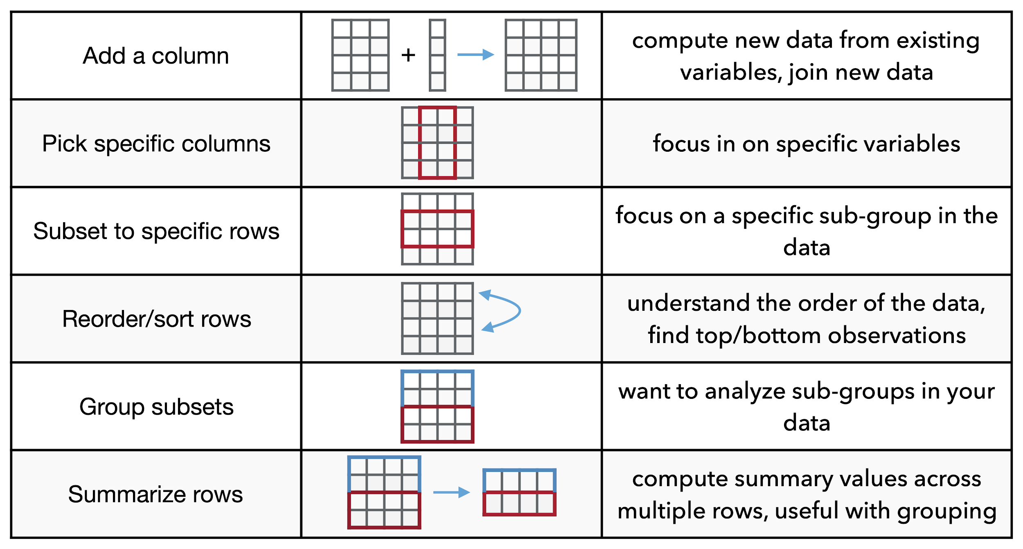
Fundamental data manipulation operations
Operation
Use case

Slide 24
Fundamental data manipulation operations
Operation
Use case
dplyr verb
mutate
select
filter
arrange
group_by
summarize

Slide 25
We'll use this table for the following examples
 | mpg | cyl | disp | hp | drat | wt | qsec | vs | am | gear | carb
Mazda RX4 | 21 | 6 | 160 | 110 | 3.9 | 2.62 | 16.46 | 0 | 1 | 4 | 4
Mazda RX4 Wag | 21 | 6 | 160 | 110 | 3.9 | 2.875 | 17.02 | 0 | 1 | 4 | 4
Datsun 710 | 22.8 | 4 | 108 | 93 | 3.85 | 2.32 | 18.61 | 1 | 1 | 4 | 1
Hornet 4 Drive | 21.4 | 6 | 258 | 110 | 3.08 | 3.215 | 19.44 | 1 | 0 | 3 | 1
Hornet Sportabout | 18.7 | 8 | 360 | 175 | 3.15 | 3.44 | 17.02 | 0 | 0 | 3 | 2
Valiant | 18.1 | 6 | 225 | 105 | 2.76 | 3.46 | 20.22 | 1 | 0 | 3 | 1
Duster 360 | 14.3 | 8 | 360 | 245 | 3.21 | 3.57 | 15.84 | 0 | 0 | 3 | 4
Merc 240D | 24.4 | 4 | 146.7 | 62 | 3.69 | 3.19 | 20 | 1 | 0 | 4 | 2
Merc 230 | 22.8 | 4 | 140.8 | 95 | 3.92 | 3.15 | 22.9 | 1 | 0 | 4 | 2
Merc 280 | 19.2 | 6 | 167.6 | 123 | 3.92 | 3.44 | 18.3 | 1 | 0 | 4 | 4
… many more rows
This is the mtcars data set, part of the standard R installation
You can access the data table from the mtcars variable

Slide 26
Using dplyr verbs (functions)
The first argument of a dplyr function is always the data frame that you want to operate on, e.g. mutate(mtcars, …) – adds a column to mtcars select(mtcars, …) – subsets to specific columns of mtcars
The … above are additional arguments that further define what the operation is going to do
dplyr verbs always give back a data frame mtcars2 <- mutate(mtcars, …) mtcars2 is a data frame that has a new column

Slide 27
dplyr verb examples: mutate
You use mutate when you want to add a new column to your data frame, often based upon existing columns
# load the tidyverse package
library(tidyverse)
# add a new column that is the quarter-mile time in minutes
mtcars2 <- mutate(mtcars, qmin = qsec / 60)
Assign the output of mutate to a new variable
It's also common to reassign to the same variable
name of the new column that will be created
Note: you don't use quotes around the column names
the expression that will be used to fill in the values

Slide 28
dplyr verb examples: select
You use select when you to to get specific columns, or get rid of ones you don't want
# get only the miles per gallon and horsepower columns
mtcars2 <- select(mtcars, mpg, hp)
# remove the weight column
mtcars2 <- select(mtcars, -wt)
input table always comes first
the subsequent arguments specify the columns to keep
This will give you all the columns in mtcars except for wt

Slide 29
dplyr verb examples: filter
You use filter when you to to get specific rows, very often specified using a conditional expression
# only get the cars with 4 cylinders
mtcars2 <- filter(mtcars, cyl == 4)
# only get the cars with horsepower above 200
mtcars2 <- filter(mtcars, hp > 200)
# only get the cars with 4 cylinders AND horsepower above 200
mtcars2 <- filter(mtcars, cyl == 4, hp > 200)
Use conditional expressions to specify which rows you want to keep
Multiple expression are combined with the AND operator (use | for or)

Slide 30
dplyr verb examples: arrange
You use arrange when you want to re-order the rows of a data frame
# sort the rows by miles/gallon, from low to high
mtcars2 <- arrange(mtcars, mpg)
# use desc to reverse the sorting (high to low)
mtcars2 <- arrange(mtcars, desc(mpg))
sorting will occur using R's sorting rules depending on the data type being used

Slide 31
dplyr verb examples: group_by + summarize
These two verbs are often used together, when you want to group by a particular column and compute summaries for each group
# compute the average miles/gallon for each cylinder type (count)
mtcars_grouped <- group_by(mtcars, cyl)
summarize(mtcars_grouped, mean_mpg = mean(mpg))
makes 3 groups, one for each cylinder type (4, 6, 8)
for each individual group…
compute a new column…
that's the mean mpg for each cylinder group
How many rows will this expression return?

Slide 32
The pipe operator: %>%
The pipe operator takes an input data frame and “feeds” it into a function … the function performs an operation on the input data
In code, the pipe operator is three individual characters
Yes -- it looks strange
Think of %>% as a pipe, funneling the input data into the function to do some work
tidy data frame
%>%
dplyr verb
produces a
modified data frame

Slide 33
The pipe operator: %>%
Template
tidy data frame
%>%
dplyr verb
produces a
modified data frame
tidy data frame
%>%
mutate
produces a
modified data frame with a new column
tidy data frame
%>%
select
produces a
modified data frame with selected columns
tidy data frame
%>%
filter
produces a
modified data frame with filtered rows

Slide 34
Practice with pipes
R Code without pipes
filter(mtcars, cyl == 4)
R Code with pipes
mtcars %>% filter(cyl == 4)
Both lines of code do exactly the same thing, but are written differently
Can you spot the differences?

Slide 35
Practice with pipes
filter(mtcars, cyl == 4)
mtcars %>% filter(cyl == 4)
Two different ways to code the same thing
Take the first argument (the input data frame),
move it to the front, and add a pipe, %>%

Slide 36
The pipe operator can chain multiple verbs (pipeline!)
tidy data frame
%>%
dplyr verb
produces a
modified data frame
modified data frame
%>%
dplyr verb
produces another
modified data frame
tidy data frame
%>%
dplyr verb
%>%
dplyr verb
%>%
dplyr verb
...
You can chain (pipe) together dplyr verbs to produce pipelines that embody complex manipulations

Slide 37
dplyr pipeline example
Do the following with the mtcars data set:
remove cars with 6 cylinders, then…
compute the mean horsepower for cars group by the number of gears they have, then…
order the results by descending mean horsepower
# accomplish the above steps in a dplyr pipeline
mtcars %>%
filter(cyl != 6) %>%
group_by(gear) %>%
summarize(mean_hp = mean(hp)) %>%
arrange(desc(mean_hp))
Using the mtcars data table…
filter out cars with 6 cylinders…
then group by the number of gears…
and compute the mean horsepower…
then order the results by descending mean horsepower.
The code reads very similar to how you'd describe the process in words!
Note: dplyr pipelines can (and often are) placed on multiple lines (make sure %>% is at the end of a line)

Slide 38
Recap
dplyr provides a general framework for manipulating tidy data
The fundamental manipulations are specified as verbs (functions)
These verbs can be combined (piped) together to create data processing pipelines
Often, these pipelines can often be translated from “human-form” to R code in a straight-forward, natural way
dplyr helps you to focus on answering the question rather than the mechanics of how to answer the question

Slide 39
Resources
Paper on tidy data by H. Wickham https://vita.had.co.nz/papers/tidy-data.pdf
R For Data Science, section on tidy data https://r4ds.had.co.nz/tidy-data.html
tidyr package website https://tidyr.tidyverse.org
Data importing cheat sheet https://github.com/rstudio/cheatsheets/blob/master/data-import.pdf

