Slide 1
Introduction to Data Visualization with ggplot2
OCRUG Hackathon – April 10, 2021

Slide 2
Goals for this module
Learn about the grammar of graphics and how to become a data visualization "chef" (instead of a data viz customer)
Learn about the ggplot2 R package
Learn essential ggplot2 syntax and create basic data visualizations

Slide 3
A few notes
ggplot2 is a deep package – it will take some time to learn and master all that's there
This intro tutorial just scratches the surface, not complete (at all…)
One of the hardest things about ggplot2 is the syntax
even a simple plots require more code vs. base R
plot code can have lots of pieces to keep track of
lots of parentheses
when to use quotes and when not to
ggplot2 is not the easiest plotting library to learn, but its power and flexibility are worth the learning curve

Slide 4
Ggplot2 and the Grammar of Graphics
ggplot2 is one of the most popular R packages
Based on the ideas of L. Wilkinson and collaborators, forms a grammar for construction data visualizations
ggplot2 allows for the creation of highly flexible and customized plots using a "layer-by-layer" approach
See H. Wickham's paper and references for more info http://vita.had.co.nz/papers/layered-grammar.pdf

Slide 5


ggplot2 let's you become a data viz chef!
Many data vis tools/packages give you a menu of plots to choose from
ggplot2 gives you the ingredients to make any kind of plot you want
You're a customer
You only get what you can order
You're a chef
You can make anything you want

Slide 6
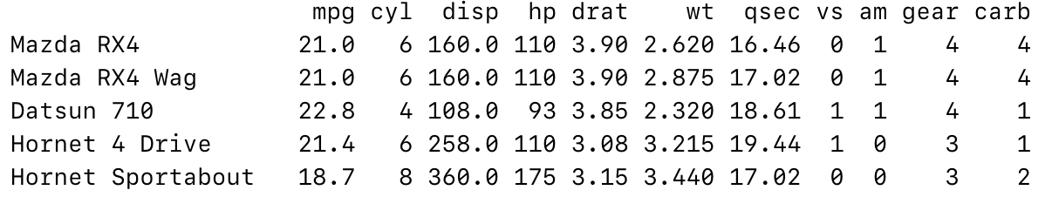
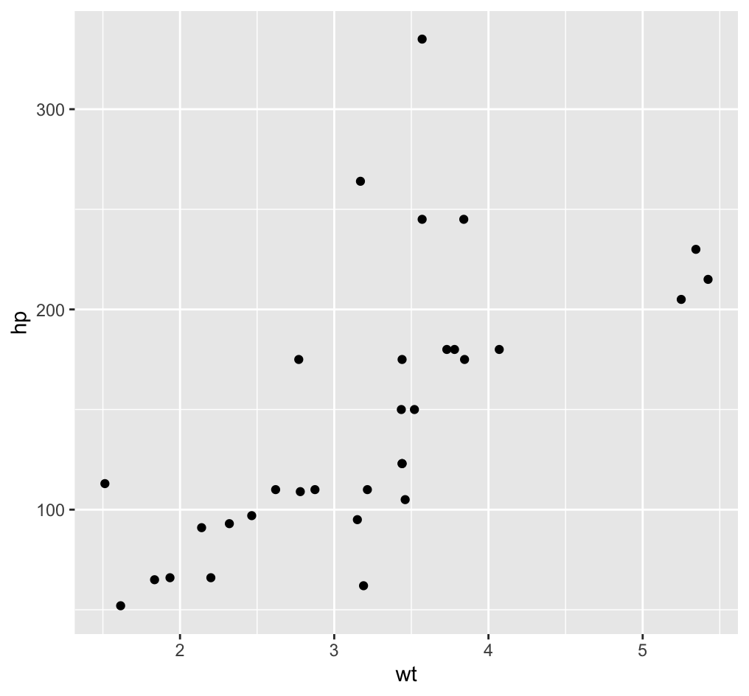
High-level view of making a ggplot2 plot
1. Start with a data set
3. Out comes a ggplot2 plot
2. Write ggplot2 code
# loading tidyverse will also load ggplot2
library(tidyverse)
# Make a simple plot
ggplot(mtcars) +
geom_point(mapping = aes(x = wt, y = hp))

Slide 7
Important ggplot2 concepts
Goal: map data to visual representations/properties to make a plot
geoms: geometric (think shapes) representations for your data
points
lines
bars
aesthetics, aes: visual properties of the objects in your plot
position (x, y)
size
shape
Color
mapping: a link between variables in your data and their aesthetic properties

Slide 8
The (basic) ggplot2 plotting template
The variable name of the data table you want to create a plot with
ggplot(data = <DATA>) +
<GEOM_FUNCTION>(mapping = aes(<MAPPINGS>))
A ggplot2 function that defines the type of geometric representation you want to use, e.g.
expression(s) that link columns in your <DATA> to aesthetic properties
geom_point
geom_line
geom_histogram
geom_boxplot

Slide 9
Let's revisit the first plotting example
ggplot(data = mtcars) +
geom_point(mapping = aes(x = wt, y = hp))

Slide 10
What's going on here?
1. Initialize the plot with the data set you want to plot
ggplot(data = mtcars) +
geom_point(mapping = aes(x = wt, y = hp))
2. Use the + sign to add a layer to your plot
3. Specify a geom function for the type of representation you want to plot
4. Define the mapping of columns in your data to the geom's aesthetic properties
Notes
geom_point says we want to represent our data as points
(2-D) points need x and y positions, so we need to specify these in our mapping
wt and hp are columns in the mtcars data table
you don't put quotes (" ") around the column names inside aes

Slide 11
In practice, the code is often simplified further
We removed the function argument names because the argument were specified in the assumed order
ggplot(mtcars) +
geom_point(aes(x = wt, y = hp))
The first argument of ggplot is the input data table
The first argument of a geom function is the mapping

Slide 12
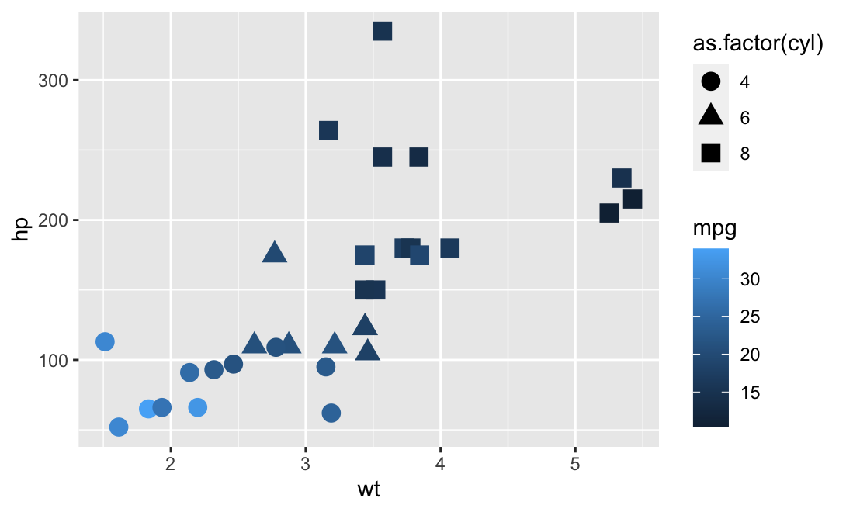
A more complex plot
We are also mapping point shape and size to our data.
Note: a shape is a discrete object not numerical, so we need to make it a factor
ggplot(mtcars) +
geom_point(aes(x = wt, y = hp, shape = as.factor(cyl), color = mpg),
size = 4)
We also specified the size of the points, but it is a defined single value, NOT mapped to the input data table.
Defined single values go OUTSIDE aes
What if you wanted to make all the points red? Where would you put this in the code?

Slide 13
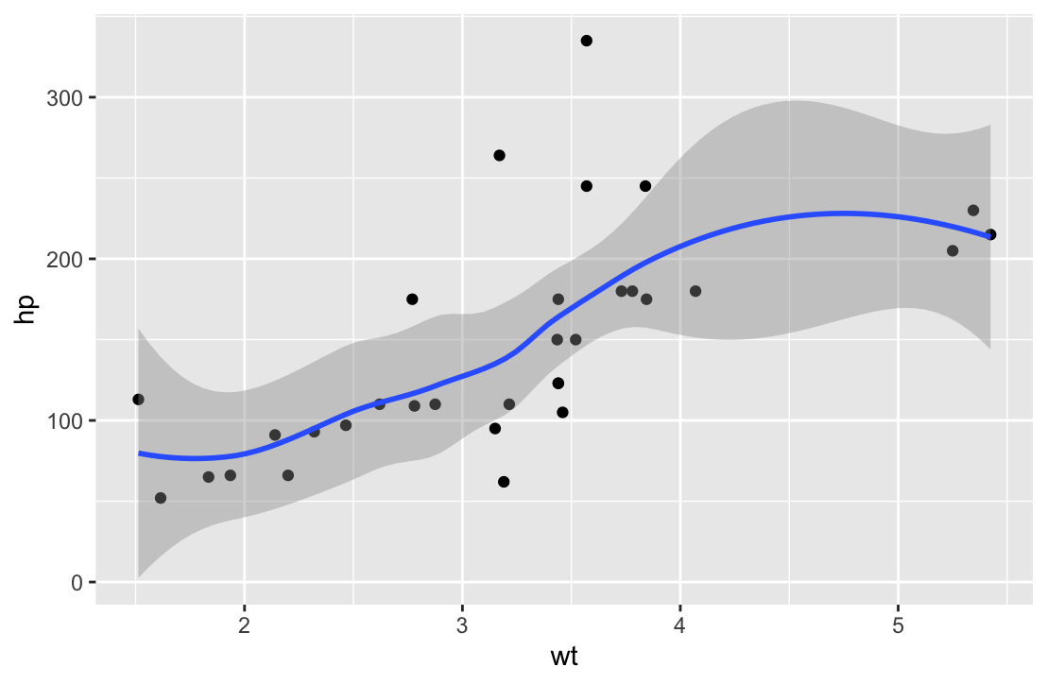
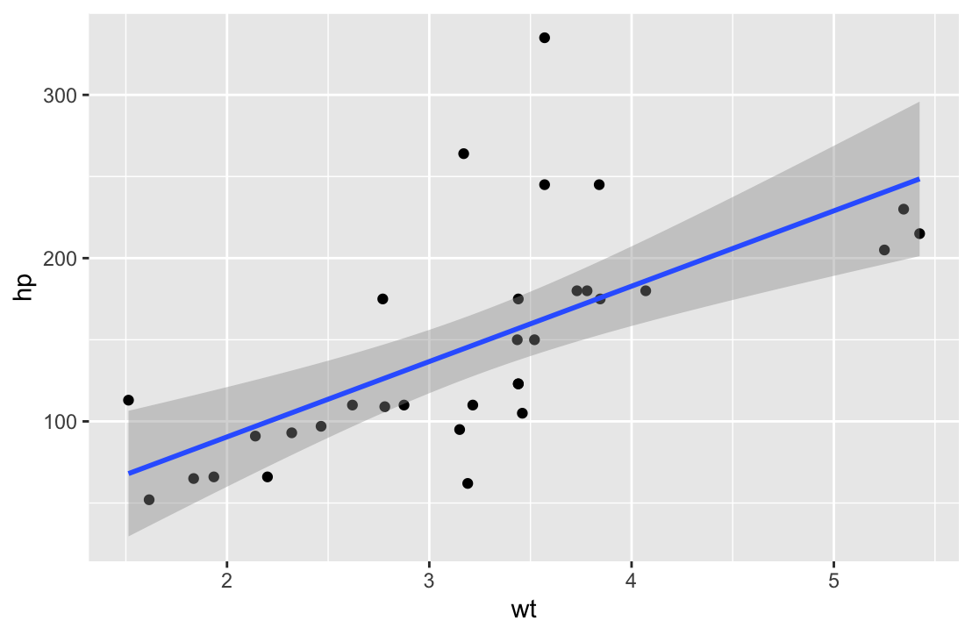
You can build plots up layer by layer using +
ggplot(mtcars) +
geom_point(aes(x = wt, y = hp)) +
geom_smooth(aes(x = wt, y = hp))
ggplot(mtcars) +
geom_point(aes(x = wt, y = hp)) +
geom_smooth(aes(x = wt, y = hp), method = "lm")

Slide 14
You can also put mapping inside the ggplot part
This code is duplicated (not optimal)
ggplot(mtcars) +
geom_point(aes(x = wt, y = hp)) +
geom_smooth(aes(x = wt, y = hp))
ggplot(mtcars, aes(x = wt, y = hp)) +
geom_point() +
geom_smooth()
Move it inside the ggplot part and all geom's will have the same mapping

Slide 15
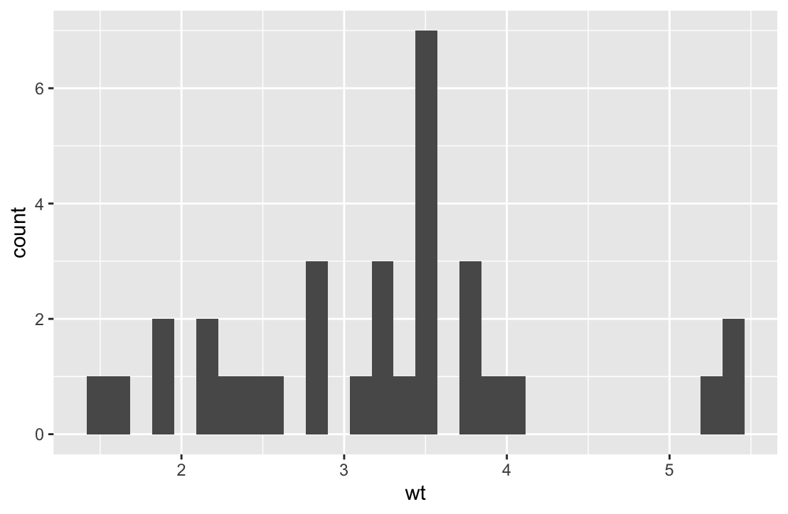
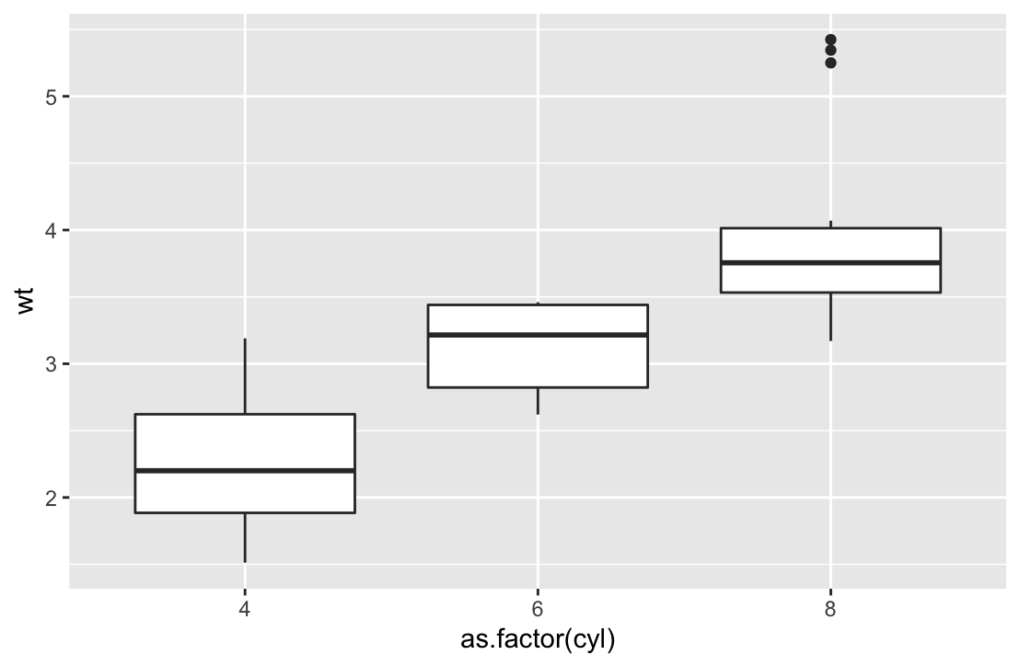
Ways to represent data: 1 continuous variable
Histograms
Boxplots
ggplot(mtcars) +
geom_hist(aes(x = wt))
ggplot(mtcars) +
geom_boxplot(aes(x = as.factor(cyl),
y = wt))

Slide 16
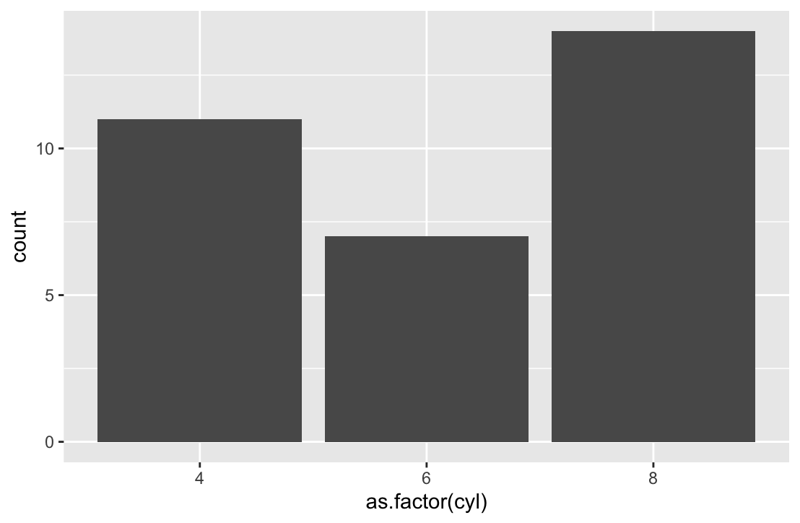
Ways to represent data: 1 categorical variable
Bar Plots
ggplot(mtcars) +
geom_bar(aes(x = as.factor(cyl))

Slide 17
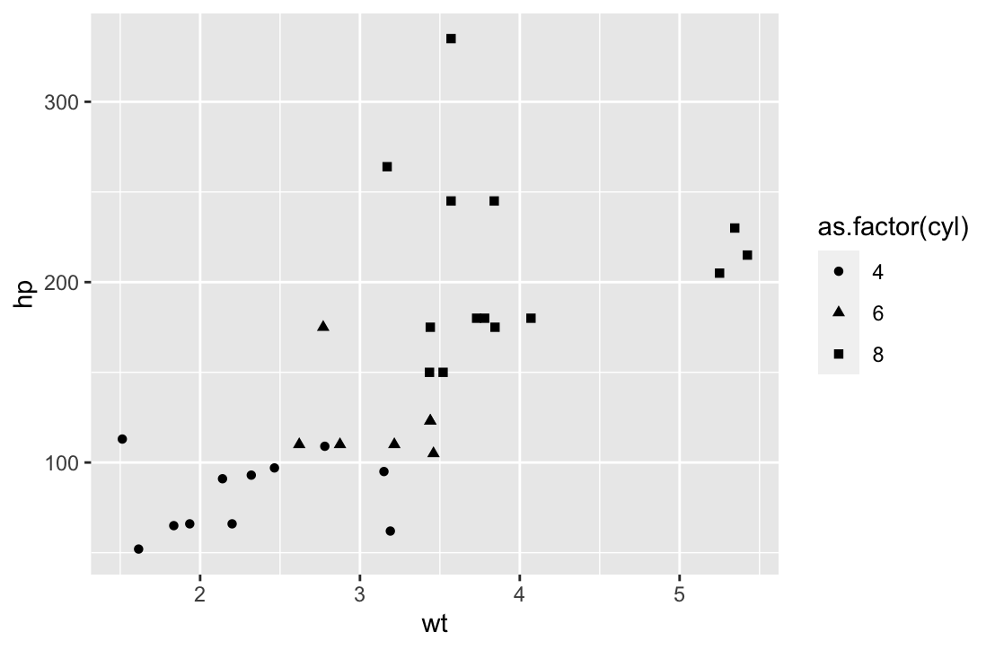
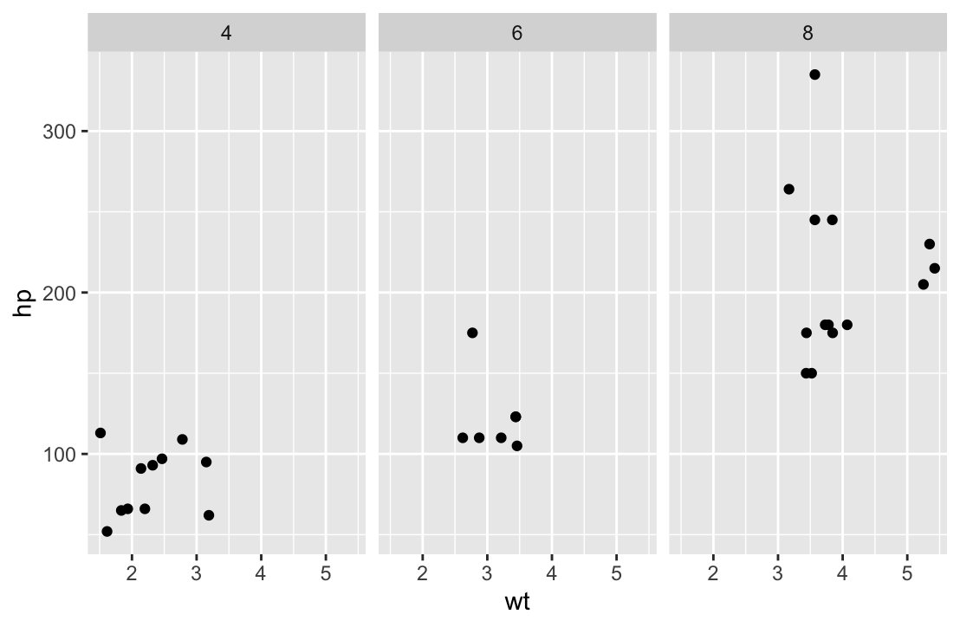
Facetting is useful for multivariate data
ggplot(mtcars) +
geom_point(aes(x = wt, y = hp,
shape = as.factor(cyl)))
ggplot(mtcars) +
geom_point(aes(x = wt, y = hp)) +
facet_wrap(~ as.factor(cyl))

Slide 18
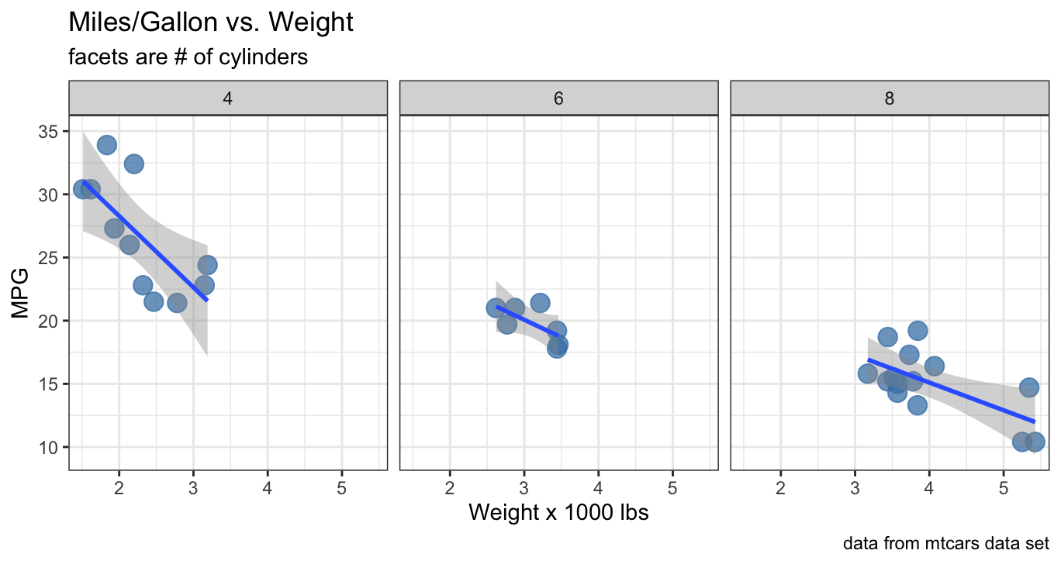
Let's make a more polished plot

Slide 19
Let's make a more polished plot
added a title
changed plot theme
colored points with alpha blending
labeled axes (with units!!)
added a caption

Slide 20
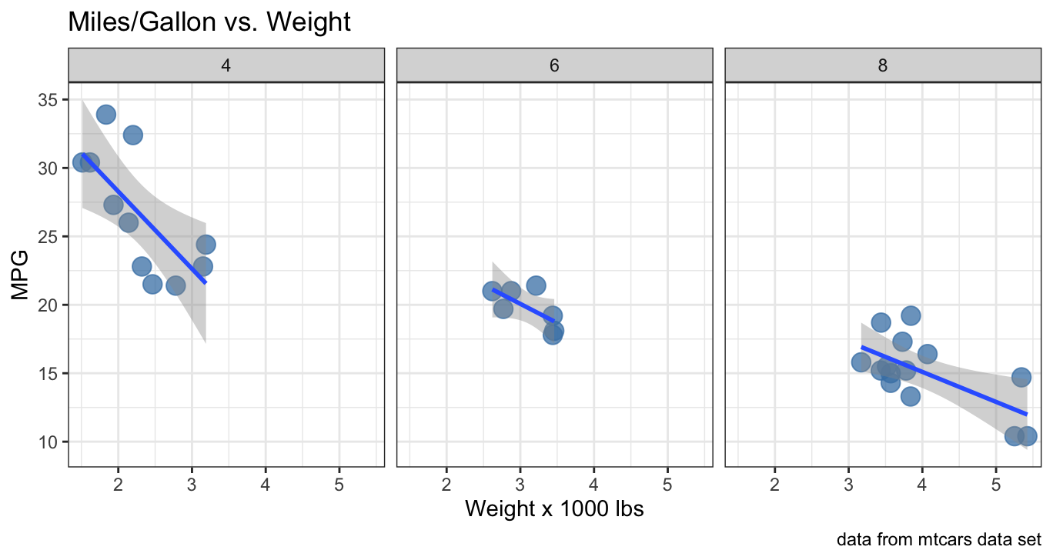
Let's make a more polished plot
ggplot(mtcars, aes(x = wt, y = mpg)) +
geom_point(color = "steelblue", size = 4, alpha = 0.75) +
geom_smooth(method = "lm") +
facet_wrap(~ as.factor(cyl)) +
theme_bw() +
labs(title = "Miles/Gallon vs. Weight",
subtitle = "facets are # of cylinders",
caption = "data from mtcars data set",
x = "Weight x 1000 lbs",
y = "MPG")

Slide 21
The more detailed ggplot2 plotting template
ggplot(data = <DATA>) +
<GEOM_FUNCTION>(
mapping = aes(<MAPPINGS>),
stat = <STAT>,
position = <POSITION>
) +
<COORDINATE_FUNCTION> +
<FACET_FUNCTION>
Check out the resources to learn more

Slide 22
Resources
R For Data Science (Chapter 3 in particular)
H. Wickham's Paper: A Layered Grammar of Graphics
ggplot2 Reference (browse all the cool things you can do)
ggplot2 Book

