Slide 1

OCRUG x Merage Hackathon Apr 2021
April 10 — 11, 2021 Online/Virtual Event
Twitter: oc_rug

Slide 2
Goals of the Hackathon
The focus is on education & teamwork
Competition is used to frame the event & give a concrete goal to work toward
Please freely share your experience and expertise, help others when you can
What might success look like?
You’ve tackled a real-world data set, and done something interesting with it
You’ve learned something new about data analysis/methods
You’ve connected with others and grown from the experience

Slide 3
Rules
All participants must abide by our code of conduct
All work presented by the teams must be based upon work performed at the hackathon
Feel free to help others, even across teams
Please be professional and courteous in all event channels (Zoom, Slack, etc)
https://github.com/ocrug/hackathon-2021-04/blob/main/code-of-conduct.md

Slide 4
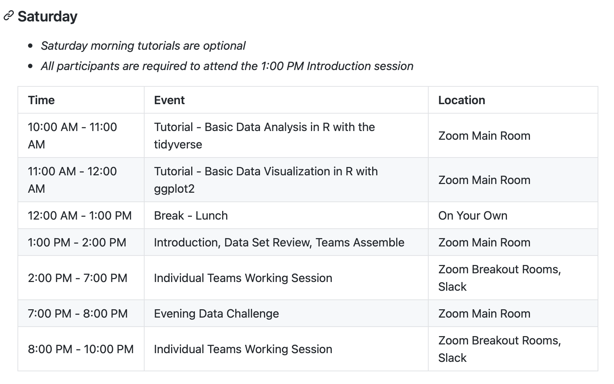
Schedule

Slide 5
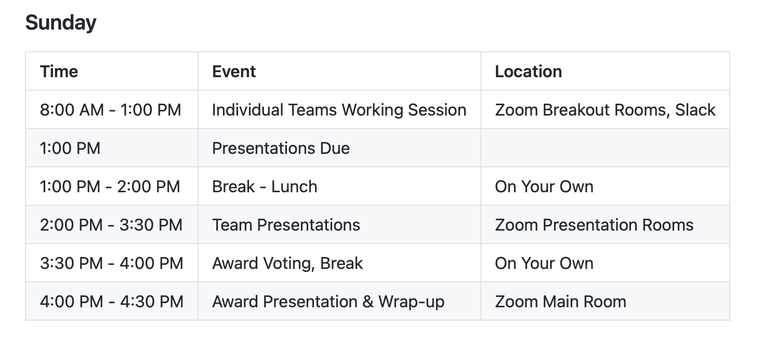
Schedule

Slide 6
Awards Categories
Best Insight
Best Visualization
Best Presentation
All participants will be judging/voting on the awards

Slide 7
Teams
Teams will be ~5 members each, may vary depending on total number of participants
Teams will be randomly assigned
Each team will pick a team name
Each team will have its own Slack channel for team communications
Feel free to work when and how you'd like, but we encourage working together with your team in Zoom break-out rooms

Slide 8
Presentations
All teams will submit a 5 page PDF summary slide deck of their findings:
Slide 1: Title slide (include your team name!)
Slide 2: Concise summary with main findings
Slides 3 & 4: Supporting slides
Slides 5: Wrap-up/conclusions & acknowledgements be sure to include reference to the data set
Teams will choose one presenter and have 5 minutes to present their work
All participants will vote on the award categories at the end
Try to have a good idea about what you’ll be presenting by Saturday night – presentations are due Sunday at 1PM!

Slide 9
Saturday Night Event
Please join the Saturday Night Event Zoom room (not the main room) at 7PM (PDT) for a short 1 hour social/data event.
We'll mix-up participants into random groups across 4 rounds
Each round will be 10 minutes
First 5 minutes: participants will quickly (1 min) introduce themselves
Remaining 5 minutes: the team will work together on a quick data "challenge"
Team will earn points for the quickest correct submissions
Prizes will be awarded to individuals with the most points

Slide 10
Logistics
Main activities (tutorials, presentations) will take place in the main Zoom room
Saturday night event will take place in a separate Zoom room (link will be provided on Slack)
Teams will work together in separate Zoom breakout rooms
If you have any questions, please use visit the main Zoom room, or post to the Slack channel, #hackathon-2021-04
Please keep an eye on the Slack channel for any announcements
Let us know if you see anything that might need our attention

Slide 11


Thanks to our Sponsors!

Slide 12
Thanks to our Volunteers!!!
👏

Slide 13
Questions?
Twitter: oc_rug
Tweet about our event with #OCRUG

