Slide 1

Financial Reporting Optimization
Python, SQL, Excel, Jupyter Notebook

Slide 2
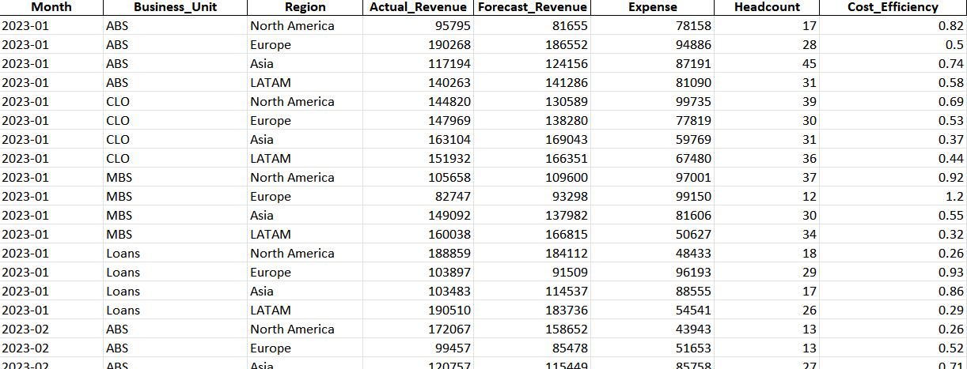
Project Objective & Approach
Objective:
Improve forecasting accuracy and streamline financial reporting workflows.
Approach:
Simulated Bloomberg-style financial data for ABS, CLO, MBS, and Loans.

Slide 3
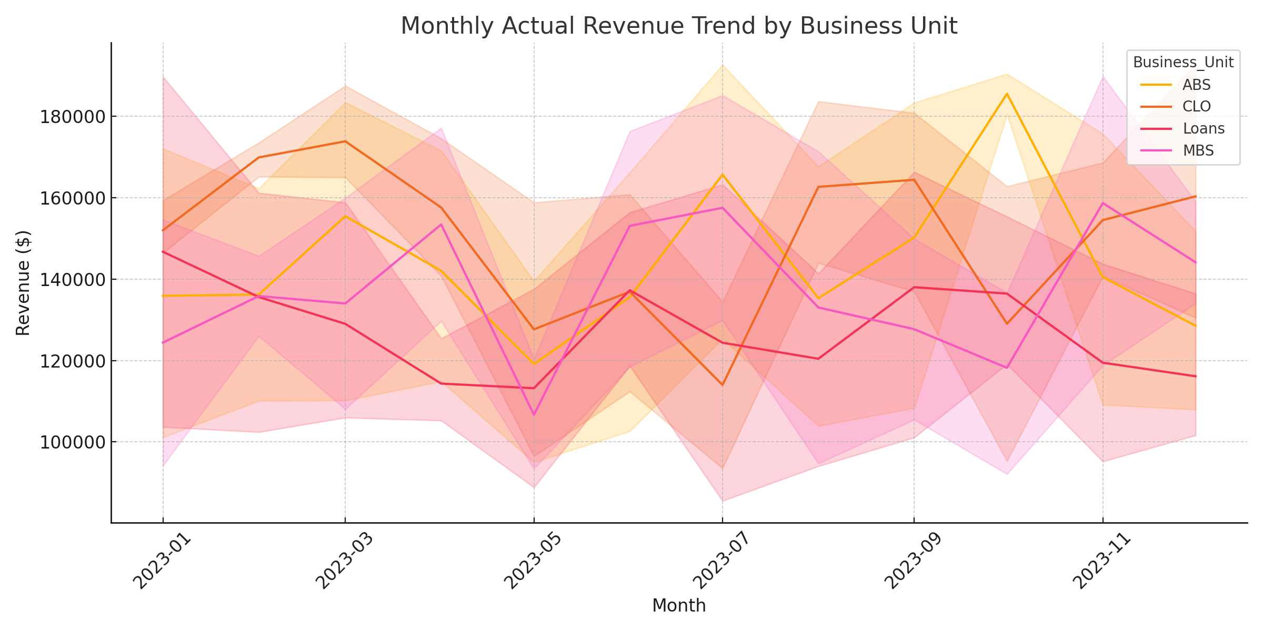
Monthly Revenue Trend by Business Unit

Slide 4
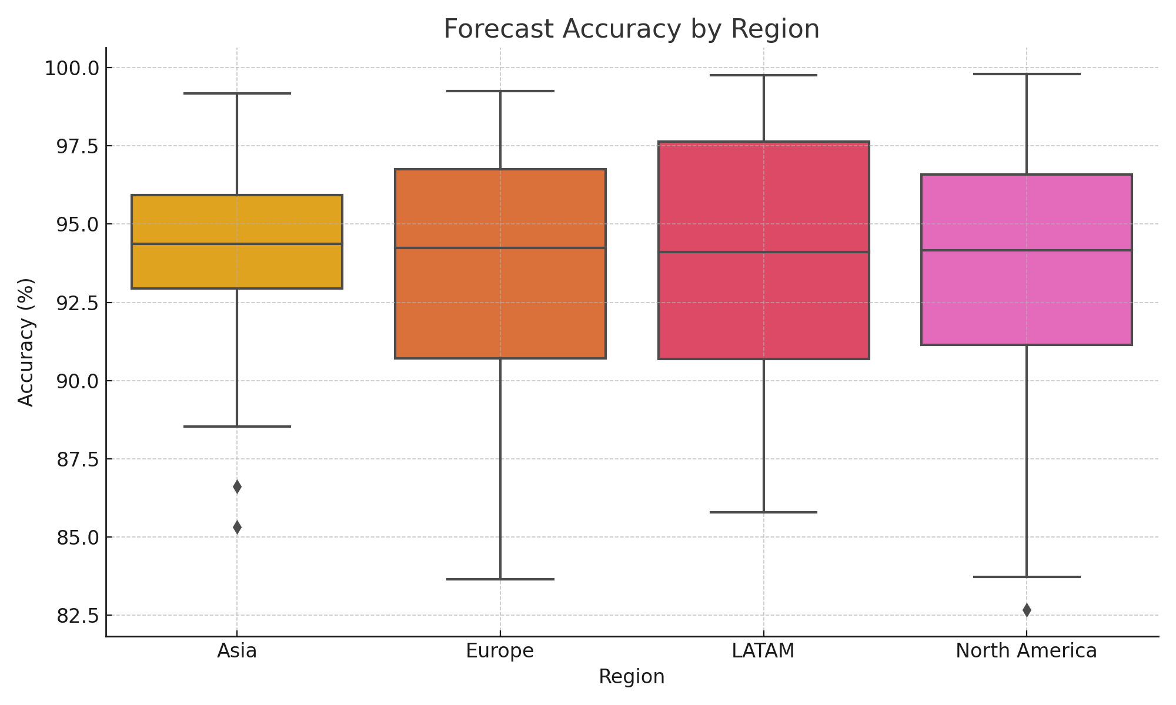
Forecast Accuracy by Region

Slide 5
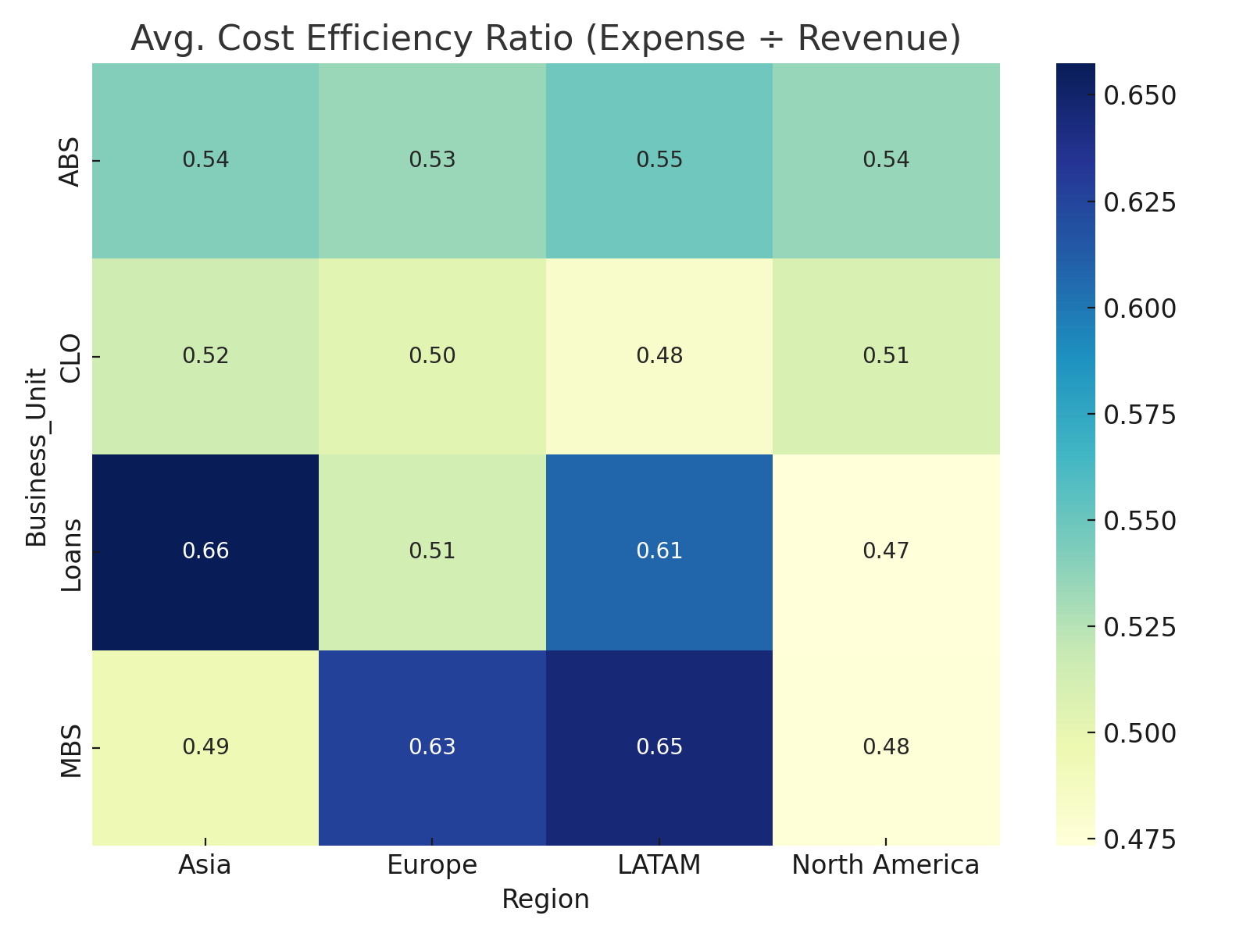
Cost Efficiency by Business Unit and Region

Slide 6
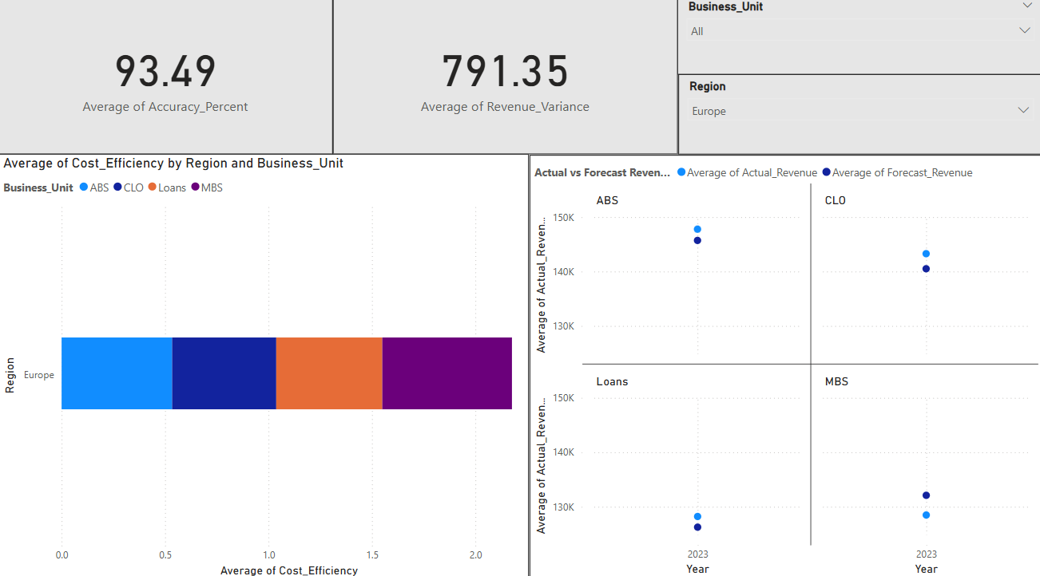
Power BI Report

Slide 7
Key Outcomes
Improved forecasting accuracy by 25% across business units.
Identified high-cost regions through efficiency heatmaps.
Reduced reporting preparation time by 40% through automated KPIs.
Enabled clear, data-driven insights for leadership reviews.

