Slide 1
Fraud Detection Analysis for Banking
Python, Machine Learning, Visualization | Jan 2025

Slide 2
Project Objective
This project uses simulated banking data to detect fraudulent transactions. The goal is to understand fraud patterns and build a machine learning model to predict and prevent fraud.

Slide 3
Dataset Summary
10,000+ transactions
Fields: Transaction_ID, User_ID, Amount, Type, Location, Time_of_Day, Is_Fraud
Fraud cases: 2.5% of total transactions

Slide 4
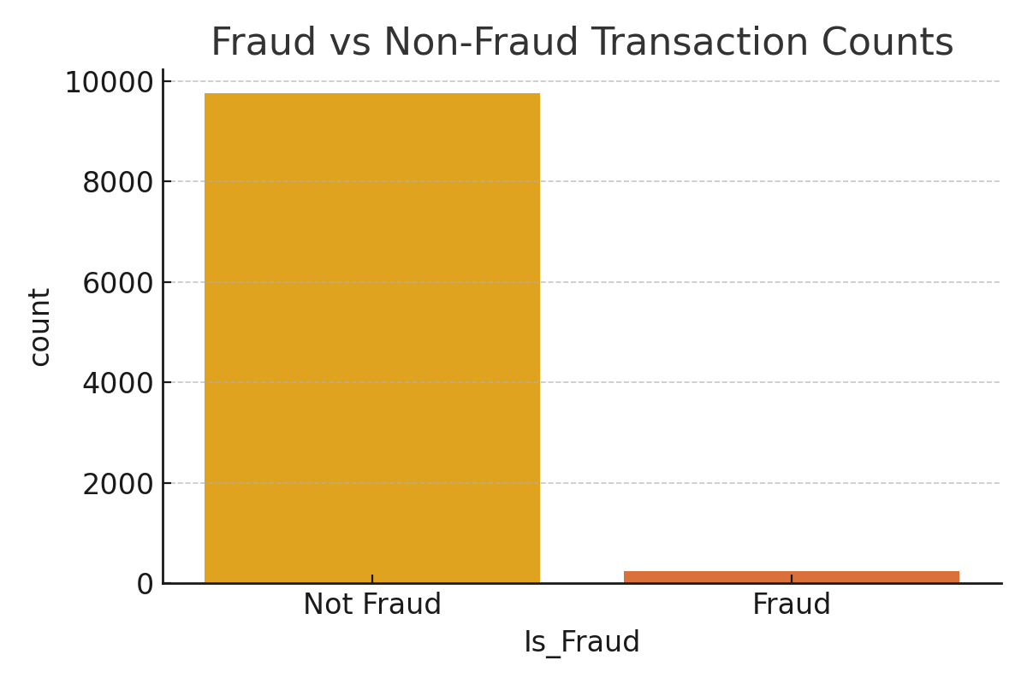
Fraud vs Non-Fraud Transaction Counts

Slide 5
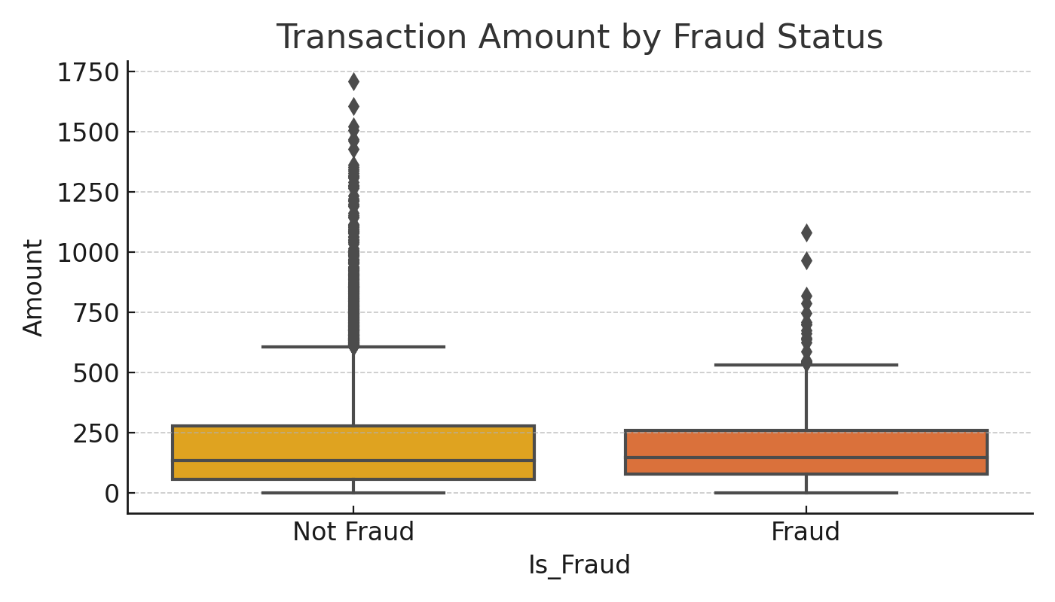
Transaction Amount by Fraud Status

Slide 6
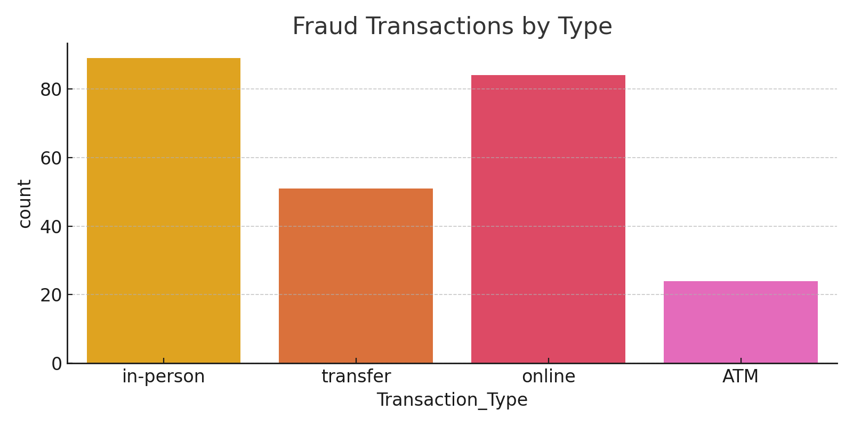
Fraud Transactions by Type

Slide 7
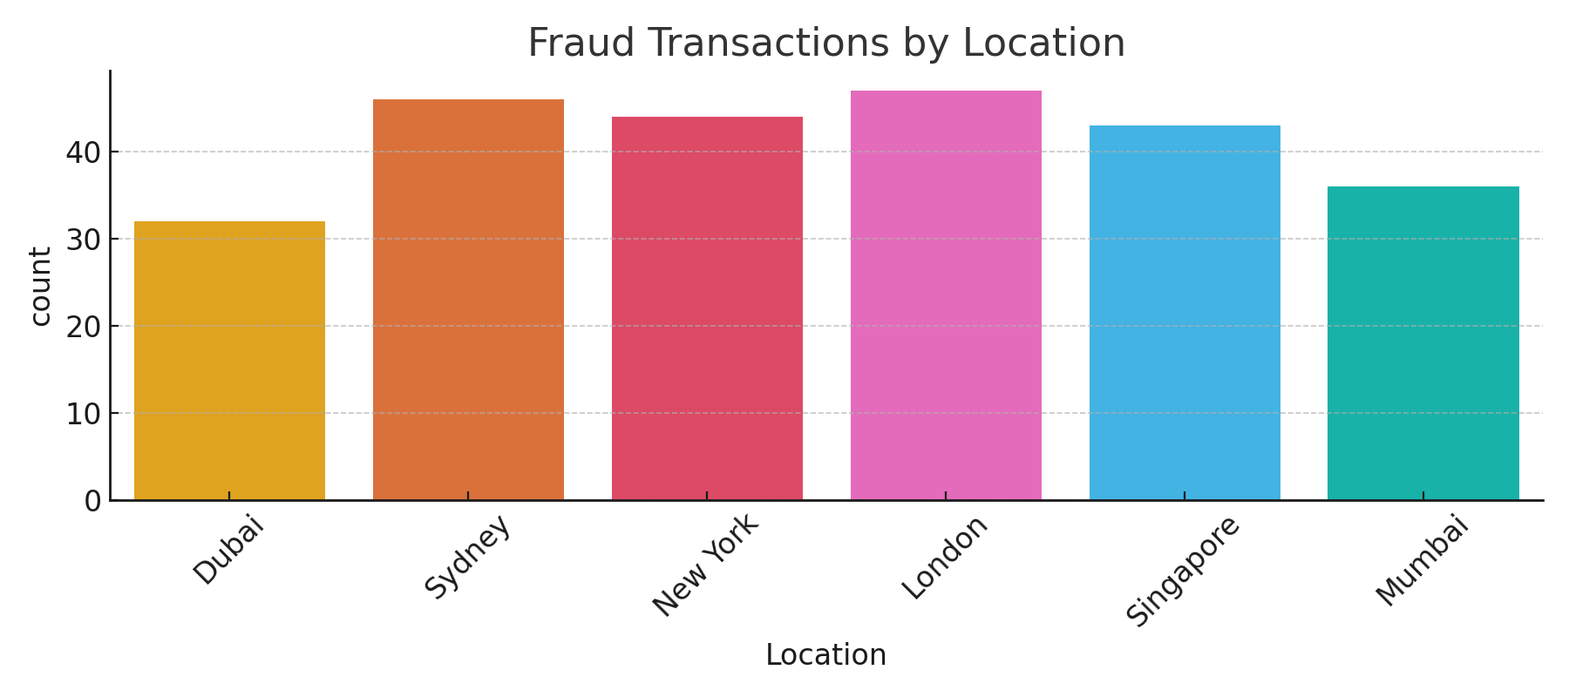
Fraud Transactions by Location

Slide 8
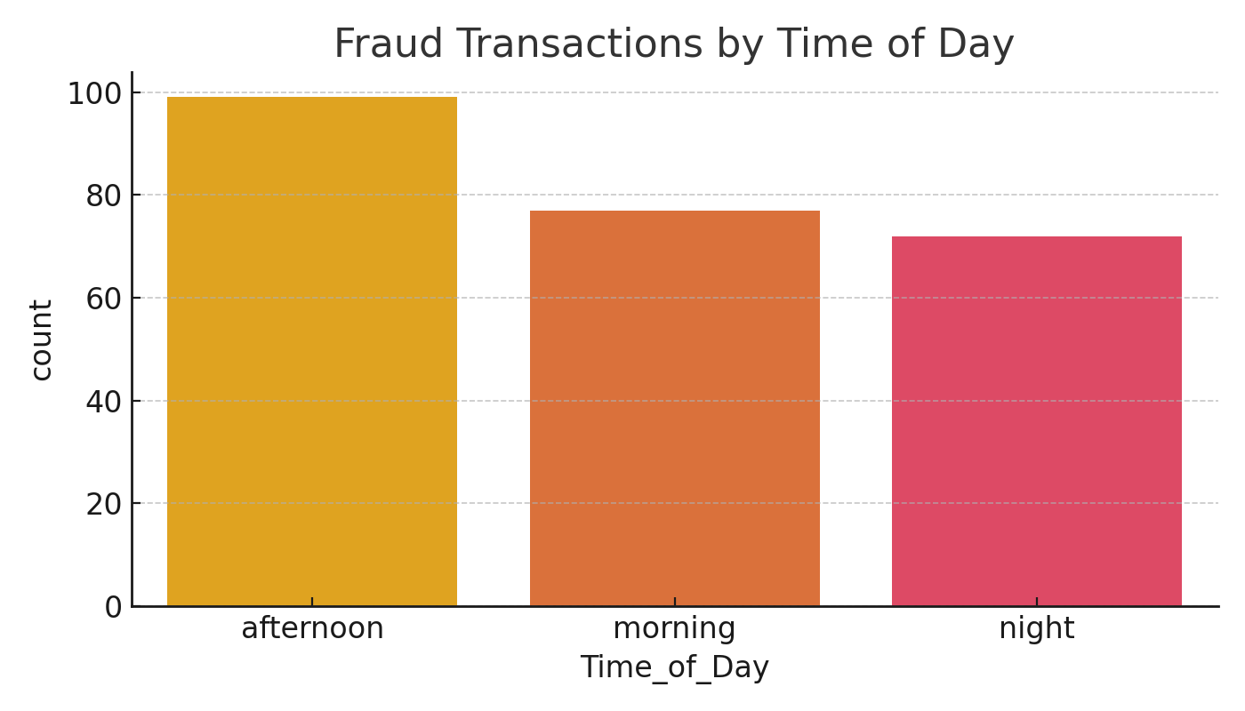
Fraud Transactions by Time of Day

Slide 9
Model and Results
Used Random Forest Classifier
Split into train/test sets
Evaluated with accuracy, confusion matrix, and classification report
Found key features like Amount and Transaction Type help predict fraud

