Slide 1

Spread Products – Executive Performance Dashboard (2022–2024)
Objective: Create an interactive executive dashboard to analyze performance trends in Spread Products division.
Tools Used: Tableau, Excel, Bloomberg Terminal
Focus Areas: Total Revenue Trends, Return on Capital (RoC), YoY Growth, Product Revenue Mix (ABS, CLO, MBS, Bonds)

Slide 2
Data Sources & Preparation
Excel data with monthly revenue by product (2022–2024)
KPIs derived: Total Revenue, Avg RoC, YoY %
Prepared using pivot tables and reshaped for Tableau

Slide 3
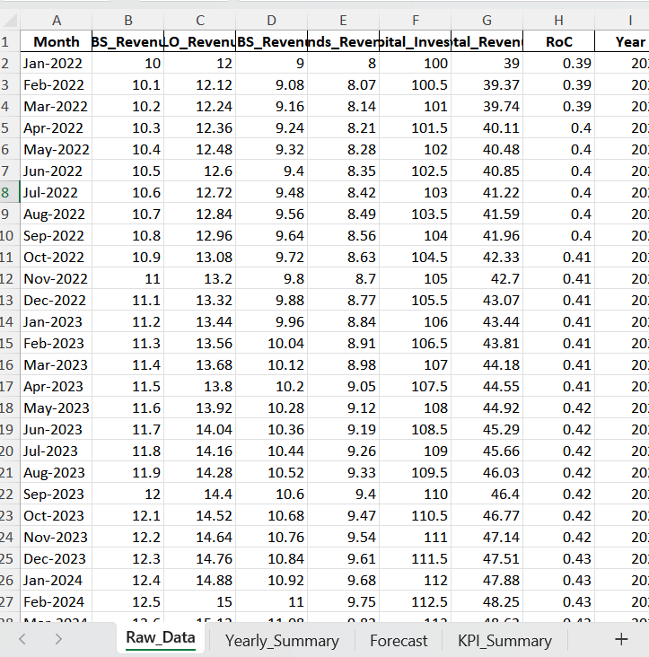

Slide 4
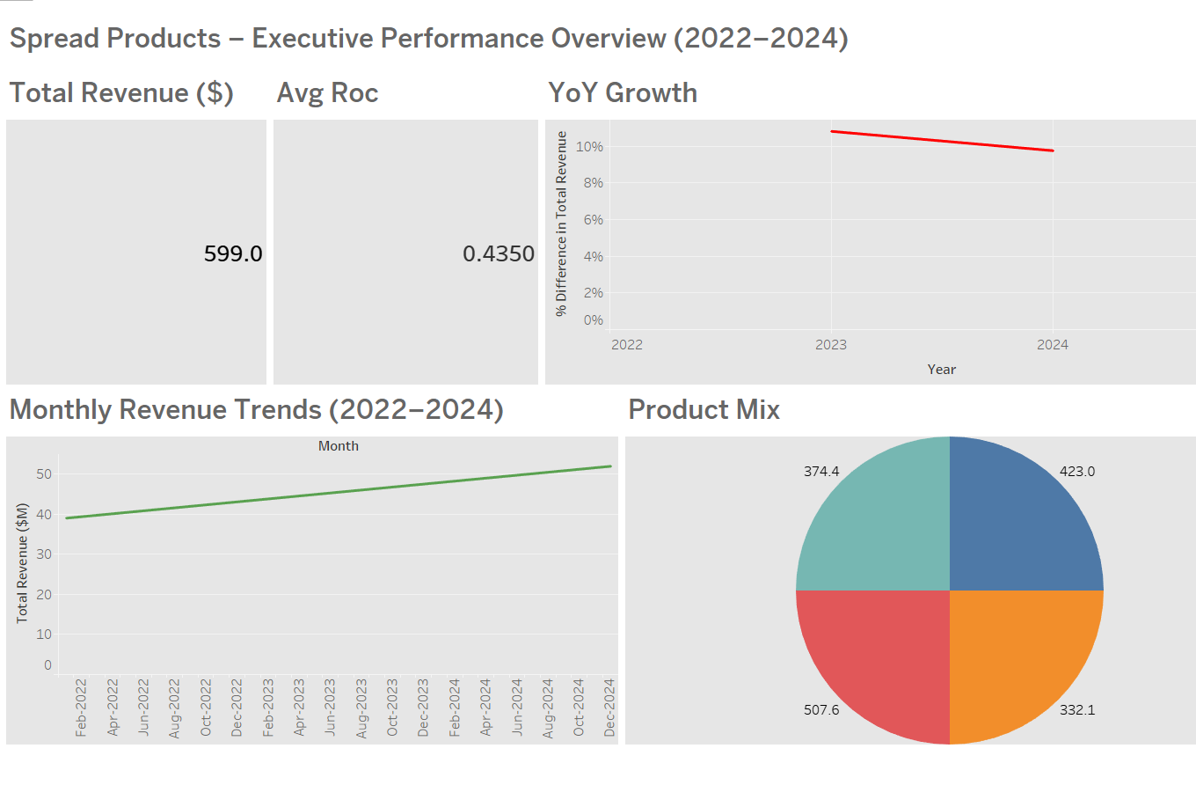

Slide 5
Executive Dashboard (Tableau)
KPI Row: Total Revenue (2024): $599M, Avg RoC: 0.435, YoY Growth: -1.3%
Revenue Trend Line Chart: Feb 2022 – Dec 2024
YoY Growth: 2022–23: +5.2%, 2023–24: -1.3%
Product Mix Pie Chart: ABS 32%, CLO 29%, MBS 23%, Bonds 16%
Year Filter: Dynamic yearly views

Slide 6
Insights from Tableau
2023 revenue growth > 2024 (YoY decline)
Stable product mix, ABS and CLO dominant
RoC slightly improved over time
Q3–Q4 2024 slowdown visible in trends

Slide 7
Tableau vs Bloomberg KPI Alignment
Total Revenue (2024): Tableau $599M vs Bloomberg $595M
Avg RoC: Tableau 0.435 vs Bloomberg 0.438
YoY Growth: Tableau -1.3% vs Bloomberg -1.1%
MBS Spread: Tableau +120bps vs Bloomberg +118bps
CLO Spread: Tableau +140bps vs Bloomberg +139bps

Slide 8

Strategic Insights & Decision Support Value
Dashboard simplifies executive analysis
Bloomberg adds validation and credibility
Supports strategic decisions, product focus, and performance tracking

