Slide 28
Ingest Tool for DataMesh
Recommended Architecture

Slide 29



Recap of Previous Proposals
Starting point before the current evaluation
        The previous evaluation round for the DAKVI squad covered AirPy, NiFi and Informatica; AirPy was recommended from the squad DAKVI
        The B2 — Template Library concept was subsequently approved at ODP SRF
        Based on a proposal from the vendor (BigHub), the Meltano alternative was added to the evaluation, followed by MiNiFi
        Both alternatives were verified through a smaller-scale Proof of Concept

Slide 30
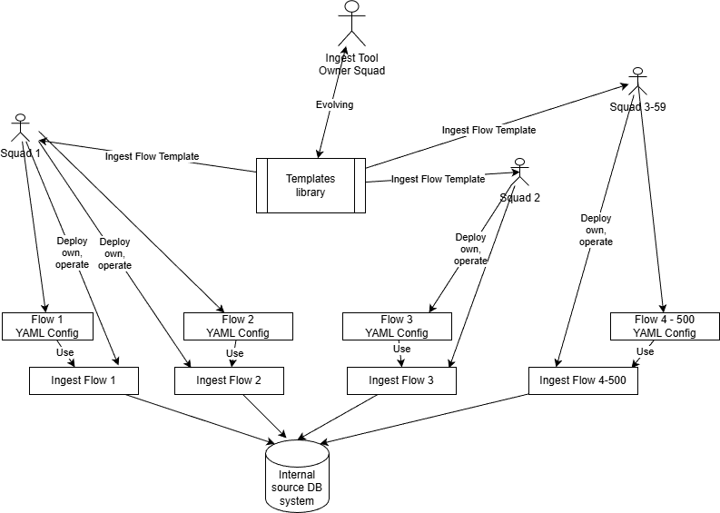
Architecture Independent of the Tool Choice
Versioned Template Library principle (variant B2)
        The chosen architectural model remains valid regardless of the outcome of the tool evaluation
        The business squad deploys a versioned copy of the template and its own configuration in its own Git repository
        The business squad is responsible for deployment, operation, and upgrade decisions
        The configuration components remain unchanged: Object Schema, Export Configuration, Run Conditions
        The choice of the specific tool (AirPy, MiNiFi) affects only the implementation, not how business squads use this architecture
B2) Versioned Template Library

Slide 31
Rejection of the Meltano Alternative
Proof of Concept results
        Exporting 80 million records took approximately 4 hours with Meltano
        The other evaluated alternatives achieved significantly shorter times: AirPy 5 minutes, Informatica 8 minutes, Apache NiFi 15 minutes
        Singer specification contributes to the slowdown: for large data volumes, it relies on batch processing, writing data to intermediate storage before loading it into the target
        This could likely be optimized, but we decided not to pursue it further — it would require flow-specific optimization with an uncertain outcome
        Meltano can also only load data into Teradata — a connector for exporting data from Teradata does not exist for this tool
        Based on these results, the Meltano alternative was rejected from further evaluation
Tool | POC Time
AirPy | 5 min.
Infa | 8 min
NIFI | 15 min
Meltano | 4 hours

Slide 32
What is MiNiFi
A lightweight agent built on the Apache NiFi platform
        The tool exists in two variants: a Java agent and a C++ agent
        The proposed solution uses the Java agent — the C++ variant has no Parquet writer, which is a hard requirement
        Included in every NiFi release since version 2.0
        Uses the same processors as NiFi — identical functional scope
        No web user interface — the flow definition is stored as a file in Git

Slide 33
Why MiNiFi Fits Our Case
Using ready-made components instead of custom development
Databases
Kafka and Elasticsearch
        Oracle, MS SQL Server, PostgreSQL via JDBC
        Incremental extraction support through Configuration
        Native processors for both technologies
        One tool instead of combining AirPy and NiFi
Parquet and S3
Flow as Code
    Built-in support for reading and writing Parquet
    Direct access to S3 storage
    The flow definition is a file, not just a UI-only configuration
    Versioned in Git, reviewed via pull requests

Slide 34
NiFi vs. MiNiFi Comparison
Source of the improved score and its cause
Both solutions use the same Apache NiFi processors. The difference lies in the deployment model — MiNiFi runs as a standalone pod started from Airflow, the flow definition is stored as a file in Git, and credential access is handled by the combination of Airflow and Kubernetes. The improved score therefore comes from the deployment model, not from the tool’s core.
Criterion | NiFi | MiNiFi | Difference
YAML configuration consistency in CI/CD | 8 | 1 | -7
Git support in CI/CD | 6 | 1 | -5
Alignment with target cloud architecture | 7 | 3 (in K8s) | -4
Reuse potential in other entities | 5 (DI?) | 1 (DI) | -4
Horizontal scalability (cross-load) | 5 | 1 (with K8s) | -4
Ease of environment promotion in CI/CD | 5 | 2 | -3
Airflow SOGE integration | 6 (PJE-REST) | 3 | -3
CyberArk / Vault integration | 5 | 3 | -2
Squad autonomy | 4 | 2 | -2
There is a moderate regression in support for incremental loads (from 0 to 2) — the solution does not use NiFi’s native processor state, but its own watermark management implementation.

Slide 35
Rationale — Why AirPy Was Not Selected
A strong score does not necessarily mean the best choice
        AirPy achieves the best results in several categories — performance, operational parameters, availability of internal expertise, compliance with Greenbook requirements
        However, it requires developing and maintaining a custom framework within Airflow (watermark management, schema validation, Parquet generation)
        Supporting Kafka and Elasticsearch would require adding a second tool (NiFi), meaning operating two technology stacks and two CI/CD processes
        MiNiFi, by contrast, covers all source systems with a single tool, using ready-made components instead of custom development

Slide 36
Proof of Concept Results
Comparison of the remaining alternatives
 | AirPy | Informatica | NiFi | MiNiFi
Export of 80 million records | 5 minutes | 8 minutes | 15 minutes | 9 minutes
CyberArk integration and password rotation | validated | validated | issues identified | not verified

Slide 37
Airflow to Kubernetes via REST API
A standard, reusable integration pattern
        Airflow’s KubernetesPodOperator communicates with the Kubernetes API server using a standard REST API
        The connection between SOGE Airflow and Kubernetes in the KB environment is implemented purely as HTTPS REST calls, with no special protocol required
        HTTPS REST API should already be permitted on the network pass-throughs between SOGE and KB
        Security is generally favorable toward REST API
        This could become a general pattern for connecting SOGE Airflow with the KB environment
from airflow.providers.cncf.kubernetes.operators.pod \
import KubernetesPodOperator
run_minifi = KubernetesPodOperator(
task_id="run_minifi_crm_export",
namespace="crm-squad-ns",
image="harbor.kb.cz/minifi/minifi-template:1.4.0",
cmds=["/opt/minifi/bin/run.sh"],
arguments=["--config", "/config/exports.yaml"],
kubernetes_conn_id="kb_onprem_k8s",
get_logs=True,
is_delete_operator_pod=True,
)
Live demo: a real DAG will be run in Airflow to show a task spinning up a pod in Kubernetes.

Slide 38
Recommendation
Target tool and next step
        Recommended tool: Apache MiNiFi (Java agent), run as a pod in Kubernetes, started per run from SOGE Airflow — replacing the previously recommended AirPy
        A single tool for all sources, including Kafka and Elasticsearch — no combination of two tools
        Ready-made components instead of a custom framework in Airflow
        Best result in Functional Capabilities, strong CI/CD and Git integration
        No licensing costs, good alignment with the target architecture (K8s, Airflow, S3, Versioned Template Library)
        AirPy remains a technically strong alternative, or fallback option, should the open validation items not be fulfilled
        Requested decision: approve MiNiFi as the target solution and proceed with validating the open items

Slide 39
Planned Next Steps
From technical validation to a go/no-go decision
Phase 1 — Technical Validation (PoC)
Phase 2 — Performance and Scale
        CyberArk integration and password rotation (Airflow → Secret → env var)
        Pod lifecycle (wrapper / NiFi Stateless) — reliable detection of run completion
        Availability of processors (Parquet, Kafka, Elasticsearch, AWS/S3) in the MiNiFi Java distribution
        Testing on larger data volumes
        Teradata connectivity and performance
        Validating the execution granularity model (pod per flow vs. per object) in real operation
Phase 3 — Governance and Compliance
Decision Checkpoint
    Confirming compliance with the Société Générale Greenbook
    Effort estimate in person-days (environment setup, upskilling, migration)
    Squad onboarding process (namespace, ServiceAccount, Conjur) with the Platform team
    Summary of PoC results → go/no-go decision for full migration

