Slide 1
Biodiversity for the National Parks

Slide 2
Examining the ‘Species’ dataset
The dataset contains 4 columns, not including the id column. The category column let’s the examiner know what classification of species it is. For example, mammal, bird, reptile, etc. Then there are the scientific_name and common_names columns. Finally, the conservation_status column lets the examiner know if the species is in a state of ‘endangered,’ ‘threatened,’ ‘concern,’ or ‘recovery.’ Some of the values in this column are missing or null. Here is when the dataset is then filled in with ‘no intervention’ for the values that are null.
In order to see if there are any patterns, the dataset will have to be grouped by a certain column. When grouping the dataset by the conservation_status to display a unique count based on scientific_name, the data reveals a high amount of species that do not need intervention (5363). However, there is 151 species that are of concern, 10 that are threatened, 15 endangered, and 4 in recovery.
Species in concern mean that the population is declining. Threatened means that the species is vulnerable to endangerment. Endangered means that there is a serious risk of extinction. In recovery are species that were previously endangered but are no longer in danger.

Slide 3
Examining the ‘Species’ dataset pt.2
To further examine if certain species are more likely to be endangered, the ‘Species’ dataset must be grouped in a manner that will display each scientific_name and category to show if the species is protected or not.
As a result, if a species is protected, it will be displayed a ‘true’ on a pivot table. If not, ‘false.’

Slide 4
Calculations for endangered status between categories of species
Based on the pivot table that was created to see which categories of species were protected or not, it was revealed that ‘Mammals’ were more likely to be endangered rather than ‘Birds.’ However, to be sure that this is true and determine if there is a significant difference, a chi-squared test had to be conducted.
The reason a chi-squared test had to be conducted rather than another hypothesis test is because the data being examined is categorical, not numerical.

Slide 5
Calculations for endangered status between categories of species pt.2
In order to perform the test, a contingency table first had to be created. The columns being ‘protected’ and ‘not protected’ while the rows were ‘Mammal’ and ‘Bird.’ The values were displayed by the previous pivot table, so no further calculations had to be conducted.
Once the contingency table had been filled out, python can run the ‘chi2-contingency’ function on the contingency table. From here, the pval (calculated propbability) can be determined. If the pval is greater than 0.05, there is no significant difference and the null hypothesis ends up being true. The null hypothesis here was that the difference between endangered mammals and birds was due to chance.
After Python calculates the pval (which was ~0.688), it results that there is no significant difference, proving the null hypothesis true.

Slide 6
Calculations for endangered status between categories of species pt.3
Even though the test between mammals and birds did not pan out, another chi-squared test was conducted between ‘Reptile’ and ‘Mammals.’
Here the result ended with a pval less than 0.05 (which was ~0.038), thus proving a significant difference.
Due to this test, the examiner can conclude that certain species are more likely to be endangered than others.

Slide 7
Recommendation for conservationists
Based on the testing done with the chi-squared test and the resulting significance, it is revealed that certain types of species are more likely to be endangered over other types of species.
Based on our own testing, reptiles are more likely to be endangered over mammals. Looking into ways to conserve reptiles will be beneficial in saving these species from extinction.
In order for conservationists to be aware and proactively look into protecting species, it is recommended that their team collects historic as well as current data on species. After collecting the historic data, using the chi-squared test can help reveal exactly what species may be more endangered. Using historic data will help be more proactive in saving or conserving species that fit into the category, as patterns may be discovered.
A chi-squared test on current data will reveal species that may need immediate intervention in order to save them from extinction.

Slide 8
Foot & Mouth – Sample Size Determination
In order to calculate a sample size, a baseline percentage must first be determined along with a minimum detectable effect.
The baseline percentage is information that is already on hand. In this case, scientists have recorded that last year, 15% of sheep had foot and mouth disease at Bryce National Park.
The minimum detectable effect is a number that is a percent of the baseline. To get this number, scientists first have to decide on a value where they believe they will be able to detect a difference. In this case, scientists want to detect a 5% reduction.
So, if scientists want to observe ‘x’ amount of change, the minimum detectable effect is then calculated by 100*5 / 15. This results in 33.3333 repeating.
It is important to select the statistical level of significance as this will be used in the calculation to determine the sample size. In this case, it is 90%

Slide 9
Foot & Mouth – Sample Size Determination pt.2
With all the values that have been collected, these values can now be plugged into a sample size calculator. The resulting sample size ends up being 870.
Now that we have these observations collected, it can be compared to the rest of the national park data.
So in order to determine how long it would to scientist to stay at Yellowstone National Park to observe enough sheep, the sample size of 870 must be divided by 507, which is the recorded observations collected for this national park. The result is 1.715 weeks. Estimated 1 week.
Scientists would like to also repeat their measurements at Bryce National Park. So the sample size 807 will need to be divided by the previous recorded observation, which is 250. The result is 3.48. Estimated 3 weeks in order to observe enough sheep.

Slide 10
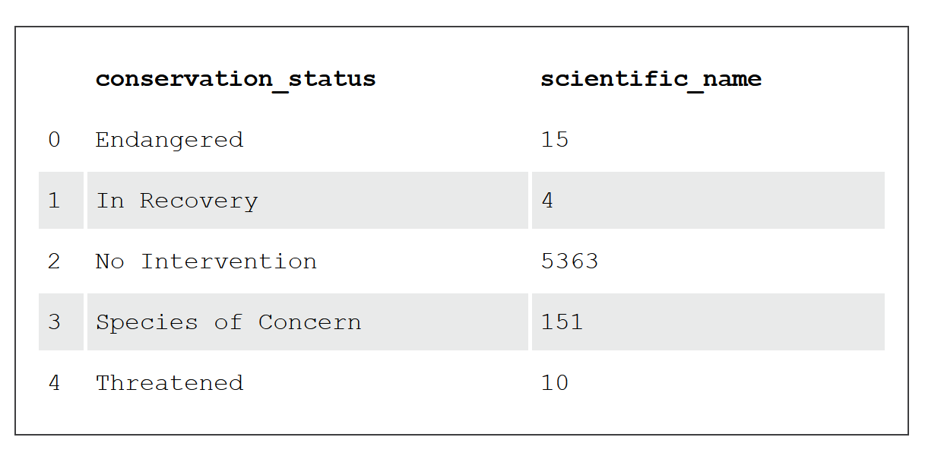
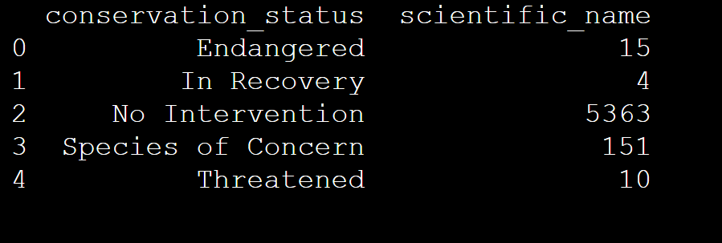
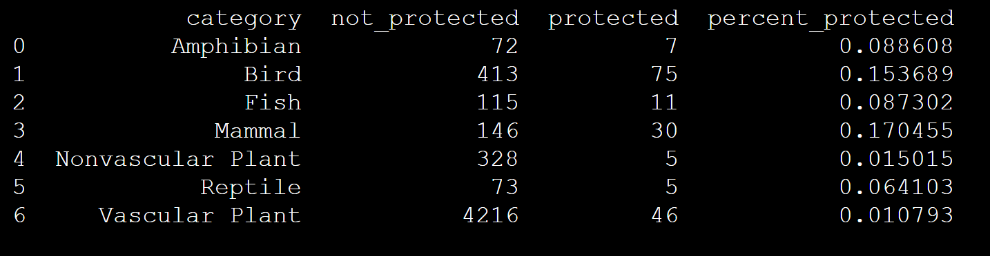
Visuals for ‘Species’

Slide 11
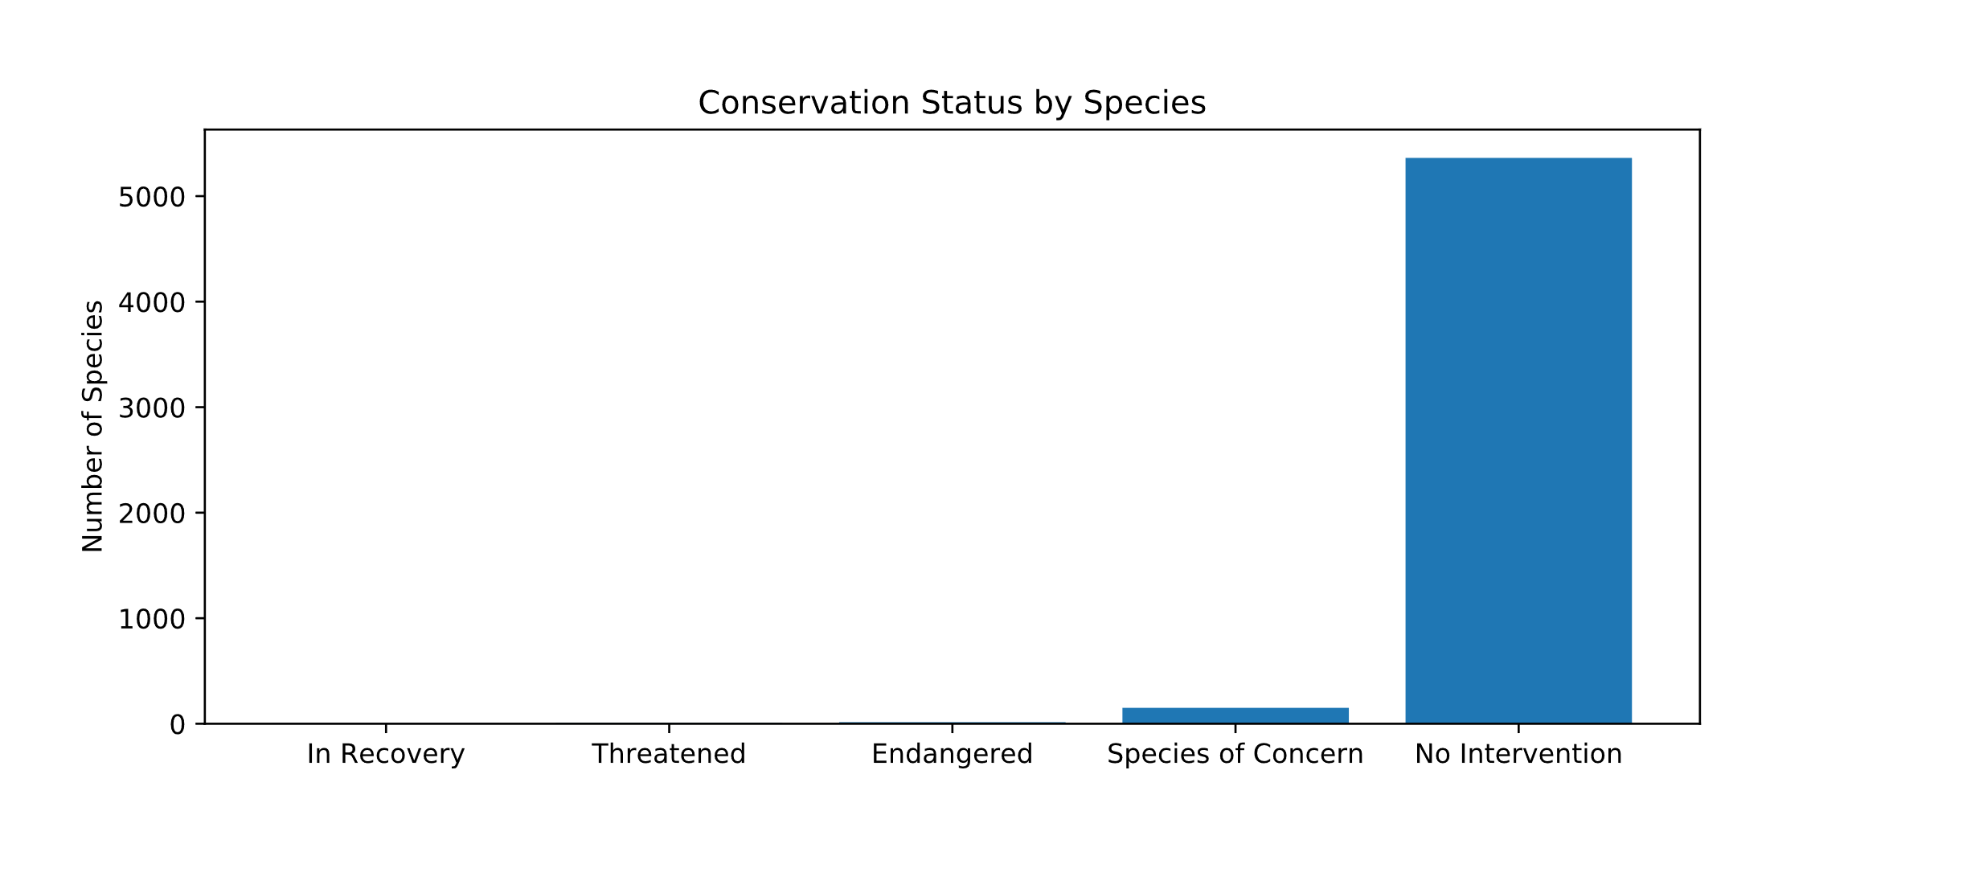
Visuals for ‘Species’ pt.2

Slide 12
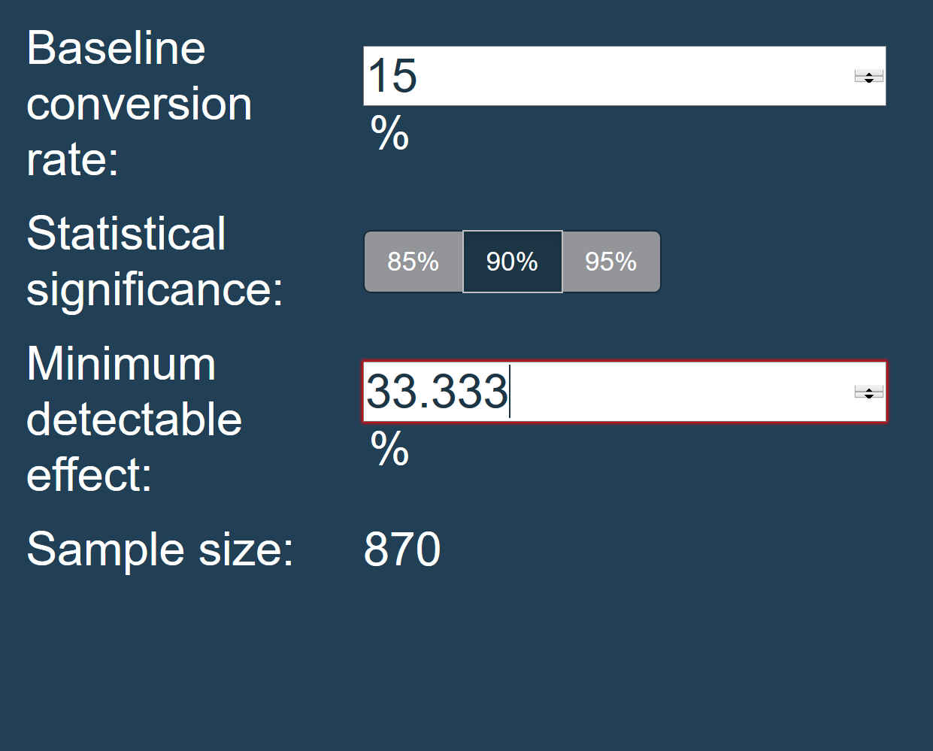
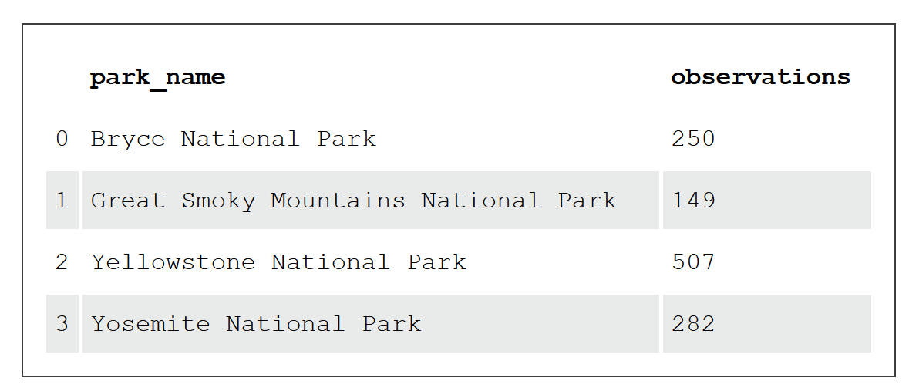
Visuals for ‘Foot & Mouth’

Slide 13
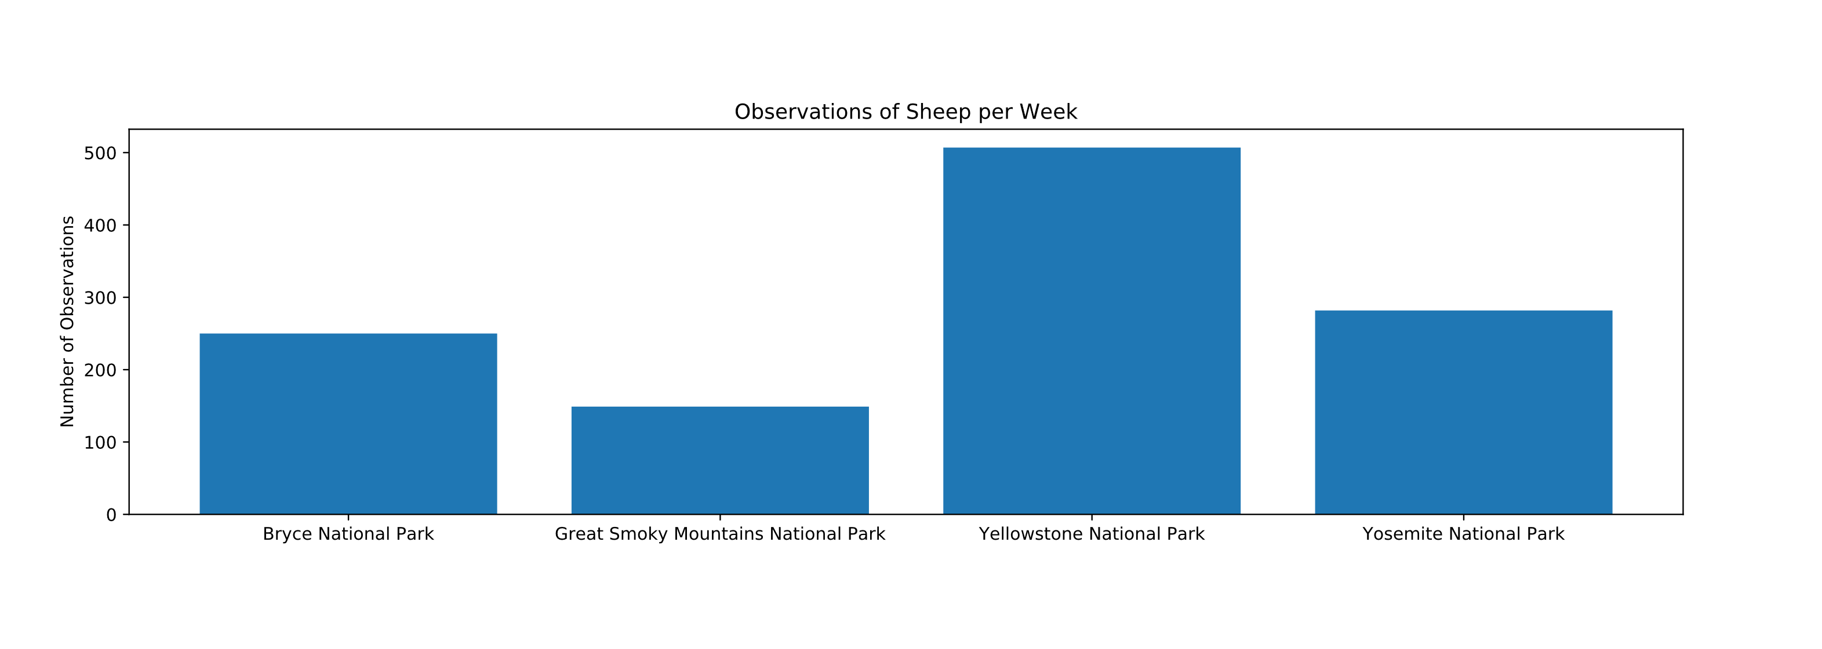
Visuals for ‘Foot & Mouth’ pt.2

