Slide 1
Fraud Transaction detection
Hackathon - Artificial Intelligence

Slide 2
Hackathon Team - Singularity
Amudhan Subbiah
Uthirapathy Rajasekar
Senthilkumar Natarajan

Slide 3
Business Problem – What are we trying to solve?
Classification Problem: Automate Fraud detection process to predict the fraudulent transaction. Customer transactions from Jan 2016 to Mar 2017 were utilized for the learning and prediction.
The Analytic Problem:
With the fraud identification process completed for the analysis period ,our team were tasked with developing a model that would help to detect fraudulent Transaction for the rest of the period.

Slide 4
Data Preparation

Slide 5
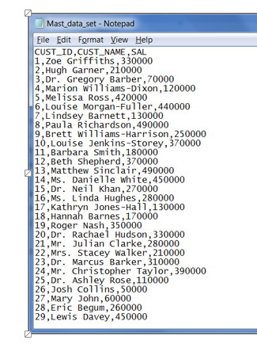
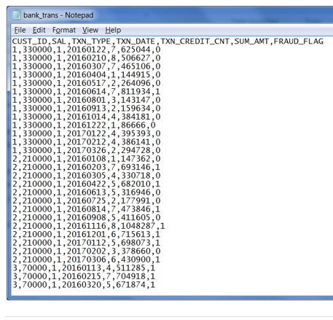
Data Integration Process
Customer master data and Transaction data are available through execution of Python scripts for this task.

Slide 6
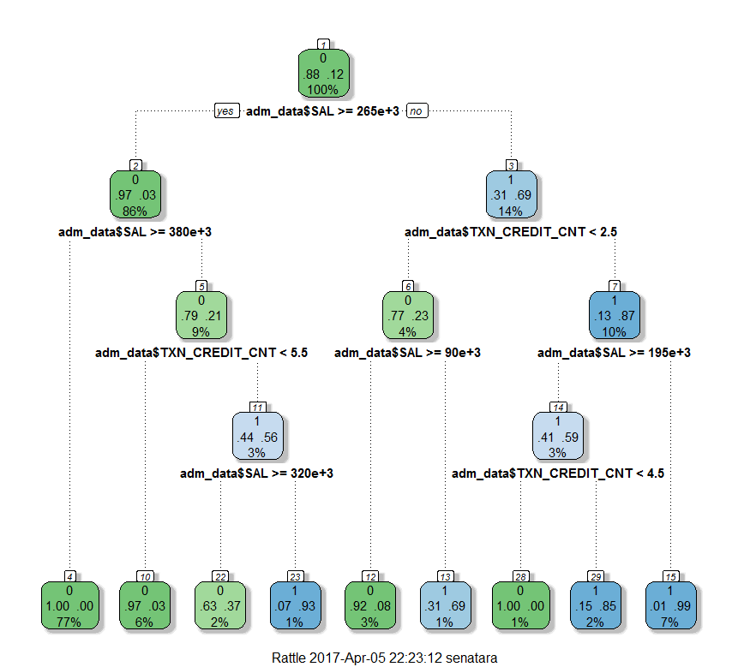
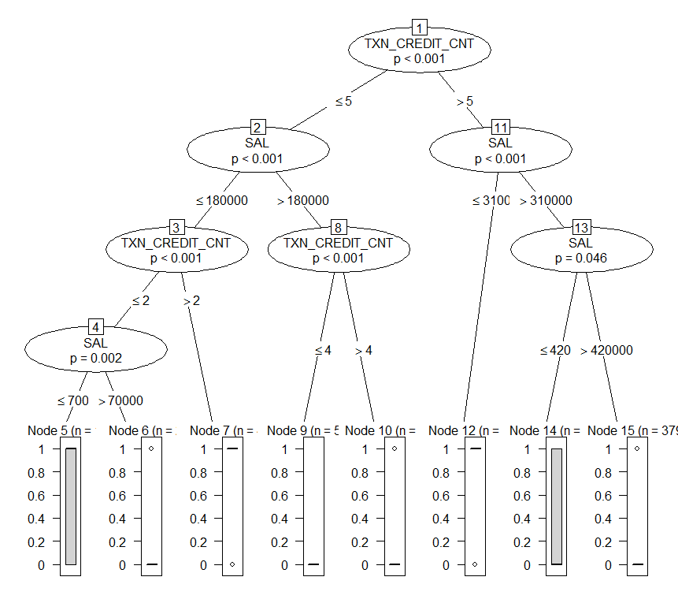
Data Understanding
Salary and Number of credits were the key features contributes for the prediction

Slide 7
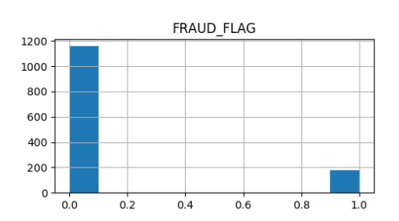
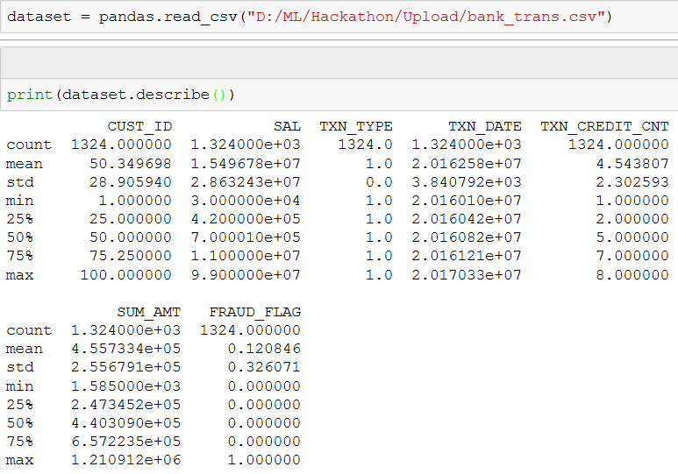
Aggregating Data From BUSINESSTXN Data File
Approximately 16% of the customer transaction were fraudulent
The detail transaction data is aggregated to monthly level for identifying fraudulent transaction

Slide 8
Modeling

Slide 9
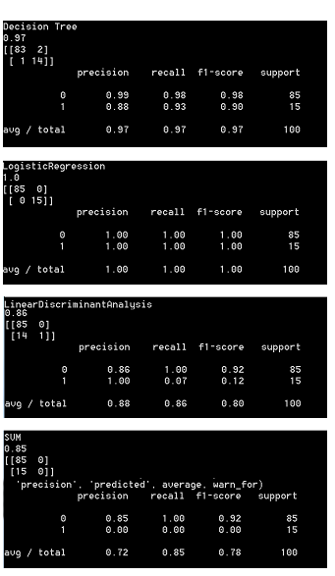
Model Results and Findings
Model classification measures
Precision: When it predicts yes, how often is it correct?
TP/predicted yes
True Positive Rate: When it's actually yes, how often does it predict yes?
TP/actual yes
also known as "Sensitivity" or "Recall
F Score: This is a weighted average of the true positive rate (recall) and precision

Slide 10
Takeaways and Conclusion

Slide 11

Recommendation and Takeaways Placeholder
We have considered supervised learning algorithms like Decision Tree, Logistic Regression, LinearDiscriminantAnalysis, SVM Algorithms for this Fraud prediction classification problem and evaluated against each other on the below classification measures
Post Evaluation the model built using logistic regression and classification regression trees were more accurate than the others

