Slide 1
POINTLESS SLIDE IS POINTLESS

Slide 2
Raymond McDermott Lead Software Engineer & University Liaison feature[23]
Degrees from FSU and UNF in Classical Guitar and Computing respectively
Musician, martial artist, home brewer, and USCG certified (expired) captain
JavaScript Wrangler and Historian

Slide 3
Goals
Notes:
Quick walkthrough of the big picture of application development and how everything fits together
Cover JavaScript’s history and fundamentals
Walk through some examples to give you an idea of what JS looks and feels like
Showcase some libraries and frameworks
Homework

Slide 4
Previously, on Pay Attention and You’ll Get a Job…

Slide 5
Client
Server
Database
Phone, Tablet, Desktop, Laptop, Watch, Other Servers, et al
Application Code in C#, Java, Node, PHP, Python, et al
SQL, MySQL, Postgres, Mongo, et al
Notes:
Client: Laptop, Desktop, Phone, Tablet, Watch, other Servers
Client requests a resource
Server might authenticate/authorize, retrieve some data, and send a response in some format (HTML, JSON, XML, et al)

Slide 6
Client
Server
Database
What the User sees and interacts with
The heart of your Application
That stuff everyone ignores that eventually cripples your team, client, and company.
Notes:
Traditional Boundaries

Slide 7
Client
Server
Database
Application Code
Notes:
Traditional Boundaries

Slide 8


Client
Server
Database
JavaScript
JavaScript
JavaScript
Notes:
Traditional Boundaries

Slide 9
On Today’s Episode of Pay Attention and You’ll Get a Job…

Slide 10
JavaScript: How Ten Days of Hacking Changed the Web
…and desktop, and mobile, and even satellites.
“Software JavaScript is eating the world…” Marc Andreessen
Notes:
This Is not a joke

Slide 11
War Drives Technology
Notes:
Written in 10 days by Brendan Eich in May 1995, while working at Netscape, which eventually became Mozilla.
Original name was Mocha.
2005, AJAX was coined by Jesse James Garrett, fundamentally shifting the course of Web Development (dynamic apps)
Mosaic Wars, Second Browser Wars, Current Browser Wars

Slide 12
Why Should You Care About JavaScript?

Slide 13
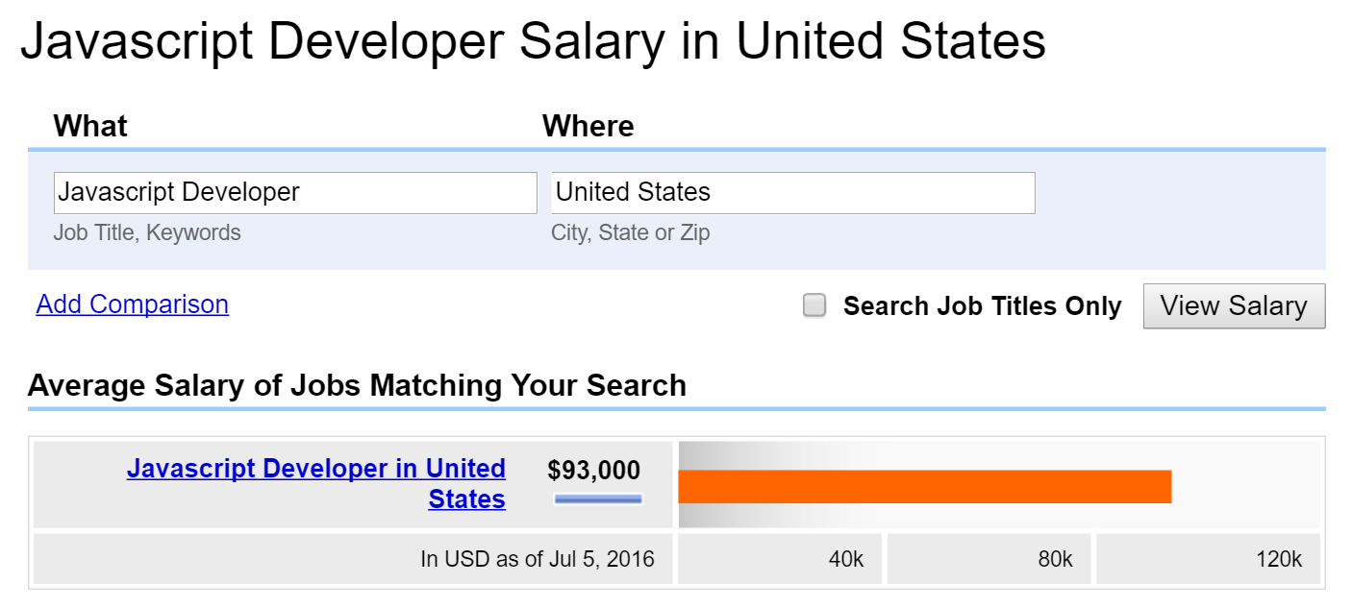
Notes:
I can give you three really good reasons
Seriously though, because of its ubiquity we have inevitability (SQL, Security, it’s everywhere) because of our own stupidity. Just learn it.

Slide 14
Basics
Notes:
Demo
Language Fundamentals
So, why frameworks? Because JavaScript

Slide 15
Frameworks & Libraries

Slide 16
jQuery
Notes:
First, there was jQuery.
It solved a ton of problems for Web Developers, but most importantly it provided a higher level abstraction over JavaScript that hid a lot of the underlying bugs and handled cross browser issues.

Slide 17
Backbone, Angular, Ember, Knockout, Polymer, React, Mithril, Ampersand, Flight, Vue, Node… WTFJS
Notes:
Then all this shit just happened.
It’s like Ford versus Chevy on steroids.
Everyone is right, everyone is wrong.
Whatever you choose should be based on the constraints you’re given and the context within which you’re operating. If you choose Framework A or Library X because “it’s what you know” or because “it’s easy” then you’re acting unethically.

Slide 18
Silver Bullets
Notes:
There are no Silver Bullets in software, just the SOTA.

Slide 19
SPAs
Notes:
Single Page Applications are currently quite popular.
But I would argue for mobile or native development of SPAs. Again, this depends on your client’s needs.
They require experience, and I wouldn’t recommend them for student projects.

Slide 20
Code

Slide 21
Questions?

Slide 22
Homework

Slide 23
Resources
https://developer.mozilla.org/en-US/docs/Web/JavaScript
http://interactivepython.org/runestone/static/webfundamentals/Javascript/intro.html
https://www.codecademy.com/learn/javascript
http://www.crockford.com/
https://javascriptweblog.wordpress.com/
https://facebook.github.io/react/
https://angularjs.org/
http://emberjs.com/
https://jquery.com/
https://github.com/getify/You-Dont-Know-JS
http://www.webhammer.com/javascript/exercises/index.html
http://www.w3resource.com/javascript-exercises/

