Slide 1
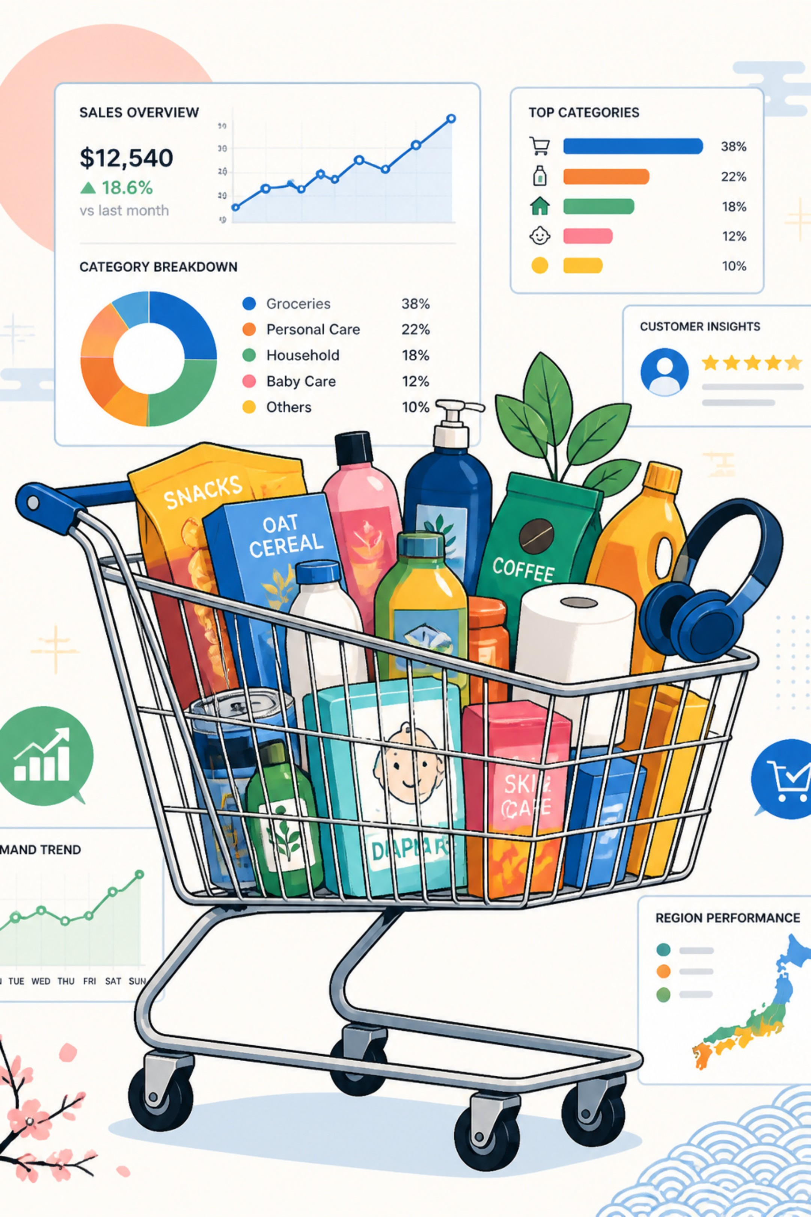
Customer Shopping Behavior Analysis
Analyzing customer purchasing patterns to drive
data-driven retail business decisions.

Slide 2
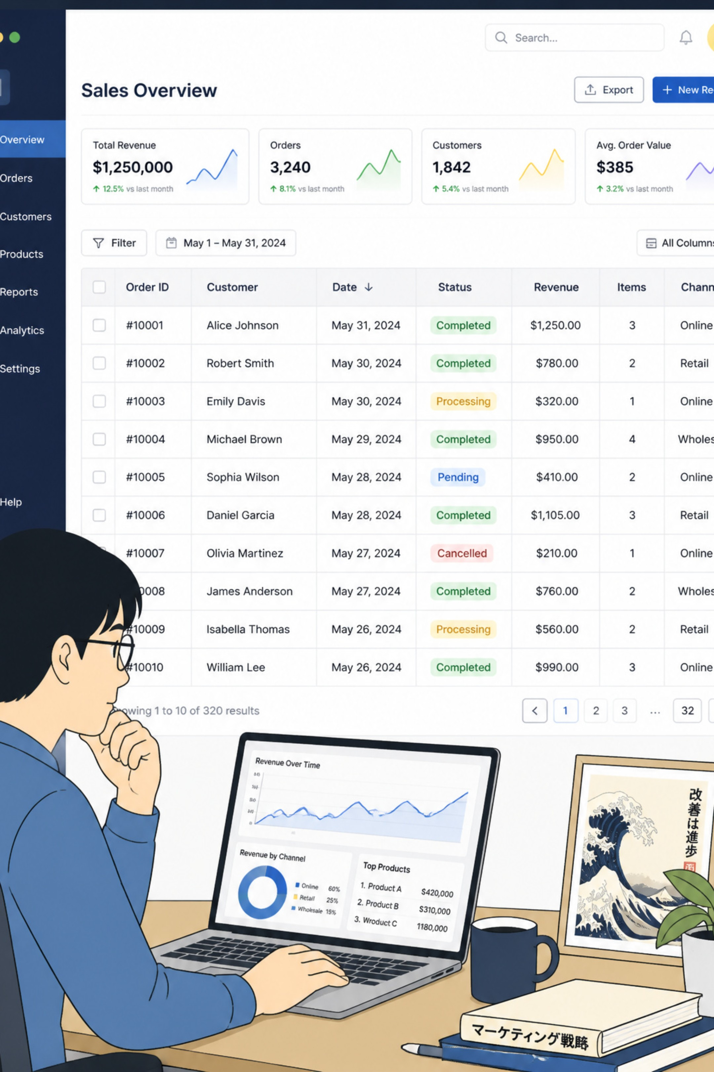
Dataset Snapshot
Rows & Columns
Key Features
3,900 rows • 18 columns
Demographics, Purchase details, Behavior flags
Missing Data
Review Rating: 37 nulls

Slide 3

Data Preparation (Python)
Load & Inspect
pandas: df.info(), .describe()
Impute
Review Rating → median by category
Rename
Columns → snake_case
Feature Eng.
age_group, purchase_frequency_days

Slide 4
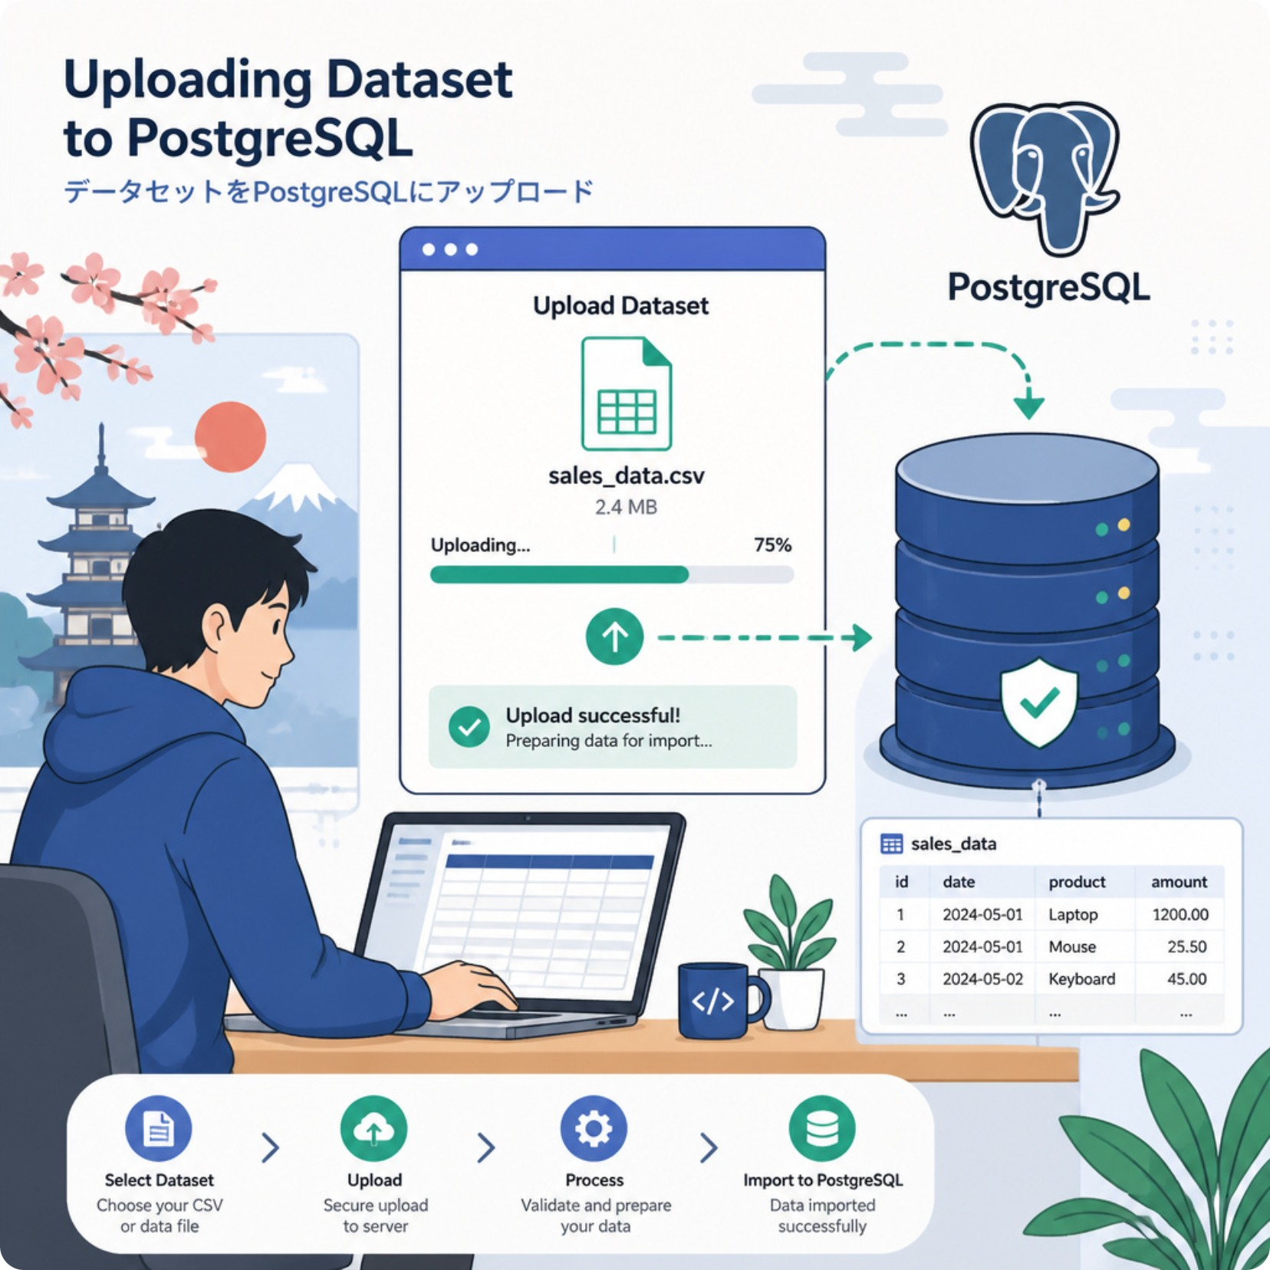

Data Consistency & Integration
Consistency
DB Load
Dropped redundant promo_code_used (redundant with discount_applied)
Cleaned DataFrame → PostgreSQL for SQL analysis

Slide 5
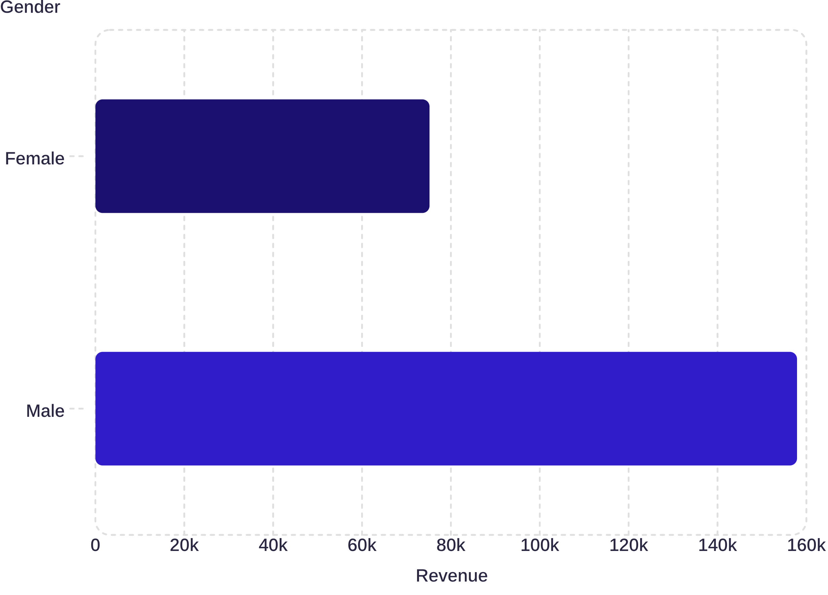
Revenue by Gender
Key Insights
• Male customers contribute nearly twice the total revenue compared to female customers.
• The revenue gap may be influenced by differences in customer count, purchase frequency, or average order value.
• Female customers still represent a significant revenue segment with growth potential.
• A deeper analysis of product preferences can help identify opportunities to increase female customer spending.

Slide 6

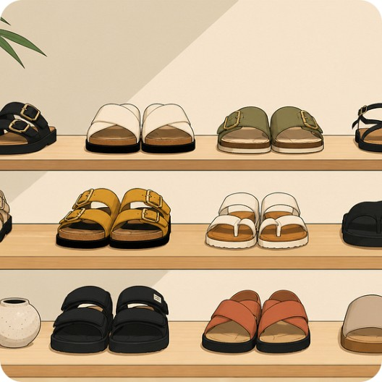
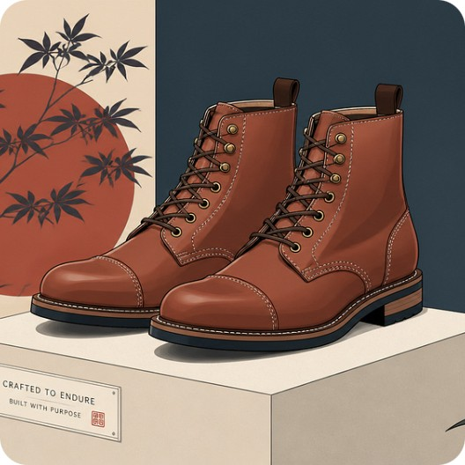

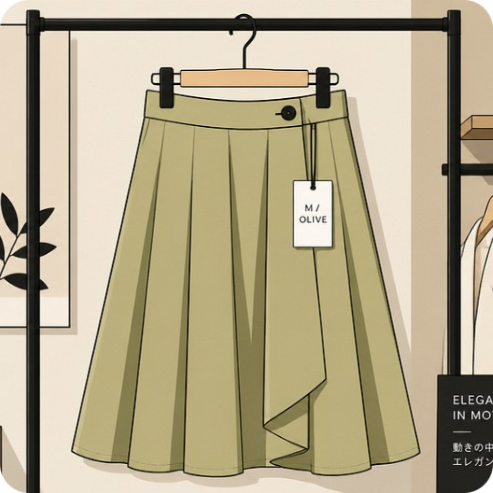
Top Products & Ratings
Gloves
Sandals
Boots
Hat
Avg rating 3.86
Avg rating 3.84
Avg rating 3.82
Avg rating 3.80
Skirt
Avg rating 3.78

Slide 7
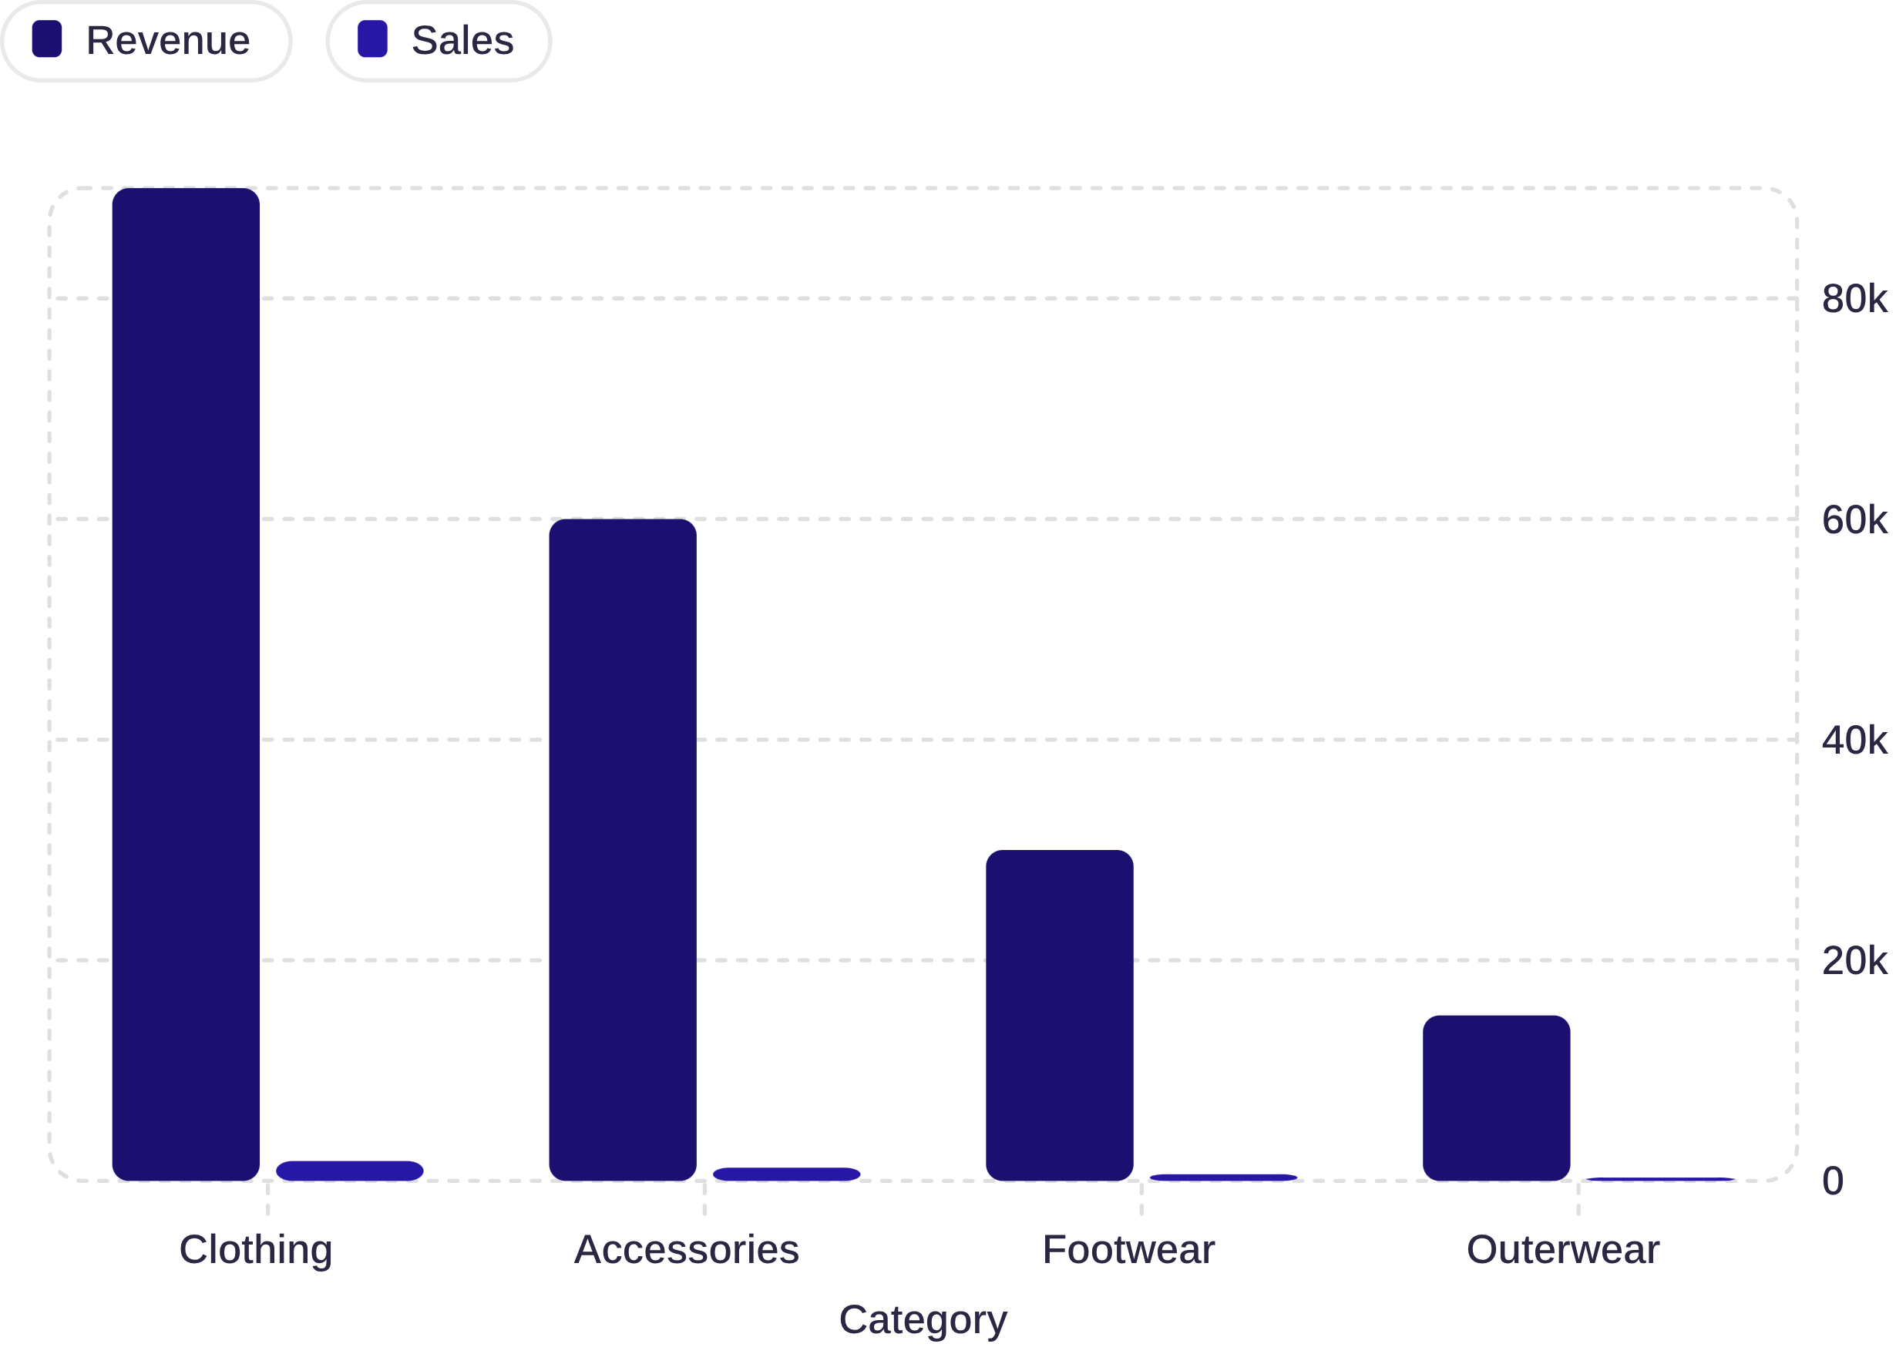
Sales & Revenue by Category
Key Insights
• Clothing contributes the highest share of total revenue.
• Accessories generate strong revenue with fewer sales, indicating a higher average selling price.
• Footwear and Outerwear have lower sales volumes, presenting opportunities for targeted promotions.
• Revenue is concentrated in two major categories, suggesting dependency on Clothing and Accessories.

Slide 8
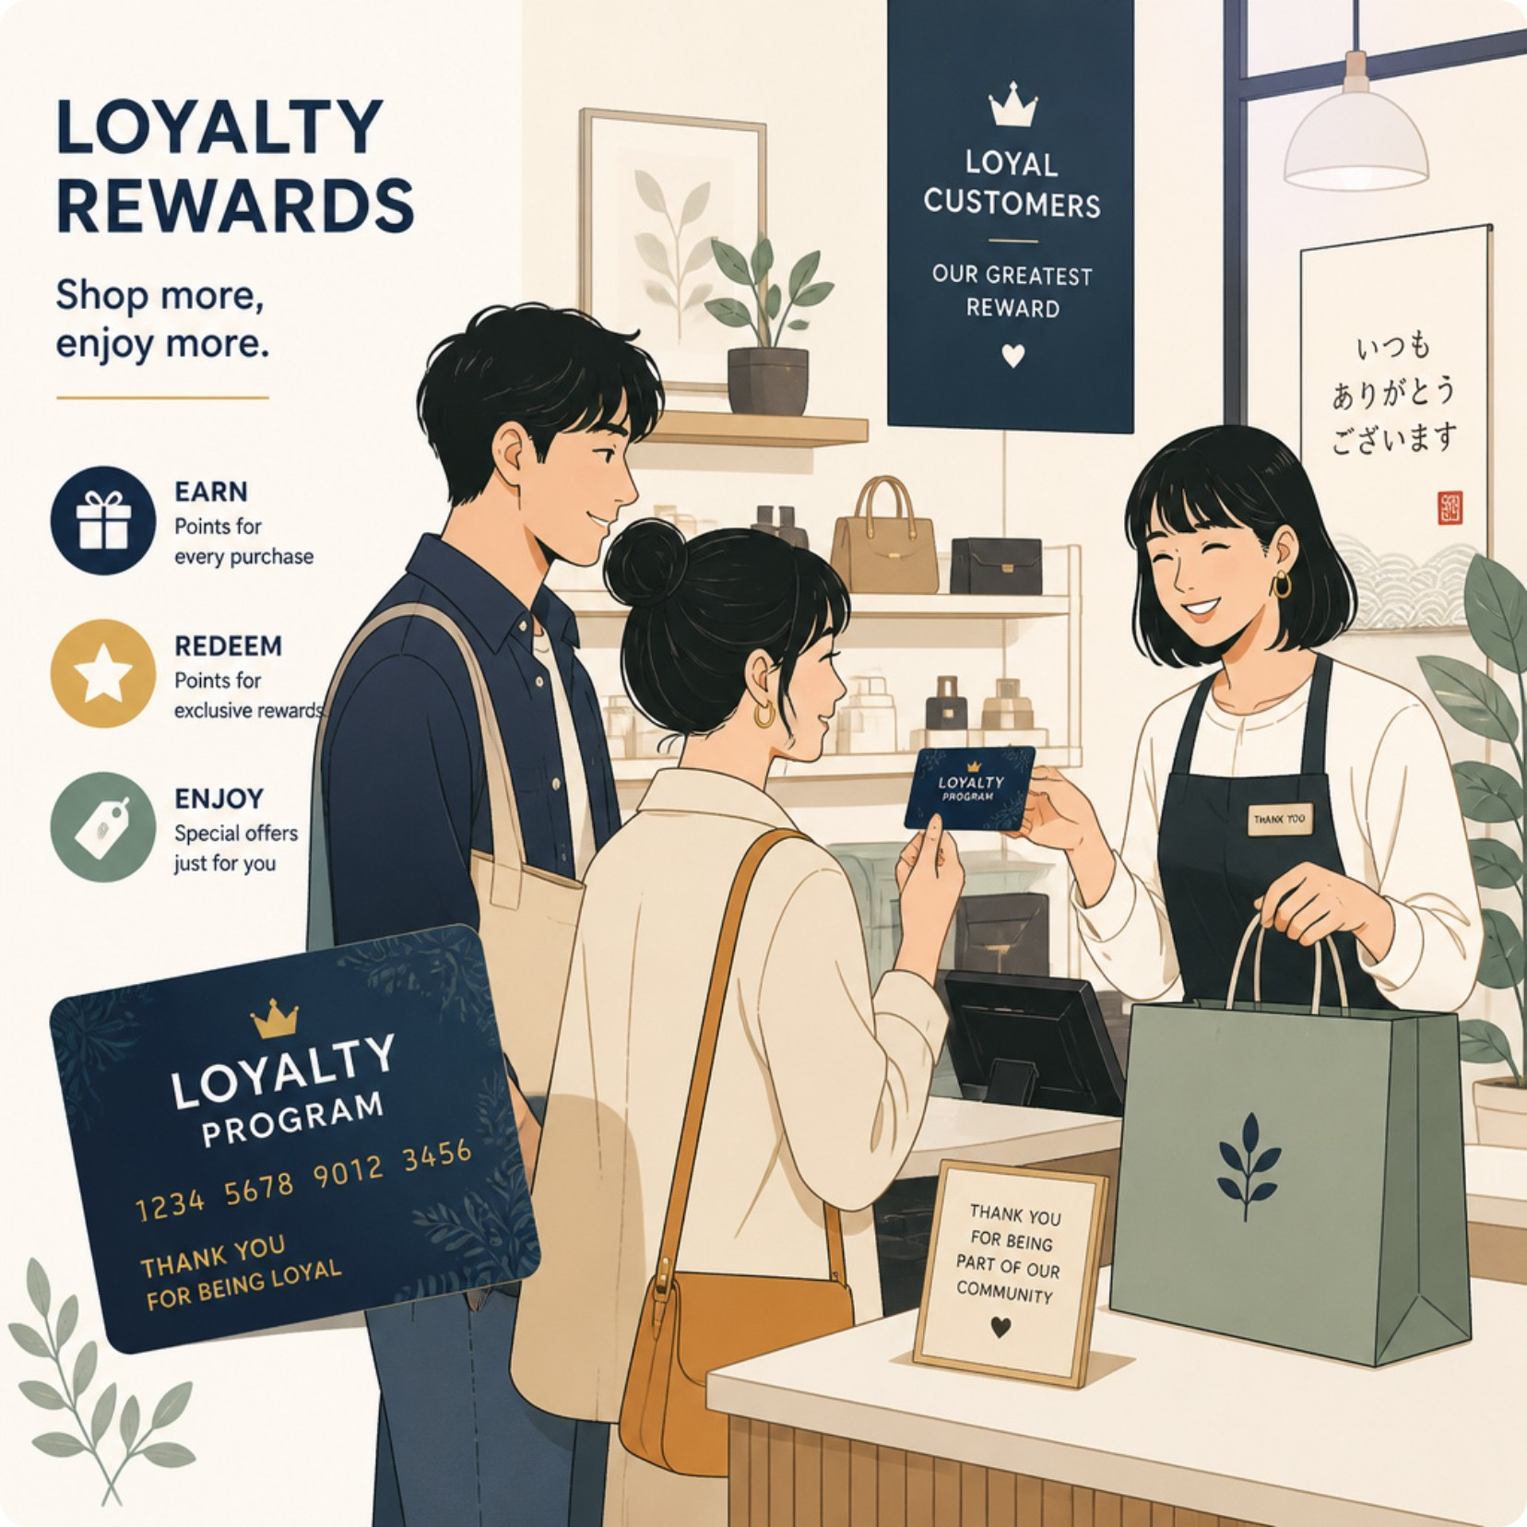
Customer Segments & Subscriptions
Segments
Subscriptions
Non-Subscribers
Loyal 3,116 • Returning 701 • New 83
Yes: 1,053 customers • Avg spend $59.49 • Revenue $62,645
No: 2,847 customers • Avg spend $59.87 • Revenue $170,436

Slide 9



Key Business Insights
Discount Analysis
Shipping Effect
Revenue by Age
Top discounted items:
Hat 50%, Sneakers 49.66%,
Coat 49.07%, Sweater 48.17%, Pants 47.37%
Avg purchase:
Standard $58.46
Express $60.48
Young Adult 62,143
Middle-aged 59,197
Adult 55,978
Senior 55,763

Slide 10

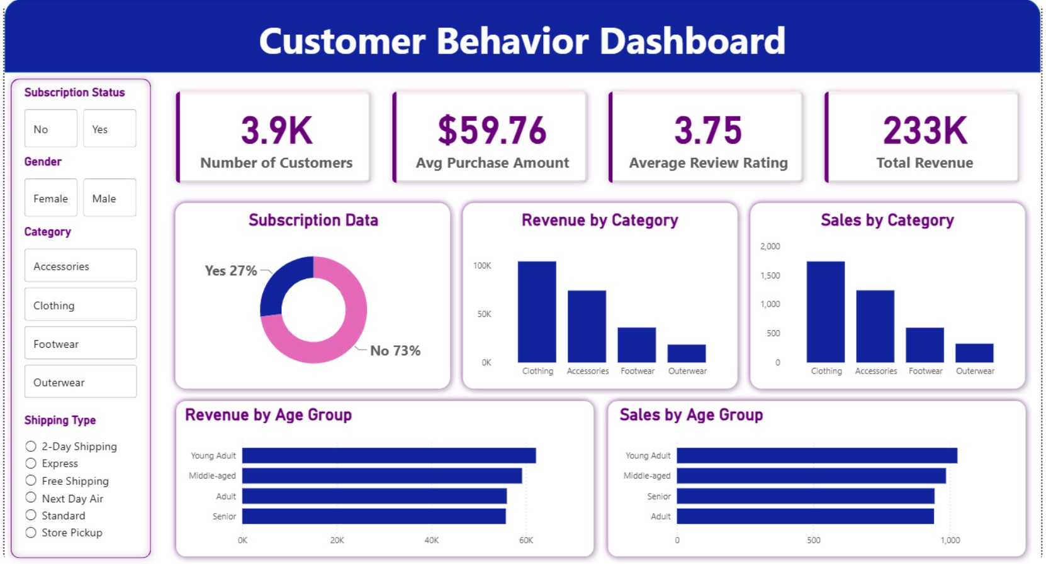

Dashboard & Recommendations
Boost Subscriptions
Loyalty Programs
Review Discount Policy
Promote exclusive benefits
Reward repeat buyers to convert to Loyal
Balance volume with margin
Product Positioning
Targeted Marketing
Highlight top-rated & best-selling items
Focus on high-revenue age groups & express-shipping users

