Slide 1
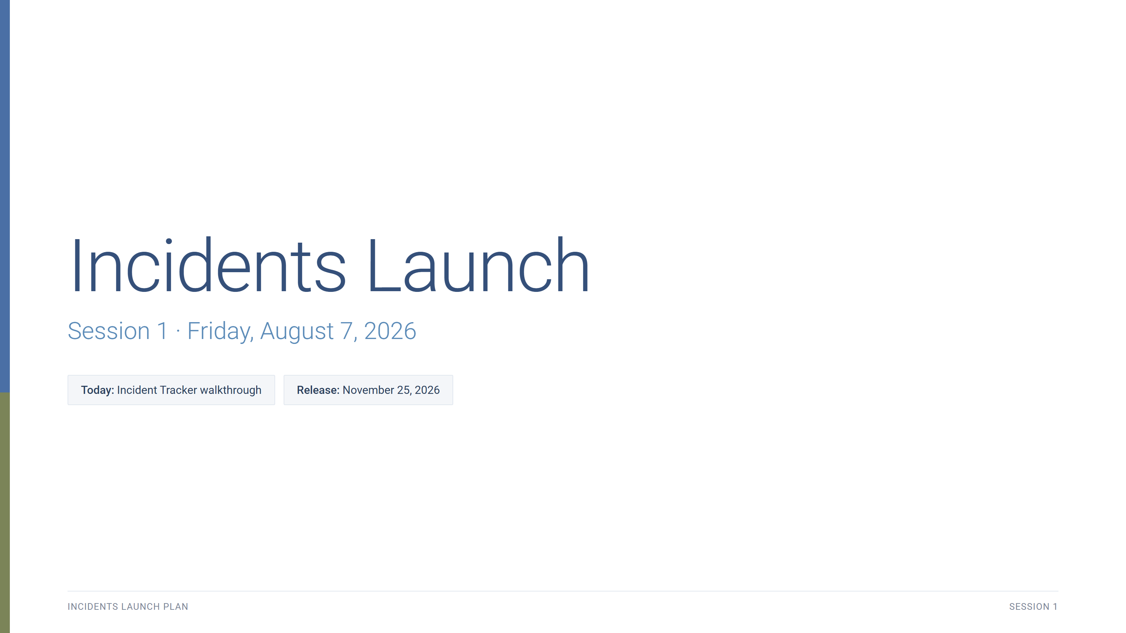
Notes:
30 minutes, every Friday. Purpose: work the Incidents Launch Plan to the November 25, 2026 release.

Slide 2
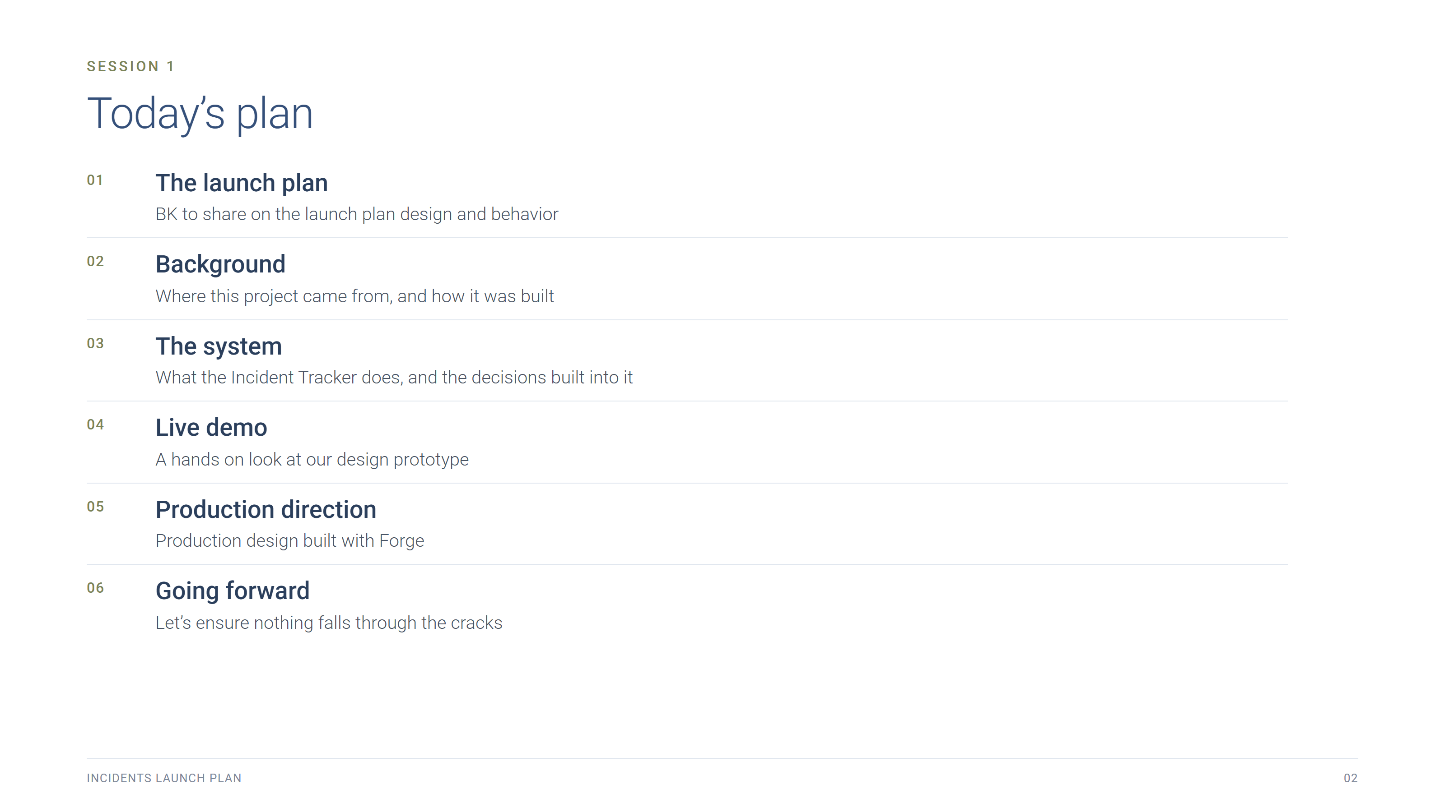
Notes:
Today's plan, six subjects. Keep the room moving.

Slide 3
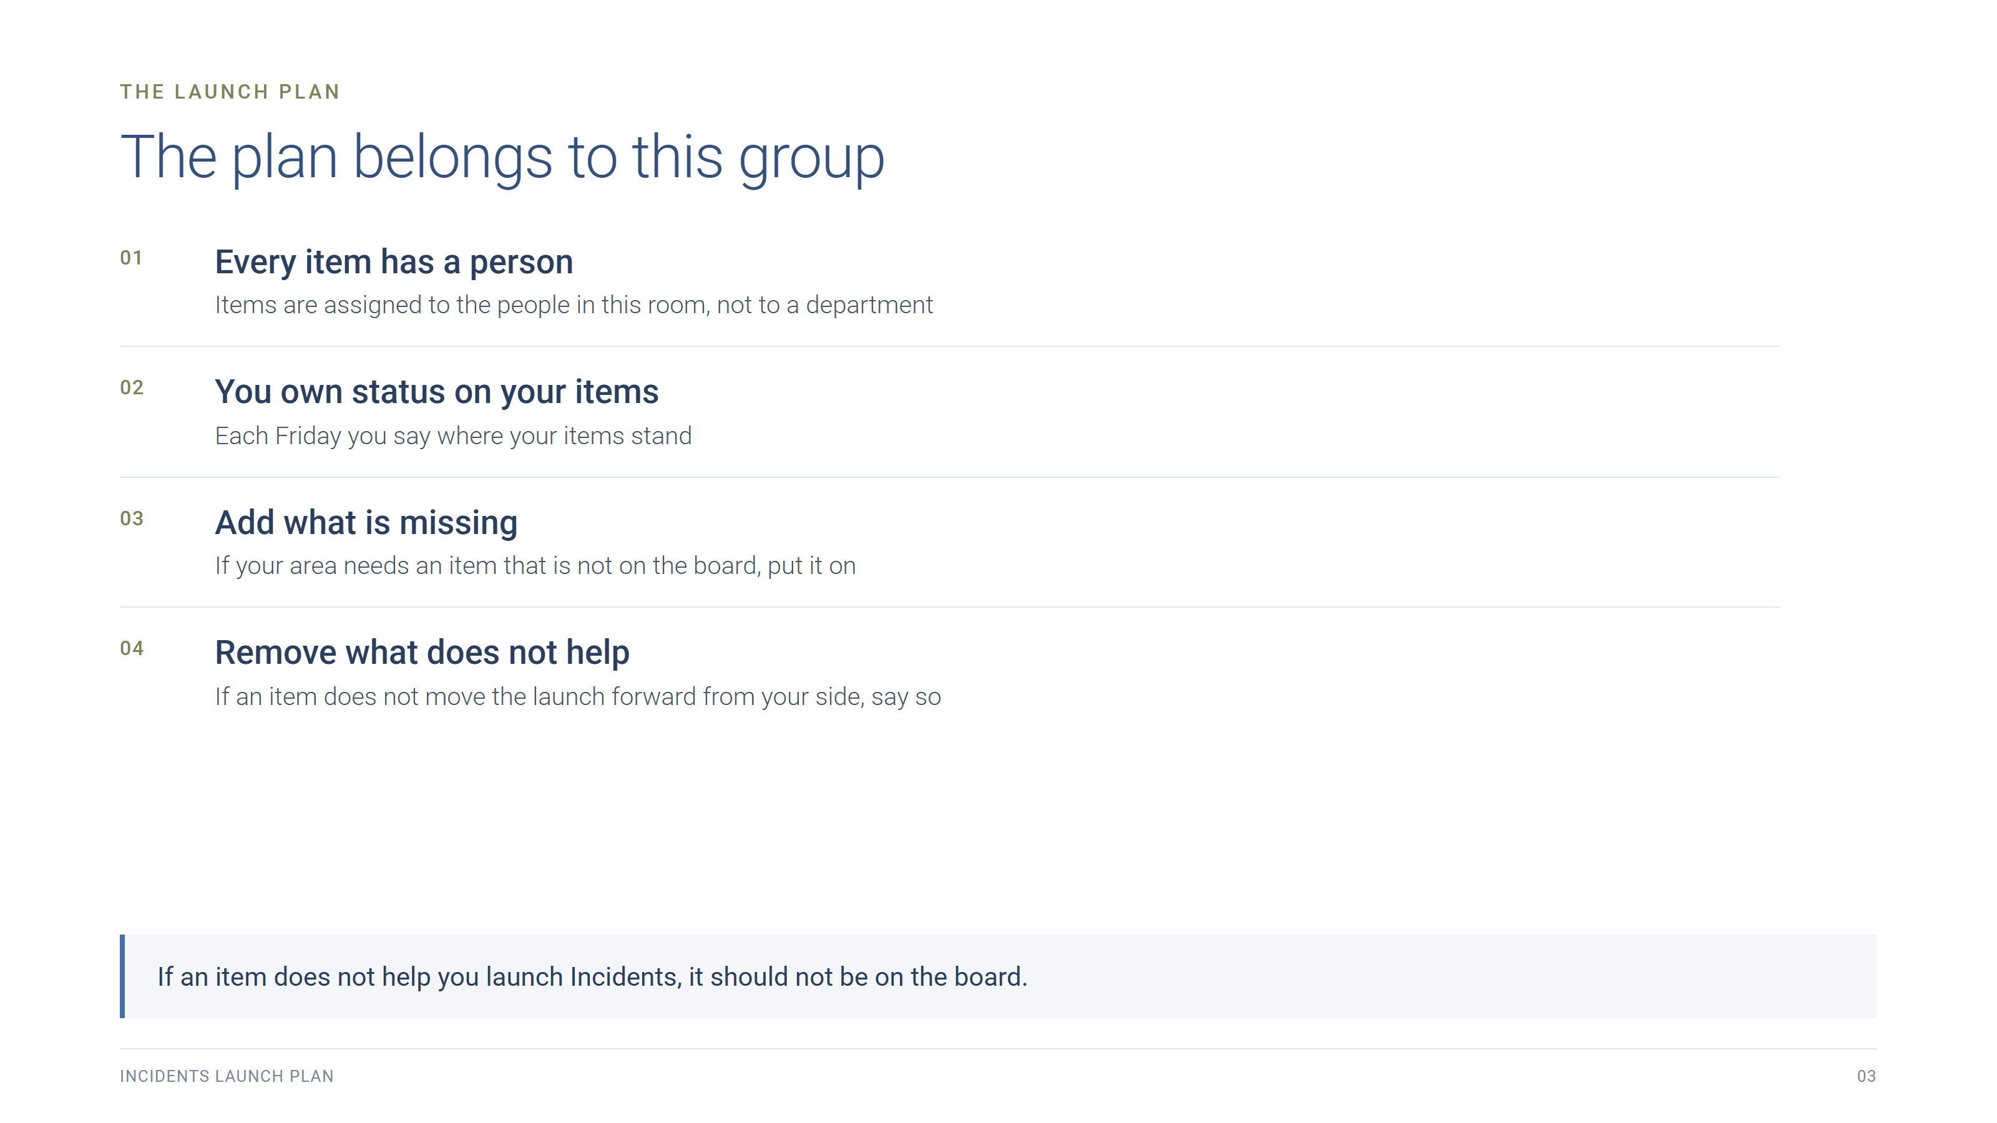
Notes:
BK opens here. The plan belongs to the people in the room: every item has a person on it, that person owns status, and anyone can add an item their area needs or call out an item that does not help the launch.

Slide 4
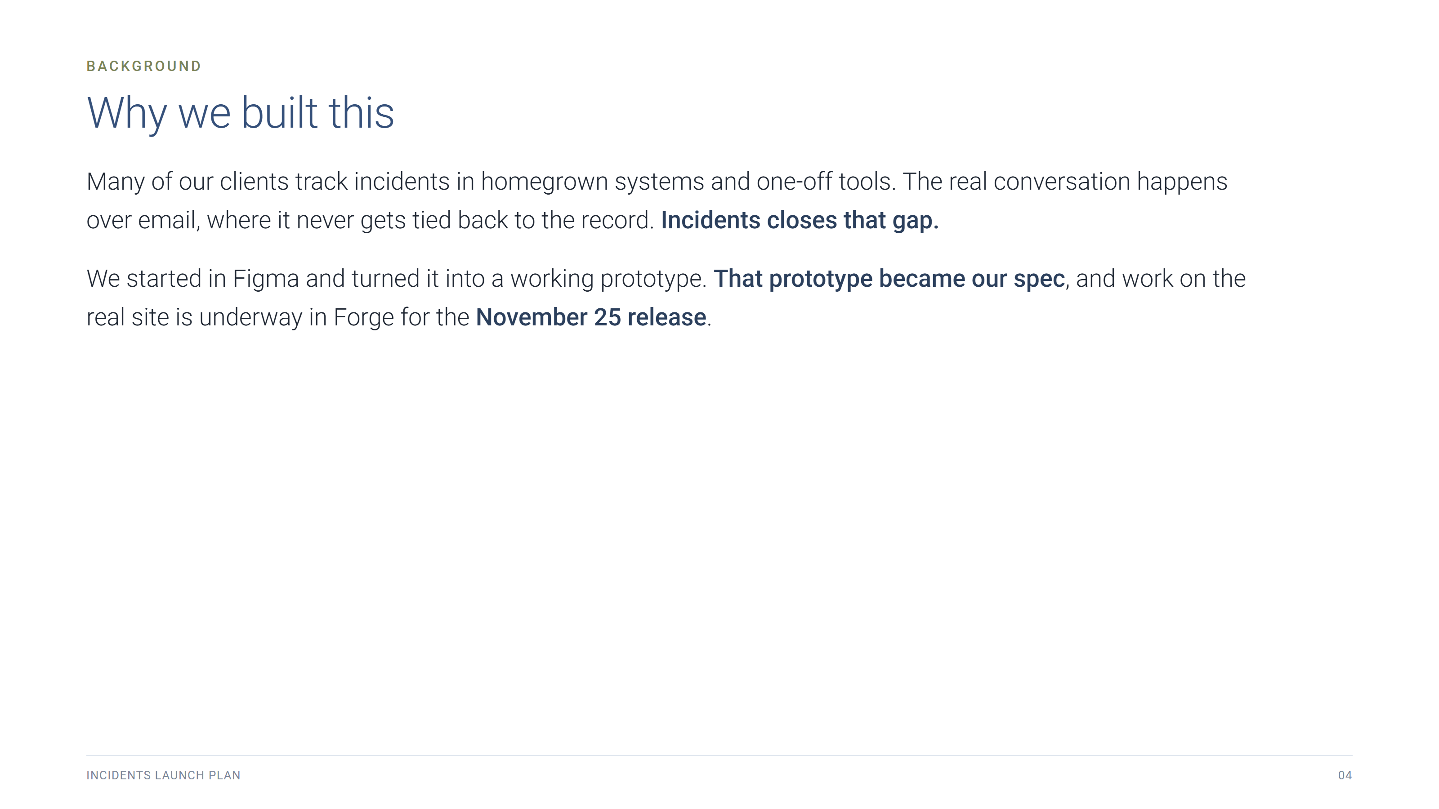
Notes:
Background. The gap Incidents fills: clients on homegrown tools, the real conversation in email and never tied to the record.

Slide 5
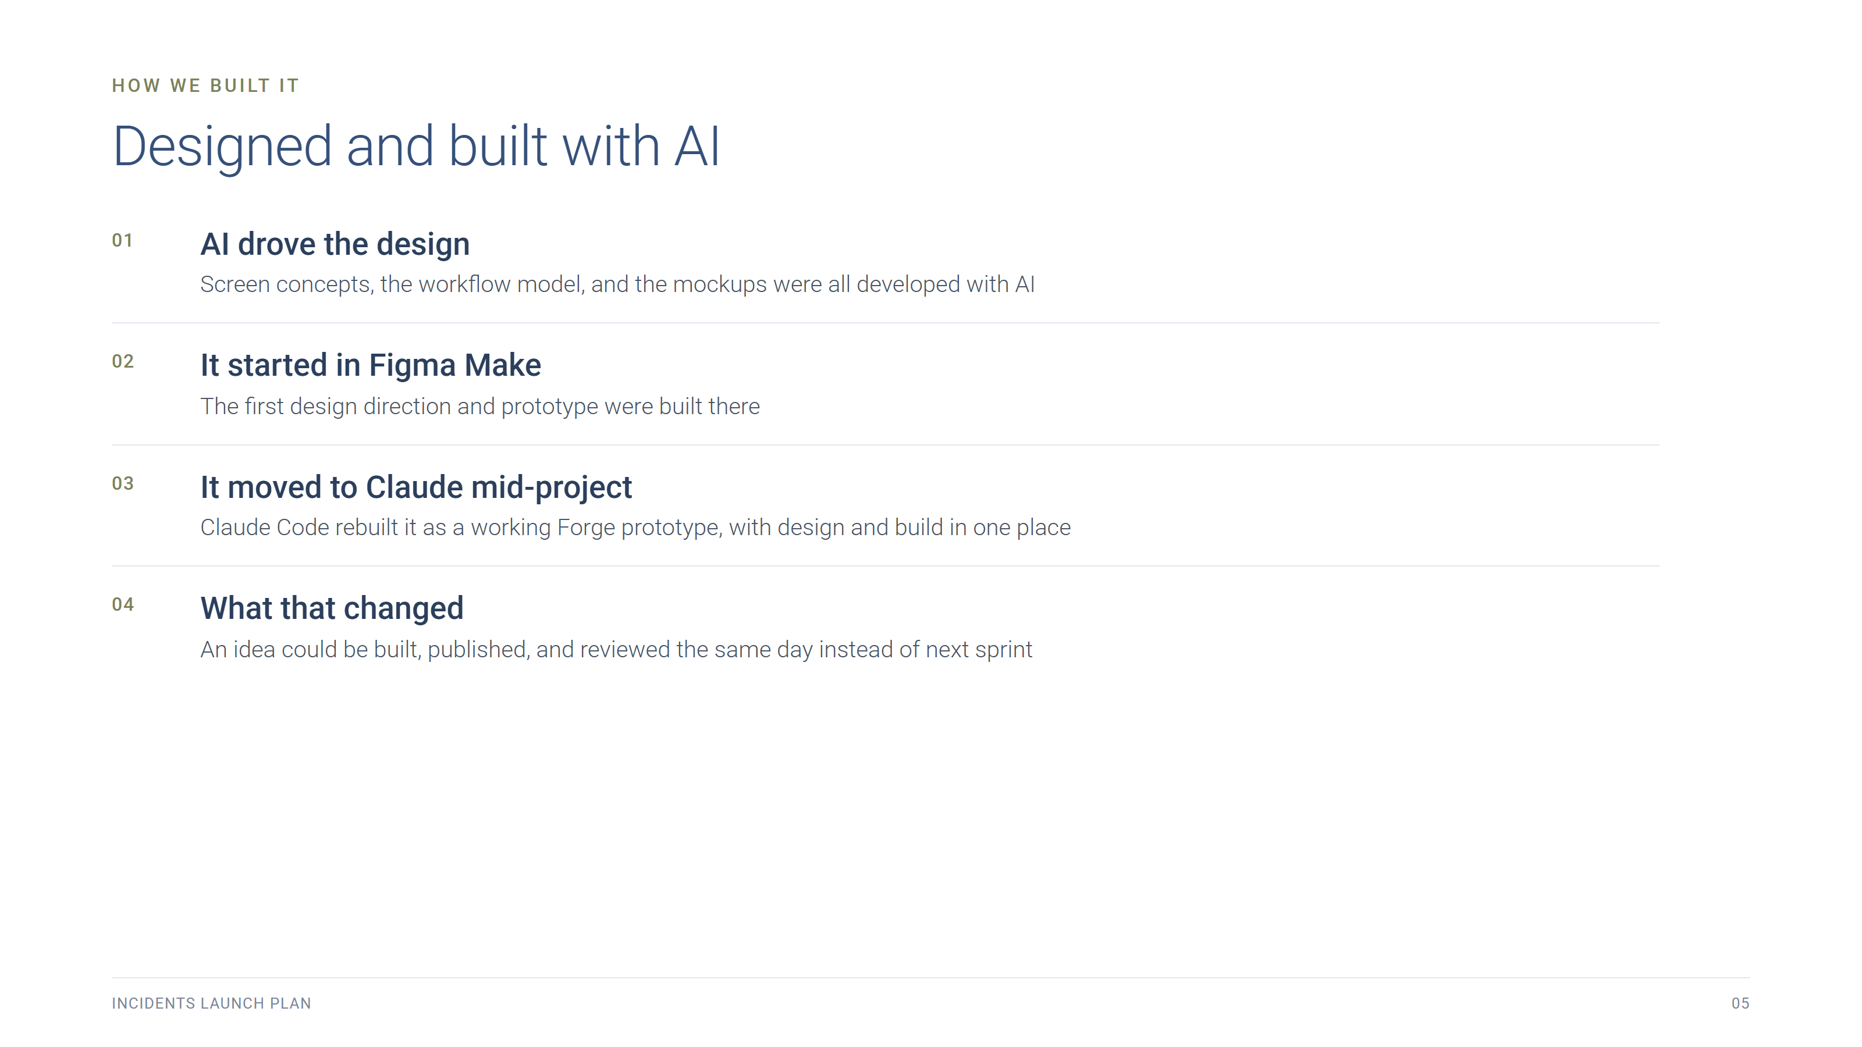
Notes:
The process is part of what makes this project unusual: AI drove the design and the mockups. It began as a Figma Make design and moved to Claude mid-project, where Claude Code built the working Forge prototype. Say AI-powered, not hackathon.

Slide 6
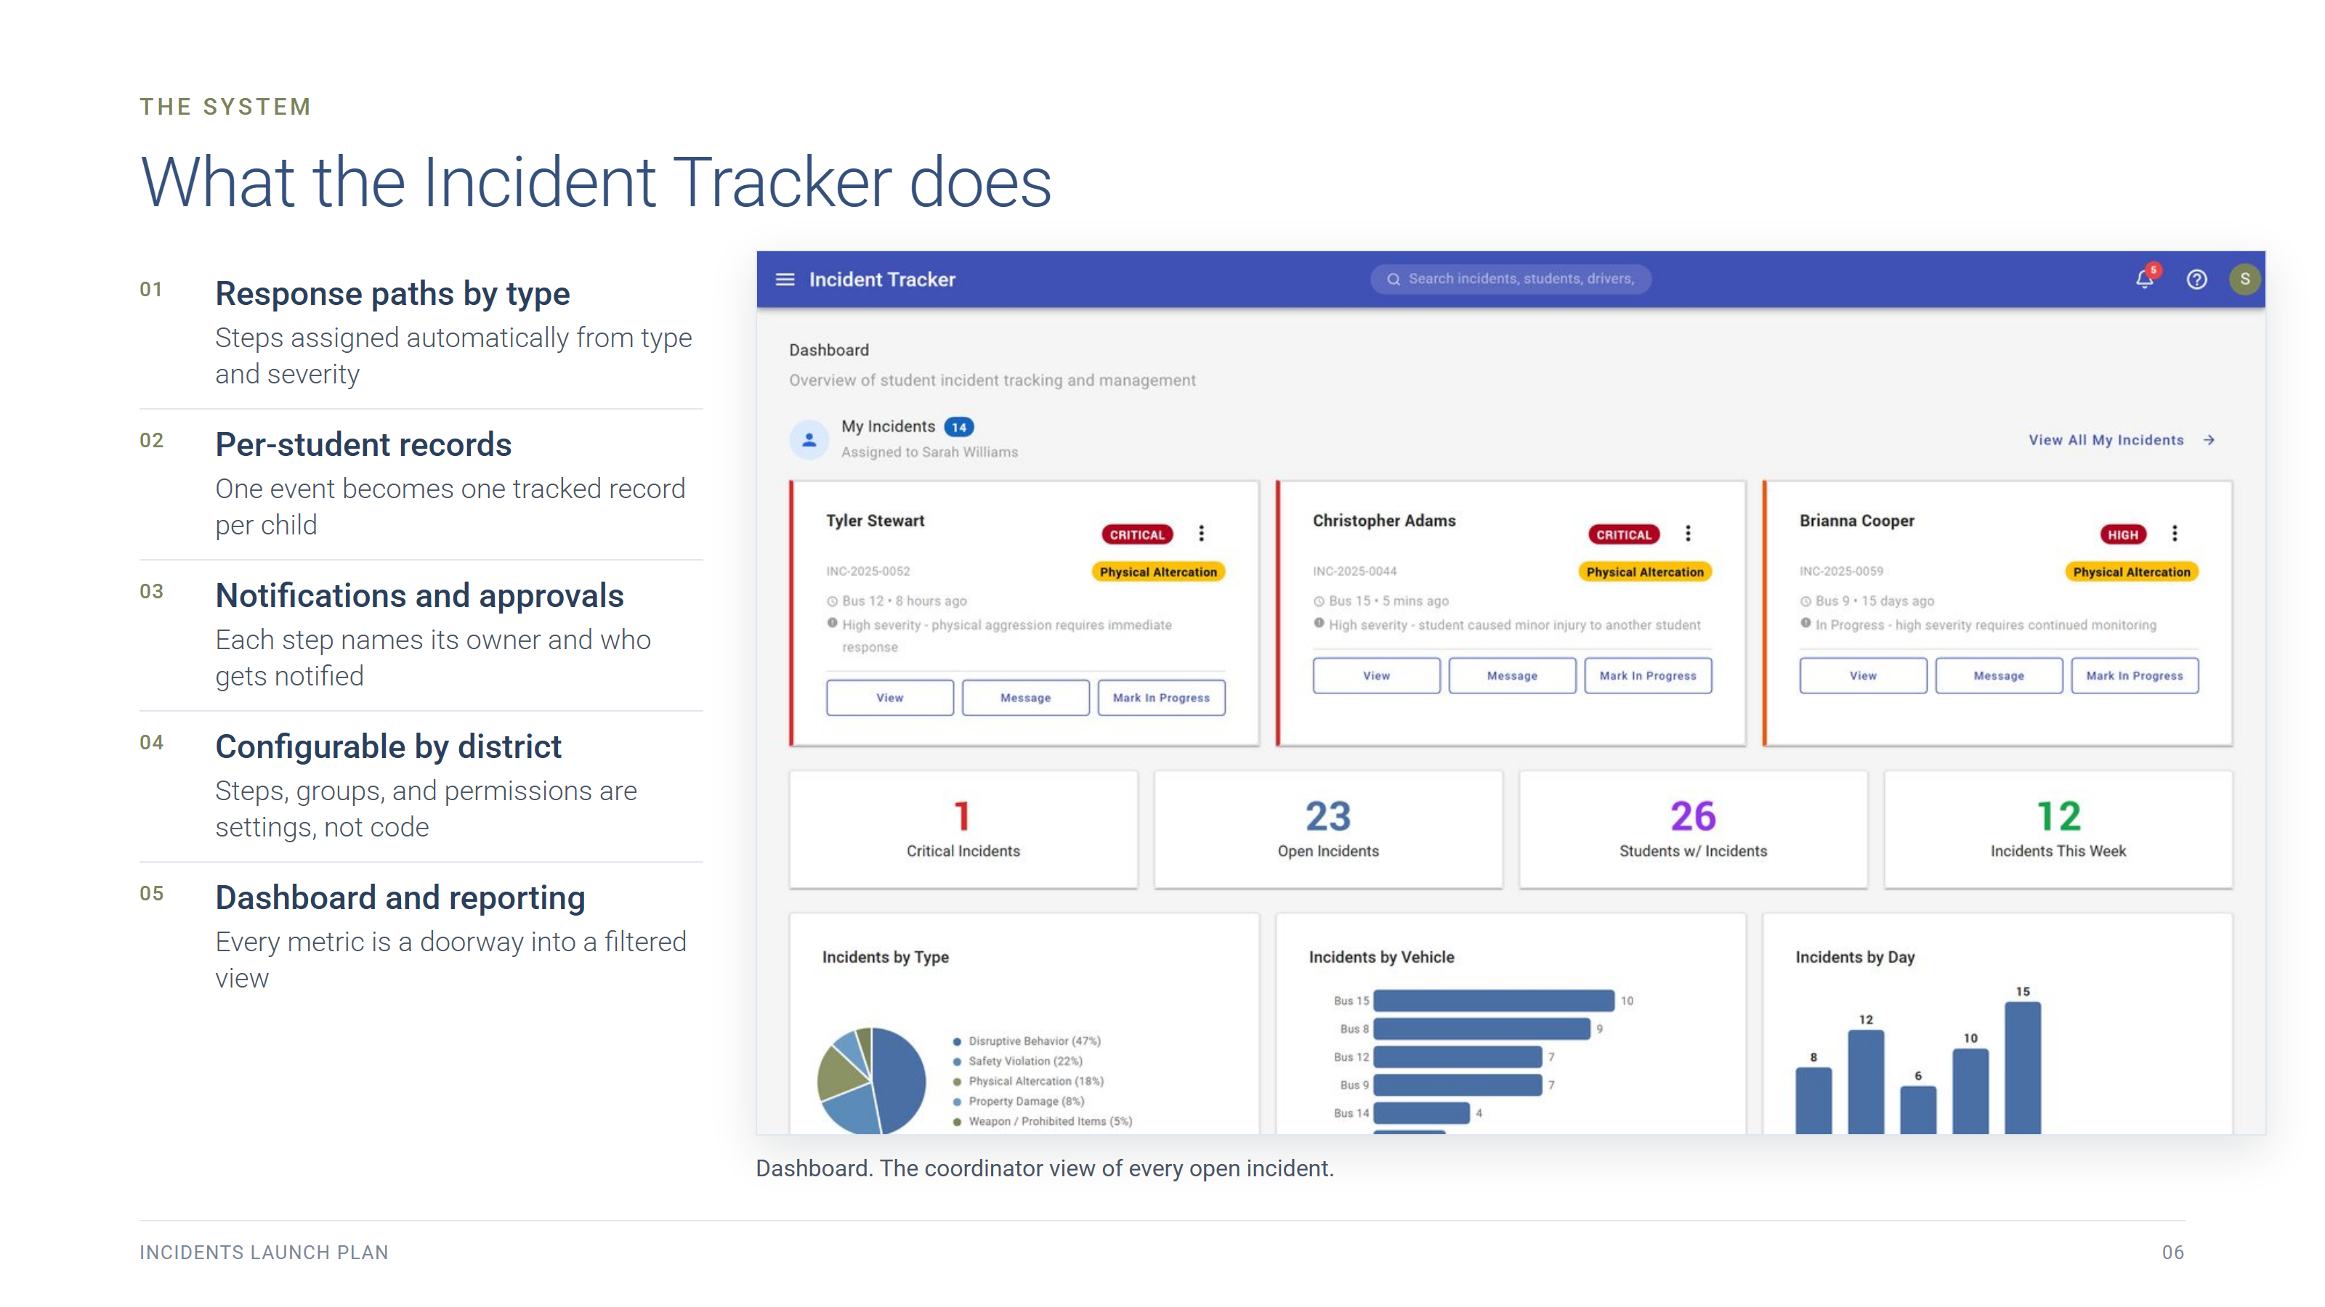
Notes:
The only system slide. Name the five capabilities, do not explain them here: the demo does that. Data is realistic but simulated, so no real notifications go out.

Slide 7
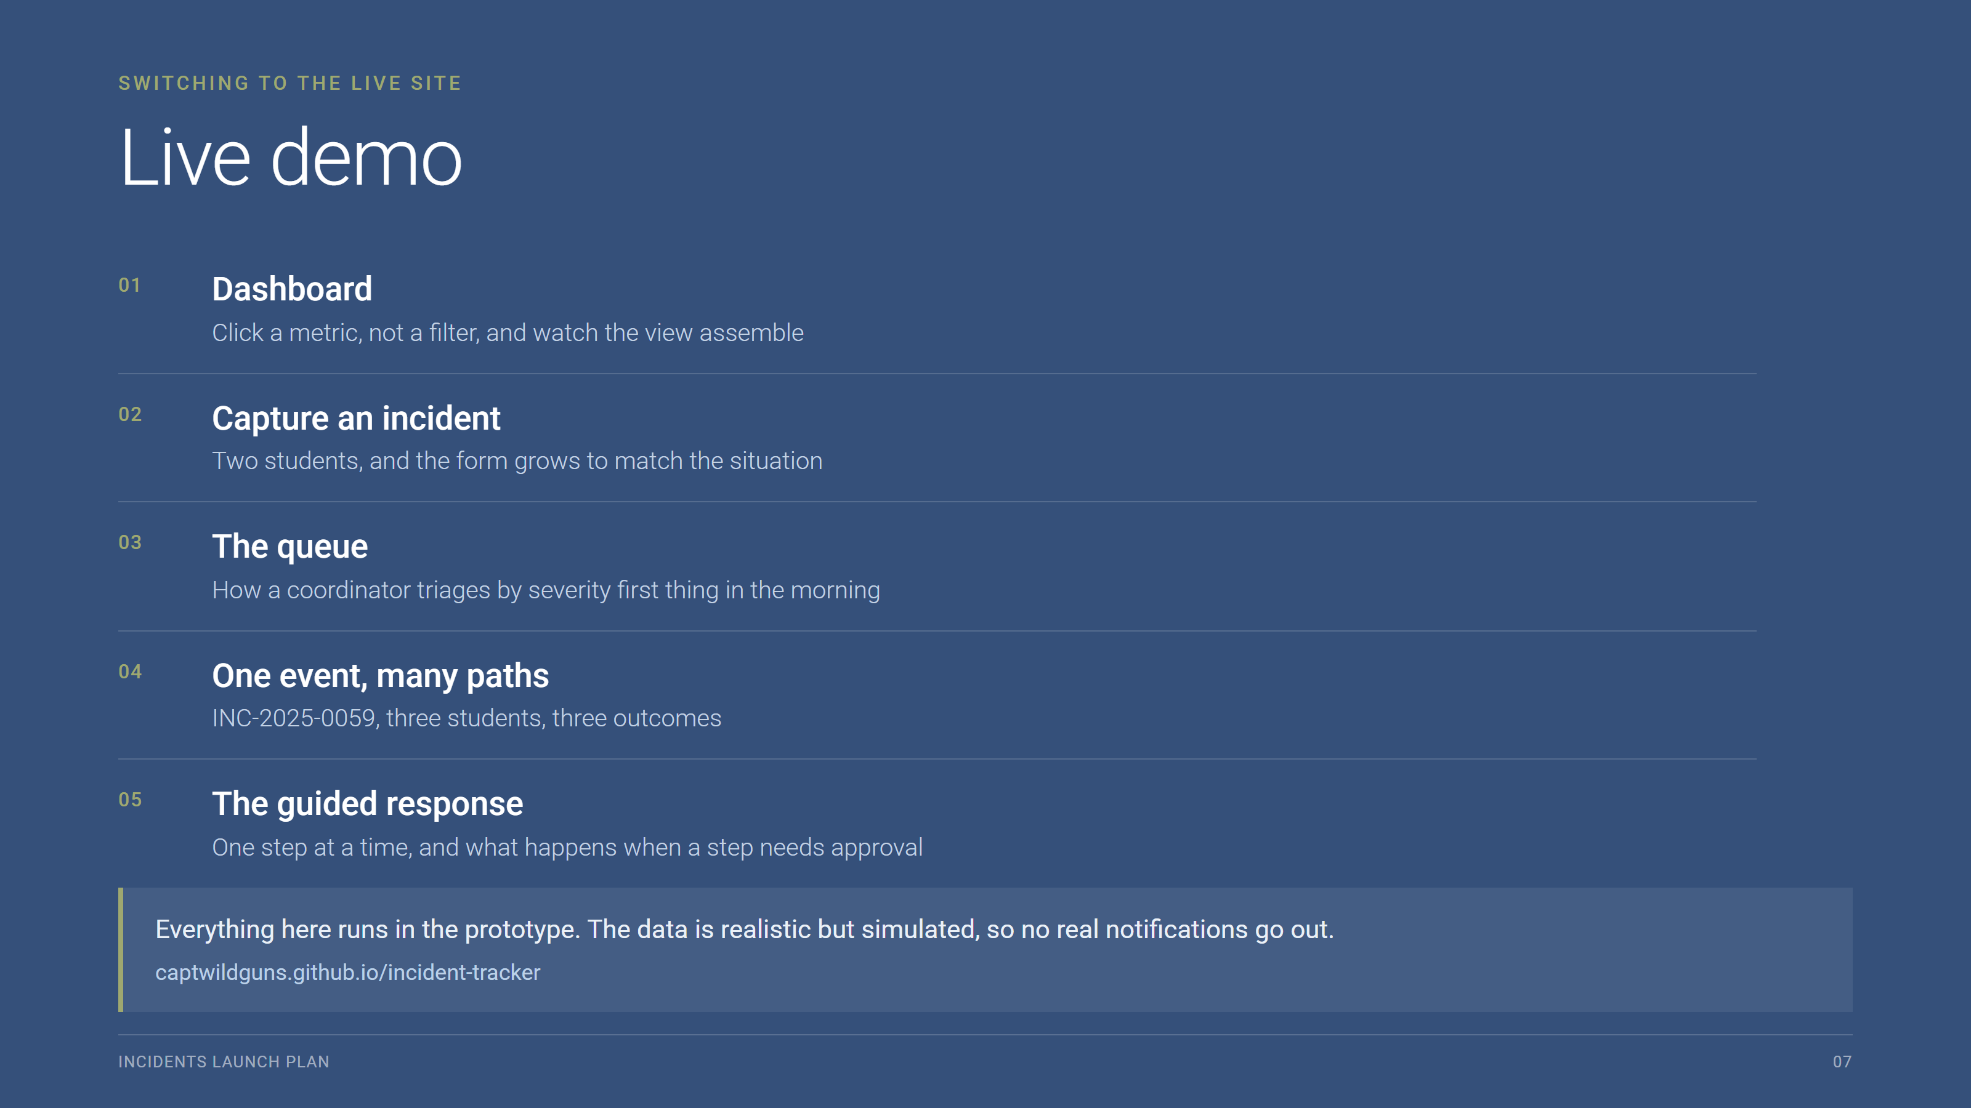
Notes:
Switch to captwildguns.github.io/incident-tracker. Five beats, about 15 minutes. This is where the detail lives now. Worth mentioning out loud: a driver files from a tablet after the route, not during it, and we are not showing the tablet today.

Slide 8
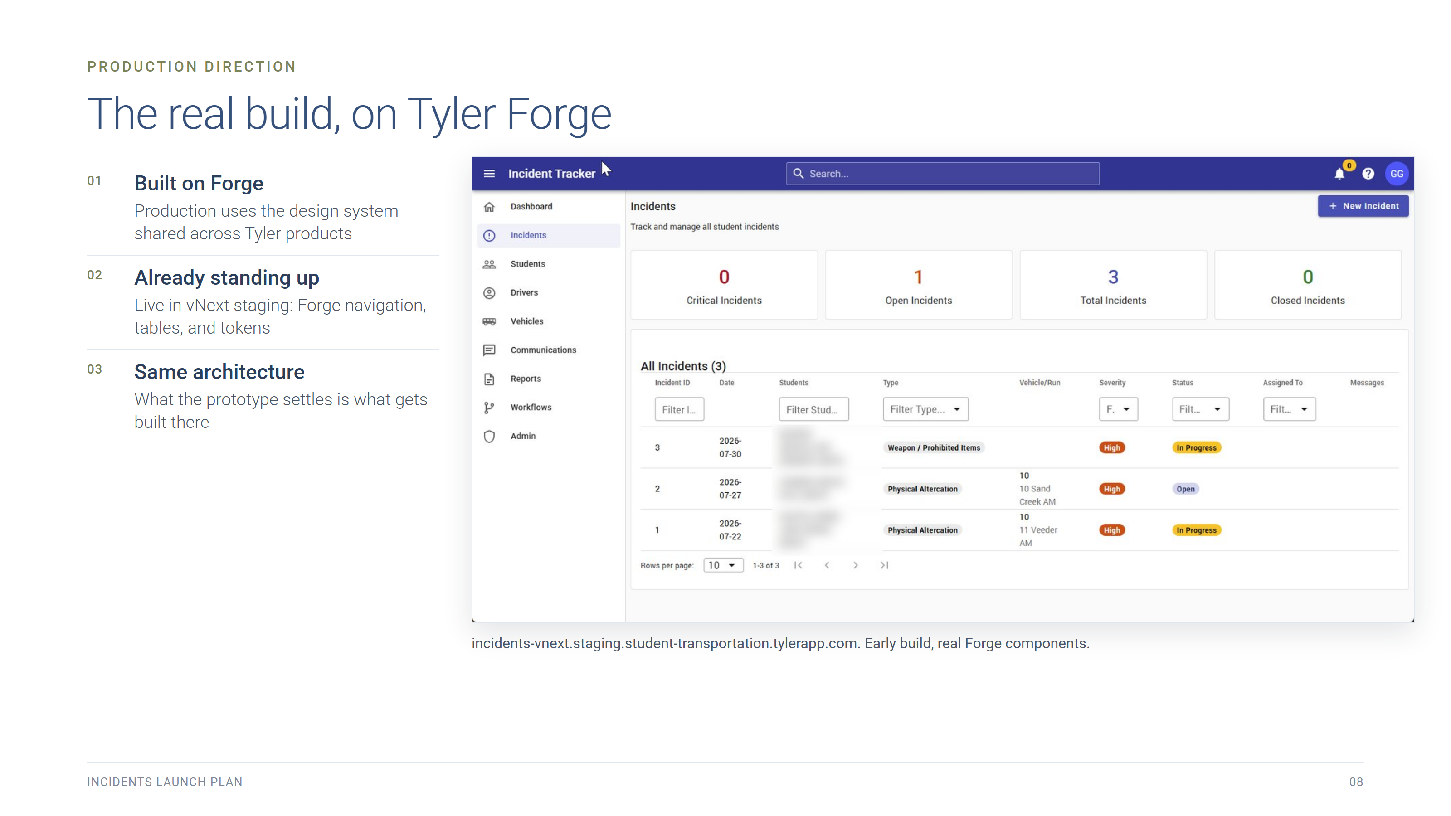
Notes:
Show incidents-vnext.staging.student-transportation.tylerapp.com briefly. Student names in this screenshot are blurred.

Slide 9
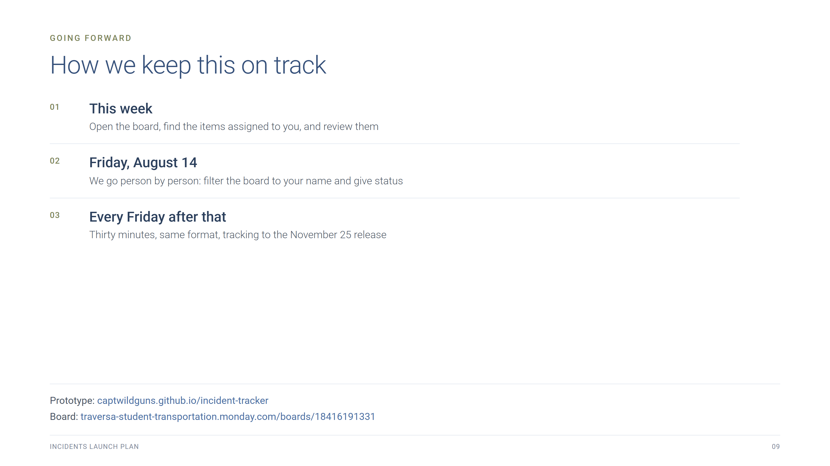
Notes:
Going forward. From next Friday the board gets filtered by person and each owner gives status on their own items.

