Slide 1

Introduction to
SUPPLY CHAIN MANAGEMENT
HAROLD B. LLAGONO, MIT

Slide 2

What is Supply Chain Management?
can be defined as the management of flow of products and services, which begins from the origin of products and ends at the product’s consumption.
It comprises movement and storage of raw materials that are involved in work in progress, inventory and fully furnished goods.

Slide 3
Objectives of SCM
is to monitor and relate production, distribution, and shipment of products and services. This can be done by companies with a very good and tight hold over internal inventories, production, distribution, internal productions and sales.

Slide 4
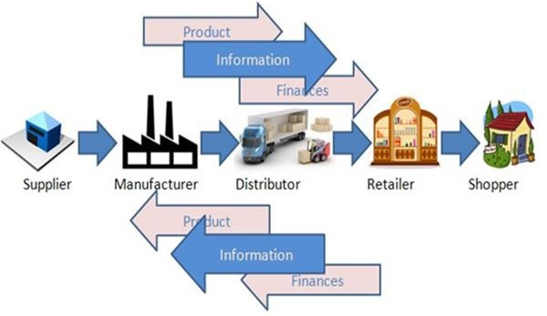
Objectives of SCM continue
In the figure, we can see the flow of goods, services and information from the producer to the consumer. The picture depicts the movement of a product from the producer to the manufacturer, who forwards it to the distributor for shipment. The distributor in turn ships it to the wholesaler or retailer, who further distributes the products to various shops from where the customers can easily get the product.

Slide 5
Objectives of SCM continue…
Supply chain management basically merges the supply and demand management. It uses different strategies and approaches to view the entire chain and work efficiently at each and every step involved in the chain. Every unit that participates in the process must aim to minimize the costs and help the companies to improve their long term performance, while also creating value for its stakeholders and customers. This process can also minimize the rates by eradicating the unnecessary expenses, movements and handling.

Slide 6
Supply Chain Management - Advantages
In this era of globalization where companies compete to provide the best quality products to the customers and satisfy all their demands, supply chain management plays a very important role. All the companies are highly dependent on effective supply chain process.
Major advantages of supply chain. The key benefits of supply chain management are as follows:
    Develops better customer relationship and service.
  Creates better delivery mechanisms for products and services in demand with minimum delay.
  Improvises productivity and business functions.
  Minimizes warehouse and transportation costs.
  Minimizes direct and indirect costs.
  Assists in achieving shipping of right products to the right place at the right time.
  Enhances inventory management, supporting the successful execution of just-in-time stock models.
  Assists companies in adapting to the challenges of globalization, economic upheaval, expanding consumer expectations, and related differences.
  Assists companies in minimizing waste, driving out costs, and achieving efficiencies throughout the supply chain process.
Notes:
Direct costs are expenses that a company can easily connect to a specific “cost object,” which may be a product, department or project.
For example, if an employee is hired to work on a project, either exclusively or for an assigned number of hours, their labor on that project is a direct cost. If your company develops software and needs specific assets, such as purchased frameworks or development
Indirect costs extend beyond the expenses you incur when creating a product; they include the costs involved with maintaining and running a company. These overhead costs are the ones left over after direct costs have been computed.
The materials and supplies needed for a company’s day-to-day operations – such as computers, electricity and rent – are examples of indirect costs. While these items contribute to the company as a whole, they are not assigned to the creation of any one service.

Slide 7
Supply Chain Management - Goals
Every firm strives to match supply with demand in a timely fashion with the most efficient use of resources. Here are some of the important goals of supply chain management −
Supply chain partners work collaboratively at different levels to maximize resource productivity, construct standardized processes, remove duplicate efforts and minimize inventory levels.
Minimization of supply chain expenses is very essential, especially when there are economic uncertainties in companies regarding their wish to conserve capital.
Cost efficient and cheap products are necessary, but supply chain managers need to concentrate on value creation for their customers.
Exceeding the customers’ expectations on a regular basis is the best way to satisfy them.
Increased expectations of clients for higher product variety, customized goods, off-season availability of inventory and rapid fulfillment at a cost comparable to in-store offerings should be matched.
To meet consumer expectations, merchants need to leverage inventory as a shared resource and utilize the distributed order management technology to complete orders from the optimal node in the supply chain.
Supply chain management aims at contributing to the financial success of an enterprise. In addition to all the points listed above, it aims at leading enterprises using the supply chain to improve differentiation, increase sales, and penetrate new markets. The objective is to drive competitive benefit and shareholder value.

Slide 8
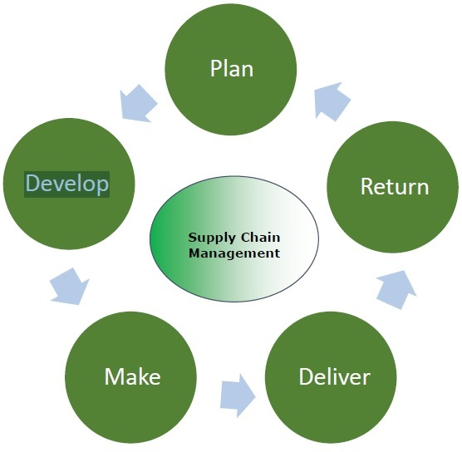
Supply Chain Management - Process
Supply chain management is a process used by companies to ensure that their supply chain is efficient and cost-effective. A supply chain is the collection of steps that a company takes to transform raw materials into a final product. The five basic components of supply chain management are discussed below:

Slide 9
Supply Chain Management – Process cont.
Plan
The initial stage of the supply chain process is the planning stage. We need to develop a plan or strategy in order to address how the products and services will satisfy the demands and necessities of the customers. In this stage, the planning should mainly focus on designing a strategy that yields maximum profit.
For managing all the resources required for designing products and providing services, a strategy has to be designed by the companies. Supply chain management mainly focuses on planning and developing a set of metrics.

Slide 10
Supply Chain Management – Process cont.
Develop(Source)
After planning, the next step involves developing or sourcing. In this stage, we mainly concentrate on building a strong relationship with suppliers of the raw materials required for production. This involves not only identifying dependable suppliers but also determining different planning methods for shipping, delivery, and payment of the product.
Companies need to select suppliers to deliver the items and services they require to develop their product. So in this stage, the supply chain managers need to construct a set of pricing, delivery and payment processes with suppliers and also create the metrics for controlling and improving the relationships.
Finally, the supply chain managers can combine all these processes for handling their goods and services inventory. This handling comprises receiving and examining shipments, transferring them to the manufacturing facilities and authorizing supplier payments.

Slide 11
Supply Chain Management – Process cont.
Make
The third step in the supply chain management process is the manufacturing or making of products that were demanded by the customer.
In this stage, the products are designed, produced, tested, packaged, and synchronized for delivery.
Task of the supply chain manager is to schedule all the activities required for manufacturing, testing, packaging and preparation for delivery. This stage is considered as the most metric-intensive unit of the supply chain, where firms can gauge the quality levels, production output and worker productivity.

Slide 12
Supply Chain Management – Process cont.
Deliver
The fourth stage is the delivery stage. Here the products are delivered to the customer at the destined location by the supplier. This stage is basically the logistics phase, where customer orders are accepted and delivery of the goods is planned. The delivery stage is often referred as logistics, where firms collaborate for the receipt of orders from customers, establish a network of warehouses, pick carriers to deliver products to customers and set up an invoicing system to receive payments.

Slide 13
Supply Chain Management – Process cont.
Return
The last and final stage of supply chain management is referred as the return. In the stage, defective or damaged goods are returned to the supplier by the customer. Here, the companies need to deal with customer queries and respond to their complaints etc.
This stage often tends to be a problematic section of the supply chain for many companies. The planners of supply chain need to discover a responsive and flexible network for accepting damaged, defective and extra products back from their customers and facilitating the return process for customers who have issues with delivered products.

Slide 14
Supply Chain Management - Process Flow
Supply chain management can be defined as a systematic flow of materials, goods, and related information among suppliers, companies, retailers, and consumers.
Types
There are three different types of flow in supply chain management −
Material flow
Information/Data flow
Money flow

Slide 15
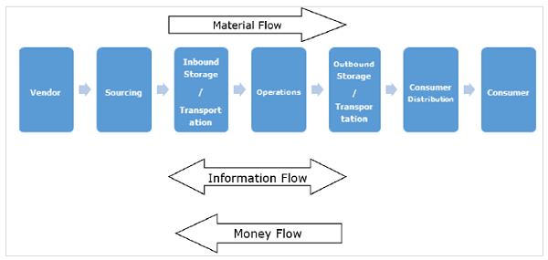
Supply Chain Management - Process Flow cont.

Slide 16
Supply Chain Management - Process Flow cont.
Material Flow
Material flow includes a smooth flow of an item from the producer to the consumer. This is possible through various warehouses among distributors, dealers and retailers.
The main challenge we face is in ensuring that the material flows as inventory quickly without any stoppage through different points in the chain. The quicker it moves, the better it is for the enterprise, as it minimizes the cash cycle.
The item can also flow from the consumer to the producer for any kind of repairs, or exchange for an end of life material. Finally, completed goods flow from customers to their consumers through different agencies. A process known as 3PL is in place in this scenario. There is also an internal flow within the customer company.
Notes:
3PL - 3rd Party Logistics

Slide 17
Supply Chain Management - Process Flow cont.
Information Flow
Information/data flow comprises the request for quotation, purchase order, monthly schedules, engineering change requests, quality complaints and reports on supplier performance from customer side to the supplier.
From the producer’s side to the consumer’s side, the information flow consists of the presentation of the company, offer, confirmation of purchase order, reports on action taken on deviation, dispatch details, report on inventory, invoices, etc.
For a successful supply chain, regular interaction is necessary between the producer and the consumer. In many instances, we can see that other partners like distributors, dealers, retailers, logistic service providers participate in the information network.
In addition to this, several departments at the producer and consumer side are also a part of the information loop. Here we need to note that the internal information flow with the customer for in-house manufacture is different.

Slide 18
Supply Chain Management - Process Flow cont.
Money Flow
On the basis of the invoice raised by the producer, the clients examine the order for correctness. If the claims are correct, money flows from the clients to the respective producer. Flow of money is also observed from the producer side to the clients in the form of debit notes.
In short, to achieve an efficient and effective supply chain, it is essential to manage all three flows properly with minimal efforts. It is a difficult task for a supply chain manager to identify which information is critical for decision-making. Therefore, he or she would prefer to have the visibility of all flows on the click of a button.

Slide 19
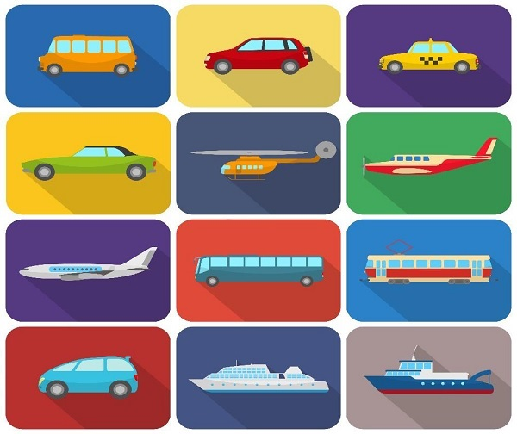
Supply Chain Management - Flow Components
Transportation
Transportation or shipment is necessary for an uninterrupted and seamless supply. The factors that have an impact on shipment are economic uncertainty and instability, varying fuel prices, customers’ expectations, globalization, improvised technologies, changing transportation industry and labor laws.

Slide 20
Supply Chain Management - Flow Components cont.
Transportation
The major elements that influence transportation should be considered, as it is completely dependent on these factors for order completion as well as for ensuring that all the flows work properly. The major factors are −
Long-term Decisions
Transportation managers should acknowledge the supply freight flow and accordingly design the network layout. Now, when we say long term decision, we mean that the transportation manager has to select what should be the primary mode of transportation.
The manager has to understand the product flows, volume, frequency, seasonality, physical features of products and special handlings necessities, if any. In addition to this, the manager has to make decisions as to the extent of outsourcing to be done for each and every product. While considering all these factors, he should carefully consider the fact that the networks need not be constant.
For example, in order to transport stock to regional cross dock facilities for sorting, packaging and brokering small loads to individual customers, stock destinations can be assembled through contract transportation providers.

Slide 21
Supply Chain Management - Flow Components cont.
Transportation
Lane Operation Decisions
These functional decisions stress on daily freight operations. Here, the transportation managers work on real time information on products’ requirements at different system nodes and must collaborate every move of the product that is both inbound and outbound shipping lanes so as to satisfy their services demands at the minimal possible cost.
Managers who make good decisions easily handle information and utilize the opportunities for their own profit and assure that the product is moved to them immediately, whenever it is demanded, that too in the right quantity. At the same time, they are saving cost on transportation also.
For example, a shipment has landed from a supplier who is based in New Jersey and in the same week, a product needs to be dispatched to New York as it becomes available for movement. If the manager is aware of this information in advance, he would prepare everything as per the demand and the products could be shipped out immediately.

Slide 22
Supply Chain Management - Flow Components cont.
Transportation
Choice and Mode of Carrier
A very important decision to be made is to choose the mode of transportation. With the improvement in the means of transportation, modes of transport that were not available in the traditional transportation modes in the past can be now be a preferred choice.
For example, rail container service may offer a package that is cost-efficient and effective as compared to a motor transport. While making a decision, the manager has to consider the service criteria that need to be met, like the delivery time, date special handling requirements, while also taking into consideration the element of cost, which would be an important factor.

Slide 23
Supply Chain Management - Flow Components cont.
Transportation
Dock Level Operations
This involves the last level of decision-making. This comprises planning, routing and scheduling.
For example, if a carriage is being loaded with different customers’ orders, the function of the dock-level managers is to assure that the driver is informed of the most efficient route and that loads are placed in the order of the planned stops.

Slide 24
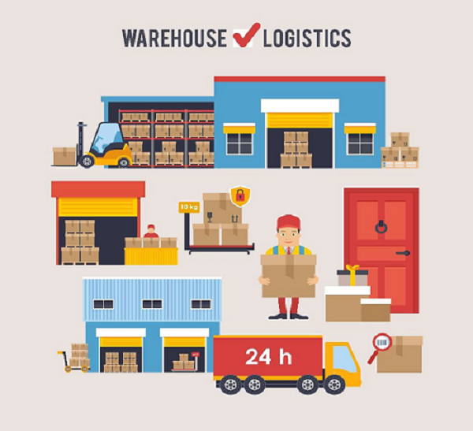
Supply Chain Management - Flow Components
Warehousing
Warehousing plays a vital role in the supply chain process. In today’s industry, the demands and expectations of the customers are undergoing a tremendous change. We want everything at our door step – that too with efficient price. We can say that the management of warehousing functions demands a distinct merging of engineering, IT, human resources and supply chain skills.

Slide 25
Supply Chain Management - Flow Components cont.
Warehousing
To neutralize the efficiency of inbound functions, it is ideal to accept materials in an immediately storable conveyance, like a pallet, case or box. For labeling the structure, tool selection and business process demand the types and quantities of orders that are processed. Further, the number of stock-keeping units (SKU’s) in the distribution centers is a crucial consideration.
The Warehouse Management Systems (WMS) leads the products to their storage location where they should be stored. The required functionality for the completion and optimization of receiving, storing and shipping functions is then supplied.

Slide 26
Supply Chain Management - Flow Components cont.
Sourcing and Procurement
Sourcing and procurement are a vital part of the supply chain management. The company decides if it wants to perform all the exercises internally or if it desires to get it done by any other independent firm. This is commonly referred as the make vs buy decision, which we will be discussing in brief in another chapter.

Slide 27
Supply Chain Management - Flow Components cont.
Returns Management
Returns management can be defined as the management that invites the merger of challenges and opportunities for inbound logistics. A cost-effective reverse logistics program links the available supply of returns with the product information and demand for repairable items or re-captured materials. We have three pillars that support returns management processes. These are as follows:
Speed − It is a must to have quick and easy returns management and automate decisions regarding whether to produce return material authorizations (RMAs) and if so, how to process them. Basically, the tools of speed return processing include automated workflows, labels & attachments and user profiles.

Slide 28
Supply Chain Management - Flow Components cont.
Returns Management
Visibility − For improving the visibility and predictability, information needs to be captured initially in the process, ideally prior to delivering the return to the receiving dock. Most effective and easily implementable approaches for obtaining visibility are web-based portals, carrier integration and bar-coded identifiers.
Control − In case of returns management, synchronizing material movements is a common issue that needs to be handled. The producers need to be very cautious and pay close attention to receipts and reconciliation and update the stakeholders of impending quality issues. In this case, reconciliation activates visibility and control all over the enterprise. The key control points in this process are regulatory compliance, reconciliation and final disposition and quality assurance.

Slide 29
Supply Chain Management - Flow Components cont.
Post - Sales Service
Now that the ordered shipment is over, what is the next step? The post sales service in supply chain tends to be an increasingly essential factor as businesses offer solution instead of products.
The post sales services comprise selling spare parts, installing upgrades, performing inspection, maintenance and repairs, offering training & education and consulting.
Presently, with the growing demands of the clients, a high volume of after sales service proves to be a profitable business. Here, the services are basically heterogeneous and the value-added services are different from those provided prior to sales service.

Slide 30
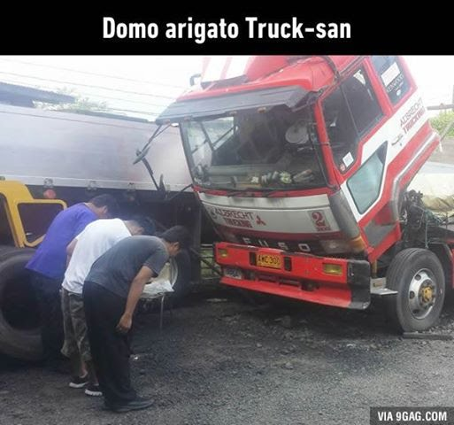
Thank
You!

