Slide 1
Parseq
Fallback (First solve ends sequence)
Parallel (Race with many solves needed)
Failing any required activity, fails workflow
Activity
Activity
Activity
None won’t do.
Required
Activity
To succeed workflow,
succeed all required.
Any will do.
Required
Activity
Optional
Activity
Ignore, fail, or succeed
optional activities.
Race (First solve ends parallel)
Activity
Any will do.
Sequence (Fix-forward, all solves required)
Activity
All are required.
Required
Activity
Required
Activity
Required
Activity
Activity
None won’t do.
None can fail.

Slide 2
Parseq
Fallback (First solve ends sequence)
None won’t do.
Activity 1
Activity 2
Activity 3
decision(undefined, reason)
activity2(activity3, result1)
activity3(decision, result2)
decision(result1)
decision(result2)
decision(result3)
Any will do.
Sequence (Fix-forward, all solves required)
All are required.
Activity 1
activity2(activity3, result1)
Activity 2
activity3(decision, result2)
Activity 3
decision(result3)
decision(undefined, reason)
decision(undefined, reason)
None can fail.

Slide 3
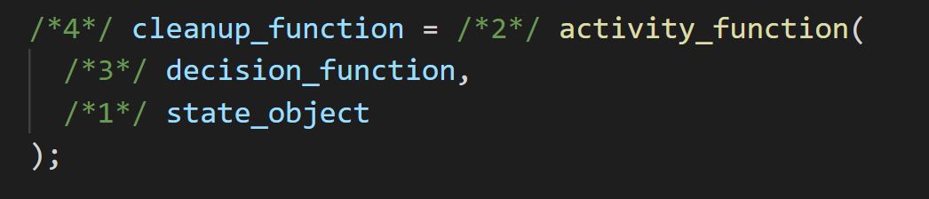
Problem: right-to-left evaluation unreadable programs

Slide 4
Sequence (Fix-forward, all solves required)
All are required.
Required
Activity
Required
Activity
Required
Activity
Workflow starts
Decision by invoking callback
None can fail.
Workflow ends successfully
Workflow ends in failure
Fallback (First solve ends sequence)
Activity
Activity
Activity
None won’t do.
Any will do.

Slide 5
Requestor to Activity
Callback is a Decide:
Solved: A decision that solves the activity – decide(result)
Failed: A decision that does not solve the activity – decide(undefined, 'wump')
Value to Result
Reason is Reason
Actor’s mailbox is Sequence
Actor model’s process is an iframe

Slide 6
Actor
View
Sequence (Mailbox, FIFO, queue)
State
Rules
If state, mutate sequence
“If product shippable, add shipping address form”
“If product rated mature, add age verification form”
Let’s imagine we have an actor that behaves like a calculator and that its initial state is simply the number 0. When this actor receives the add(1) message, instead of mutating its original state, it designates that for the next message it receives, the state will be 1.
On message receipt:
Create more actors
Send messages to other actors
Designate what to do with the next message
simply letting it crash, but make this critical code be supervised by someone whose only responsibility is to know what to do when this crash happens (like resetting this unit of code to a stable state), and what makes it all possible is the actor model.

Slide 7
TODOs
Websockets to allow main.js to receive messages from the server https://www.ably.io/blog/websockets-vs-long-polling/
Docker
Kubernetes
Watch on Rules Engines https://www.youtube.com/watch?v=MAY4TvGUkZQ

Slide 8
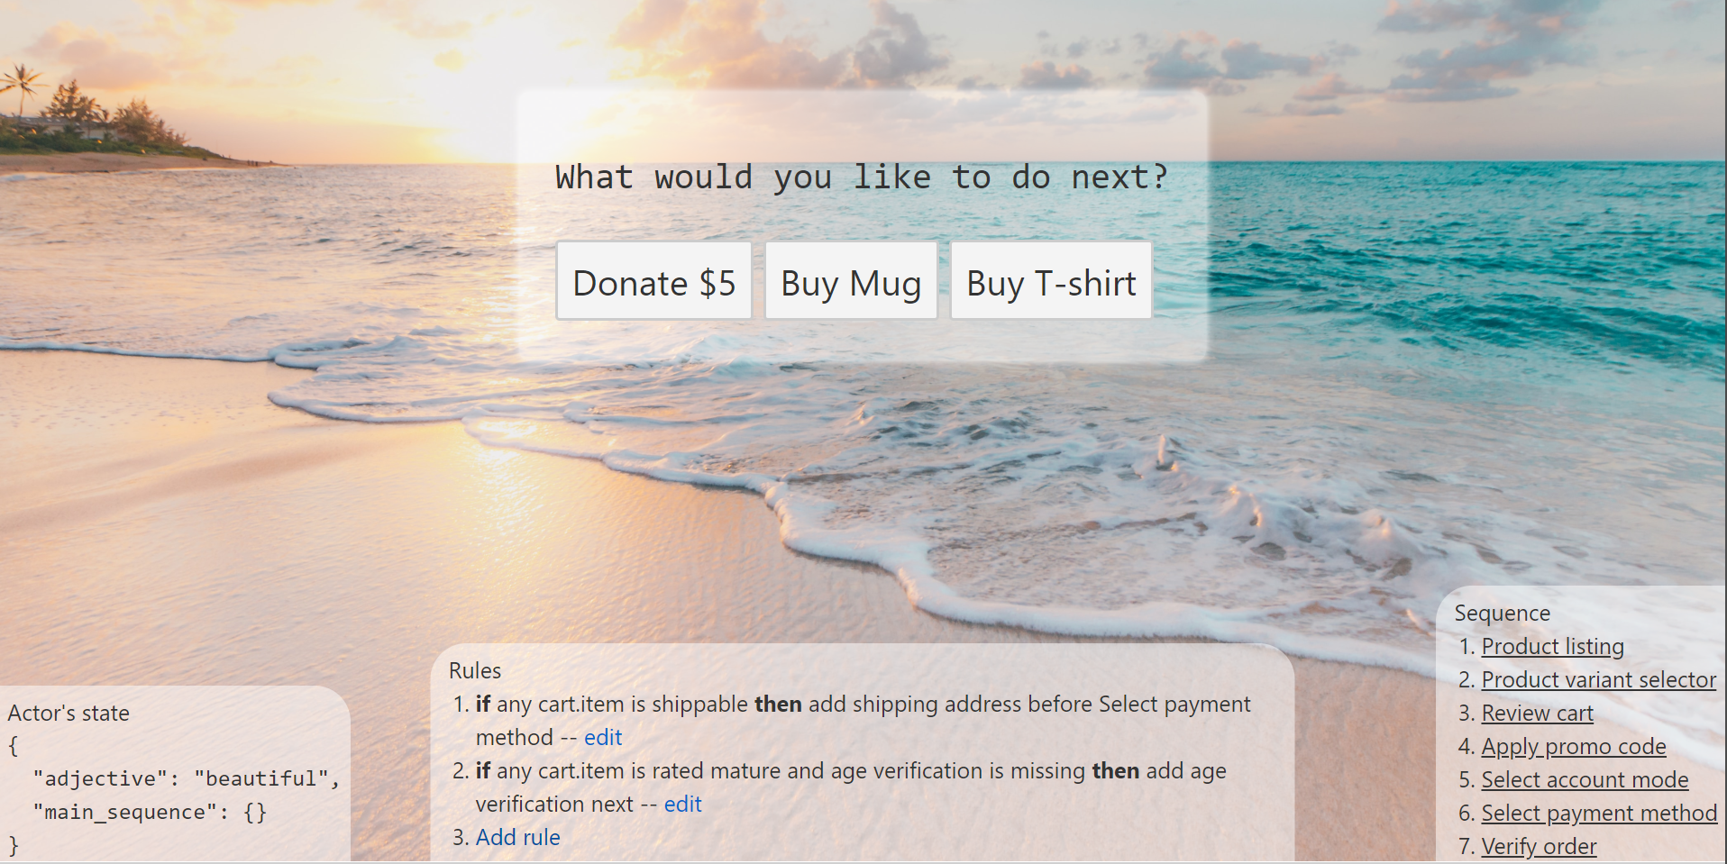
StateUpdate
Control Flow
Reflow

