Slide 1
Fault Injector
Nicholas Engle
Original Developer: Jayson Boubin

Slide 2
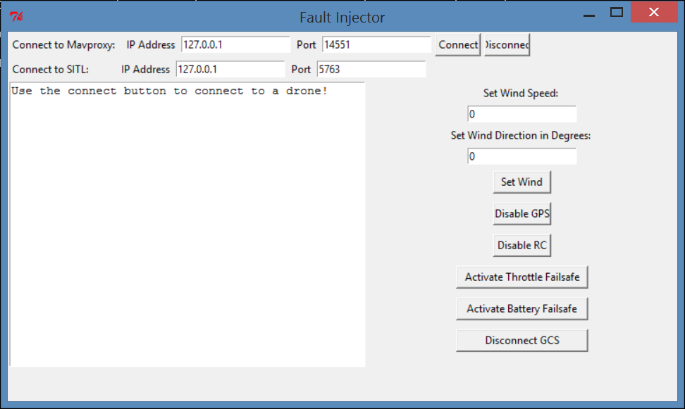
History
Developed by Jayson Boubin
Trigger Failsafes in SITL Simulations

Slide 3
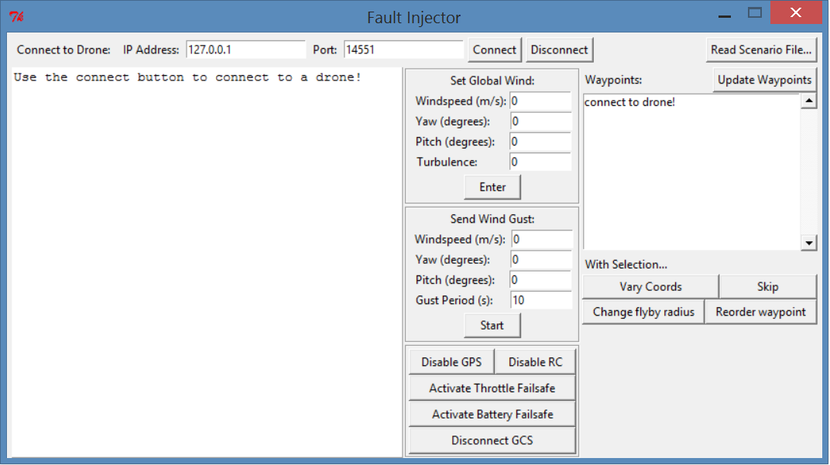
Features
Failsafe Activation
Wind Injection
Mission/Waypoint Control
File-Based Scenario Execution

Slide 4
Future Improvements
Wind Gust Model
Other Injections / Failsafe Triggers
Integration with Autonomy Framework
Compatibility with other Sims

