Slide 1
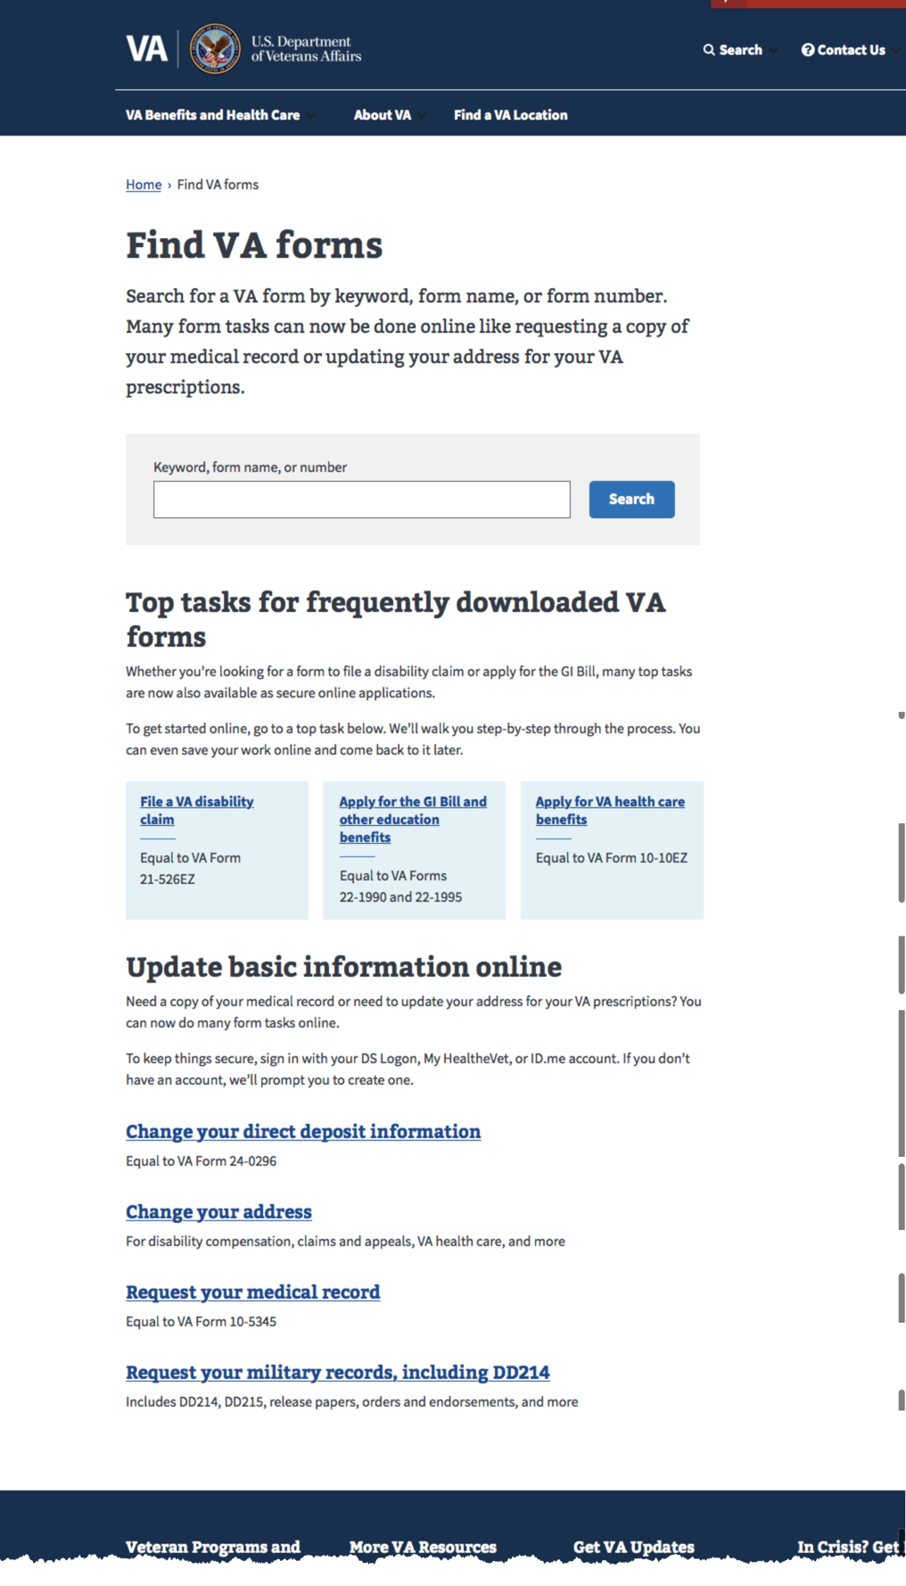
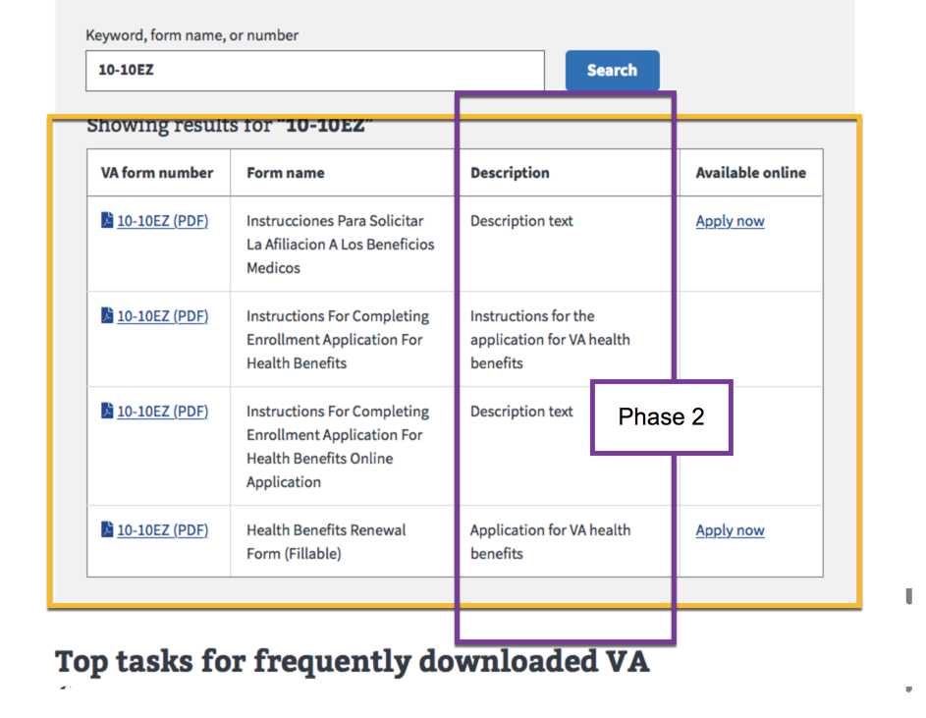
Phase 1 MVP: Frontend redesign Phase 2 MVP: Frontend and forms db
Phase 1 MVP
Design
Content
SEO & analytics tracking
Digital path for top forms only (EX: health care, disability, education, pension, medical records, military records, etc.)
Phase 2 MVP
Description field (frontend) and text (forms db)
Identify other forms with digital experience (forms db)

Slide 2
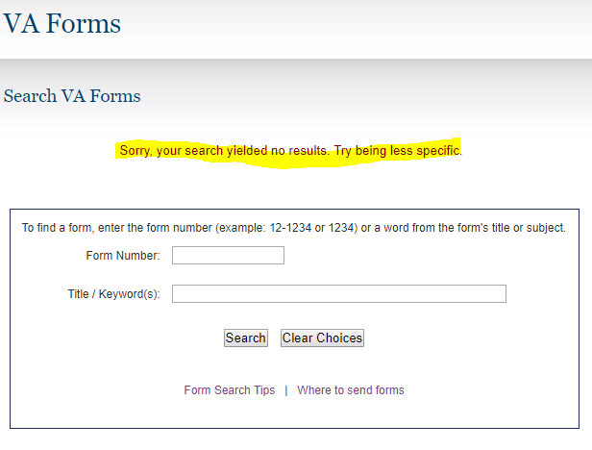
Search results for “1010ez”
Slight variation excludes possible results.
Doesn’t show what term you just searched for. Now I have to do another search but – um – what did I type in? What is the tool driving the forms search engine?

Slide 3
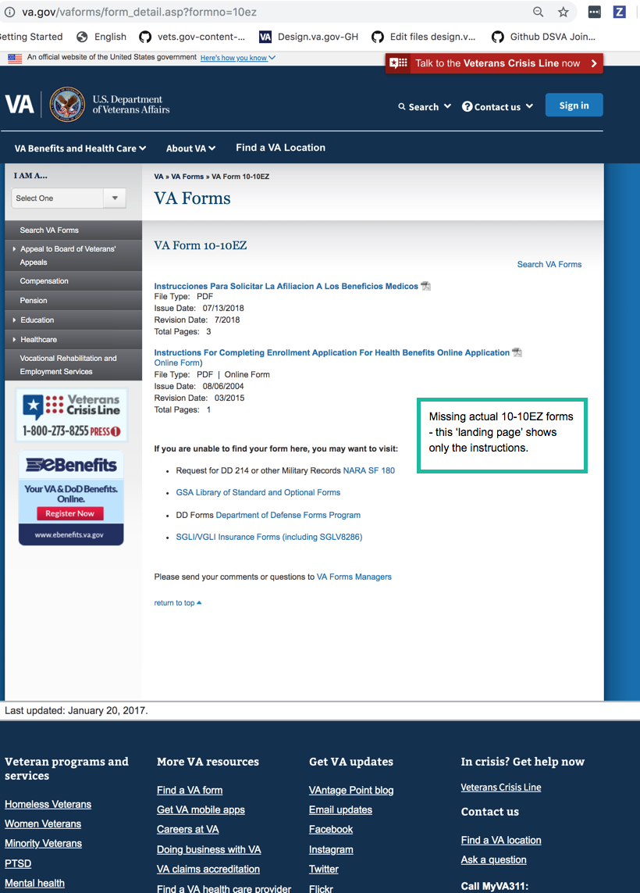
Example of a forms landing (“detail”) page 10-10EZ health care application https://www.va.gov/vaforms/form_detail.asp?formno=10ez Only lists the instructions (Spanish and English versions) - 2 of the 4 10-10EZ forms. Missing the actual application forms. Learned: Form “DETAIL” page The forms here are dynamically pulled from the db The content at the bottom (“If you’re unable to find…”) – static content

