Slide 1
Coffee Hub Recommendations
24693197

Slide 2
Introduction
Report uses coffee review database (2,095 reviews across origins, roasters, and roast strengths)
Generates various plots in order to help the Entrepreneur identify the best growing region, roast strength and supplier (to match student-tastes) for the new Neelsie shop

Slide 3
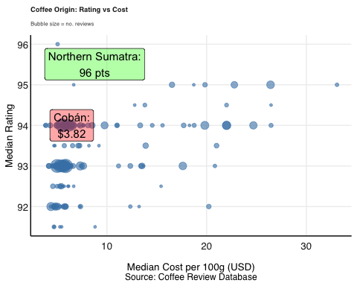
Origin vs. Cost Scatter
Northern Sumatra is both the highest-rated origin and inexpensive, while Cobán shows a well-rated coffee can be found for under $4. Thus, high rating doesn’t require a high price in this data.

Slide 4
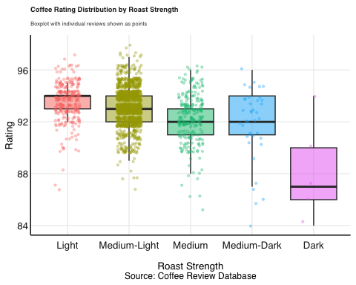
Roast Strength
Light and Medium-Light roasts consistently outscore Medium, Medium-Dark, and especially Dark roasts.

Slide 5
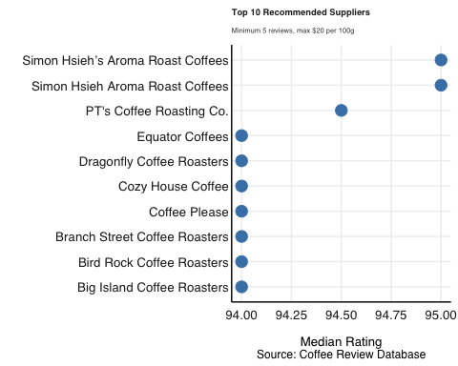
Top Suppliers
Top-rated suppliers under $20/100g with at least 5 reviews each.

Slide 6
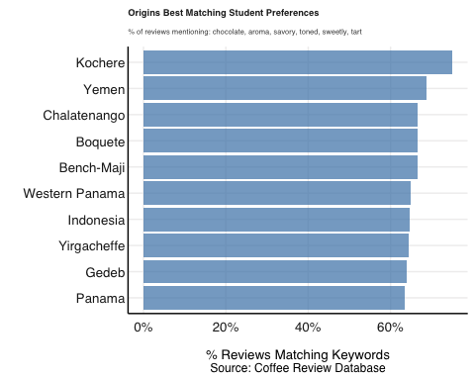
Matching Student Preferences
Reviews from Yemen, Tarrazu, and Boquete mention student-preferred flavour words (chocolate, aroma, savory, toned, sweetly, tart).

Slide 7
Recommendations
Roast Strength: Aim to prioritise Light/Medium-Light across all stock.
Stellenbosch Students Taste Match: Kochere, Yemen, and Boquete best match what Stellenbosch students say they like.
Top pick: Northern Sumatra, since it is top-rated and surprisingly affordable.

