Slide 1
IMPRO-3/DBPRO
Translator
Christoph Brücke
Christian Fischer
Robert Schulz

Slide 2
Team
Christoph Brücke (M.Sc. Student Computer Science)
Christian Fischer (B.Sc. Student Computer Science)
Robert Schulz (Diploma Student Tech. Computer Science)

Slide 3
Status
Translating word by word
Read and parse dictionary
Convert to JSON dictionary
Language model
Translation service provided by local Jetty server

Slide 4
Milestones
Word by Word
Language Model
Sentence Alignment
Web Service
Language Prediction

Slide 5
Timeline - February
13.-19. Final presentation Bachelor
20.-26. First experiments w/ sentence alignment
27.-04. Prototype w/ sentence alignment

Slide 6
Timeline – March
05.-11. Web service
12.-18. Further improvements, e.g. experiments w/ language prediction
19.-25. Finalisation of project
26.-01. Final presentation Master

Slide 7
Translator Description
Goals
Translate german sentences into english ones
Web service with restful API
Means
Dictionary from http://www.dict.cc
Language model w/ training corpus containing protocols of EU parliament
How it works
JSON dictionary yields set of possible translations for a given word
BiGram language model determines best translation considering the predecessor in a given sentence

Slide 8
DEMO

Slide 9
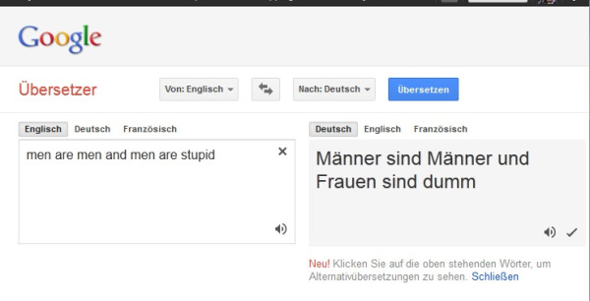
Graphic: twitpic.com

Slide 10
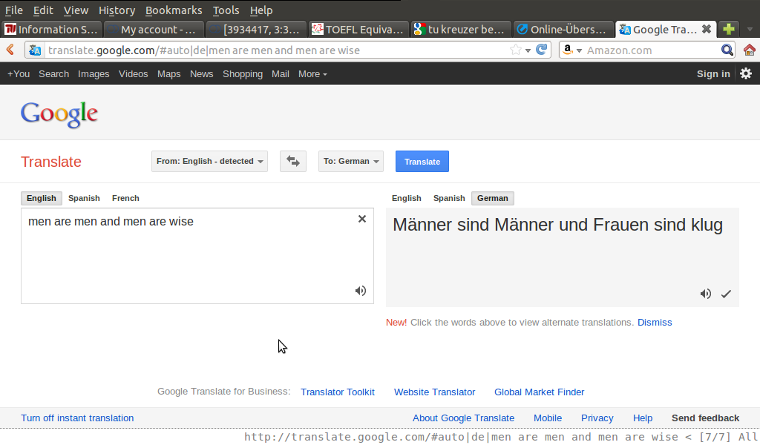
Graphic: C. Fischer

