Slide 1
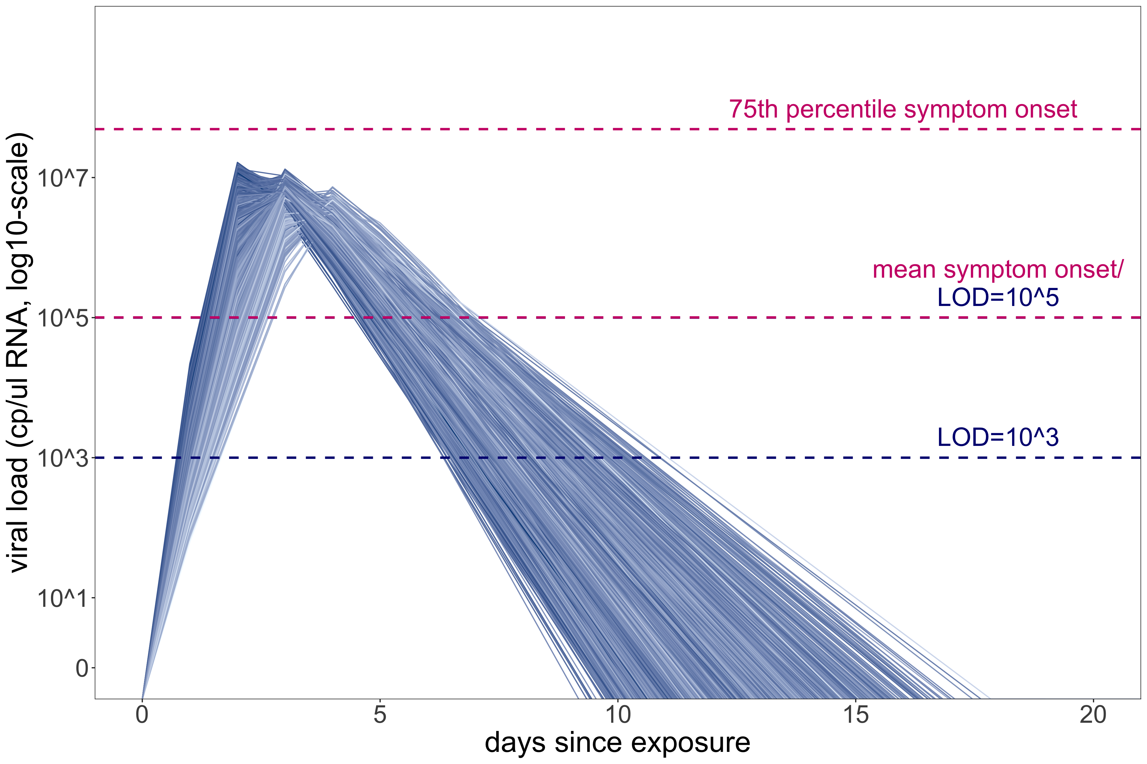
new infection
new infection
test isolation
symptom onset
infection prevented
isolation not needed
exposure
test
Person A
C
D
B
period of test sensitivity (based on limit of detection)
R = 3
generation time B
turnaround
time
generation time C
time to symptomatic isolation
generation time D
tracing isolation
symptom
onset
infection prevented
isolation not needed
Person B
(traced p)
exposure
E
tracing delay
period of test sensitivity (based on limit of detection)
R = 1
generation time E
time to symptom iso
test notification
new infection
symptom
onset
symptomatic
isolation
infection prevented
Person C
(not traced, 1-p)
test
exposure
F
G
turnaround time
time to symptom iso
period of test sensitivity (based on LOD)
R = 2
generation time F
generation time G

