Slide 1
College towns
Narrowing the search based on venues nearby

Slide 2
Ten schools being considered
Northwestern University (Evanston, Illinois)
University of Michigan (Ann Arbor, Michigan)
Stanford (Palo Alto, California)
Auburn (Auburn, Alabama)
Florida State (Talllahasse, Florida)
Wellesley College (Wellesley, Massachusetts)
Tufts (Medford, Massachusetts)
Columbia University (New York City, New York)
Duke University (Durham, North Carolina)
Washington University (St. Louis, Missouris)

Slide 3
Key findings
Several colleges form one cluster suggesting they have a similar make-up of venues in the area; these are primarily schools in urban areas:
Northwestern University, University of Michigan, Auburn University, Florida State, Columbia University, and Washington University
Four colleges do not fit into that cluster and, instead, fit into their own unique clusters. They present a more unique “college life”:
Wellesley, Duke, Stanford, and Tufts
Wellesley and Duke have significantly less venues in their area than others suggesting they are in less urban areas

Slide 4
Method
As a web-based service that assists students in selecting schools, we accept requests from prospective high school students to compare colleges and universities along a variety of factors. As high school students prepare to apply to colleges, they want to consider their college experience. What type of college town are their target schools based in?
They can't afford to visit all. Therefore, we will leverage the Foursquare API and develop a K-means clustering to get some sense of what types of environments exist and how similar different schools are.

Slide 5
data
We used the Foursquare API and the school address to pull the top venues around with a 1 kilometer radius of the school, easily within walking distance.
The Foursquare data is regularly updated, high quality data set for understanding the types of venues that exist whether it be coffee shops, bars, or parks.
To use this data, we will take the school addresses and use the geopy.goecoders package to convert them into latitudes and longitudes for each school. We will then retrieve the nearby venues from the API.

Slide 6
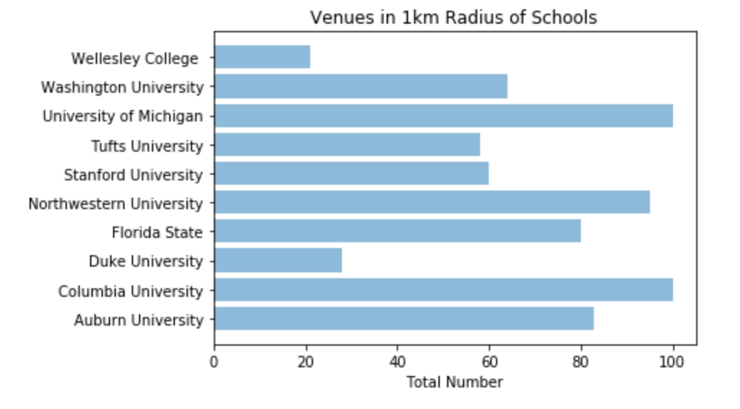
Range of nearby venues
Number of venues within 1km of school vary with range from 21 (Wellesey College) to 100 (maximum number pulled; Michigan and Columbia)
This is likely to to the setting of each school with Wellesley being more secluded and schools like Northwestern and Columbia being in urban areas

Slide 7
Most common college area cluster
The first cluster contains a majority of the schools. Their top nearby veunues include a high number of coffee shops and American restaurants.
School | 1st Most Common Venue | 2nd Most Common Venue | 3rd Most Common Venue | 4th Most Common Venue | 5th Most Common Venue | 6th Most Common Venue | 7th Most Common Venue | 8th Most Common Venue | 9th Most Common Venue | 10th Most Common Venue
Northwestern University | Coffee Shop | Park | American Restaurant | Asian Restaurant | Thai Restaurant | Pizza Place | Sandwich Place | Bar | New American Restaurant | Mexican Restaurant
University of Michigan | Coffee Shop | Pizza Place | Bar | Clothing Store | Korean Restaurant | American Restaurant | Noodle House | Mexican Restaurant | Sandwich Place | Museum
Auburn University | Sandwich Place | American Restaurant | Pizza Place | Coffee Shop | Mediterranean Restaurant | Burger Joint | Fast Food Restaurant | College Cafeteria | Sushi Restaurant | Deli / Bodega
Florida State | Sandwich Place | Bar | Coffee Shop | Italian Restaurant | Restaurant | Grocery Store | Pizza Place | Donut Shop | Student Center | Liquor Store
Columbia University | Coffee Shop | Park | Café | American Restaurant | Italian Restaurant | Seafood Restaurant | Grocery Store | Bookstore | Playground | Chinese Restaurant
Washington University | American Restaurant | Candy Store | Thai Restaurant | Ice Cream Shop | Hookah Bar | Coffee Shop | Thrift / Vintage Store | Pizza Place | Music Venue | Golf Course

Slide 8
Other college areas (1 of 2)
The second cluster contains only Wellesey. Its top venues differ significantly from the other clusters with yoga studio, cosmetic shops, and spas topping the list.
School | 1st Most Common Venue | 2nd Most Common Venue | 3rd Most Common Venue | 4th Most Common Venue | 5th Most Common Venue | 6th Most Common Venue | 7th Most Common Venue | 8th Most Common Venue | 9th Most Common Venue | 10th Most Common Venue
Wellesley College | Yoga Studio | Cosmetics Shop | Spa | Cheese Shop | Lake | Fast Food Restaurant | Clothing Store | Coffee Shop | Italian Restaurant | Bus Stop
Next, is a cluster contains Standford. While coffee shops rank high, there are not many food establishments in the list of nearby venues.
School | 1st Most Common Venue | 2nd Most Common Venue | 3rd Most Common Venue | 4th Most Common Venue | 5th Most Common Venue | 6th Most Common Venue | 7th Most Common Venue | 8th Most Common Venue | 9th Most Common Venue | 10th Most Common Venue
Stanford University | Coffee Shop | Sculpture Garden | Café | College Cafeteria | Tennis Stadium | Sandwich Place | Park | Outdoor Sculpture | Monument / Landmark | Fountain

Slide 9
Other college areas (2 of 2)
Next is Duke University. Its top venues are mostly places related to school including teh cafeteria, auditorium, and food court.
School | 1st Most Common Venue | 2nd Most Common Venue | 3rd Most Common Venue | 4th Most Common Venue | 5th Most Common Venue | 6th Most Common Venue | 7th Most Common Venue | 8th Most Common Venue | 9th Most Common Venue | 10th Most Common Venue
Duke University | College Cafeteria | Café | Fast Food Restaurant | Food Court | Pharmacy | College Auditorium | Coffee Shop | Museum | Chinese Restaurant | Eye Doctor
The last cluster contains Tufts University. Cafes are its top ranking venue along with a diverse set of restaurants that differ greatly from those in the first cluster.
School | 1st Most Common Venue | 2nd Most Common Venue | 3rd Most Common Venue | 4th Most Common Venue | 5th Most Common Venue | 6th Most Common Venue | 7th Most Common Venue | 8th Most Common Venue | 9th Most Common Venue | 10th Most Common Venue
Tufts University | Café | Pizza Place | Italian Restaurant | Breakfast Spot | Park | Sushi Restaurant | Mediterranean Restaurant | Vegetarian / Vegan Restaurant | Mexican Restaurant | Indian Restaurant

