Slide 1
Design Rationale (1)
Account based Design vs UTXO (Bitcoin)
Higher Privacy for UTXO
Account based security vs Transaction based
Space Savings
Simplicity
Constant light-client reference
Bitcoin design allows efficient light clients working with limited set of blocks ready to answer the validity of a transaction

Slide 2
Design Rationale (2)
Ethereum Data Structures are designed to answer queries like
Has this transaction been included in a particular block?
Tell me all instances of an event of type X (eg. a crowdfunding contract reaching its goal) emitted by this address in the past 30 days
What is the current balance of my account?
Does this account exist?
Pretend to run this transaction on this contract. What would the output be?

Slide 3
Ethereum Vs Bitcoin Blockchain
Bitcoin
A hash of the previous header
A timestamp
A mining difficulty value
A proof of work nonce
A root hash for the Merkle tree containing the transactions for that block.
Ethereum Maintains Three Data Structures
Transactions (Block specific - trie)
Receipts (essentially, pieces of data showing the effect of each transaction) (Block Specific)
State (Global)

Slide 4
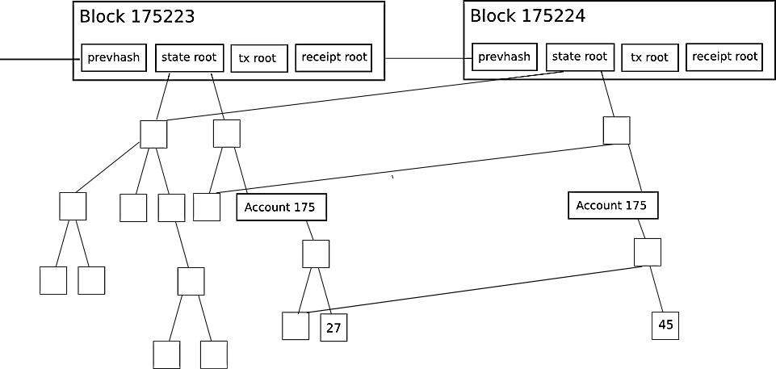
Ethereum Blockchain

Slide 5
Account State
nonce: Number of transactions sent from this address or the number of contract-creations made by this account.
balance: Number of Wei owned by this address.
storageRoot: A 256-bit hash of the root node of a Merkle Patricia tree that encodes the storage contents of the account
codeHash: The hash of the EVM code of this account

Slide 6
Transactions
Message call
Creation of new accounts with associated code
Nonce: No.of Transactions Sent by Sender
GasPrice: Wei to be paid per unit of Gas involved in computation of Transaction
GasLimit: Max amount of gas that can be spent
To: 160 bit address, empty for contract creation
Value: amount given to the recipient
Code for Contract Creation and Data part contains byte array consisting of input data

Slide 7
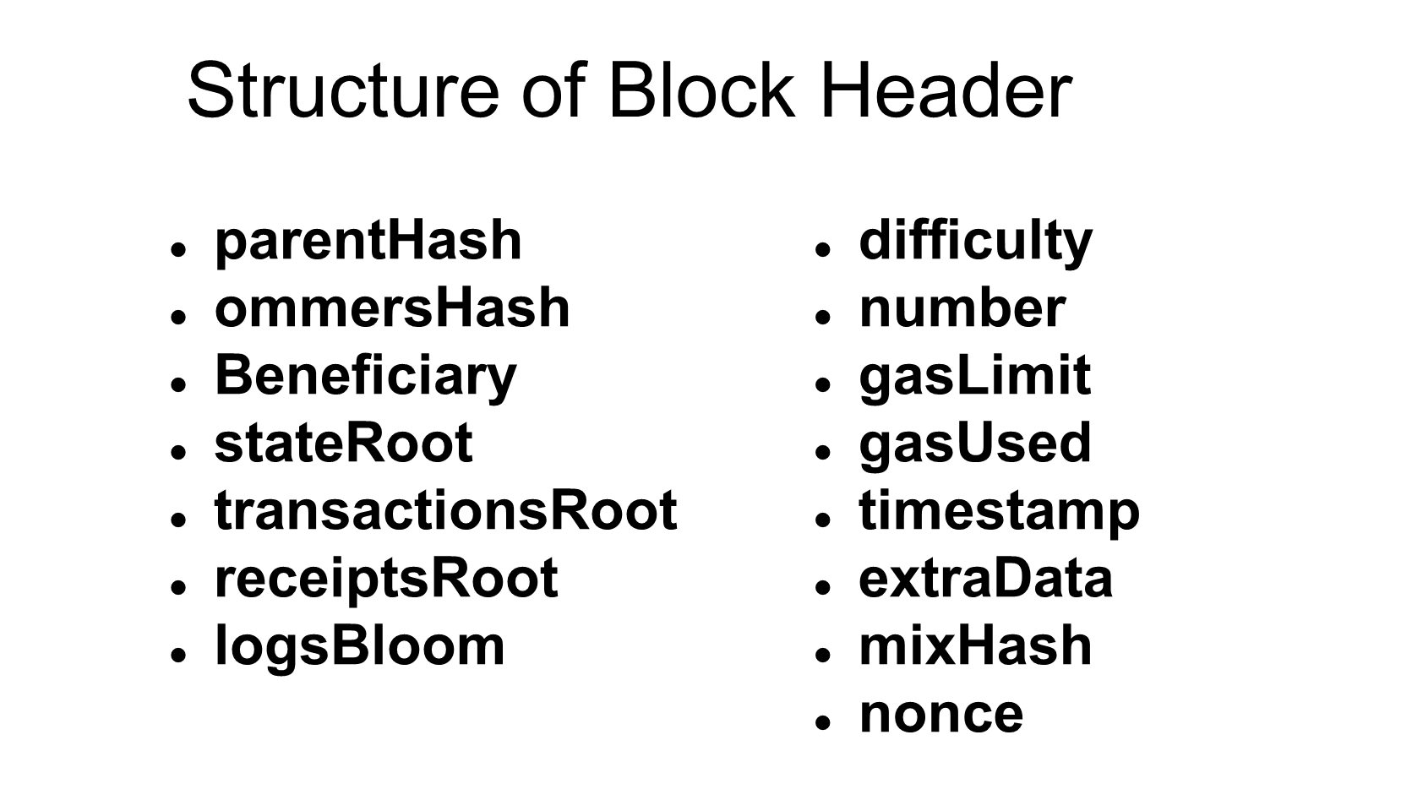

Slide 8
State Trie
Captures the state of all accounts
Entries are Key, Value pairs
Allows the efficient Merkle root computation in the face of state updates
State remains same if same set of changes are performed from the same initial state
Bitcoin Blockchain is designed to keep track of history of transactions

Slide 9
Node Types in State Trie
Blank node
Leaf node which is list of [key, value]
Extension nodes are also [key, value] but value is hash of some other node
Branch nodes which are lists of length 17 consisting of 16 hex characters and one key meant for the branch node
HexPrefix based coding is used to split key space
Key should be a string of max 32 bytes

Slide 10
Block & Transaction Validity
Consistent with the ommer and transaction block hashes
Transactions when executed in order on the base state result in the same new state
New State is identified by the root of the Merkel Patricia tree
Successful Transaction when executed results in gas deduction depending on number and type of instructions incurred
If Transaction fails, State changes are undone with gas deducted for the amount of computation incurred till the failure

Slide 11
Ethereum Mining Algorithm
PoW serves as the method of securing the distributed network
Also serves as wealth distribution mechanism
PoW should be accessible to as many people (no custom hardware as is the case with Bitcoin Mining)
No advantage of power generation cost skew across globe
Adversary should not find it profitable to acquire significant portion of the network and thereby destabilise the overall security of the system

Slide 12
ASIC-Hard Mining
ASIC based Mining negates the democratic distribution aspect of cryptocurrency mining
It increases resource waste, and centralizes mining in the hands of a few actors
Dagger Approach:
A DAG is constructed randomly
PoW based on DAG edges
Nonce adjusted to get appropriate proof
Hashimoto Approach: Dataset dependent construction of in-memory data structure

Slide 13
Mining Rewards
All block rewards for winning block (5 ethers)
All gas expended in the block will be given

Slide 14
Reducing the Time to Create Block
Network Delay in Propagating a new Block to all peer miners is 12 sec
Bitcoin uses Block Creation interval of 10 mins
Stale Rate: No.of stale blocks per valid block
Miner’s effort goes waste and does not contribute to network security in Bitcoin protocol
Centralized Mining: Larger miners forming pools have inherent advantage due to efficiency shoot-up
GHOST (Greedy Heaviest Observed Subtree) Strategy
Blocks away from main-chain contribute to the security
Uncle blocks up to depth 7 are incentivised

