Slide 1
The Bitcoin Blockchain
N. V. Narendra Kumar
IDRBT, Hyderabad
nvnarendra@idrbt.ac.in

Slide 2
Overview
Bitcoin
Network
Transaction
Block
Blockchain
Mining and Consensus
Characteristics

Slide 3
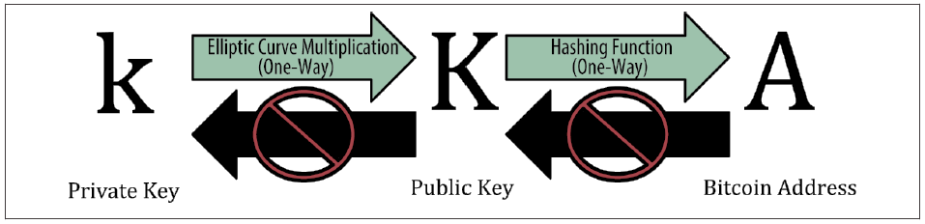
Bitcoin
Decentralized digital currency ecosystem
Unit of currency
Each entity has a private key, public key and an address

Slide 4
Bitcoin Network
Peer-to-peer (P2P) network architecture on top of the Internet
all the nodes in the network are equal
flat topology (no hierarchy)
nodes share the burden of network services
reciprocity is the incentive for participation
inherently resilient, decentralized, open
decentralization of control is a core design principle

Slide 5
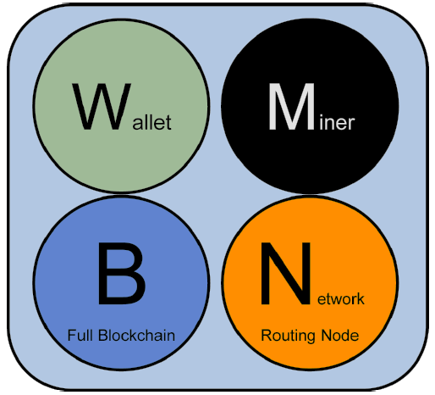
Functions of a Node

Slide 6
Types of Nodes
Reference Client (Bitcoin Core)
Full Blockchain Node
Solo Miner
Lightweight (SPV) Wallet

Slide 7
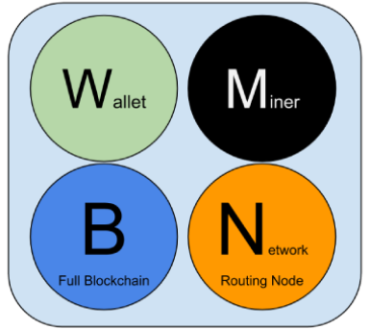
Reference Client (Bitcoin Core)

Slide 8
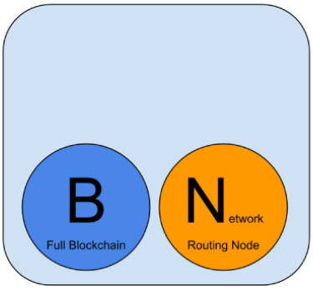
Full Blockchain Node

Slide 9
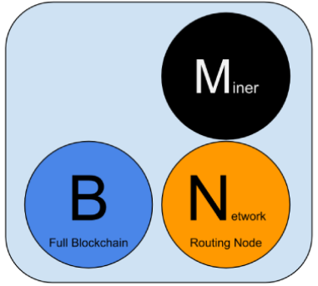
Solo Miner

Slide 10
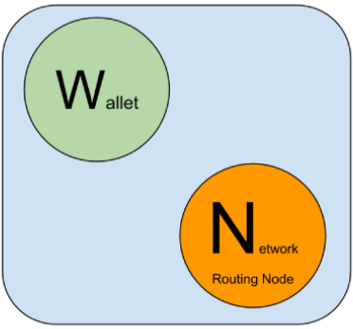
Lightweight (SPV) Wallet

Slide 11
UTXO
Unspent transaction output (UTXO) is the fundamental building-block of a transaction, and represents an indivisible chunk of bitcoin
locked to a specific owner
recorded on the blockchain
accepted as currency by the entire network
Note: there are no accounts or balances in bitcoin; there are only UTXO scattered in the blockchain

Slide 12
Transfer of Value in Bitcoin
Chunks of bitcoin value move forward from owner to owner in a chain of transactions
the UTXO consumed (by unlocking it with the signature of the current owner) by a transaction are called inputs, and the UTXO created (by locking it to the bitcoin address of the new owner) by a transaction are called outputs
Exception: coinbase transaction creates new bitcoin from no input

Slide 13
Transaction Structure
INPUTS
IN₁
IN₂
•
•
•
IN_{n}
OUTPUTS
OUT₁
OUT₂
•
•
•
OUT_{m}
unlock
lock
unlock
lock
unlock
lock

Slide 14
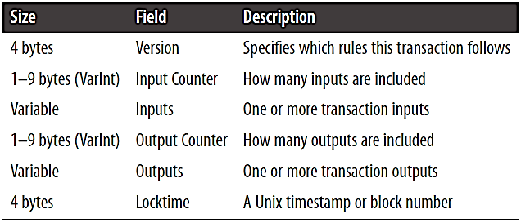
Transaction Data Structure
Encodes the transfer of value from sources of funds to destinations

Slide 15
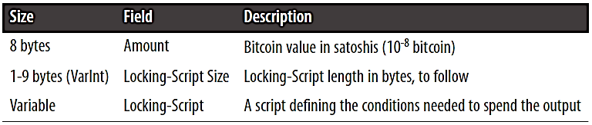
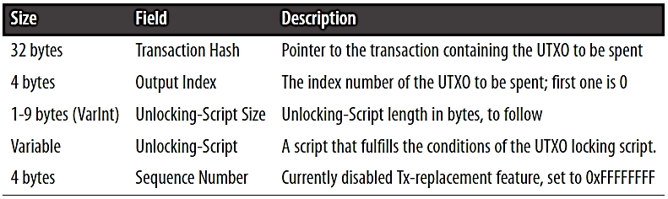
Structure of Outputs and Inputs

Slide 16
Transaction Fee, Chaining, Orphans
Transaction fee = sum(inputs) – sum(outputs)
Transactions form a chain: one transaction spends the outputs of a parent transaction and creates outputs for a child transaction
Orphan transaction pool: pool of transactions that arrive before their parents

Slide 17
Transaction Scripts
scriptPubKey / locking script: an encumbrance placed on an output, specifying the conditions that must be met to spend it
scriptSig / unlocking script: script that satisfies the conditions for spending an output

Slide 18
Scripting Language Features
The bitcoin transaction script language, called Script, is a reverse-polish notation stack-based execution language
Simple, Turing-incomplete language
limited complexity, predictable execution time
The bitcoin transaction script language is stateless, and all the information needed to execute a script is contained within the script ⇒ predictable outcomes

Slide 19
Standard Transaction Types
Pay-to-Public-Key-Hash (P2PKH)
Pay-to-Public-Key
Multi-Signature
Data Output (OP_RETURN)
Pay-to-Script-Hash (P2SH)
unlocking script
locking script

Slide 20
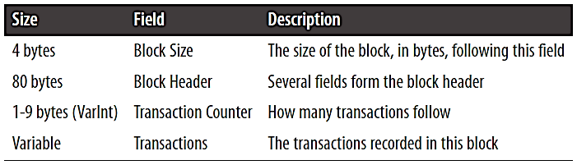
Block Structure
Block is a data structure that aggregates transactions for inclusion in the public ledger, the blockchain

Slide 21
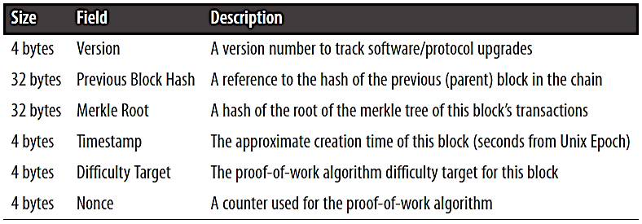
Block Header
Difficulty, Nonce and Timestamp: Mining
Merkle Root: efficient summary of all the transactions in the block

Slide 22
Blockchain
The blockchain is an ordered, back-linked list of blocks of transactions
visualized as a vertical stack
height: distance from the first block
top: most recently added block
Back-linking by including parent’s hash ⇒ the more generations that a block has following it, the more stable it becomes

Slide 23
The Genesis Block
The first block in the blockchain is called the genesis block, and is the common ancestor of all the blocks in the blockchain
The genesis block is statically encoded within the bitcoin client software
every node knows the genesis block’s hash, structure, the time it was created, and the single transaction in it
every node has the starting point for the blockchain, a secure root from which to build a trusted blockchain

Slide 24
Merkle Trees
A merkle tree, also known as a binary hash tree, is a data structure used for efficiently summarizing and verifying the integrity of large sets of data
used in bitcoin to summarize all the transactions in a block, and to efficiently verify whether a transaction is included in a block
constructed by recursively hashing pairs of nodes until there is only one hash, called the root, or merkle root

Slide 25
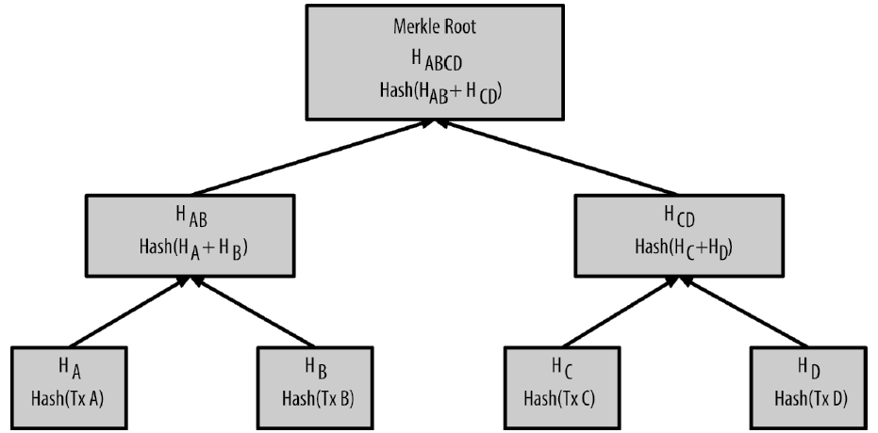
Example Merkle Tree

Slide 26
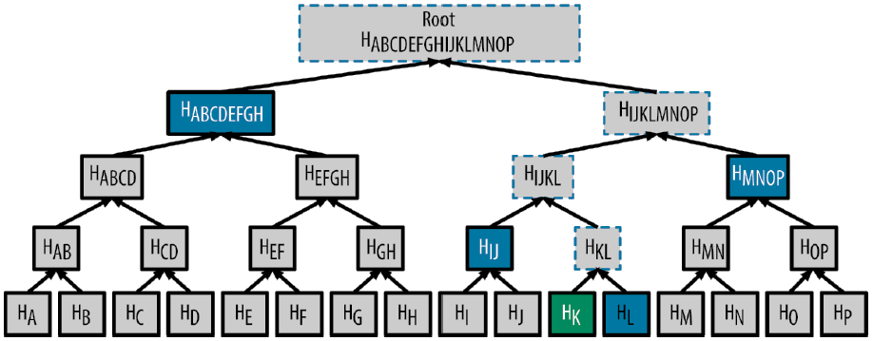
Merkle Path: Proof of Existence
To Prove: existence of H_{K}
Merkle Path: H_{L}, H_{IJ}, H_{MNOP}, H_{ABCDEFGH}

Slide 27
Mining
Miners validate new transactions and record them on the global ledger (the blockchain) by “mining” a new block containing transactions that occurred since the last block
Transactions that become part of a block and added to the blockchain are considered “confirmed”, which allows the new owners of bitcoin to spend the bitcoin they received in those transactions

Slide 28
Mining Rewards
The miners compete to solve a difficult mathematical problem based on a cryptographic hash algorithm
The solution to the problem, called the proof-of-work (PoW), is included in the new block
Successful miners receive 2 types of rewards:
new coins created with each new block, and
transaction fees from the transactions in the block

Slide 29
Decentralized Consensus
Consensus is the process by which the bitcoin network achieves agreement on the global state without a central authority
Decentralized consensus emerges from:
independent verification of each transaction
independent transaction aggregation into blocks with PoW demonstration
independent block verification and chaining
independent selection of the chain with most work

Slide 30
Transaction Verification
For each input, the referenced output must exist and cannot already be spent
For each input, if the referenced output transaction is a coinbase output, it must have at least COINBASE_MATURITY (100) confirmations
The sum of input values has to be more than sum of output values
The unlocking scripts for each input must validate against the corresponding output locking scripts

Slide 31
Aggregating Transactions into a Block
Validated transactions are added to the memory pool, or transaction pool, to be included (mined) into a block
Candidate block is constructed by selecting transactions based on their age, fees, priority
Demonstrate PoW by finding a value for the nonce that results in a block header hash that is less than a threshold (the difficulty target)

Slide 32
Validating a New Block
The block header hash is less than the target difficulty (enforces the proof of work)
The block timestamp is less than two hours in the future (allowing for time errors)
The first transaction (and only the first) is a coinbase generation transaction
All transactions within the block are valid

Slide 33
Selecting Chains of Blocks
Main chain at any time is the chain with the most cumulative difficulty
A fork occurs whenever there are two candidate blocks competing to form the longest blockchain
Confirmation time (time for settlement of transactions) and the probability of a fork are inversely related

Slide 34
Resilience to Double-Spending
When a node receives a transaction, it verifies the following before forwarding to its peers “for each input, the referenced output exists and is not already be spent”
When a miner selects transactions for mining a block he verifies that “no two transactions reference the same UTXO”

Slide 35
Transparency and Trust
P2P network structure ⇒ every node in the network “sees” all the information (blocks and transactions) being exchanged in the network
Linking of blocks and hardness of mining ⇒ easy for a node to verify the blockchain provided by its peers, but, difficult for a node to cheat its peers by providing incorrect blockchain

Slide 36


