Slide 1
Analyzing Data
Sean McMinn
American University – Spring 2020
https://github.com/shmcminn/AU-data-spring2020

Slide 2
Data stories?

Slide 3
Steps to a data story
Find data
Clean data
Analyze data
Present data

Slide 4
Agenda
Interviewing data
Data analysis in Excel

Slide 5
“Interviewing” Data
Questions you might ask a human source (let’s say a cop):
“Are there any interesting stories from your time on the force?”
Which college in town gives you guys the most trouble?
What’s the busiest shift to work on?

Slide 6
“Interviewing” Data
“Are there any interesting stories from your time on the force?”
Look for unusual data. For example:
Filter police reports to drunk and disorderlies
Filter time 0800 – 1200
Map XY data, and look for any unexpected locations

Slide 7
“Interviewing” Data
“Which college in town gives you guys the most trouble?”
Use XY coordinates to determine if police report is within a mile of a college
Group police reports by month
Sum up the number of monthly police reports for each college

Slide 8
“Interviewing” Data
“What’s the busiest shift to work on?”
Group police reports by shift
Group reports by month
Calculate average number of reports per month for each shift

Slide 9





“Interviewing” Data
Tips for “regular” interviews:
Ask direct, but open ended, questions
Be willing to go where answers lead you
Ask newsworthy questions
Get the name of the dog
Be aware your source may be dishonest or have an agenda

Slide 10
“Interviewing” Data
Tips for data interviews:
Phrase specific questions in your head before you begin using the computer
If you find an interesting trend, keep exploring it
Find the newsworthy trends/stories in the data
See if there’s any color you can track down either in the data or through external sources
Think about what your data may be missing and who published it

Slide 11
Chicago city salaries
Name
Job Titles
Department
Full or Part-Time
Salary or Hourly
Typical Hours
Annual Salary
Hourly Rate

Slide 12
Chicago city salaries
Exploring new data:
Sort/look for outliers
Filter
Group with pivot tables
Notes:
Sort by wage (min), filter by office (mayor), group and look at highest average (DOIT)

Slide 13
Chicago city salaries
WARNINGS: Exploring new data:
Sort/look for outliers
Make sure entire sheet gets sorted
Filter
Remember this is only part of your data: calculations only apply to that subset
Group
ALWAYS make a copy of your data
Notes:
Sort by wage (min), filter by office (mayor), group and look at highest average (DOIT)

Slide 14
Chicago city salaries
Standardize data using a formula
Examples:
= a2 + b2
= a2 / 50
=sum(a2:a10)
=average(b2:b10)
=year(b3)
=weekday(b3)
Cheat sheet:
https://www.dummies.com/software/microsoft-office/excel/excel-formulas-and-functions-for-dummies-cheat-sheet/
Notes:
Sort by wage (min), filter by office (mayor), group and look at highest average (DOIT)

Slide 15
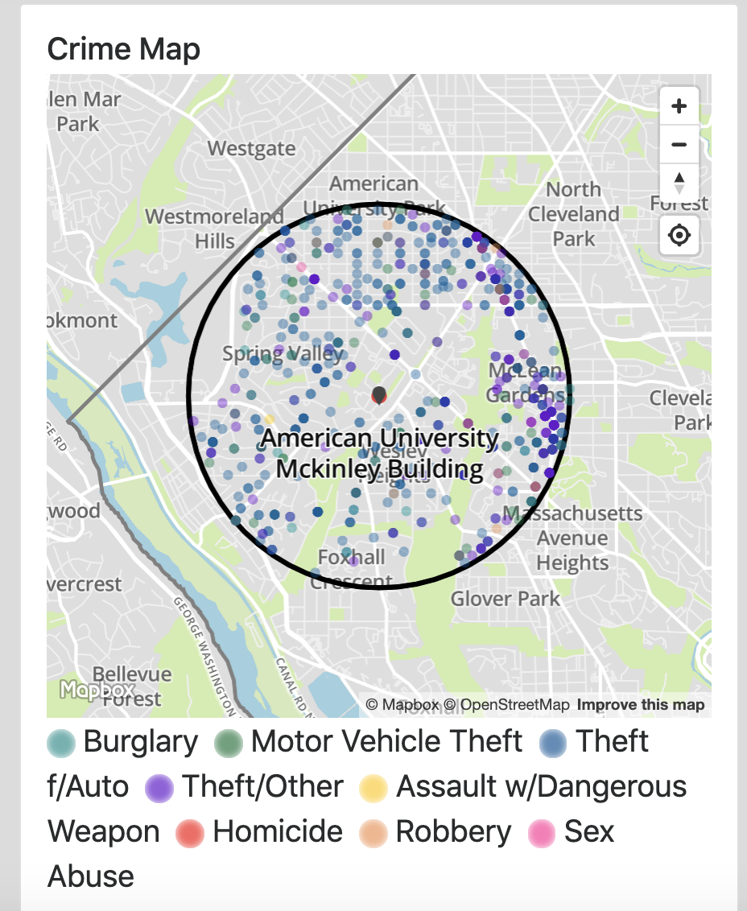
Crime data
Download dc-crimes-search-results.csv

Slide 16
Crime data
Fields
NEIGHBORHOOD_CLUSTER
CENSUS_TRACT
offensegroup
LONGITUDE
END_DATE
offensetext
SHIFT
YBLOCK
DISTRICT
WARD
YEAR
offensekey
BID
sector
PSA
ucrrank
BLOCK_GROUP
VOTING_PRECINCT
XBLOCK
BLOCK
START_DATE
CCN
OFFENSE
OCTO_RECORD_ID
ANC
REPORT_DAT
METHOD
location
LATITUDE

Slide 17
Crime data
Questions for PIVOT TABLES!
What is the most common type of crime in our area?
What block has the most/least crimes on it?
What time of day has most/least crimes?
What day of week has most/least crimes?

Slide 18
Crime data
Find something interesting in the 1,000-foot radius around somewhere else in DC (could be your home, your internship office, a landmark, etc) using data from the last year
https://dcatlas.dcgis.dc.gov/crimecards/

