Slide 1
EYELECTURE
Signing up for EyeLecture
What every kind of user sees — before, during and after approval
eyelecture-d.next2.ai 29 September 2026 test environment
Rebuilt after the September review — every screen here is the current one.
Notes:
Every screenshot was taken on the live test site with real accounts, on 29 September 2026.

Slide 2
SINCE THE LAST DECK
What changed after the September review
The review asked for five things. All five are in the screenshots that follow.
Personal email first
A private address is now required and asked for before anything else. An institutional mailbox is switched off the day somebody graduates; the personal one is what keeps the account theirs.
Super User and Program Administrator
What used to be one “administrator” is now two ranks. A super user works across the platform; a program administrator runs one institution and approves everybody at it.
PGY levels
Residents are asked how far along they are — PGY-1 to PGY-7, editable from Reference lists rather than hard-coded.
A record of every affiliation
Moving institutions no longer overwrites the old one. Each is kept with its dates, and past ones still grant access to that institution’s material.
Invitations
The first program administrator at an institution is invited by email rather than having to sign up and wait in a queue.
Wording on every screen was taken from the review comments verbatim where one was given.

Slide 3
1
Signing up
Two steps, and an account exists after the first one. Nothing is asked about somebody’s training until there is an account to attach it to.

Slide 4
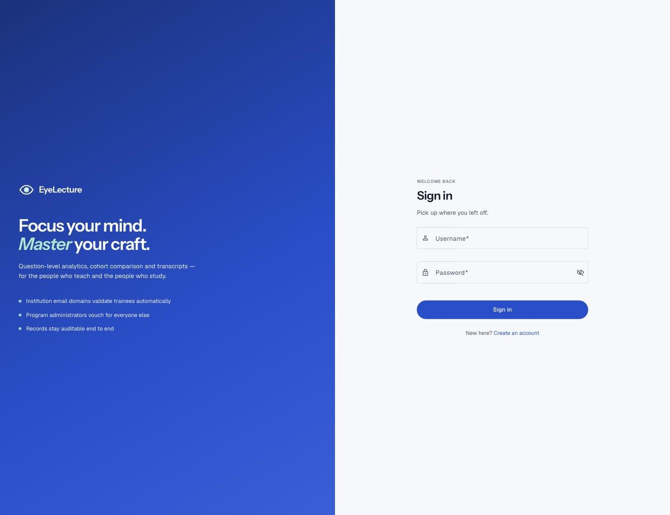
SIGNED OUT
Sign in
People sign in with a username, not an email address — so an account survives changing institutions.
Notes:
The three points on the left are the whole access model in one line each.

Slide 5
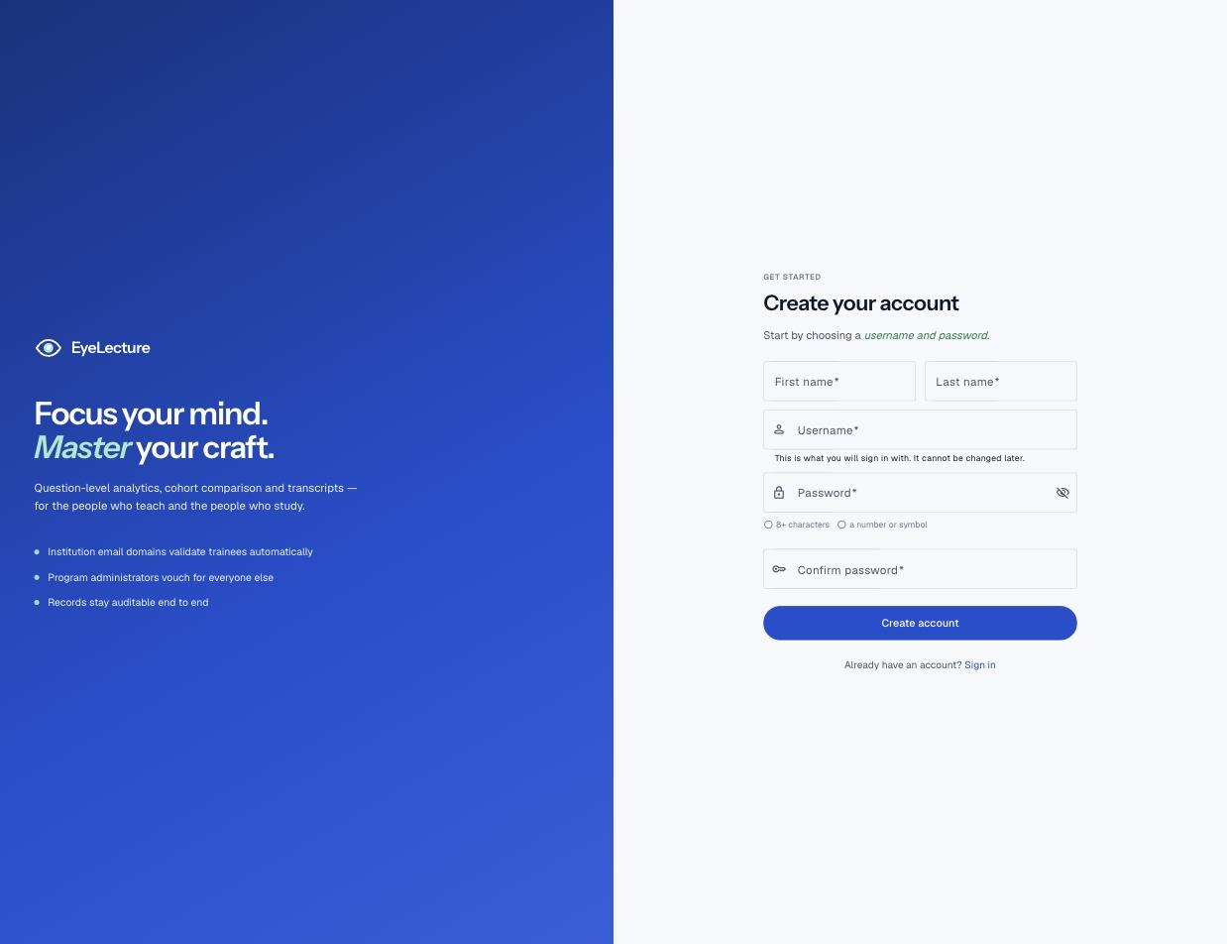
STEP ONE
Create your account
A name, a username and a password. No email address yet: everything an address is needed for happens after the account exists.

Slide 6

STEP ONE
The username is permanent
Said on the field itself rather than in a confirmation nobody reads. Password rules are two, and both are shown as you type.

Slide 7
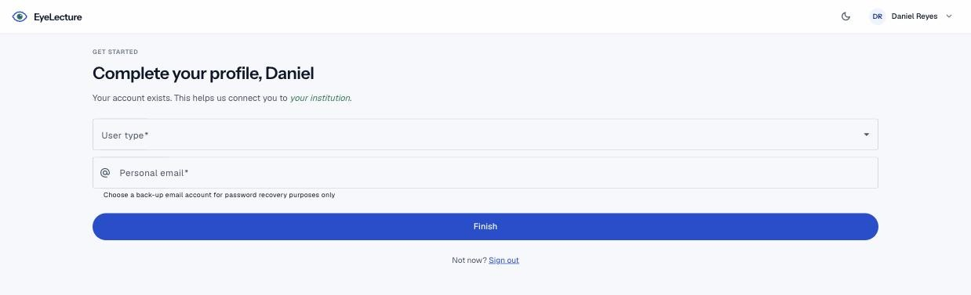
STEP TWO
Complete your profile
User type first, because it decides every question after it. Then the personal address — the one that outlasts everything else on the form.
Notes:
Wording here is the review’s: "Your account exists. This helps us connect you to your institution."

Slide 8
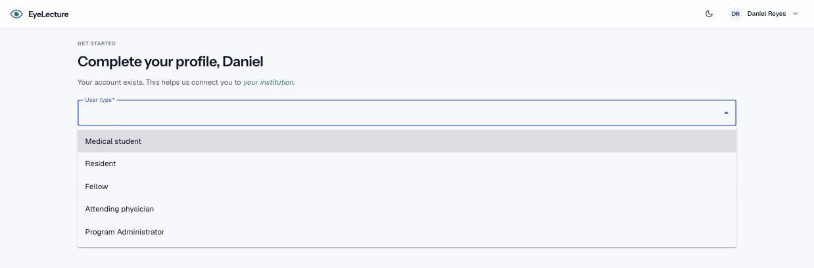
STEP TWO
Five user types
Each one is asked a different set of questions. A medical student is never asked for a clinical focus; an attending physician is never asked for an institutional address.

Slide 9
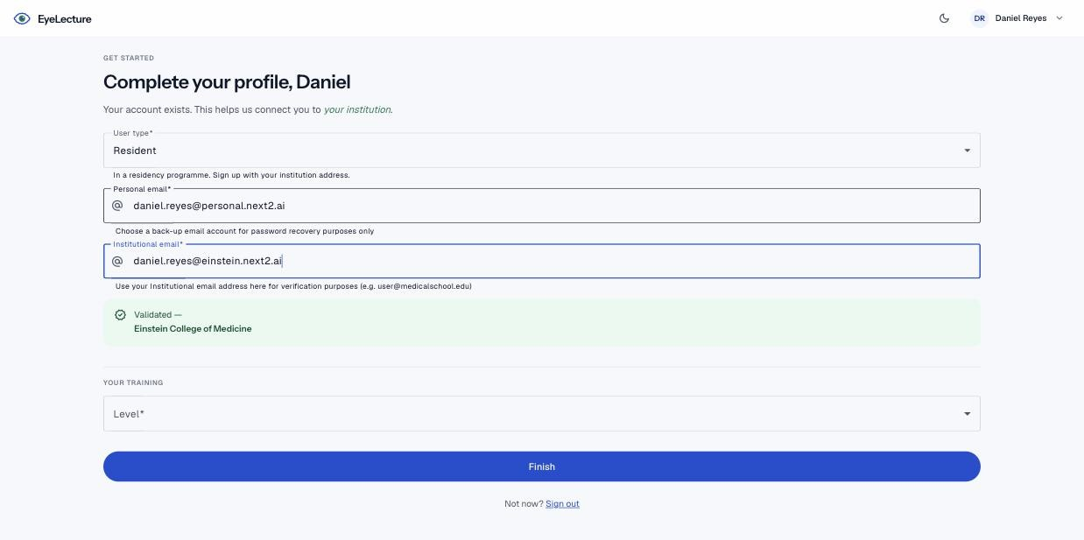
STEP TWO
A recognised domain confirms you on the spot
Typing an address on a domain the institution owns validates a trainee immediately — no queue, no waiting on a person. A resident is also asked their PGY level.
Notes:
Only trainees are let in by their address alone. An attending physician is reviewed either way, and a program administrator vouches for other people — neither is something a domain match can establish.

Slide 10
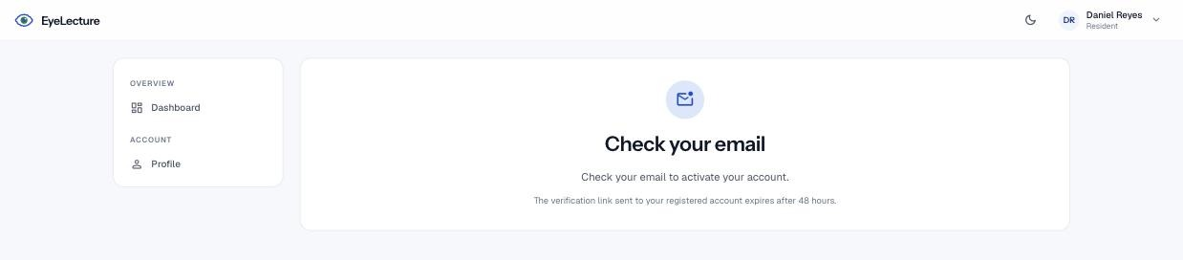
STEP TWO
Confirm the address, and you are in
The link is what proves the mailbox is theirs. It is the last thing between them and signing in.

Slide 11
2
After signing up
Two outcomes: confirmed by your address, or waiting for a person. Both land somewhere that says which one you are.

Slide 12
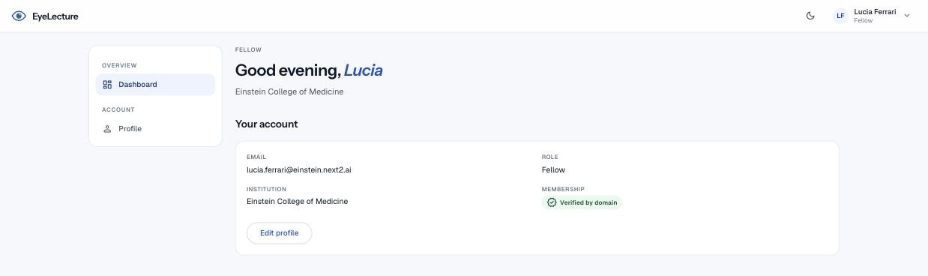
VALIDATED
Confirmed by your domain
Nothing to do. The badge says how the membership was established, so nobody has to ask.

Slide 13
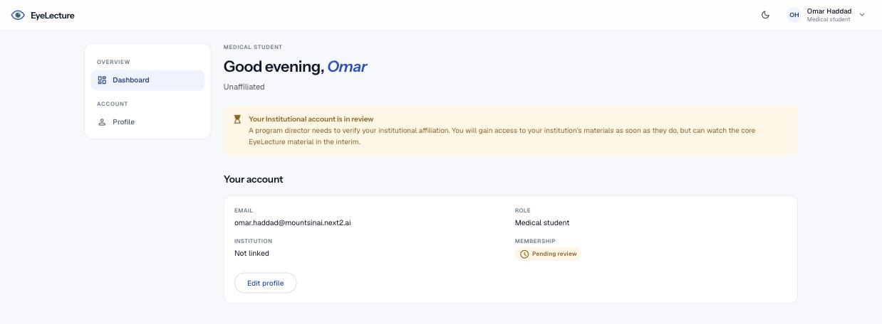
WAITING
Waiting for a program director
An address on a domain we do not recognise means a person has to vouch for them — but the core material is open in the meantime.
Notes:
Wording taken from the review: they can watch the core EyeLecture material in the interim.

Slide 14
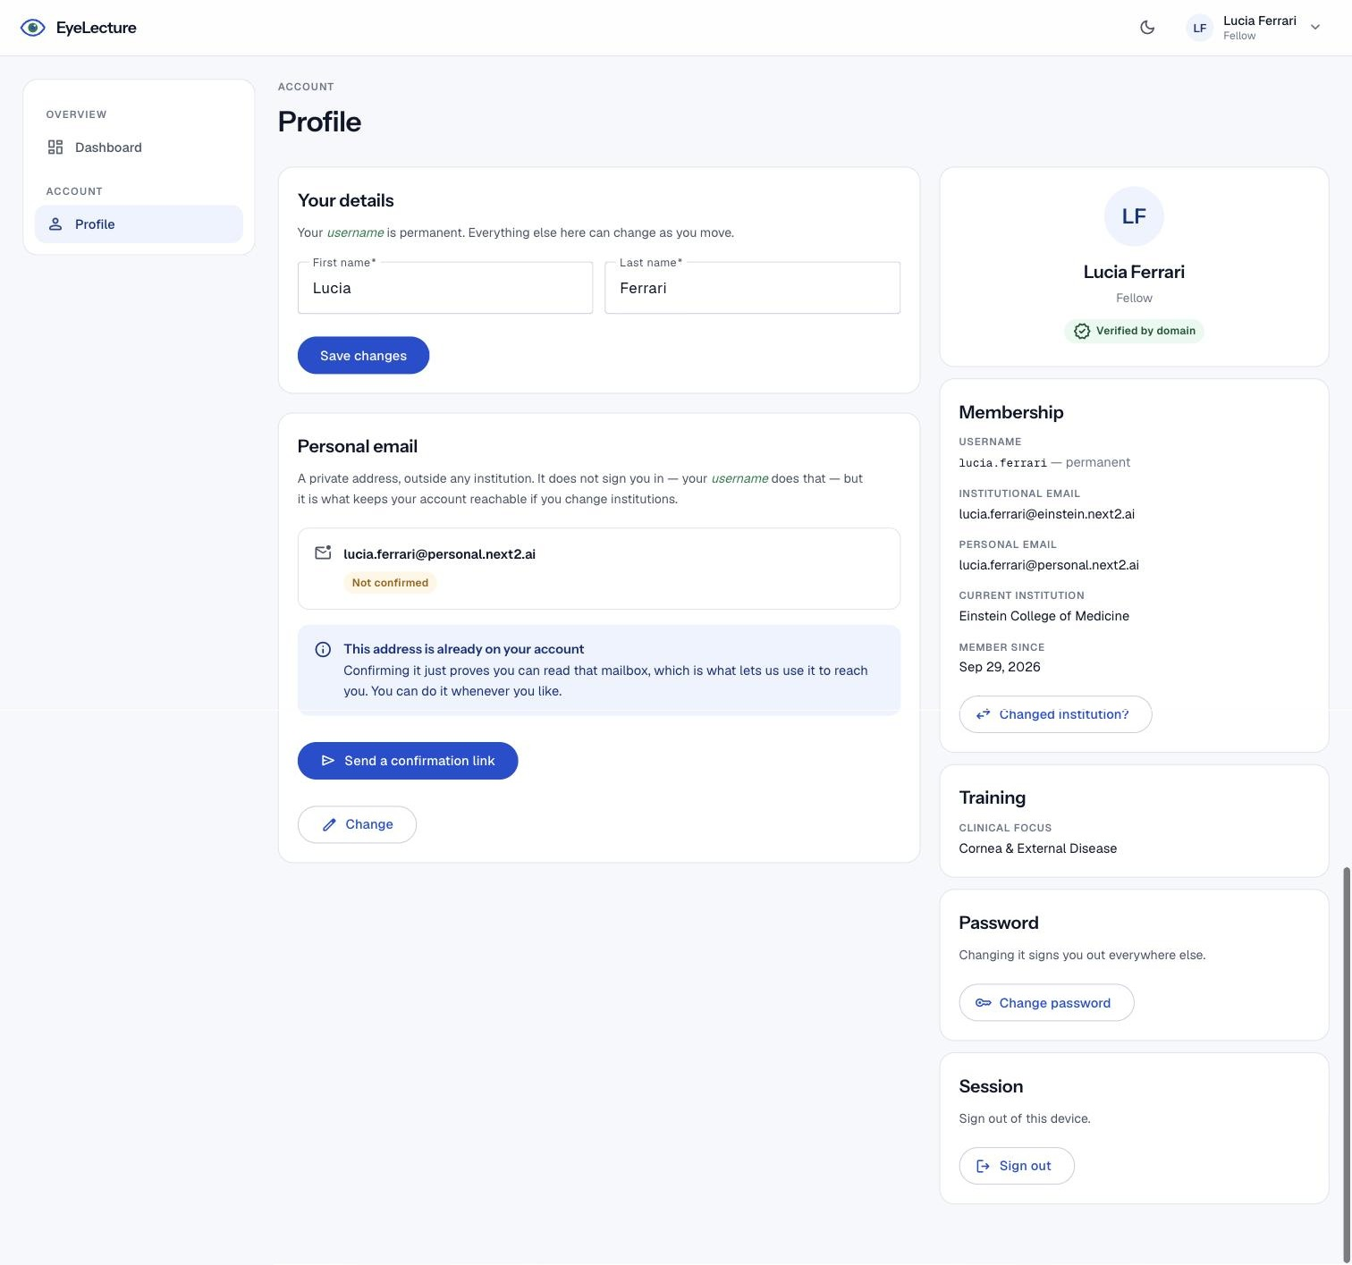
ACCOUNT
The profile
Username permanent, institutional address changeable, personal address separate and confirmable on its own. Past affiliations appear here once there are any.

Slide 15
3
Running an institution
A super user works across the platform. A program administrator runs one institution — and is the person the queue is really for.

Slide 16
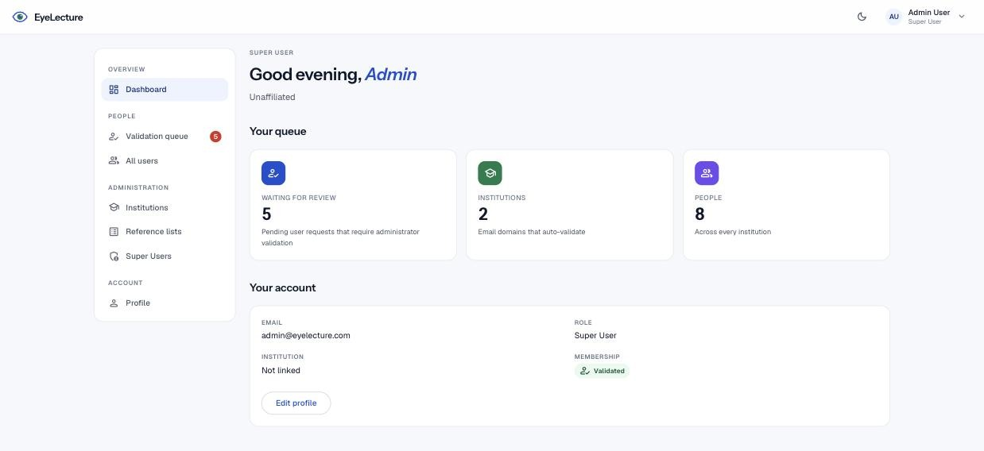
SUPER USER
The dashboard
How many people are waiting, how many institutions auto-validate, and how many accounts exist. Each is a link to the screen that answers it.

Slide 17
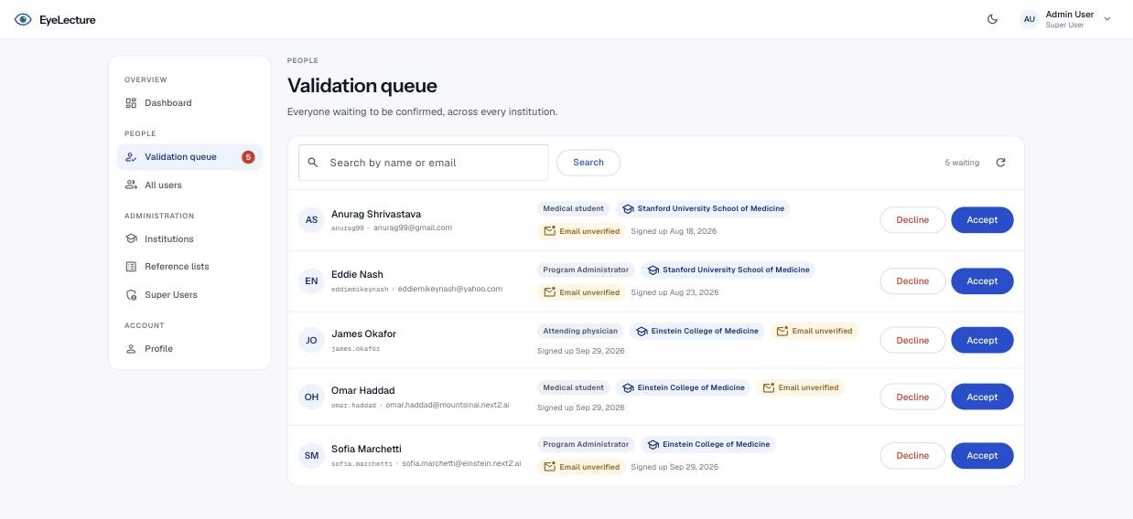
SUPER USER
The validation queue
Everybody waiting, with the institution they named and whether they have confirmed their address. Two buttons, and both are final.

Slide 18
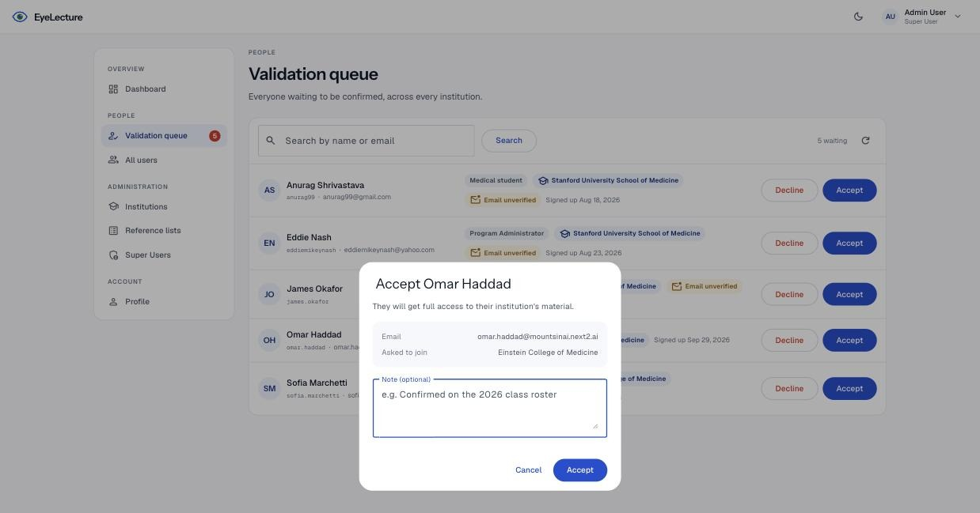
SUPER USER
Accepting somebody
The dialog repeats what is being decided and offers a note, which is kept on the record with who made the decision.
Notes:
A program administrator sees no institution picker here — they can only ever validate into their own.

Slide 19
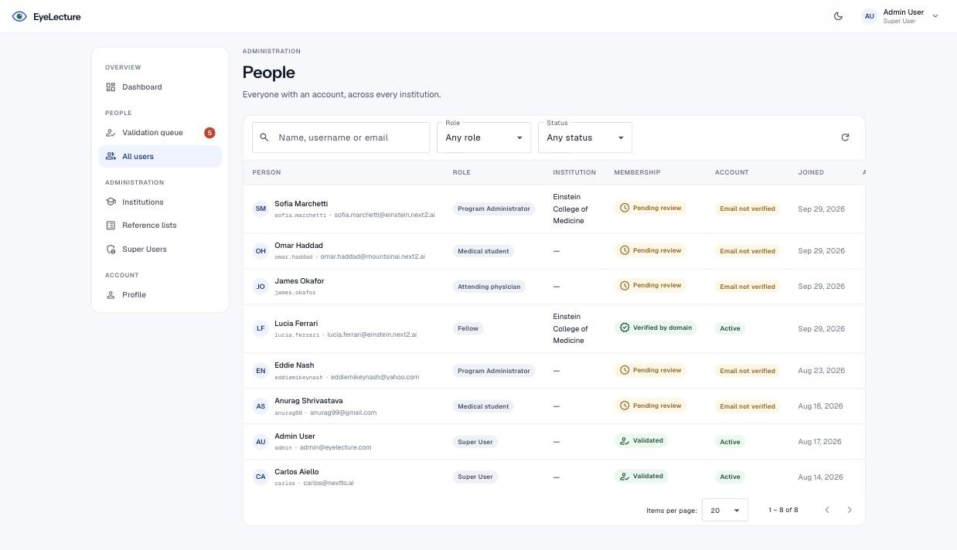
SUPER USER
People
Every account, with its rank, institution, how its membership was established and whether the address is confirmed. A program administrator sees this same screen, scoped to their own institution.

Slide 20
4
Institutions
An institution owns email domains. Anyone who signs up on one of them is validated automatically — which is how the queue stays short.

Slide 21
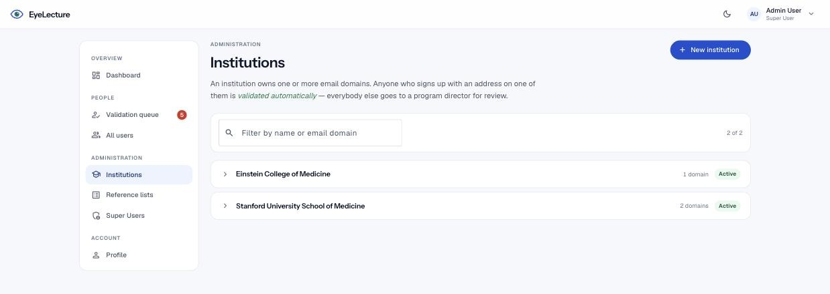
INSTITUTIONS
A line each
The list is going to be long, so a closed row is a name and whether it is on. Everything else is what you look at when you are working on one institution, not when you are looking for one.

Slide 22
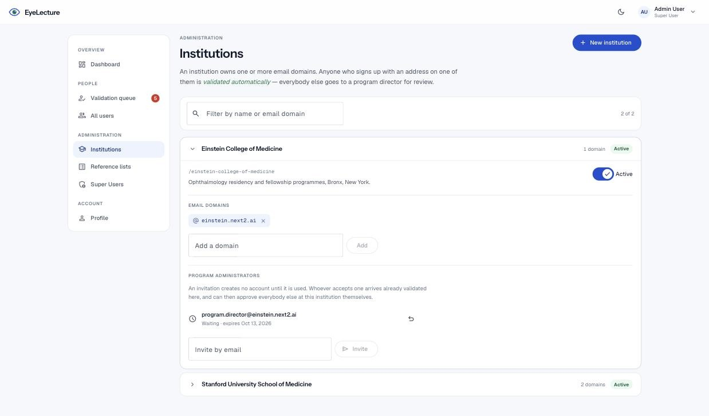
INSTITUTIONS
Open one, and it is all there
Domains, description, and the people invited to administer it. Removing a domain never removes anybody already validated by it.
Notes:
The invitation shown is waiting. Accepted, withdrawn and expired ones stay on the list too — the question people ask months later is "did we ever ask them, and what came of it".

Slide 23
INSTITUTIONS
How the first administrator gets in
Everybody after them is approved locally. Only the first one has to come from us.
A super user sends an invitation
Typed on the institution’s own row. No account is created — the invitation is an offer, and it expires after fourteen days.
They open the link and pick a username
A name, a username, a password and a personal address. The institution and the rank came with the link, so there is nothing to choose and nothing to get wrong.
They arrive already validated
No review queue and no confirmation mail: reading the invitation is the proof that the mailbox is theirs.
From then on it is local
That administrator approves the trainees, the attending physicians and any further administrators at their institution. A super user is not in the loop again.
One live invitation per address per institution. Withdrawing one stops its link working immediately.

Slide 24
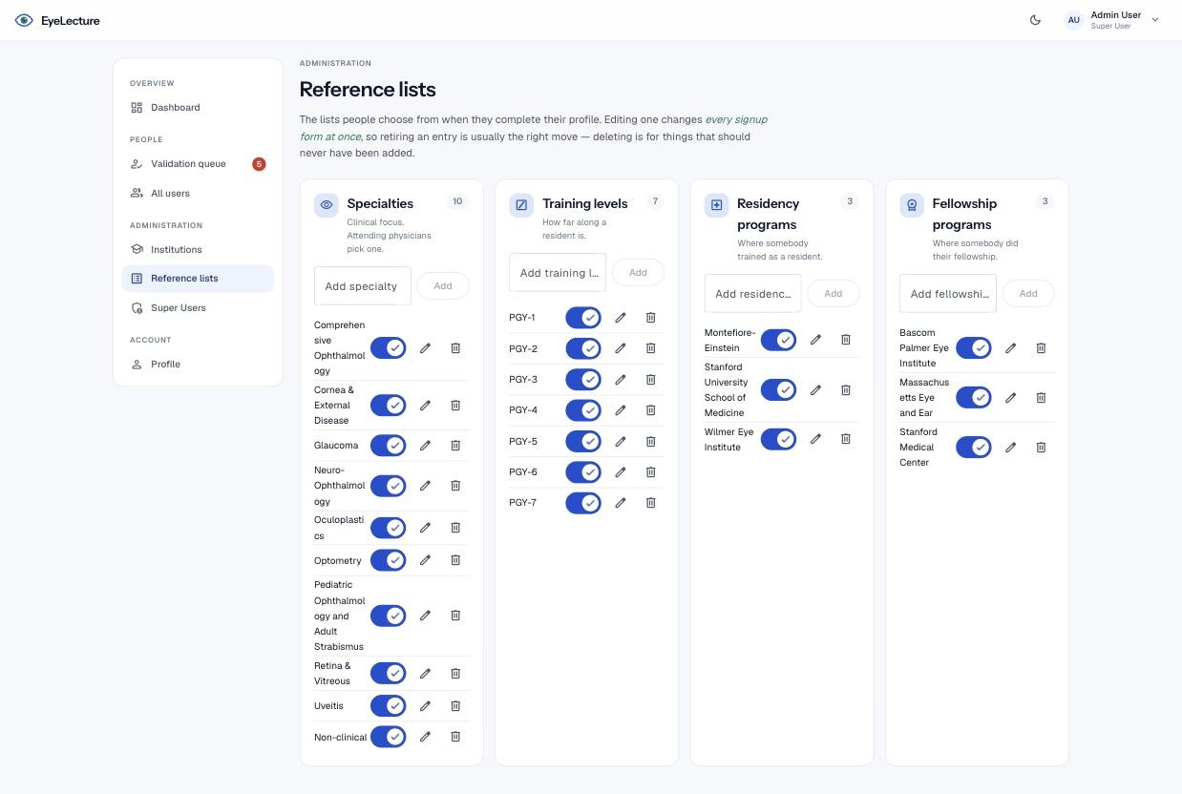
REFERENCE LISTS
The lists behind the forms
Specialties, PGY levels, residency and fellowship programmes. Editing one changes every signup form at once, so retiring an entry is usually the right move over deleting it.

Slide 25
WHAT IS NEXT
Two things we need from you
The email domains
Who the first administrator is
For Einstein and Duke — the domain each one owns is what makes the happy path work at all. Without it nobody is auto-validated.
One name and one address per institution. That is the only thing an invitation needs.
Comments welcome — highlight anything on any slide and comment on it.

