Slide 1
Introduction to Nextflow
Akshai Parakkal Sreenivasan

Slide 2
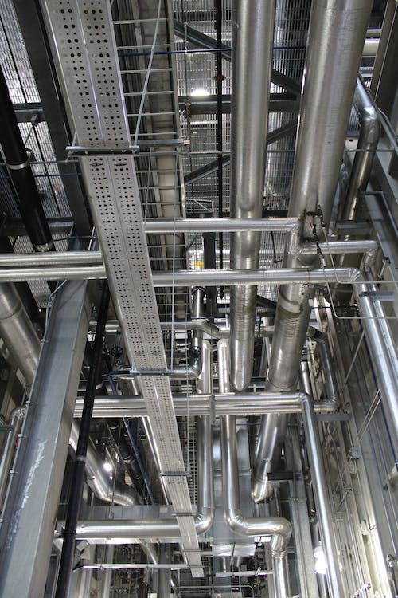
Pipeline
What is a pipeline?
The main benefits of a pipeline include reproducibility, reduced manual work, time efficiency, scalability, ease of use, and robust error handling.

Slide 3

What is Nextflow?
Nextflow is a domain-specific language for building workflow pipelines.
It is based on the Groovy programming language, which itself runs on the Java platform.
It enables scalable and reproducible workflows without the need to manage filenames, error handling, environments, dependencies, execution resumption, parallelisation, and related concerns.

Slide 4


Slide 5
Nextflow
Fast prototyping - Easily combine multiple tasks into a workflow
Reproducibility - Supports Docker, Singularity, Conda, and version control (e.g., GitHub).
Portable - Runs on local systems, HPC (SLURM), and cloud platforms (AWS, Azure, Kubernetes)
Parallelism - Automatically parallelizes tasks and scales efficiently
Continuous checkpoints - Intermediate results are stored, allowing workflow resumption
Stream oriented - Enables flexible and scalable pipeline construction

Slide 6






















Slide 7
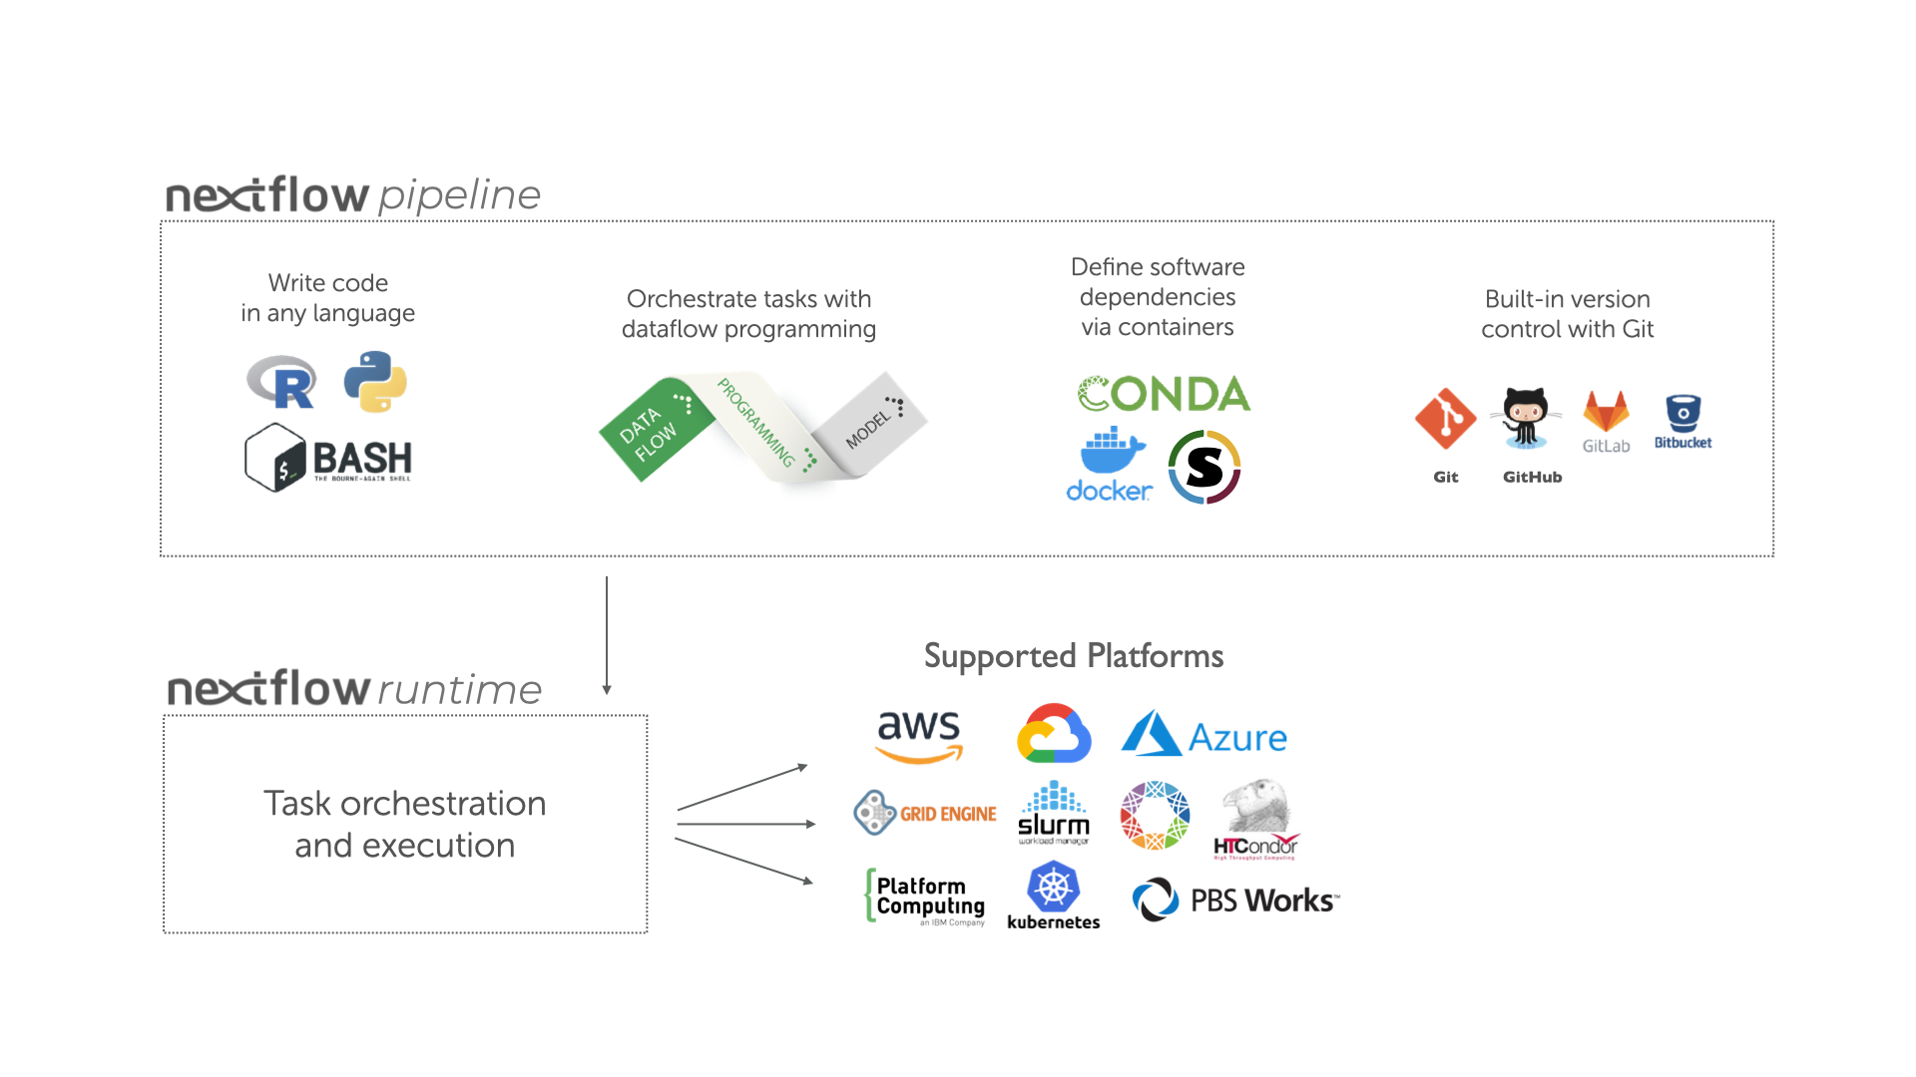
Overview

Slide 8
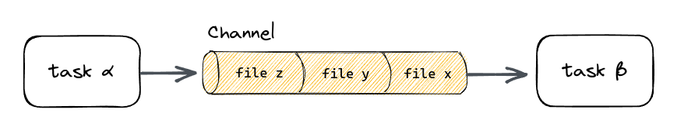
How does it work?
Pipeline is made by stitching different processes together. Process can be in any scripting language executed by linux platform
Processes are executed independently and are isolated. The communicate via asynchronous FIFO (First-in, first-out) queues called channels.
Each process defines input and output channels that connect it to other processes.

Slide 9
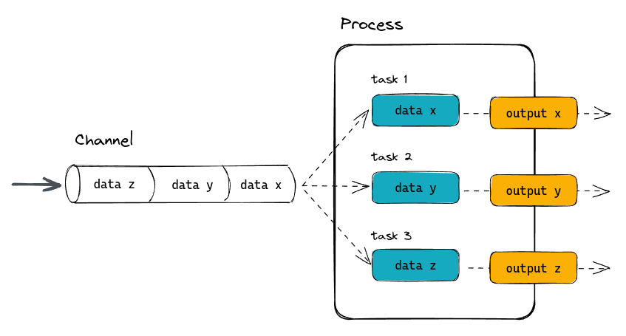
Example
#!/usr/bin/env nextflow → shebang
params.greeting = 'Hello world!' → input parameter
greeting_ch = Channel.of(params.greeting) → creating channel
process SPLITLETTERS { → Process 1
cpus 4
label “splitting_letters”
input: → input block
val x
output: → output block
path 'chunk_*'
"""
echo '$x' | split -b 6 - chunk_
"""
}
process CONVERTTOUPPER { → Process 2
input:
path y
output:
stdout
"""
cat $y | tr '[a-z]' '[A-Z]'
"""
}
workflow {
greet_out_ch = SPLITLETTERS(greeting_ch)
read_ch = CONVERTTOUPPER(greet_out_ch)
read_ch.view()}
Directives
Currently Nextflow run in DSL2
Script section
Define workflow

Slide 10
Usage
The Nextflow script is usually saved in a file called main.nf
The script is run using
nextflow run main.nf
nextflow main.nf
To resume an unfinished pipeline
nextflow main.nf -resume
Parameters are passed using
nextflow main.nf --param_name1 parameter1 --param_name2 parameter2 -resume
Eg: nextflow main.nf --greeting “hello world”

Slide 11
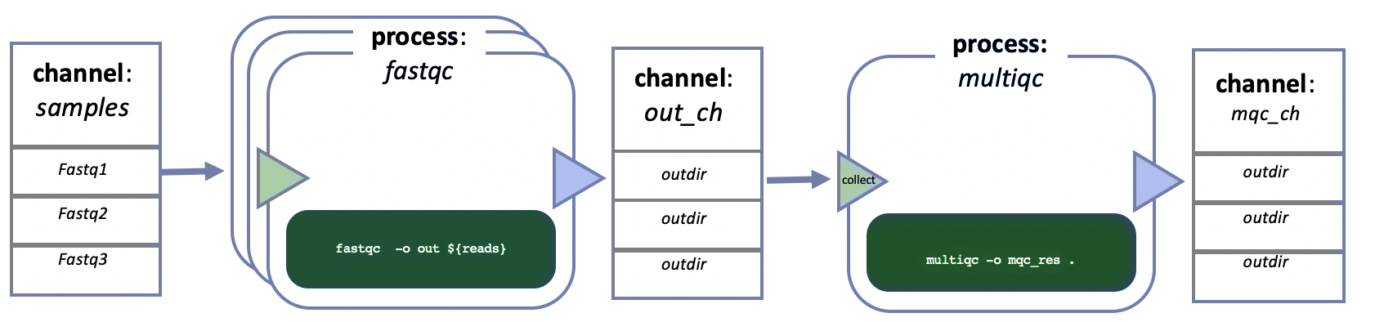
Basics
Channels: They connect tasks/process to each other or apply data transformation
Two types i) Queue channel ii) Value channel
Processes: To run any script
May contain five definition blocks
Directives, Input, Output, When, Script
Operators: Connect and transforms channels content
Eg. collect, flatten
Workflow
The data flow or logic of the workflow

Slide 12
Channels
Channels connect one process to another
Consider as data is flowed through the channels and the receiving process will do necessary operation on it
The channels can contain different types of data based on how it is defined
The Queue channels cannot be used more than once but the value channels can be used multiple times
Queue channels are asynchronous, unidirectional and FIFO

Slide 13
How to create a channel?
Value Channel: value()
Output:
Queue Channel: of()
Output:
Queue Channel: fromList()
Output:
ch1 = Channel.value( 'Hello there' )
ch2 = Channel.value( [1,2,3,4,5] )
ch1.view()
ch2.view()
list = ['hello', 'world' , '!', '.']
Channel.fromList(list)
.view()
ch = Channel.of( 1, 3, 5, 7 )
ch.view()
Hello there
[1, 2, 3, 4, 5]
1
3
5
7
hello
world
!
.

Slide 14
How to create a channel?
Queue Channel: of()
ch = Channel.of( 1, 3, 5, 7 )
ch.view()
ch = Channel.of( [1, 3, 5, 7])
ch.view()
1
3
5
7
[1,3,5,7]

Slide 15
How to create file channels?
Queue Channel: fromPath()
Output:
Channel.fromPath( './data/folder/*.csv' )
The “*” represents the glob character. It matches the pattern in the filename.
“**.csv” would do recursive file pattern matching
i.e., search for pattern in a folder inside a folder
/user/project/csv_files/file_1.csv
/user/project/csv_files/file_2.csv
/user/project/csv_files/file_3.csv
Other channels such as Channel.fromFilePairs() and Channel.fromSRA()
We can avoid them for now

Slide 16
Processes
process < name > {
[ directives ]
input:
< process inputs >
output:
< process outputs >
when:
< condition >
[script|shell|exec]:
"""
< user script to be executed >
"""
}
Directives: Initial declarations that are optional (eg: cpus, label, memory etc)
Input: Defines the input channel
Output: Defines the output channel
When: Optional statement to check, If condition is true, the process will run or else otherwise.
Script: Defines the commands to be executed within the process

Slide 17

Directives
process < name > {
[ directives ]
input:
< process inputs >
output:
< process outputs >
when:
< condition >
[script|shell|exec]:
"""
< user script to be executed >
"""
}
This is an optional settings for the execution of the current process without affecting the logic of the task itself.
It should be on top of the process body, i.e., above input and output blocks

Slide 18
Directives
#!/usr/bin/env nextflow
params.greeting = 'Hello world!'
greeting_ch = Channel.of(params.greeting)
process SPLITLETTERS {
cpus 4
tag “splitting_letters”
time ‘1d’
memory ‘8 GB’
disk ‘15 GB’
input:
val x
output:
path 'chunk_*'
"""
echo '$x' | split -b 6 - chunk_
"""
}
workflow {
out_ch = SPLITLETTERS(greeting_ch)
}
cpus : number of logical cores to be used
time : defines the maximum allowed runtime for a process (helpful when program is taking too long than it should)
memory : the amount of RAM to be used in the process
tag : gives a custom label to the process (easier to identify when the process is running)
disk : the space the process can use

Slide 19
Directives - publishDir
#!/usr/bin/env nextflow
params.greeting = ['Hello world!','world','hello']
greeting_ch = Channel.fromList(params.greeting)
process SPLITLETTERS {
debug true
cpus 4
memory '8 GB'
disk '15 GB'
publishDir "results"
input:
val x
output:
path 'chunk_*'
"""
echo '$x' | split -b 6 - chunk_
"""
}
workflow {
out_ch = SPLITLETTERS(greeting_ch)
}
The publishDir outputs the results of the process to a separate folder given. The workflow outputs are usually stored in work directory.
The publishDir directive can be specified more than one time in to publish the output files to different target directories
In this example, these files chunk_aa, chunk_ab, chunk_ac are created inside results folder. The result folder is created in the same directory as the process is ran.
The results will get overwritten if the process produces files with the same name.

Slide 20
Directives - publishDir
#!/usr/bin/env nextflow
params.greeting = ['Hello world!','world','hello']
greeting_ch = Channel.fromList(params.greeting)
process SPLITLETTERS {
echo true
cpus 4
memory '8 GB'
disk '15 GB'
publishDir "results/$x"
input:
val x
output:
path 'chunk_*'
"""
echo '$x' | split -b 6 - chunk_
"""
}
workflow {
out_ch = SPLITLETTERS(greeting_ch)
}
To avoid overwriting, process specific and output specific files or folders have to be created.
In this process we create dynamic folders using “/$x”. This creates three folders inside result directory named “hello world!”, “world”, “hello”

Slide 21
Directives - publishDir
#!/usr/bin/env nextflow
params.greeting = ['Hello world!','world','hello']
greeting_ch = Channel.fromList(params.greeting)
process SPLITLETTERS {
echo true
cpus 4
memory '8 GB'
disk '15 GB'
publishDir "results/$x" , mode: 'copy'
input:
val x
output:
path 'chunk_*'
"""
echo '$x' | split -b 6 - chunk_
"""
}
workflow {
out_ch = SPLITLETTERS(greeting_ch)
}
By default, publishDir creates symbolic links rather than copying files.
The files that are linked to are present in the work directory.
If the work directory is deleted, symbolic links in the publishDir location will break.
Hence to make a copy of the file,
mode: 'copy'

Slide 22
Directives - conda
#!/usr/bin/env nextflow
params.greeting = 'Hello world!'
greeting_ch = Channel.of(params.greeting)
process SPLITLETTERS {
conda ‘bwa=0.7.15’
input:
val x
output:
path 'chunk_*'
"""
echo '$x' | split -b 6 - chunk_
"""
}
workflow {
out_ch = SPLITLETTERS(greeting_ch)
}
The conda directive tells the process to use dependencies using conda package manager
Nextflow will automatically set the conda environment for the process to run
Specific package can be downloaded and used by specifying channel of the package eg: “bioconda::bwa=0.7.15”
Already existing environment can be also provided by specifying the path of the environment directory
Multiple packages can be specified separating them with spaces eg. "Openms xcms". The name of the channel from where a specific package needs to be downloaded can be specified using the usual Conda notation i.e. prefixing the package with the channel name as shown here bioconda::Openms=2.4.0

Slide 23
Directives - module
#!/usr/bin/env nextflow
params.greeting = 'Hello world!'
greeting_ch = Channel.of(params.greeting)
process SPLITLETTERS {
module 'openms/2.4.0’
input:
val x
output:
path 'chunk_*'
"""
echo '$x' | split -b 6 - chunk_
"""
}
workflow {
out_ch = SPLITLETTERS(greeting_ch)
}
Environment Modules is a package manager that allows you to dynamically configure your execution environment and easily switch between multiple versions of the same software tool
If it is available in your system you can use it with Nextflow in order to configure the processes execution environment in your pipeline
In a process definition you can use the module directive to load a specific module version to be used in the process execution environment
Multiple modules can be specified in a single module directive by separating all the module names by using a : (colon) character

Slide 24
Directives - container
#!/usr/bin/env nextflow
params.greeting = 'Hello world!'
greeting_ch = Channel.of(params.greeting)
process SPLITLETTERS {
cpus 4
container ‘dockerbox:tag’
input:
val x
output:
path 'chunk_*'
"""
echo '$x' | split -b 6 - chunk_
"""
}
workflow {
out_ch = SPLITLETTERS(greeting_ch)
}
The container allows to execute the process script in a docker container
It requires the Docker daemon to be running in machine where the pipeline is executed, i.e. the local machine when using the local executor or the cluster nodes when the pipeline is deployed through a grid executor.

Slide 25
Directives - stageInMode
#!/usr/bin/env nextflow
params.greeting = 'Hello world!'
greeting_ch = Channel.of(params.greeting)
process SPLITLETTERS {
cpus 4
stageInMode copy
input:
val x
output:
path 'chunk_*'
"""
echo '$x' | split -b 6 - chunk_
"""
}
workflow {
out_ch = SPLITLETTERS(greeting_ch)
}
The stageInMode defines how the data is stored in the work directory
Nextflow by default uses symbolic link to stage files
Set this to “copy” if you have the same file names in input and output
Will increase overhead of the pipeline significantly

Slide 26

Directives - tag
#!/usr/bin/env nextflow
params.greeting = 'Hello world!'
greeting_ch = Channel.of(params.greeting)
process SPLITLETTERS {
tag “$x”
input:
val x
output:
path 'chunk_*'
"""
echo '$x' | split -b 6 - chunk_
"""
}
workflow {
out_ch = SPLITLETTERS(greeting_ch)
}
The tag directive allows to give custom name for the process.
Makes it easier to identify them in the log file or in the trace execution report

Slide 27
Directives - label
#!/usr/bin/env nextflow
params.greeting = 'Hello world!'
greeting_ch = Channel.of(params.greeting)
process SPLITLETTERS {
cpus 4
label “basic_process”
input:
val x
output:
path 'chunk_*'
"""
echo '$x' | split -b 6 - chunk_
"""
}
workflow {
out_ch = SPLITLETTERS(greeting_ch)
}
The label directive allows the annotation of processes with an identifier of your choice
The same label can be applied to more than a process and multiple labels can be applied to the same process using the label directive more than one time
Labels are useful to organise pipeline processes in separate groups which can be referenced in the configuration file to select and configure subset of processes having similar computing requirements

Slide 28
Directives - some more
maxForks → Defines maximum number of process instance that can be executed in parallel
executor → Defines where the processes are executed (eg: awsbatch, azurebatch, slurm etc)
debug → setting debug to true will print the stdout on the terminal. Useful while creating a pipeline **

Slide 29

Input
process < name > {
[ directives ]
input:
< process inputs >
output:
< process outputs >
when:
< condition >
[script|shell|exec]:
"""
< user script to be executed >
"""
}
Processes in nextflow are isolated and they are connected by sending values through channels
Input determines the parallel execution of the process
An input block can contain multiple input declarations
A process is started when there is new data to be consumed from the input channel

Slide 30
Input
What type of input the process is getting (file, value etc)?
The input qualifier declares the type of data to be received.
The value can be accessed in the process script by using the specified input name,
input:
<input qualifier> <input name>
A name used to access the received value?
Qualifier | Semantic
val | Access the input value by name in the process script.
file | (DEPRECATED) Handle the input value as a file, staging it properly in the execution context.
path | Handle the input value as a path, staging the file properly in the execution context.
env | Use the input value to set an environment variable in the process script.
stdin | Forward the input value to the process stdin special file.
tuple | Handle a group of input values having any of the above qualifiers.
each | Execute the process for each element in the input collection.

Slide 31
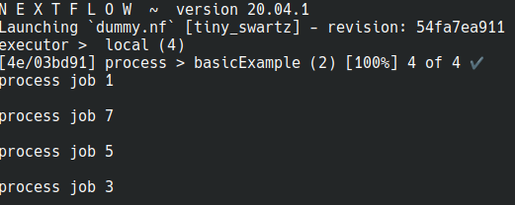
Input - val
num = Channel.of( 1, 3, 5, 7 )
process basicExample {
echo true
input:
val x
script:
"echo process job $x"
}
workflow {
basicExample(num)
}
The val qualifier allows you to receive data of any type as input. It can be accessed in the process script by using the specified input name
1
3
5
7
x=1
x=3
x=5
x=7
echo process job 1
echo process job 5
echo process job 3
echo process job 7

Slide 32
Input - file
mzMLFiles = Channel.fromPath( '/some/path/*.mzML' )
process featureFinder {
Input:
path mzML
"FeatureFinderMetabo -in ${mzML} -out ${mzML.baseName}.featureXML"
}
workflow {
featureFinder(mzMLFiles)
}
The file qualifier allows the handling of file values in the process execution context. This means that Nextflow will stage it in the process execution directory, and it can be access in the script by using the name specified in the input declaration
x.mzML
y.mzML
z.mzML
mzML=x.mzML
mzML=y.mzML
mzML=z.mzML
FeatureFinderMetabo -in x.mzML -out x.featureXML
FeatureFinderMetabo -in y.mzML -out x.featureXML
FeatureFinderMetabo -in z.mzML -out x.featureXML

Slide 33
Input - tuple
values = Channel.of( [1, "x.mzML"], [2, 'y.mzML'], [3,
'z.mzML'] )
process tupleExample {
input:
tuple val(x), path(fl)
"""
echo Processing $x in file $fl
"""
}
workflow {
tupleExample(values)
}
The tuple qualifier allows you to group multiple parameters in a single parameter definition. It can be useful when a process receives tuples of values that need to be handled separately
1:x.mzML
2:y.mzML
3:z.mzML
fl=x.mzML
x=1
fl=y.mzML
x=2
fl=z.mzML
x=3
echo Processing 1 in file x.mzML
echo Processing 2 in file y.mzML
echo Processing 3 in file z.mzML

Slide 34
Input - each
mzMLFiles = Channel.fromPath('../xcms_pipeline/test-datasets/*.*' )
num = Channel.of( 1, 2, 3 )
process featureFinder {
input:
each path(x)
path y
"""
echo value $x file $y
"""
}
workflow {
featureFinder(num,mzMLFiles)
}
The each qualifier allows you to repeat the execution of a process for each item in a collection, every time a new data is received
x.mzML
y.mzML
z.mzML
1
2
3
x=1
x=2
x=3
y=x.mzML
y=y.mzML
y=z.mzML
echo value 1 file y.mzML
echo value 1 file z.mzML
echo value 2 file x.mzML
…
echo value 1 file x.mzML

Slide 35

When
#!/usr/bin/env nextflow
params.greeting = ['Hello world!','world','hello']
greeting_ch = Channel.fromList(params.greeting)
process SPLITLETTERS {
input:
val x
output:
path 'chunk_*'
when:
x == "world"
"""
echo “$x” | split -b 6 - chunk_
"""
}
workflow {
outputChannel = SPLITLETTERS(greeting_ch)
}
The when declaration defines a condition that must be verified in order to execute the process. This can be any expression that evaluates a boolean value
It is useful to enable/disable the process execution depending on the state of various inputs and parameters.
In this example the process is executed only when the value of "x" becomes “world”

Slide 36

Script
process < name > {
[ directives ]
input:
< process inputs >
output:
< process outputs >
when:
< condition >
[script|shell|exec]:
"""
< user script to be executed >
"""
}
The script block defines the command to be executed in the process
It is the last block of the process body, i.e., after input, output, and when blocks
It can be a command, script or combination of them that would normally use terminal shell or bash
The script block can be defined using single-quotes or double quotes and multiline strings can be defined in three single-quotes or three double-quotes

Slide 37
Script
var = "world"
process SIMPLYECHO_BASH {
input:
val var
script:
"""
echo 'hello $var'
"""
}
process SIMPLYECHO_SHELL {
input:
val var
shell:
'''
echo hello !{var}
'''
}
process SIMPLYECHO_NATIVE {
input:
val var
exec:
println "hello $var"
}
workflow {
SIMPLYECHO_BASH(var)
SIMPLYECHO_SHELL(var)
SIMPLYECHO_NATIVE(var)
}
Double quotes allow variable interpolation
Single quotes prevent variable interpolation
Use triple quotes (""") for multi-line scripts
Exec will run the native groovy commands
“$” sign will replace the value with nextflow variable
To access native bash variable “\$” is used
Eg: echo \$PATH
When running a pipeline, the assumption is that the tools are available on the system where you are running the pipeline

Slide 38
Output
process < name > {
[ directives ]
input:
< process inputs >
output:
< process outputs >
when:
< condition >
[script|shell|exec]:
"""
< user script to be executed >
"""
}
The output declaration block allows you to define the channels used by the process to send out the results produced. A process has a single output block, which can contain multiple output declarations.

Slide 39
Output
What type of output the process is giving (file, value etc)?
Optional attributes
output:
<output qualifier> <output name> [, <option>: <option value>]
Output definitions start by an output qualifier and the output name, followed by the keyword into and one or more channels over which outputs are sent. Finally some optional attributes can be specified.
The actual name of value, variable
or file the process is output. E.g.,
results of the analysis!
Qualifier | Semantic
val | Emit the variable with the specified name.
file | (DEPRECATED) Emit a file produced by the process with the specified name.
path | Emit a file produced by the process with the specified name.
env | Emit the variable defined in the process environment with the specified name.
stdout | Emit the stdout of the executed process.
tuple | Emit multiple values.

Slide 40
Output - file
mzMLFiles = Channel.fromPath( '/some/path/*.mzML' )
process featureFinder {
input:
path x
output:
path "${x.baseName}.featureXML"
"""
FeatureFinderMetabo -in ${x} -out
${x.baseName}.featureXML
"""
}
workflow {
outputChannel = featureFinder(mzMLFiles)
outputChannel.view()
}
The file qualifier allows you to output one or a collection of files to another channel that can be consumed by another process
mzMLFiles
x.mzML
y.mzML
z.mzML
FeatureFinderMetabox.mzML -out x.featureXML
FeatureFinderMetabox.mzML -out y.featureXML
FeatureFinderMetabox.mzML -out z.featureXML
outputChannel
x.featureXML
y.featureXML
z.featureXML

Slide 41
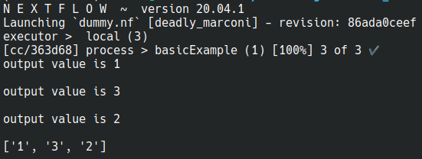
Output - val
values = Channel.of( 1,2,3 )
process basicExample {
input:
val x
output:
val "$x"
"""
echo output value is $x
"""
}
workflow {
outputChannel = basicExample(values).collect()
outputChannel.view()
}
x
1
2
3
echo output value is 1
echo output value is 2
echo output value is 3
outputChannel
[1,2,3]

Slide 42
Workflow
workflow workflow_name{
foo() → process
}
workflow {
Output_channel = foo1(input_channel)
Output_channel2 = foo2(Output_channel)
Output_channel2.collect().view()
}
// When there is two input and output channels
workflow {
(output_channel1,output_channel2) = foo(input_channel1,input_channel2)
}
// When there is only one input and output channel, another way to write (similar to bash pipe)
workflow {
foo1 | foo
}
The workflow definition starts with the keyword workflow, followed by an optional name, and finally the workflow body delimited by curly braces.
The order in which a task is executed is determined only by its dependencies, so a task will be executed as soon as all of its required inputs are available.

Slide 43
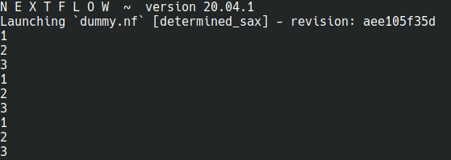
Operators - view, print, println
Channel.of(1,2,3).view()
Channel.of(1,2,3).print()
Channel.of(1,2,3).println()
These operators print the items emitted by a channel to the console standard output
The println operator prints the items emitted by a channel to the console standard output appending a new line character to each of them
Each operators have additional options, read more in the documentation

Slide 44
Operators - set, into
The set operator assigns the channel to a variable whose name is specified as a closure parameter
The into operator connects a source channel to two or more target channels in such a way the values emitted by the source channel are copied to the target channels
A second version of the into operator takes an integer n as an argument and returns a list of n channels, each of which emits a copy of the items that were emitted by the source channel.
Channel.of(10,20,30).set { my_channel }
my_channel = Channel.of(10,20,30)
Channel.of(10,20,30).into { my_channel1; my_channel2 }
( my_channel1, my_channel2)=Channel.of(10,20,30).into(2)

Slide 45

Operators - collect
Channel.of( 1, 2, 3, 4, 5 ).collect()
.view()
The collect operator collects all the items emitted by a channel to a List and return the resulting object as a sole emission
Eg: Collect all the output from the previous process
1
3
5
7
[1,3,5,7]
Output of process 1
Collect to get as a list

Slide 46
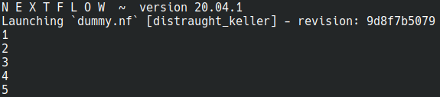
Operators - flatten
Channel.of( [1, 2, 3, 4, 5] )
.flatten()
.view()
The flatten operator transforms a channel in such a way that every item of type Collection or Array is flattened so that each single entry is emitted separately by the resulting channel
This is opposite to collect
[1,3,5,7]
1
3
5
7
Output of process 1
Flatten to four emission

Slide 47
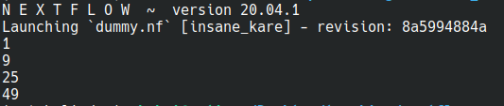
Operators - map
Channel.of( 1, 3, 5, 7 )
.map { it * it }.view()
The map operator applies a function of your choosing to every item emitted by a channel, and returns the items so obtained as a new channel. The function applied is called the mapping function and is expressed with a closure
1
3
5
7
1
9
25
49

Slide 48

Operators - until
Channel.from( 1, 3, 5, 7 )
.until { it==5}.view()
The until operator creates a channel that returns the items emitted by the source channel and stop when the condition specified is verified
Until X=5
1
3
5
7
1
3

Slide 49
Configuration file
Nextflow supports a wide range of execution platforms, from running locally, to running on HPC clusters or cloud infrastructures
Many of these settings are set in the configuration file
When a pipeline script is launched. Nextflow looks for a file named nextflow.config in the current directory and in the script base directory (if it is not the same as the current directory). Finally it checks for the file $HOME/.nextflow/config
// This is the configuration file e.g nextflow.config
executor {
$slurm{
queueSize = 200
pollInterval = '30 sec'
clusterOptions = { "-A $params.project
${params.clusterOptions ?: ''}" }
}
$local {cpus = 8}
}

Slide 50

Nextflow - how to write a pipeline
Think first before start coding!
Decide on the parameters (inputs, outputs, other arguments etc)
Choose what platforms you are supporting (Containers, cloud etc)
Open your favorite text editor
Make two files (main.nf and nextflow.config)
Define parameters both for the executors and the pipeline environment in the nextflow.config
Write the actual workflow in the main.nf
Test and test and test!
Publish on Github + Dockerhub (for the tools part of the workflow)

Slide 51

More tutorials
Most text in this presentation have been copied from here:
https://www.nextflow.io/docs/latest/
Nextflow google group: https://groups.google.com/g/nextflow
And of course google!
More tutorials:
https://nf-co.re/usage/nextflow
https://training.seqera.io
https://carpentries-incubator.github.io/workflows-nextflow
Standardization of Nextflow workflows

Slide 52
Questions

Slide 53
Demo session

Slide 54
Mass spectrometry and data analysis

Slide 55
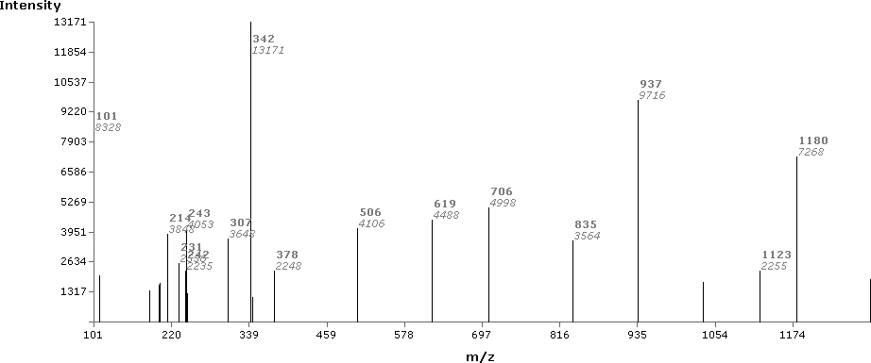
Data - snapshots
McHugh L, Arthur JW. Computational methods for protein identification from mass spectrometry data. PLoS Comput Biol. 2008 Feb;4(2):e12. doi: 10.1371/journal.pcbi.0040012. PMID: 18463710; PMCID: PMC2323404.McHugh L, Arthur JW. Computational methods for protein identification from mass spectrometry data. PLoS Comput Biol. 2008 Feb;4(2):e12. doi: 10.1371/journal.pcbi.0040012. PMID: 18463710; PMCID: PMC2323404.

Slide 56
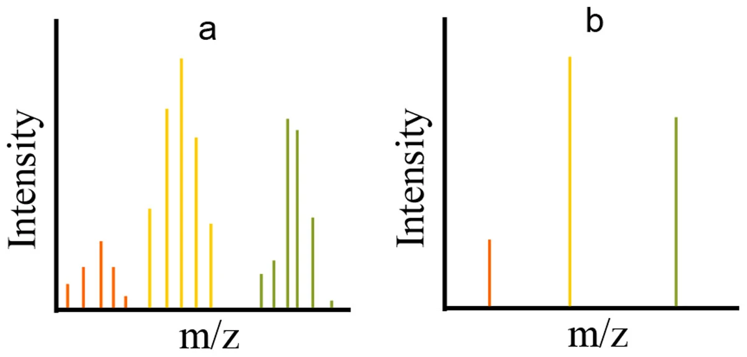
Data
Smith, R., Mathis, A.D., Ventura, D. et al. Proteomics, lipidomics, metabolomics: a mass spectrometry tutorial from a computer scientist's point of view. BMC Bioinformatics 15 (Suppl 7), S9 (2014). https://doi.org/10.1186/1471-2105-15-S7-S9

Slide 57
Data - centroiding
Smith, R., Mathis, A.D., Ventura, D. et al. Proteomics, lipidomics, metabolomics: a mass spectrometry tutorial from a computer scientist's point of view. BMC Bioinformatics 15 (Suppl 7), S9 (2014). https://doi.org/10.1186/1471-2105-15-S7-S9

Slide 58
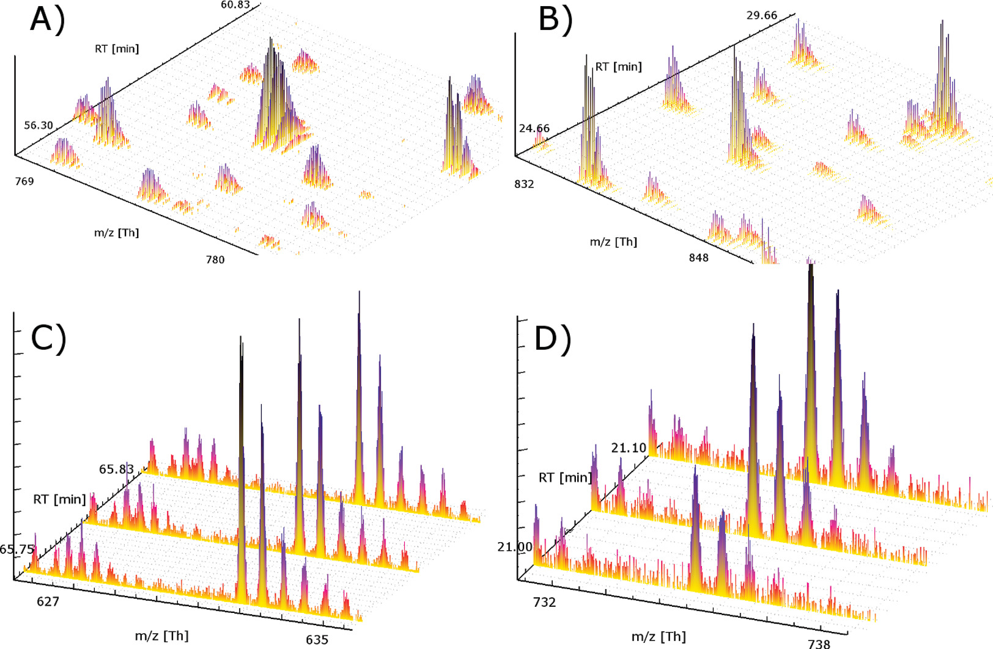
Data - over time
Bielow C, Aiche S, Andreotti S, Reinert K. MSSimulator: Simulation of mass spectrometry data. J Proteome Res. 2011 Jul 1;10(7):2922-9. doi: 10.1021/pr200155f. Epub 2011 Apr 28. PMID: 21526843.

Slide 59
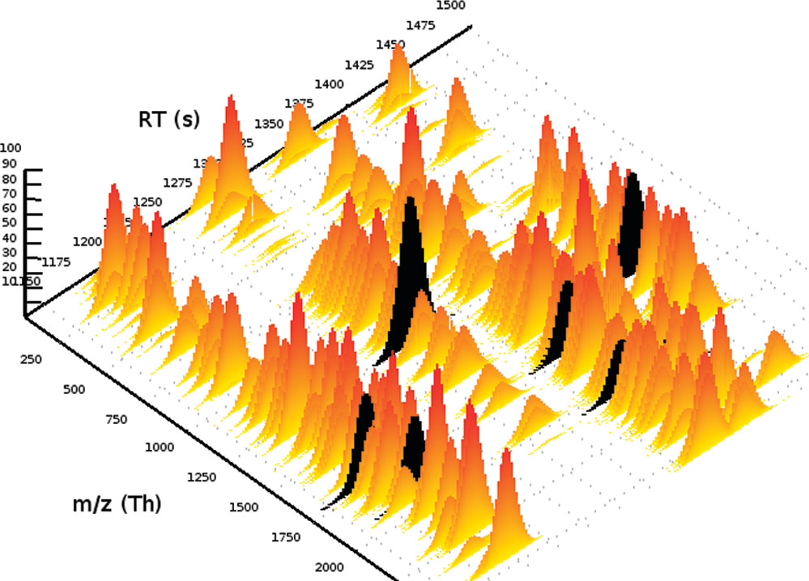
Data - over time
Bielow C, Aiche S, Andreotti S, Reinert K. MSSimulator: Simulation of mass spectrometry data. J Proteome Res. 2011 Jul 1;10(7):2922-9. doi: 10.1021/pr200155f. Epub 2011 Apr 28. PMID: 21526843.

Slide 60
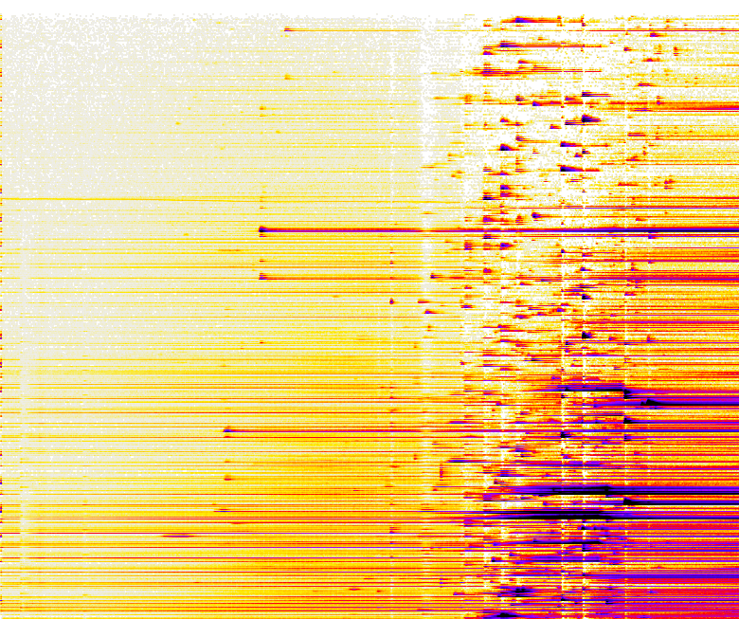
Data - 2D-View
Color signifies intensity
m/z →
Retention time →

Slide 61
Data - features
Ideal feature
Low intensity
Missing values
Many other problems
Missing mass traces

Slide 62
Data - 2D-View
Features
More than 1000s of features in total
m/z →
Retention time →

Slide 63
Data - samples
Connecting features across samples
n-samples

